Slide 1
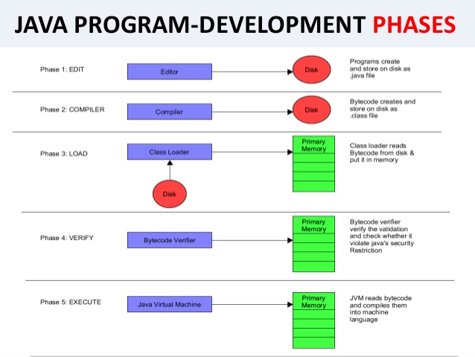

Slide 2
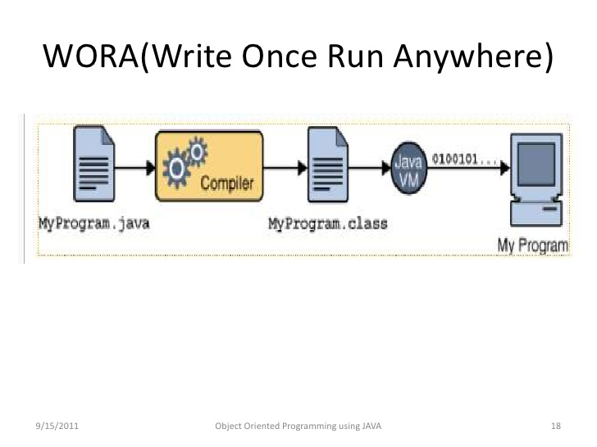

Slide 3
ADVANTAGES OF JAVA
❖ Java is simple language.
❖ Java does not support POINTERS.
❖ Java is first language in which programs can be executed using web.
❖ Write Once Run Anywhere (WORA).

Slide 4
DISADVANTAGES OF JAVA
❖ Slow Performance.
❖ No support for Low level programming.
❖ Poor features in Java.
❖ No control over Garbage Collection.

Slide 5
THANK-YOU

