Slide 1



Revenue_analysis_Dashboard
View in Power BI

Slide 2
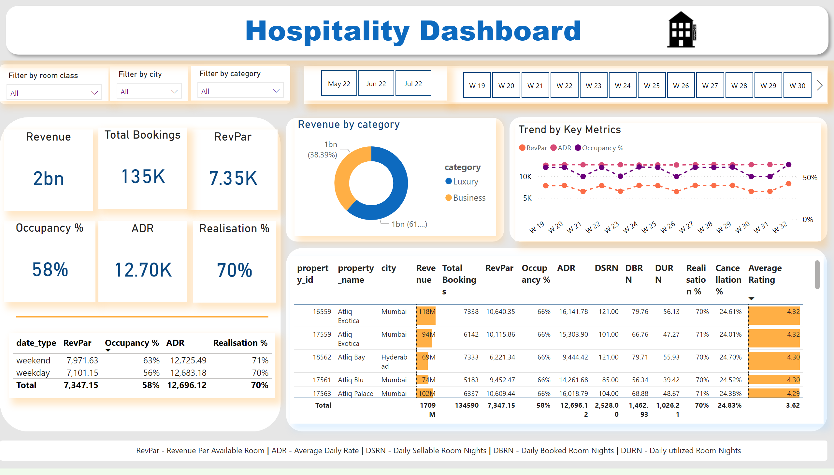
Overall Analysis
Notes:
Revenue
No alt text provided
Occupancy %
No alt text provided
RevPar
No alt text provided
Total Bookings
No alt text provided
shape
No alt text provided
ADR
No alt text provided
Realisation %
No alt text provided
shape
No alt text provided
donutChart
No alt text provided
shape
No alt text provided
tableEx
No alt text provided
shape
No alt text provided
Trend by Key Metrics
No alt text provided
shape
No alt text provided
slicer
No alt text provided
slicer
No alt text provided
shape
No alt text provided
slicer
No alt text provided
slicer
No alt text provided
shape
No alt text provided
image
No alt text provided
textbox
No alt text provided
slicer
No alt text provided
shape
No alt text provided
tableEx
No alt text provided
shape
No alt text provided
textbox
No alt text provided

Slide 3
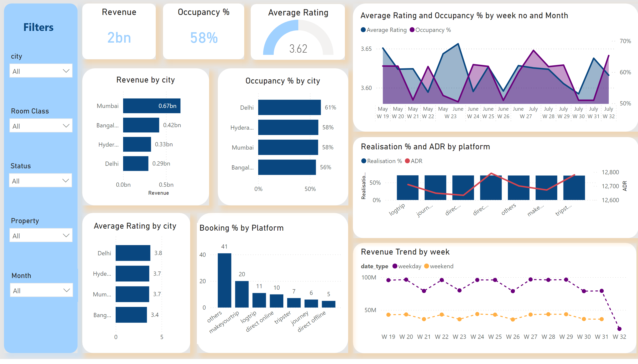
Sub Analysis
Notes:
shape
No alt text provided
textbox
No alt text provided
shape
No alt text provided
shape
No alt text provided
shape
No alt text provided
Revenue
No alt text provided
Occupancy %
No alt text provided
gauge
No alt text provided
slicer
No alt text provided
slicer
No alt text provided
slicer
No alt text provided
slicer
No alt text provided
shape
No alt text provided
shape
No alt text provided
shape
No alt text provided
barChart
No alt text provided
barChart
No alt text provided
barChart
No alt text provided
shape
No alt text provided
areaChart
No alt text provided
Booking % by Platform
No alt text provided
shape
No alt text provided
slicer
No alt text provided
shape
No alt text provided
Realisation % and ADR by platform
No alt text provided
Revenue Trend by week
No alt text provided
shape
No alt text provided

Slide 4
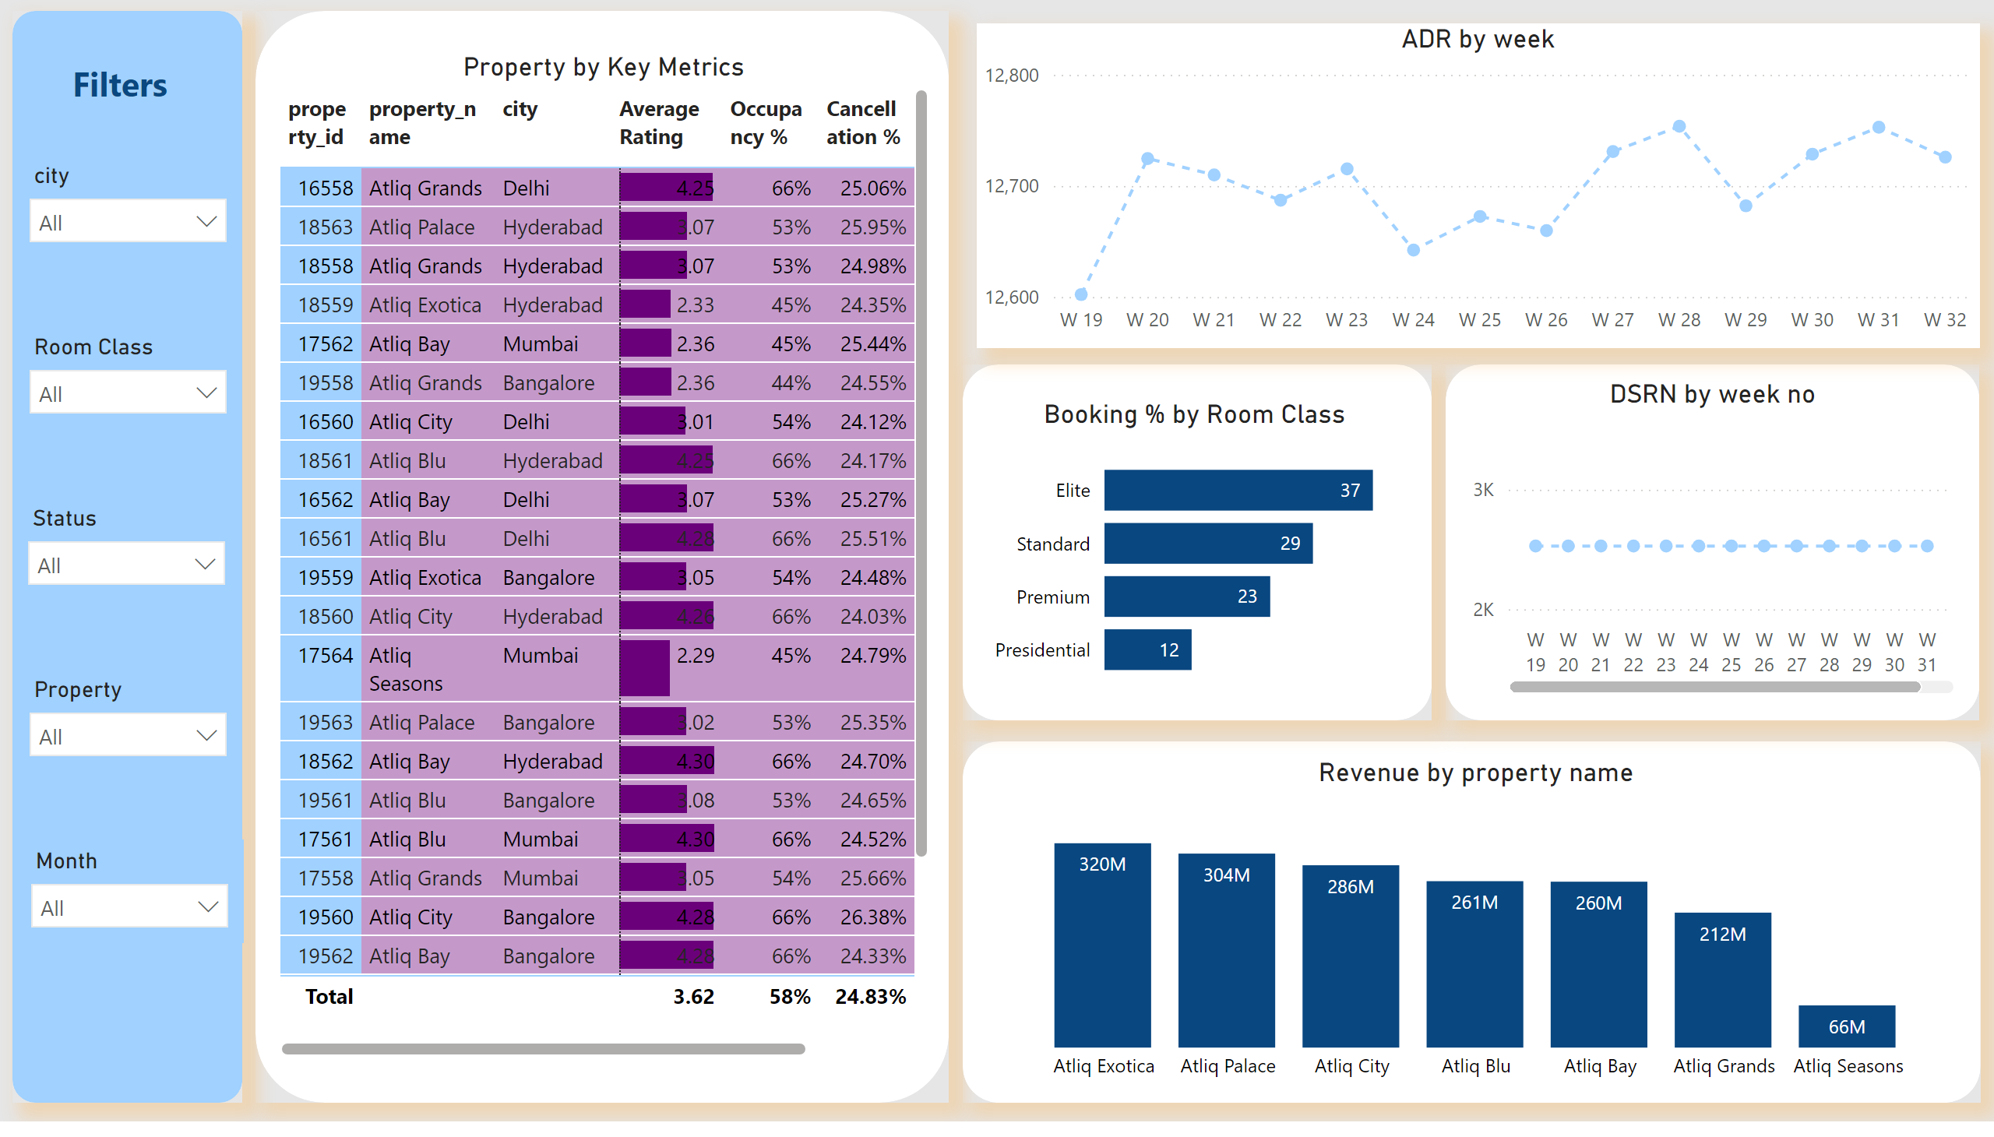
Property Key Metrics
Notes:
shape
No alt text provided
textbox
No alt text provided
slicer
No alt text provided
slicer
No alt text provided
slicer
No alt text provided
slicer
No alt text provided
shape
No alt text provided
shape
No alt text provided
slicer
No alt text provided
shape
No alt text provided
Property by Key Metrics
No alt text provided
Booking % by Room Class
No alt text provided
Revenue by property name
No alt text provided
shape
No alt text provided
DSRN by week no
No alt text provided
ADR by week
No alt text provided

Slide 5
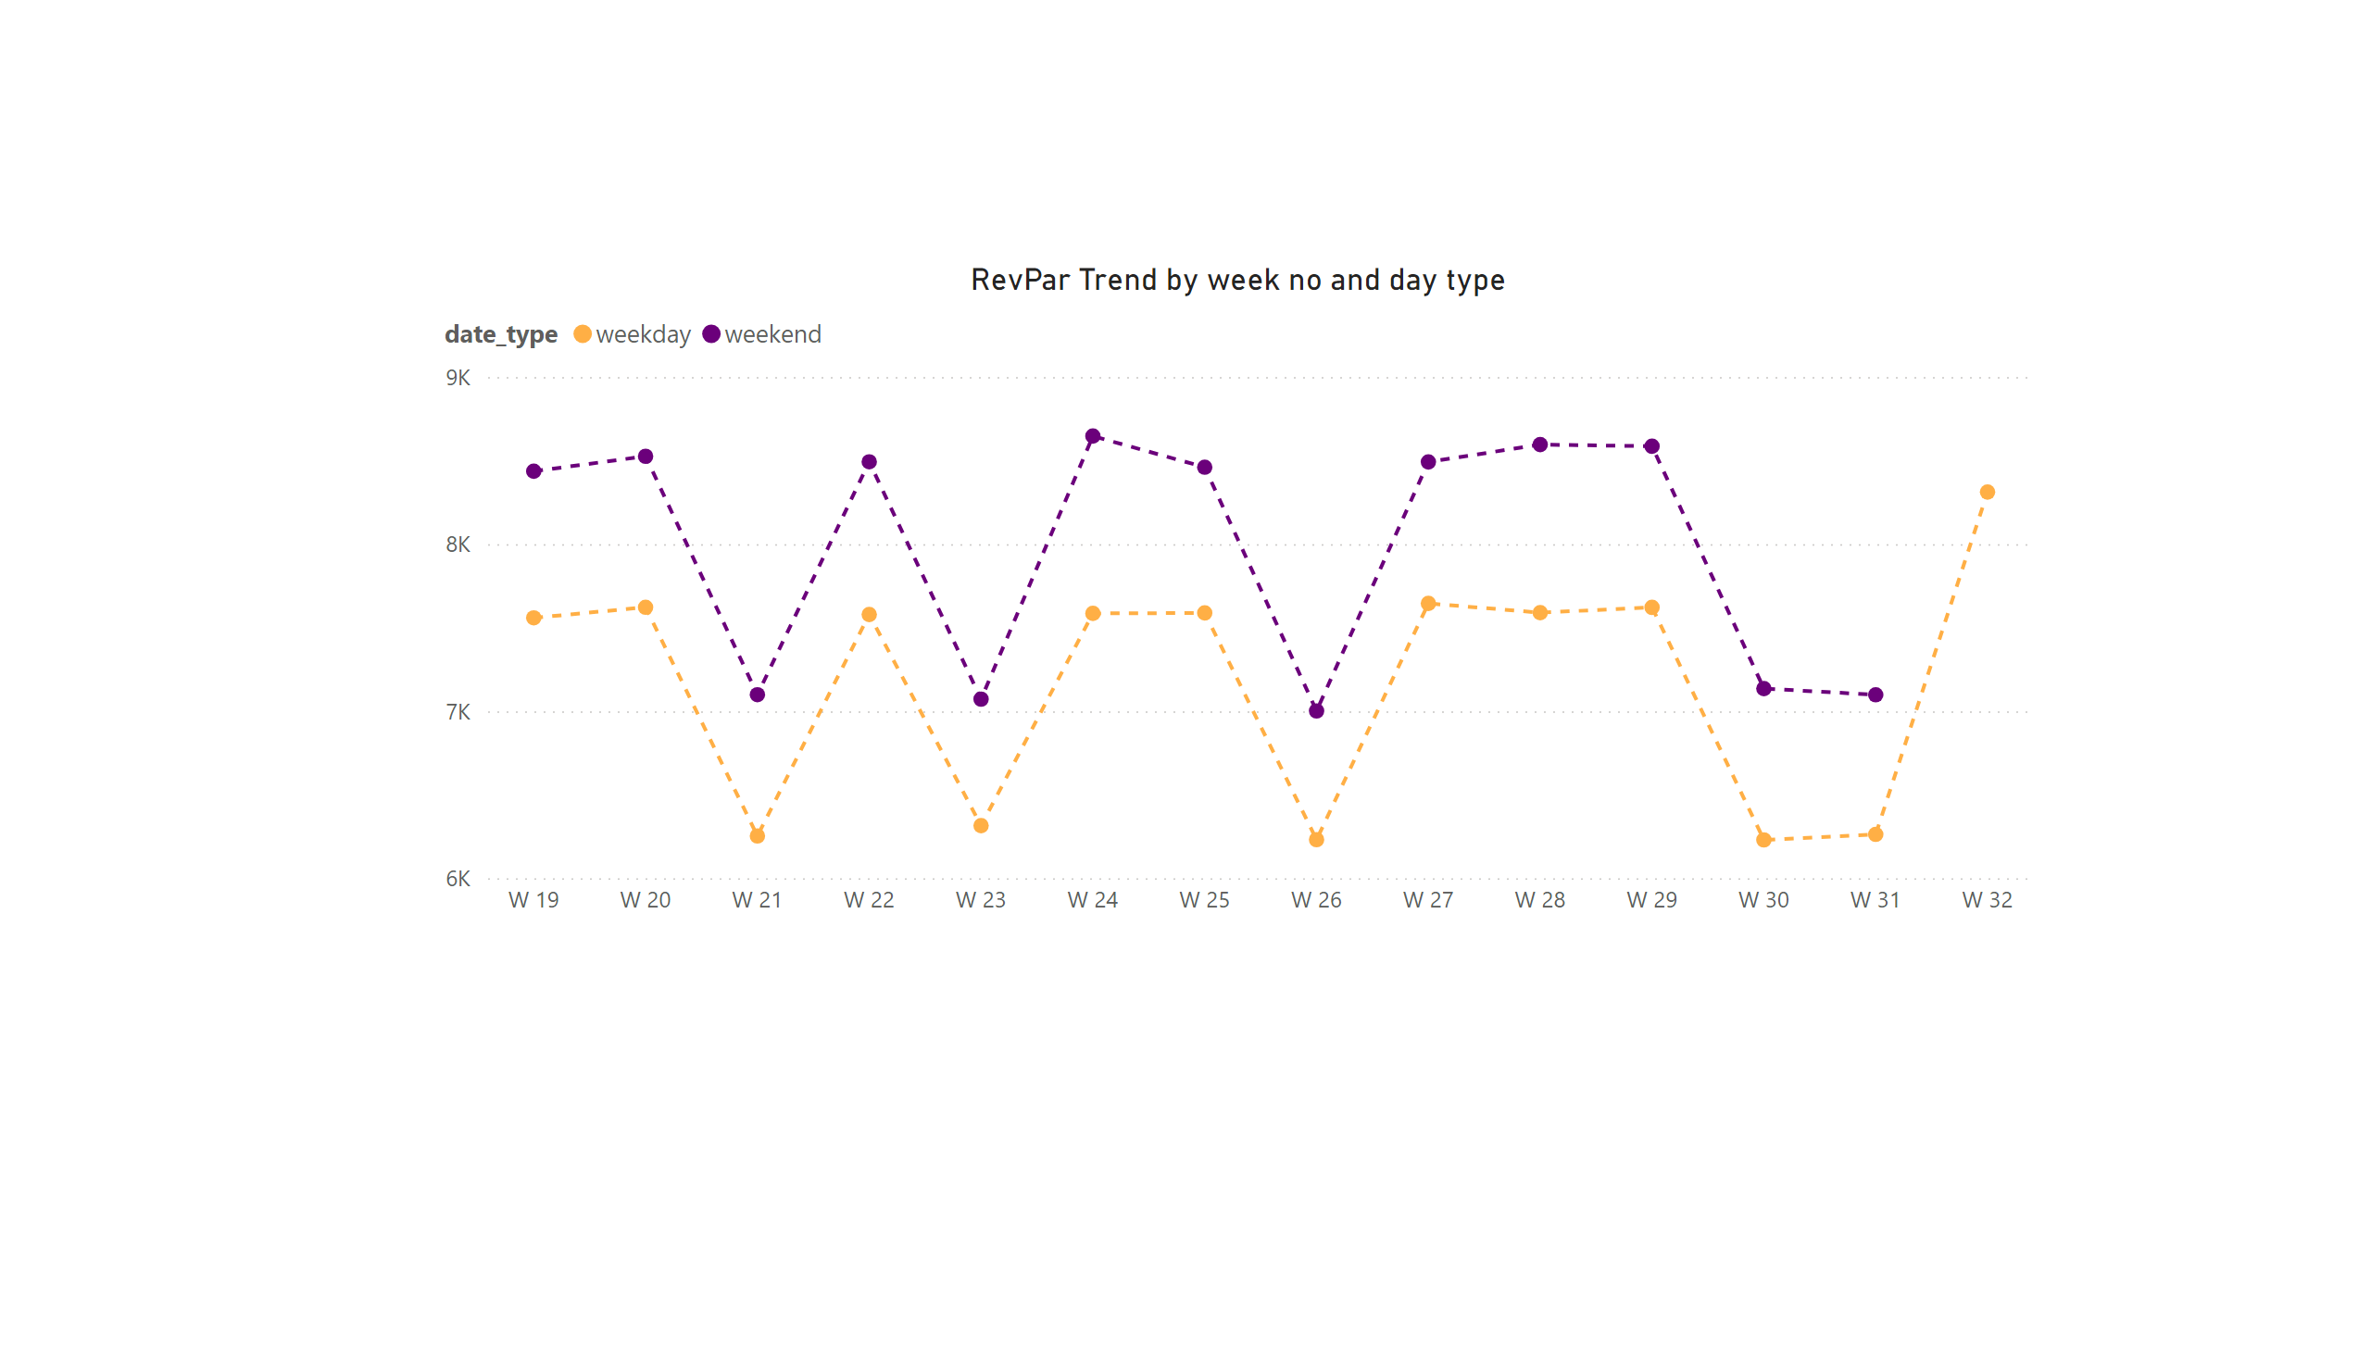
RevPar Trend
Notes:
RevPar Trend by week no and day type
No alt text provided

Slide 6
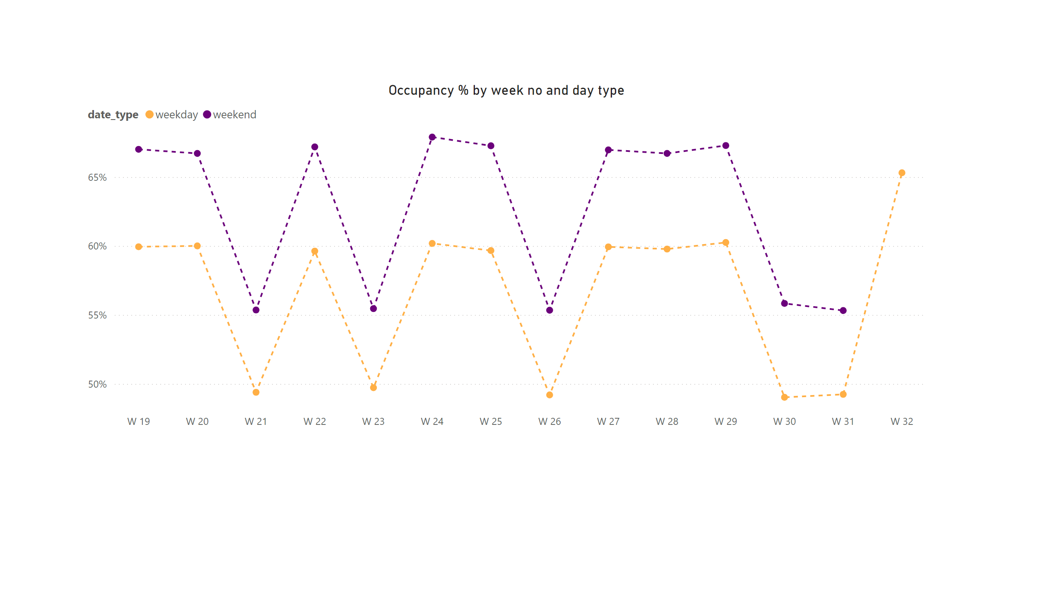
Occupancy Trend
Notes:
Occupancy % by week no and day type
No alt text provided

Slide 7
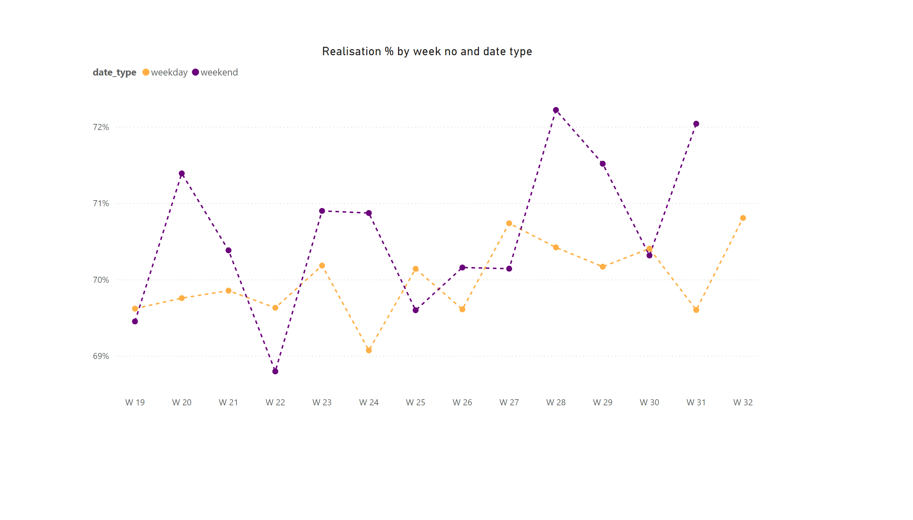
Realisation Trend
Notes:
Realisation % by week no and date type
No alt text provided

Slide 8
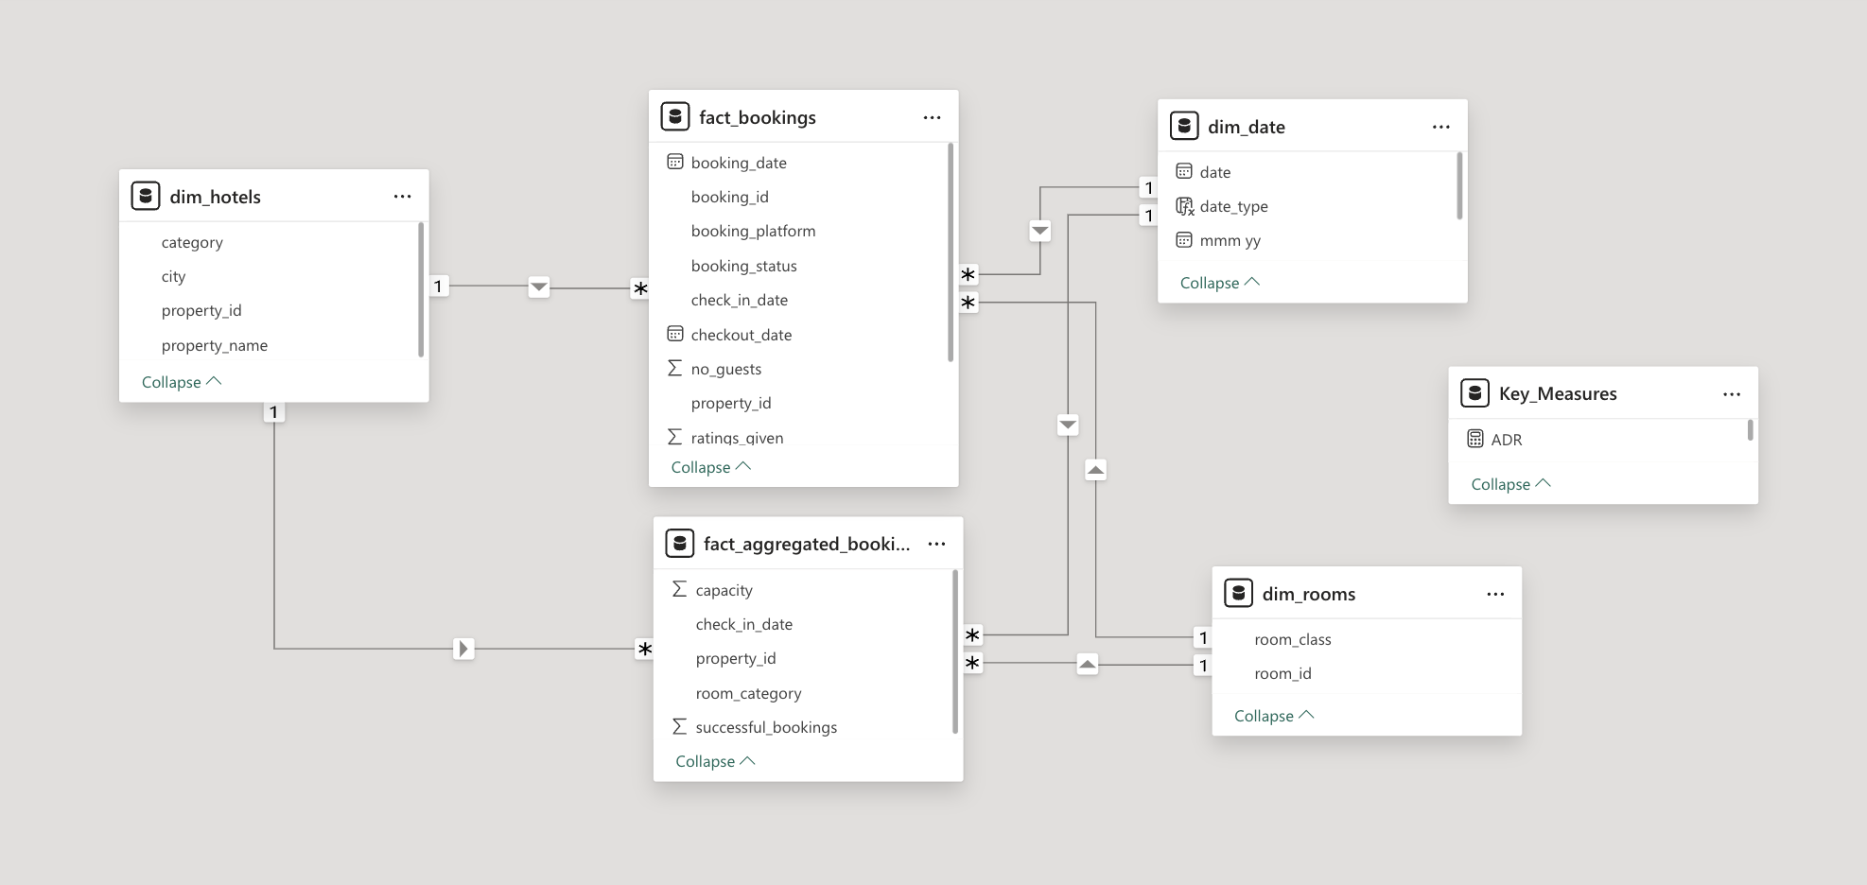
DATA MODEL

