Slide 1
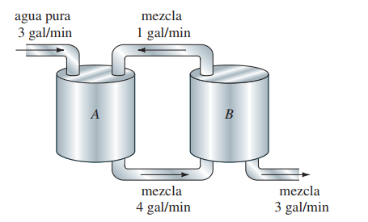

Slide 2



4 L/min
Agua pura
Tanque A
200 litros
Tanque B
150 litros
Tanque C
100 litros
$$x_{A}(0)=5 kg$$
$$x_{B}(0)=5 kg$$
$$x_{C}(0)=5 kg$$
4 L/min
4 L/min
4 L/min

Slide 3



$$A_{t}$$
$$h$$
$a$ ó $A_{0}$

Slide 4

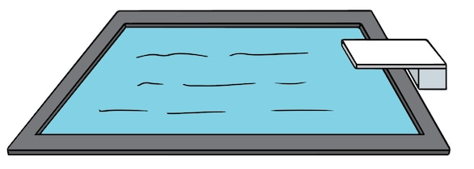



$$bv$$
$$z$$
$$−mg$$

