Slide 1
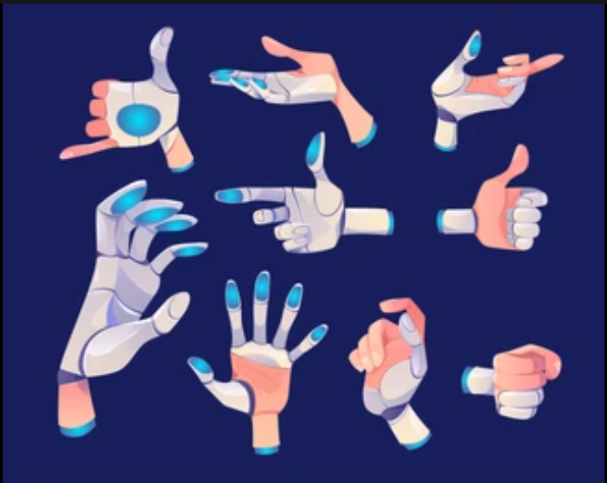
American Sign Language Detection Using Image Processing
ARTIFICIAL INTELLIGENCE laboratory
Sem 5 - Mini project
ARTIFICIAL Intelligence lab
Sem 5 - Mini project
Vanshita Jain – 112003053
Shivani Joshi - 112003058
Juhi Shekokar - 112003059

Slide 2
Specifications about the project
Performed mini project on Image Processing
Coded in Python3
Implemented using OpenCV, numpy, keras
Implemented using Convolutional Neural Networks (CNN)
Identifies gestures in ASL – numbers from 0 to 9
Accuracy is highly dependent on implementing device and environmental aspects like lighting and image capture background

Slide 3
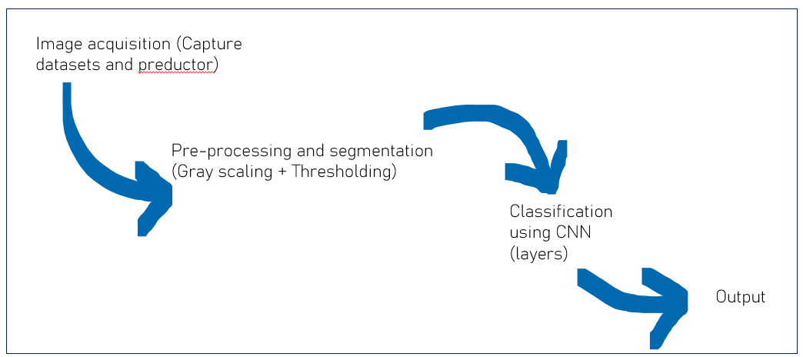
Methodology Of Implementation
Step 1: Created and initialized a CNN model
Step 2: Preprocessing of image.
Step 3: Preprocessed image was fed to model and model was trained.
Step 4: Trained model was tested.

Slide 4
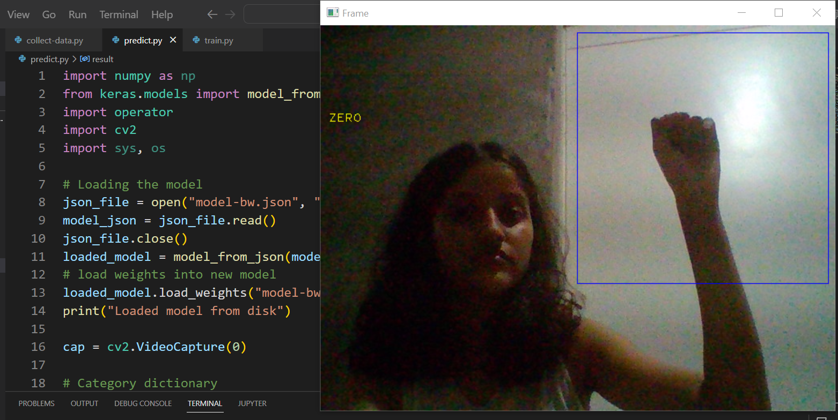

Sample Testing
0 – zero

Slide 5
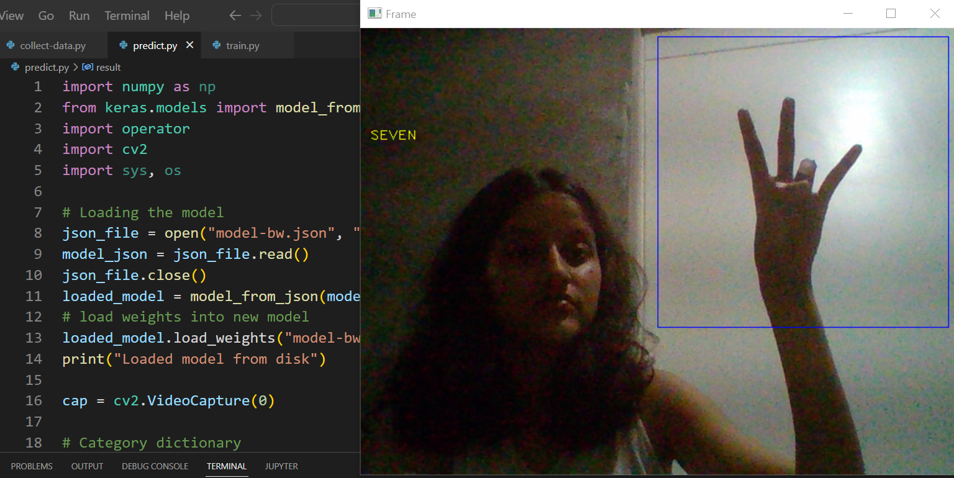

Sample Testing
7 - seven

Slide 6
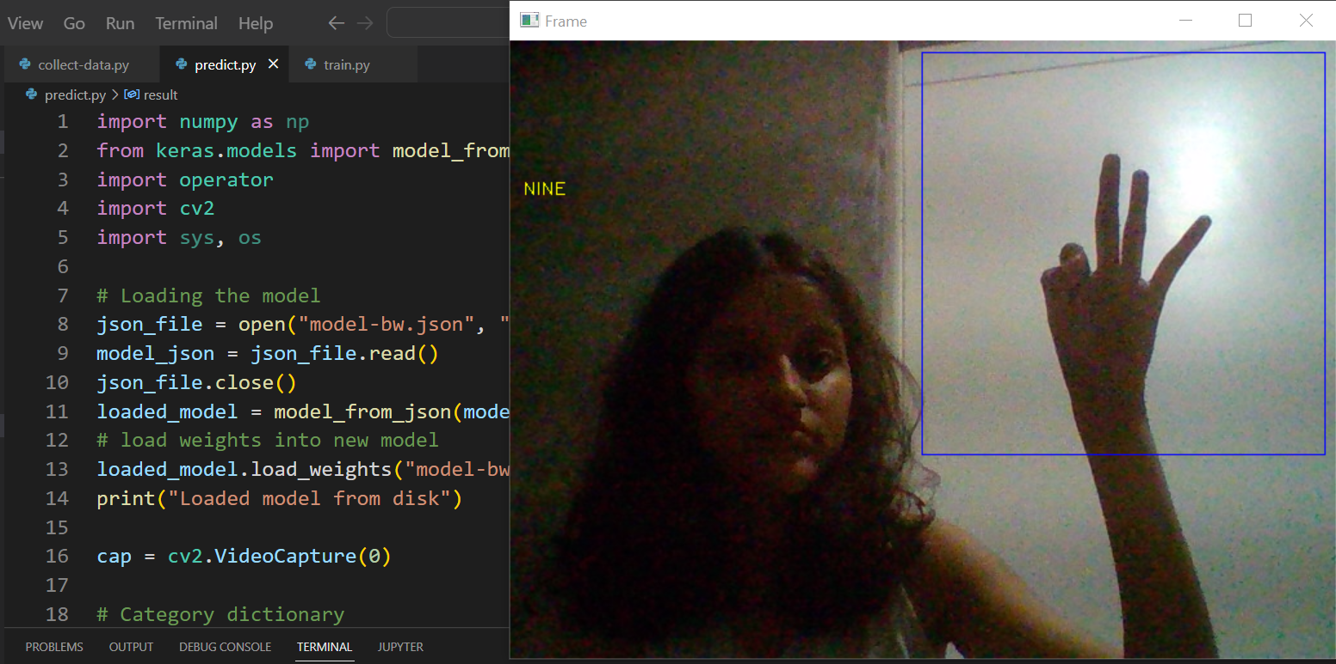

Sample Testing
9 - nine

Slide 7
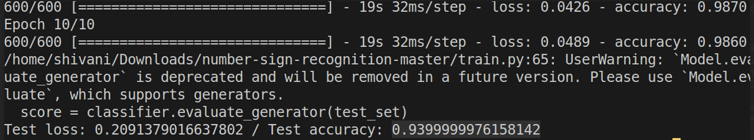
Comp Div1 – Batch T4
Vanshita Jain – 112003053
Shivani Joshi - 112003058
Juhi Shekokar - 112003059

