Slide 1

Client-Server DNS System
Computer networks laboratory
Sem 5 - Mini project
Vanshita Jain – 112003053
Juhi Shekokar - 112003059

Slide 2
Specifications about the project
Performed mini project on the Application Layer
DNS Server: supports queries and replies.
Like nslookup
Coded in Python3
Implemented using socket programming

Slide 3
To Run
New Terminal →
$sudo python3 dnsserver.py
New Terminal →
$python3 dnsclient.py [IP address] [portNumber] [url]
# Output

Slide 4
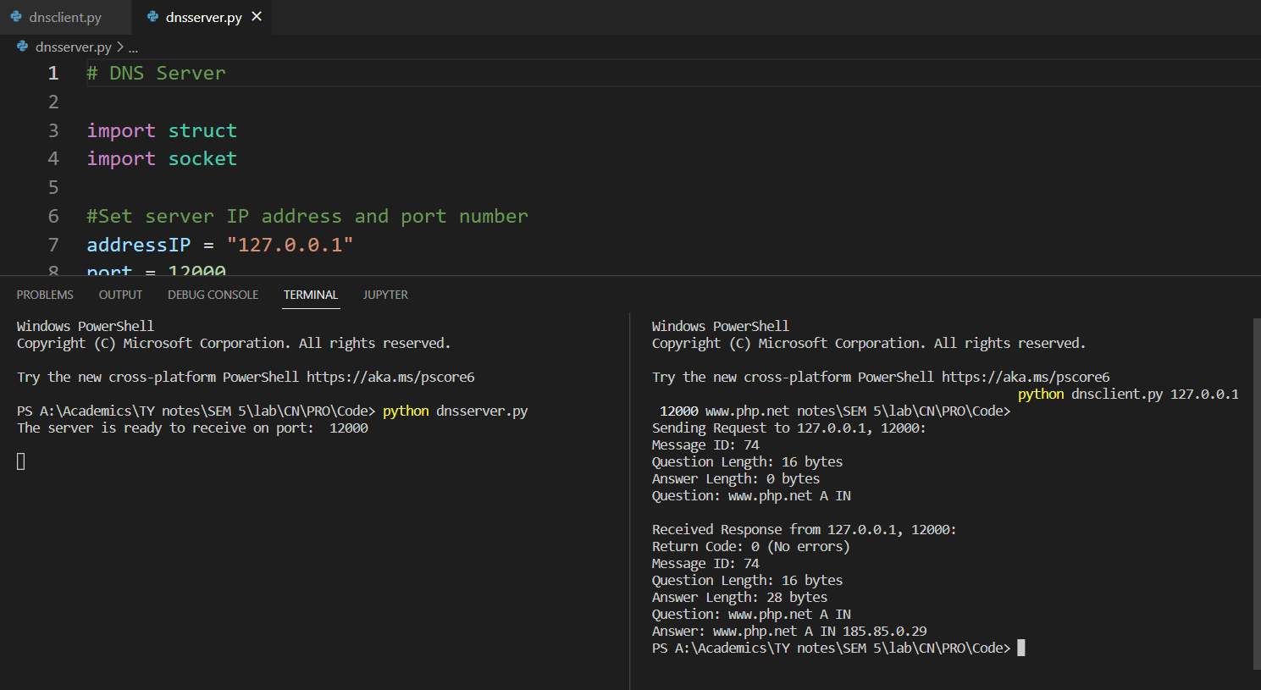
Sample Outputs

Slide 5
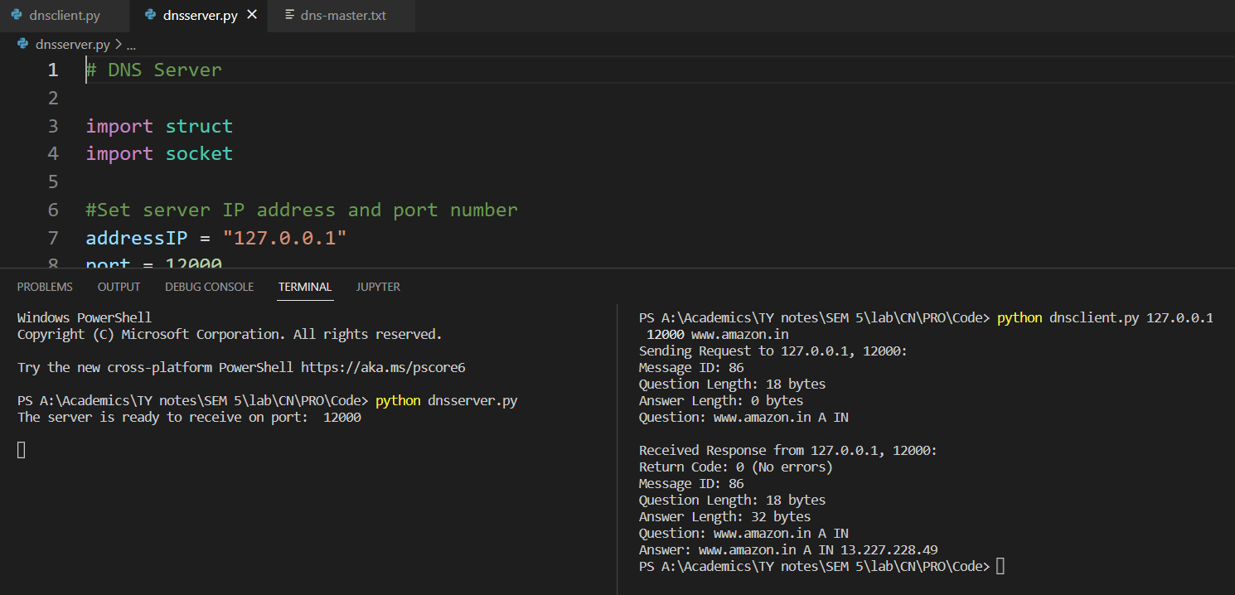
Sample Outputs

Slide 6
Comp Div1 – Batch T4 Vanshita Jain – 112003052 Juhi Shekokar - 112003059

