Slide 1

University Recommendation System
ARTIFICIAL INTELLIGENCE laboratory
Sem 5 - Mini project
DATA SCIENCE lab
Sem 6 - Mini project
Avani dhongde – 112003036
Shruti jadhav - 112003050
Juhi Shekokar - 112003059

Slide 2

Problem Statement
For an aspiring student who wants to apply for higher studies in USA.
List of 5 best universities will be suggested based on applicant profile.
Applicant can apply to those universities and maximize his chances of getting admission.

Slide 3
Project Specifications
Coded in Python3
Beautiful Soup for web scraping
Libraries: pandas, numpy, flask, sklearn
Models and Methodologies: KNN, ANN, Attribute Matching
Input student mark details
Output top 5 universities based on profile
Accuracy is highly dependent on input data (scores)

Slide 4
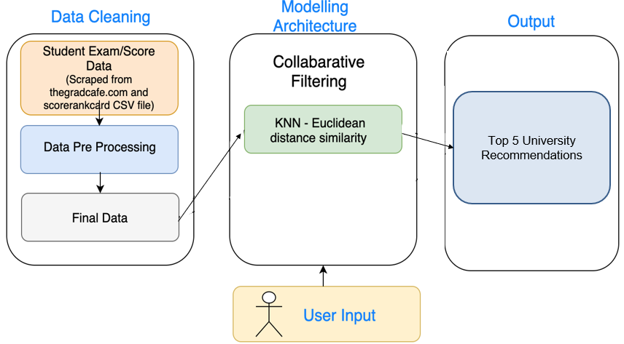
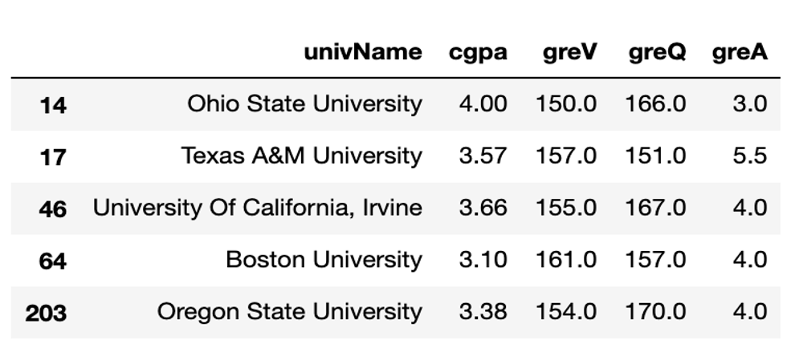
Methodology
Dataset Generation
Web scrapped data from www.thegradcafe.com (14,000 rows)
Removed redundant columns, repeated rows, null values, etc.
After data cleaning and preprocessing (approx. 6,000 rows)

Slide 5
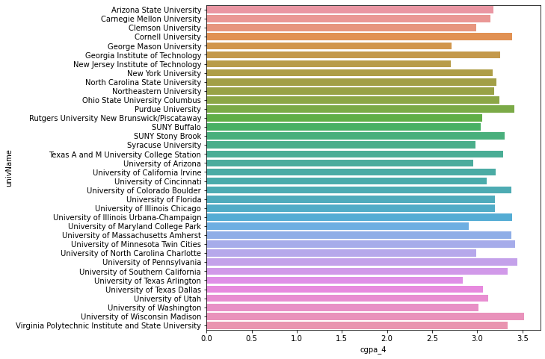
Data Visualization

Slide 6
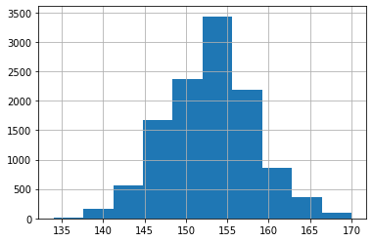
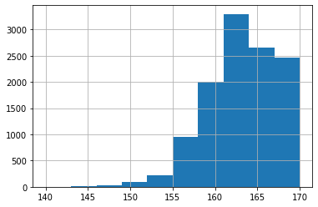
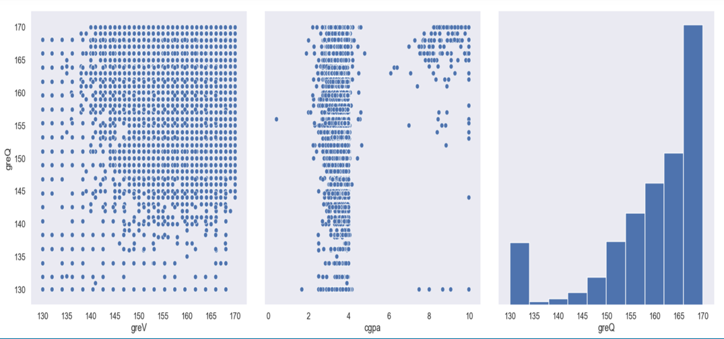
GREV
GREQ

Slide 7
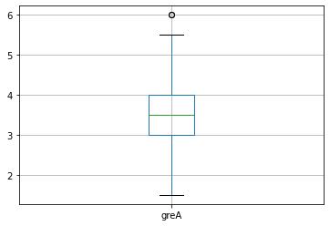
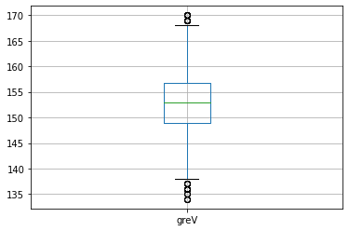
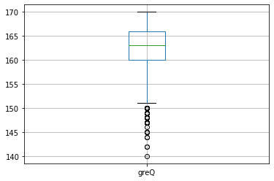

Slide 8
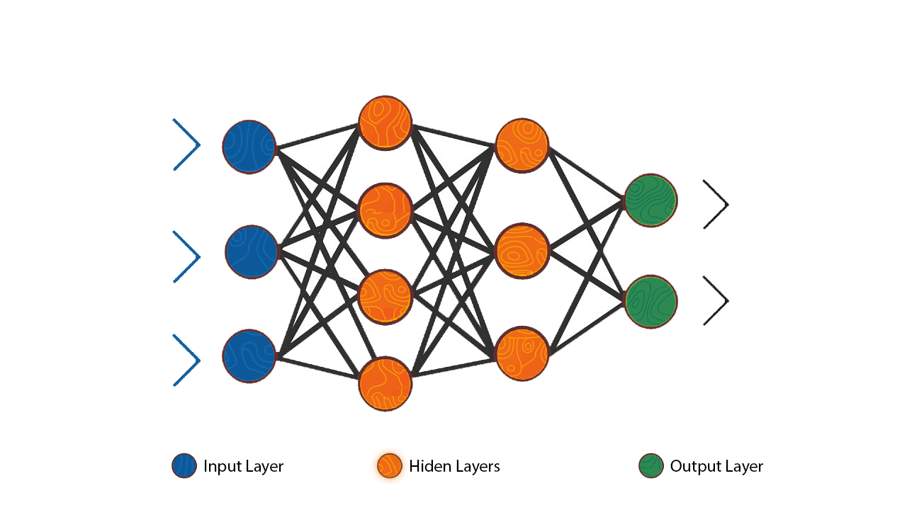
ANN – Artificial Neural Network
Consists of layers of artificial neurons that are interconnected by weights.
Each neuron receives input from previous layer, performs computation, applies activation function and passes to next layer.
Model is trained through backpropagation.
Repeated several times until the model can accurately predict new data.

Slide 9
Activation function decides whether to activate a neuron or not. It adds nonlinearity , which helps to learn and perform more complex tasks.
RELU (Rectified linear unit)function is used in hidden layers
Softmax is used to normalize the output of a network to a probability distribution over predicted output

Slide 10
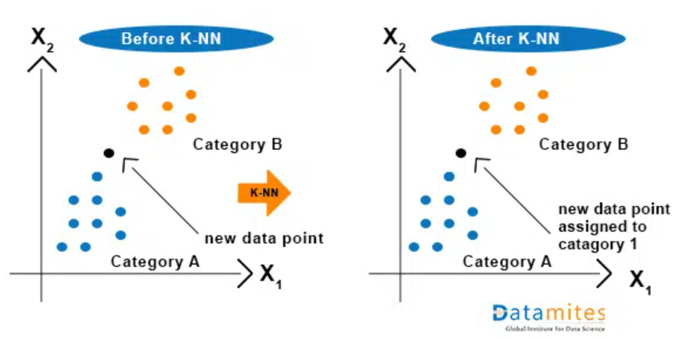
KNN – K Nearest Neighbours Model
Trained data is compared with test data and distances are calculated using Euclidean distance.
Classify instance by finding its nearest neighbors.
Recommend the top N nearest neighbor universities.

Slide 11

Sample Testing

Slide 12
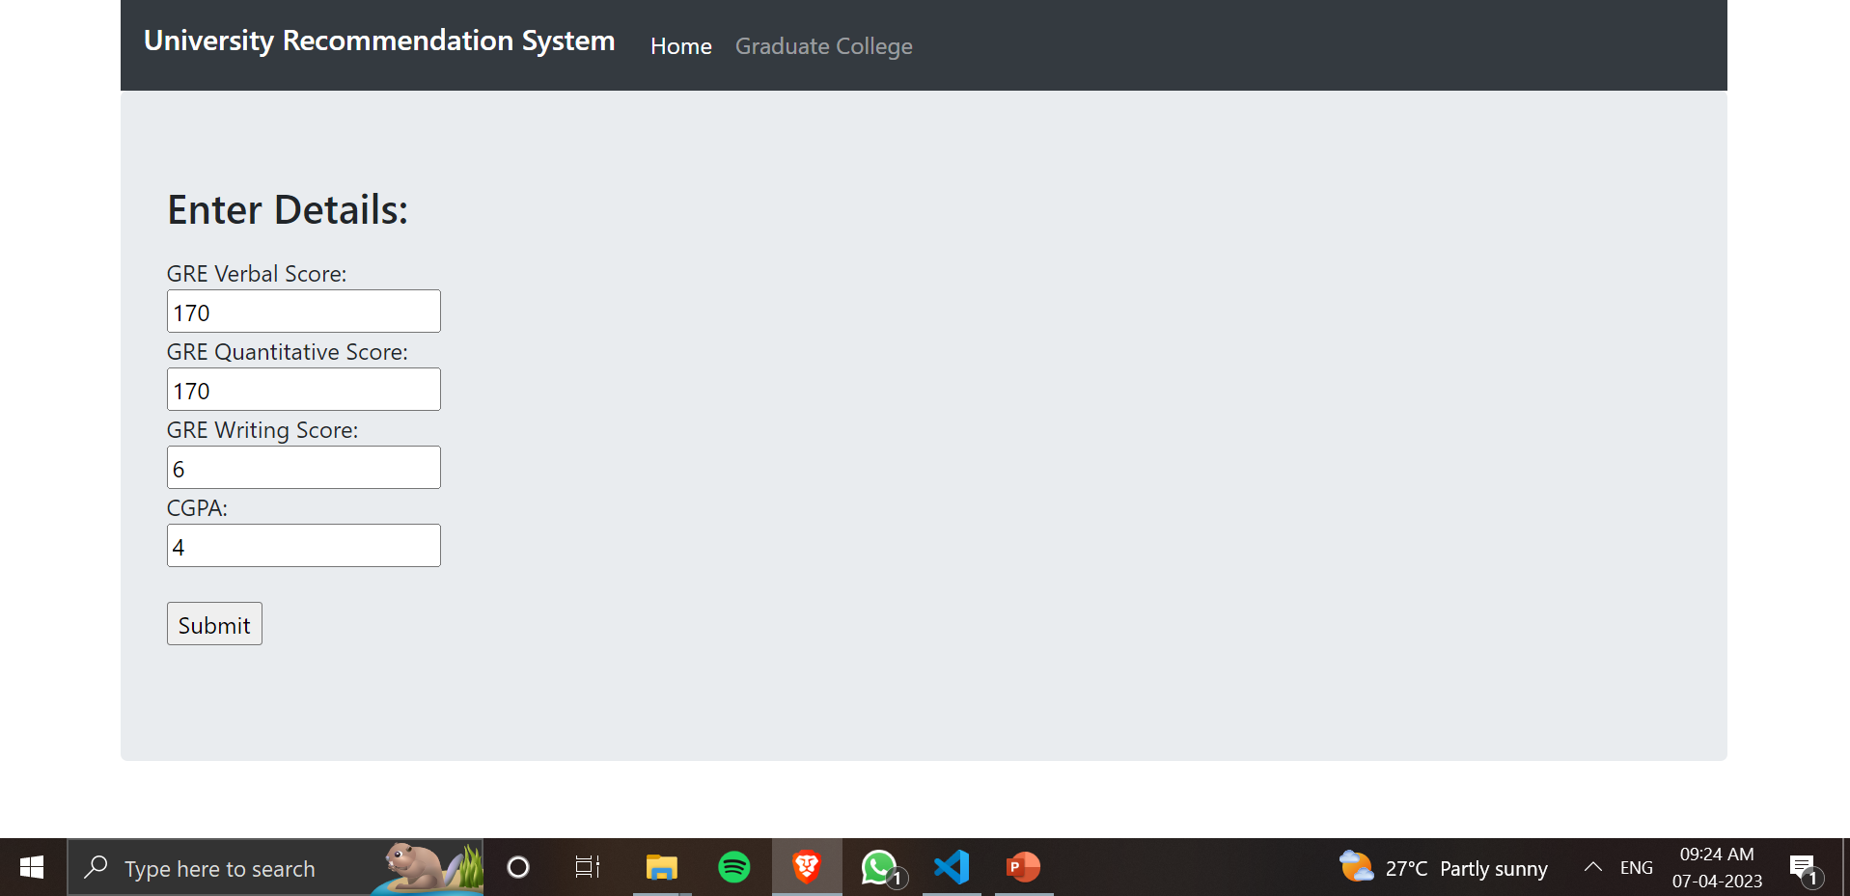
Sample Testing

Slide 13
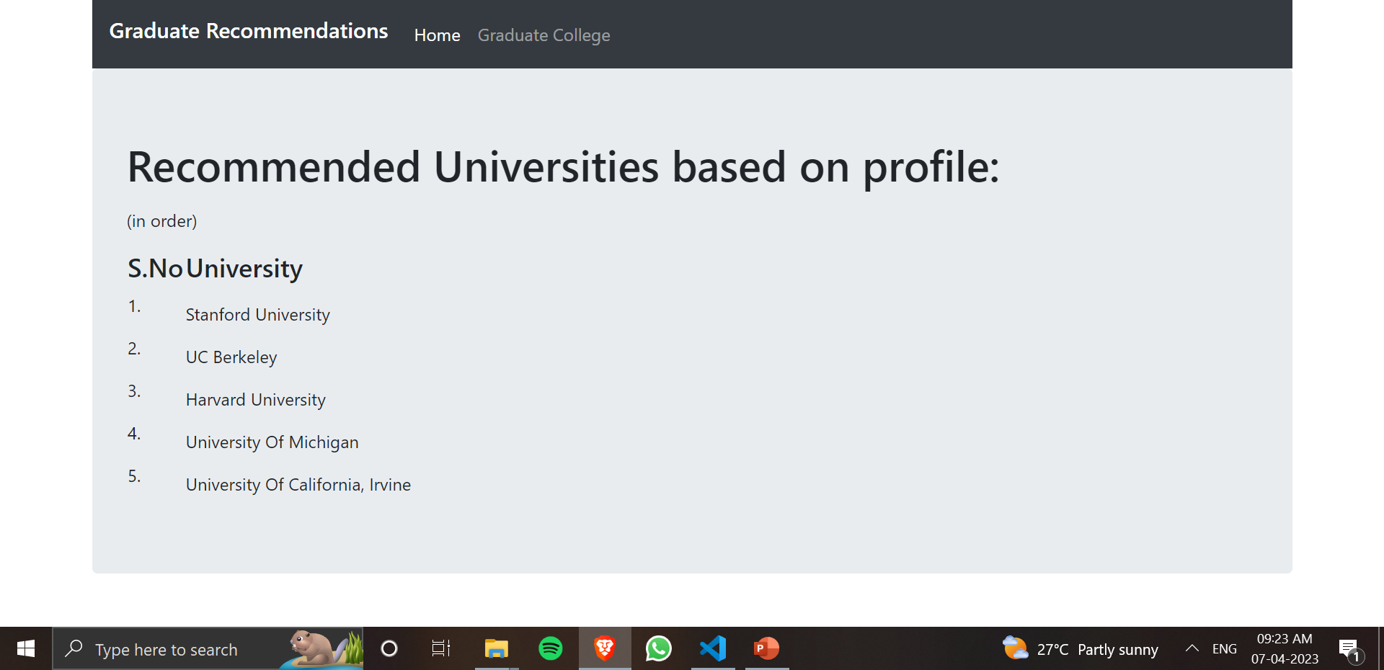
Sample Testing

Slide 14
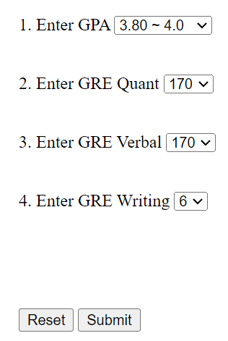
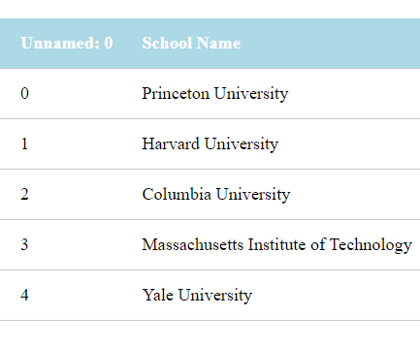
Attribute Matching Methodology
In this methodology, we compare the user inputs with the entries in our dataset.
Each attribute is quantitatively compared to the value of that attribute in the dataset.
If the same exact entries are present in the dataset then result is accurate.
If the same exact entries are not present in the dataset then result accuracy decreases.

Slide 15
Accuracy
ANN Model
Accuracy 75.9%
Train the model on training data
Batch size: specifies number of samples per gradient update. Epochs: specifies number of times to iterate over entire training set
Evaluate the model on training data
Evaluate loss value and accuracy of the model on test data
KNN Model
Accuracy 92.4%
Defining of x and y. x is input and y output
Splitting data into test and train
Making it fit the KNN model with k=3
Predicting results using test data

Slide 16
Comp Div1 – Batch T4
Avani Dhongde– 112003036
Shruti Jadhav- 112003050
Juhi Shekokar - 112003059
Thank You!

