Slide 1

Recommendation category prediction
Exploratory Data Analysis, Model Evaluation and Improvement Metrices

Slide 2
Problem statement and exploratory data analysis

Slide 3
PROBLEM STATEMENT
There are 10 Independent variables provided for training and the target variables is a binary 0 or 1.
The problem appears to be a recommendation problem for a product or a combination of products where the target variable, customer category signifies whether the customer should be recommended the product or not.

Slide 4
independent variables
There are 10 Independent Variables present in the train and test datasets, i.e.,
Customer Visit Score – Score based on recency and frequency of visits of the customer on the website
Customer Product Search Score – Score based on the brand or price value of the products searched by the customer
Customer CTR Score – Click Through Rate, i.e. no of times an ad is shown to the customer vs him/her clicking the ad
Customer Stay Score – Score based on the time spent on average by the customer on the website
Customer Frequency score – Score based on how many times customer visits the website
Customer Product Variation Score – Score based on the variation in the product categories searched by the customer
Customer Order Score – Score based on the successful orders which are not returned
Customer Affinity Score – Score that signifies how good/bad is the customer
Customer Active Segment – Customer Segmentation based on how active is the customer
X1 Segment – Anonymized Customer Segment

Slide 5
Evaluating relation between independent variables and the dependent variable

Slide 6
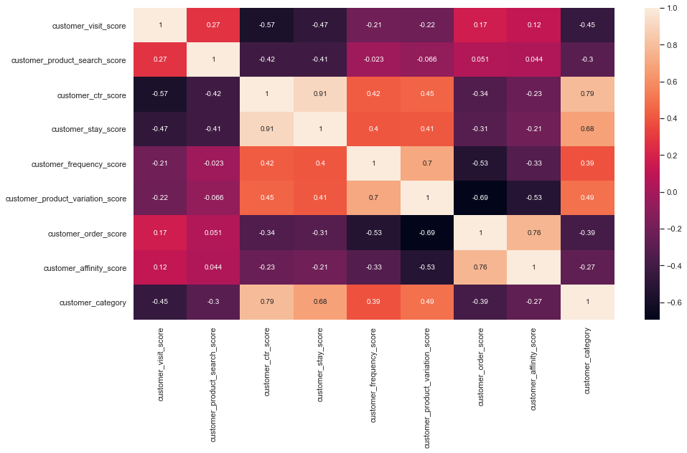
Correlation (continuous variables)
Target variable has high correlation with ctr score and customer stay score, i.e. 0.79 and 0.68 respectively.
Target variable has small correlation with customer affinity score and customer product search score, i.e. 0.27 and 0.3 respectively.
Ctr score and customer stay score has very high correlation of 0.91 which might lead to multicollinearity in linear model.

Slide 7
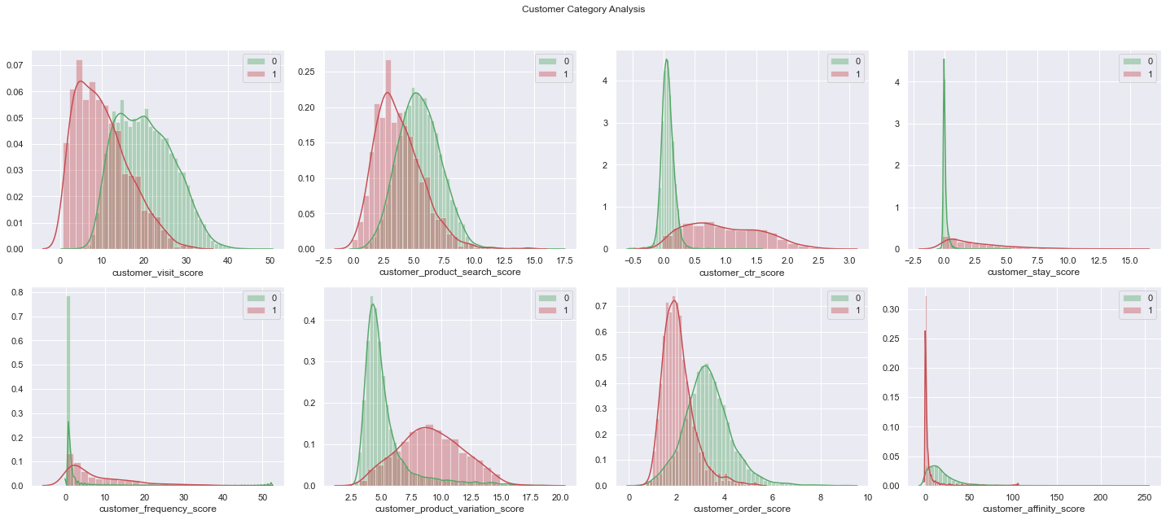
Density plots for continuous variables

Slide 8
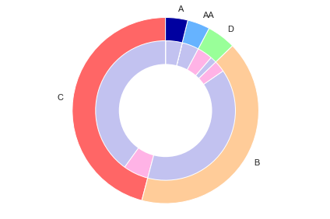
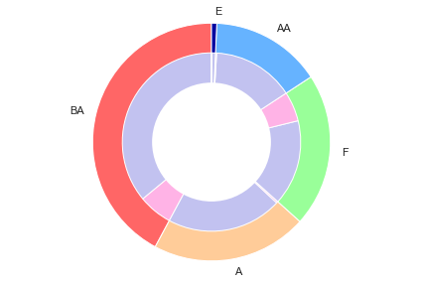
PIE Distribution for categorical variables
Customer active segment
X1 segment

Slide 9
Some highlights from the EDA Performed
The probability distribution across difference classes is, customer_category 0 – 87.9% and customer_category 1 – 12.1 %. This might lead to imbalanced classes and we can use SMOTE and under sampling of majority class to counter the solve the problem.
Customer affinity score has unusual distribution vs target variable around 0-5. So there is lack of linear relationship and correlation but population density of minority target class is very high in a particular interval.
Customer ctr score and customer stay score seems to have strong prediction power.
Customer active segment has minimal density for minority class in A and AA segments.
X1 segment has minimal density for minority class in A, AA and E segments.

Slide 10
Data preprocessing steps

Slide 11
Handling Missing Values(numeRICAL)
Filled values with Deterministic Regression Imputation. In Deterministic Regression Imputation, we replace the missing data with the values predicted in our regression model and repeat this process for each variable. But since there is more than one missing Values in a row we will need to initially fill the blanks with some random number.
Variable | Missing(Train) | Missing(Test)
customer_visit_score | 0 | 0
customer_product_search_score | 42 | 29
customer_ctr_score | 0 | 0
customer_stay_score | 37 | 16
customer_frequency_score | 0 | 0
customer_product_variation_score | 46 | 43
customer_order_score | 66 | 41
customer_affinity_score | 0 | 0

Slide 12
Handling Missing Values(Categorical)
Filling values by creating a new label named as “Missing”.
Variable | Missing(Train) | Missing(Test)
customer_active_segment | 23 | 12
X1 | 37 | 25

Slide 13
Dummy variables for CATEGORICAL
Using pandas get_dummies() function to create a separate column for each label of the categorical columns.
Making sure that one of the label value is removed from the columns list to avoid the Dummy Variable Trap.

Slide 14
CREATING WOE Binned columns for linear models
There is some non linear behavior in the data specially for the columns customer affinity score and customer product search score.
For Linear models like Logistic and SVM, these variables will not be useful enough if used directly so creating woe binning to handle such scenarios.
Also combining columns of categorical variables in case of identical distribution of target variable within a certain label.

Slide 15
Feature selection

Slide 16
BACKWARD ELIMINATION FOR Feature selection
Using sklearn statsmodels.api class with significance level, alpha = 0.05 and using Ordinary Least Square technique, we found out that the variable customer affinity score is not useful as expected because of its non linear distribution respective to the target class.
For Non- Linear models like KNN, Tree based algorithms and Neural Network, we will use the variable directly.
For Linear models like SVC and Logistic Regression, we will use the woe binned dummy variable.

Slide 17
model evaluation

Slide 18
Linear models
Logistic Regression –
Accuracy on Train – 97.63 %
Accuracy on Test – 93.27 %
ROC(area) on Train – 0.92
Support Vector Classification –
Accuracy on Train – 97.42 %
Accuracy on Test – 93.33 %
ROC(area) on Train – 0.90

Slide 19
Tree based models
Decision Tree Classifier(max depth = 5) –
Accuracy on Train – 98.43 %
Accuracy on Test – 92.17 %
ROC(area) on Train – 0.94
Random Forest Classifier(max depth = 6)–
Accuracy on Train – 97.89 %
Accuracy on Test – 91.73 %
ROC(area) on Train – 0.93
XGBoost–
Accuracy on Train – 97.94 %
Accuracy on Test – 91.34 %
ROC(area) on Train – 0.93

Slide 20
K-NN nearest neighbor
Logistic Regression –
Accuracy on Train – 97.26 %
Accuracy on Test – 94.88 %
ROC(area) on Train – 0.89
After multiple iteration, KNN with Nearest neighbor = 5 performed better than other models till now on the actual test dataset.

Slide 21
Neural network
Logistic Regression –
Accuracy on Train – 96.85 %
Accuracy on Test – 95.95%
ROC(area) on Train – 0.89
Neural Network with 3 Layers and StratifiedKFold validation was used with k =10 and epoch = 50. 3 layers included 2 of the Rectified Linear Unit activation function(ReLu) and one sigmoid function. For classifying probability > 0.85 was selected for the class 1.

Slide 22
Ensemble(combination of knn and neural network)
After careful observation it is found that borderline values are tagged as 1 by most of the models.
So, I combined the KNN model and the Neural Network Models to get the final predicted values.
Train Accuracy – 98.45 %
Test Accuracy – 96.74%
ROC(area) on Train – 0.91

Slide 23
Setbacks of current method

Slide 24
ERRORS/opportunity to improve
KNN and Neural Network outperformed other models because of the strong ability of the models to distinguish between classes.
SMOTE and undersampling technique should be added for other models to perform better and to have a consistent performance across datasets.
Here, the distribution of the train and test datasets appears to be different, that might be a reason of certain models performing better on train but not on unseen test dataset.

Slide 25
recommendation engine architecture and ideal metric addition

Slide 26
New Metrices that can improve model performance
Assuming the recommendation is for a certain product/category,
New variables corresponding to that particular category can be added to the training data. This is to check the hypothesis whether the customer is consistently shopping for that product/category.
If it’s a specific product and customer has shopped frequently in the past, a new variable can be created that will check when will the customer need the product again based on the average time for consumption of the product.
Metrics based on Customer’s Browser History can be created to use any cross sell opportunity.
Metrics based on Customer’s wish list and product/category to recommend.
Customers Demographic Data can also be added in the current system to check if it has any relation with the target variable.
Weather Conditions in the current location of the customer can also be used.

Slide 27
Architecture
Sources of data:
Customers activity on the website(clickstream data).
Customers Demographic information gathered on registration.
Customers Recent Activity on other similar sites gathered through browser history.
Customers recent purchases/financials gathered through messages in case of app based site.
Customer Location Information.

Slide 28
Architecture
General Hypothesis
Customer in similar location or belonging to similar age order similar products based on weather, lifestyle and social status.
Home, Office and Travel Locations can be tagged for the customer. Customer is more likely to click on a link when free.
Customer major activity can be tagged and recommendation can be sent during the time of most activity on the website.
Offers based on similar product search (same site/other sites) can be given to use cross sell opportunity.
Most Recent event(click/view/visit/wishlist) should be given more weightage.
Market Basket Analysis to identify similar product categories.

Slide 29
THANK YOU!!

