Slide 1
KSE801 Group Meeting
19/12/09

Slide 2

Fast Indoor <> Outdoor Transition Detection (IOTD) Through Door Crossing Awareness
Assumption: People are using a door to enter a building.
Utilize smartphone sensors to perform human activity analysis
Tasks:
Data Acquisition
Data Preprocessing
Model Training & Evaluation
Report Writing

Slide 3
Data acquisition
Time Duration: about 3 hours
Buildings: N1, 응공동, 산경동
Collected Data Type: Accelerometer, GPS, Gravity, Gyroscope, Magnetic Field, Orientation, Pressure, Wifi
# of labels: total 238
 | Outdoor > Indoor | Indoor | Indoor > Outdoor
Manual | 58 | 52 | 57
Automatic | 0 | 35 | 0
Automatic Button | 8 | 24 | 4

Slide 4
Data Preprocessing
Windowing (with 50% overlap)
Basic feature extraction (min, max, mean, std 등 [, average number of peaks, variance of peaks])
Normalization (min-max scaler 등)
apply noise filters [e.g. low pass filter] to acceleration data, also for decomposing gravitational acceleration and body motion acceleration

Slide 5
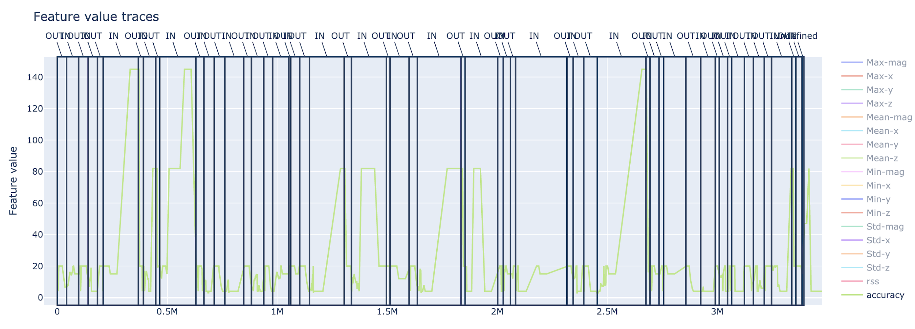
Data Visualization
Ex. Data visualization of GPS data (detection accuracy)

Slide 6
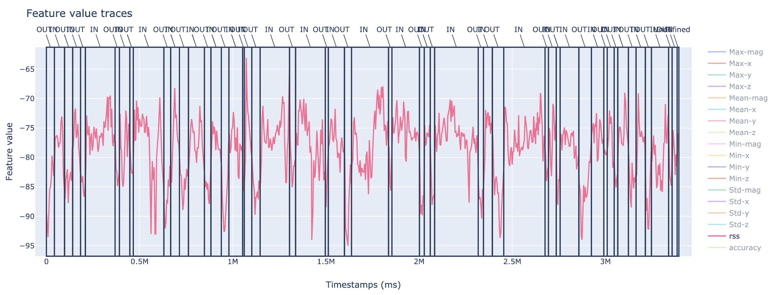
Data Visualization
Ex. Data visualization of Wifi data (signal strength of 5GHz bandwidth)

Slide 7
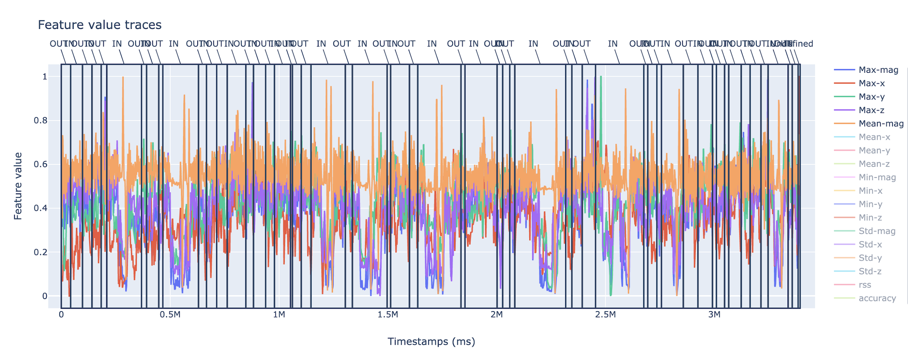
Data Visualization
Ex. Data visualization of basic feature extracted data (magnitude of acceleration)

Slide 8
Model Training
Some tests were already carried out, but results are not 100% satisfactory yet
Currently working with following models:
LSTM Network Model
CNN-LSTM Network Model
ConvLSTM Network Model

