Slide 1

“When am I entering a building?”
Fast Indoor <> Outdoor Transition Detection (IOTD) Through Door Crossing Awareness
Team 11
Keunchul Park, Juho Sun, Joseph Berkner

Slide 2


Slide 3


CONTEXT
Importance
Challenge
90% of life is spent indoors
Indoor localization increasingly important:
Indoor Wayfinding
Asset Tracking
Marketing Integration
Emergency Management
...
GPS does not work in buildings
+ Indoor localization requires higher accuracy:
current IOTD temporal accuracy often >3sec
Needed for radio map algorithm
When does the person actually enter the building?

Slide 4

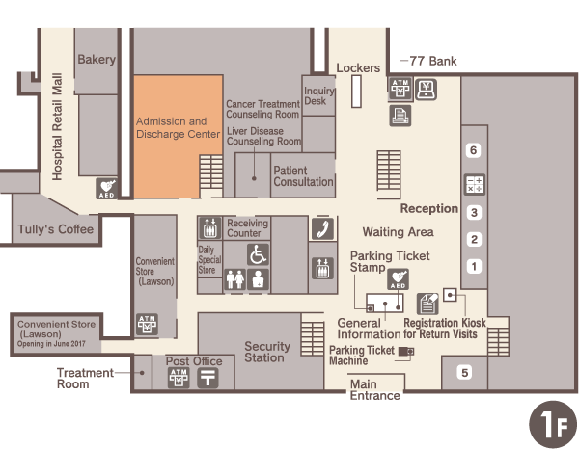
Goal
Precise
Reach >95% IOTD
---
Fast
Reach <3sec IOTD
Area of decision

Slide 5

Idea
Assumption:
People are using a door to enter a building.
Utilize smartphone sensors to perform human activity analysis
Detect moments of door crossings

Slide 6

Methodology
Collect sensor data at KAIST buildings and label moments of transition as well as type of door used to enter / exit (manual, automatic, automatic + button [, rotating])
Create different models:
Detect door crossing moments (binary classification)
Detect door crossing moments and distinguish between door type (multiclass)
Perform IOTD (with distinction of door types) (binary/multiclass)

