Slide 1




THE 5th VIETNAM SCHOOL OF BIOLOGY (VSOB5)
Mastering Agentic AI in Bioinformatics:
From Insight to Impact
October 29th-31st, 2026,
ICISE, Gia Lai, Vietnam
CBAS Server

Slide 2
The 1st VIETNAM SCHOOL OF BIOLOGY
Bioinformatic course:
Microbiome analysis in agricultural work and research
December 13-14, 2022, ICISE, Quy Nhon, Vietnam
The 2nd VIETNAM SCHOOL OF BIOLOGY
Genomic analysis of microbial pathogens
using Illumina and Nanopore sequencing
December 9-11, 2023, ICISE, Quy Nhon, Vietnam
The 3rd VIETNAM SCHOOL OF BIOLOGY
Bioinformatic analysis for bulk RNA-seq data
December 06-08, 2024, ICISE, Quy Nhon, Vietnam
The 4th VIETNAM SCHOOL OF BIOLOGY
Bioinformatics Course:
Metagenome Analysis in One Health Practice
From 16S to Shotgun
Sep 3rd -6th, 2025, ICISE, Gia Lai, Vietnam

Slide 3
The 5th VIETNAM SCHOOL OF BIOLOGY
Mastering Agentic AI in Bioinformatics:
From Insight to Impact
Oct. 29th -31st, 2026, ICISE, Gia Lai, Vietnam

Slide 4
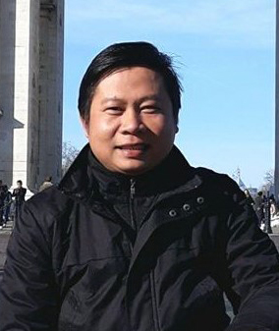
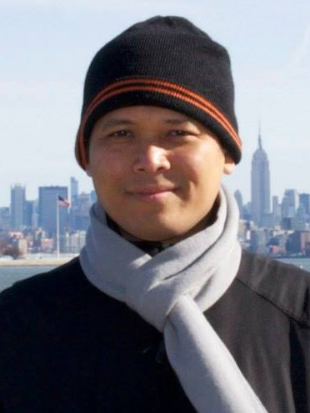
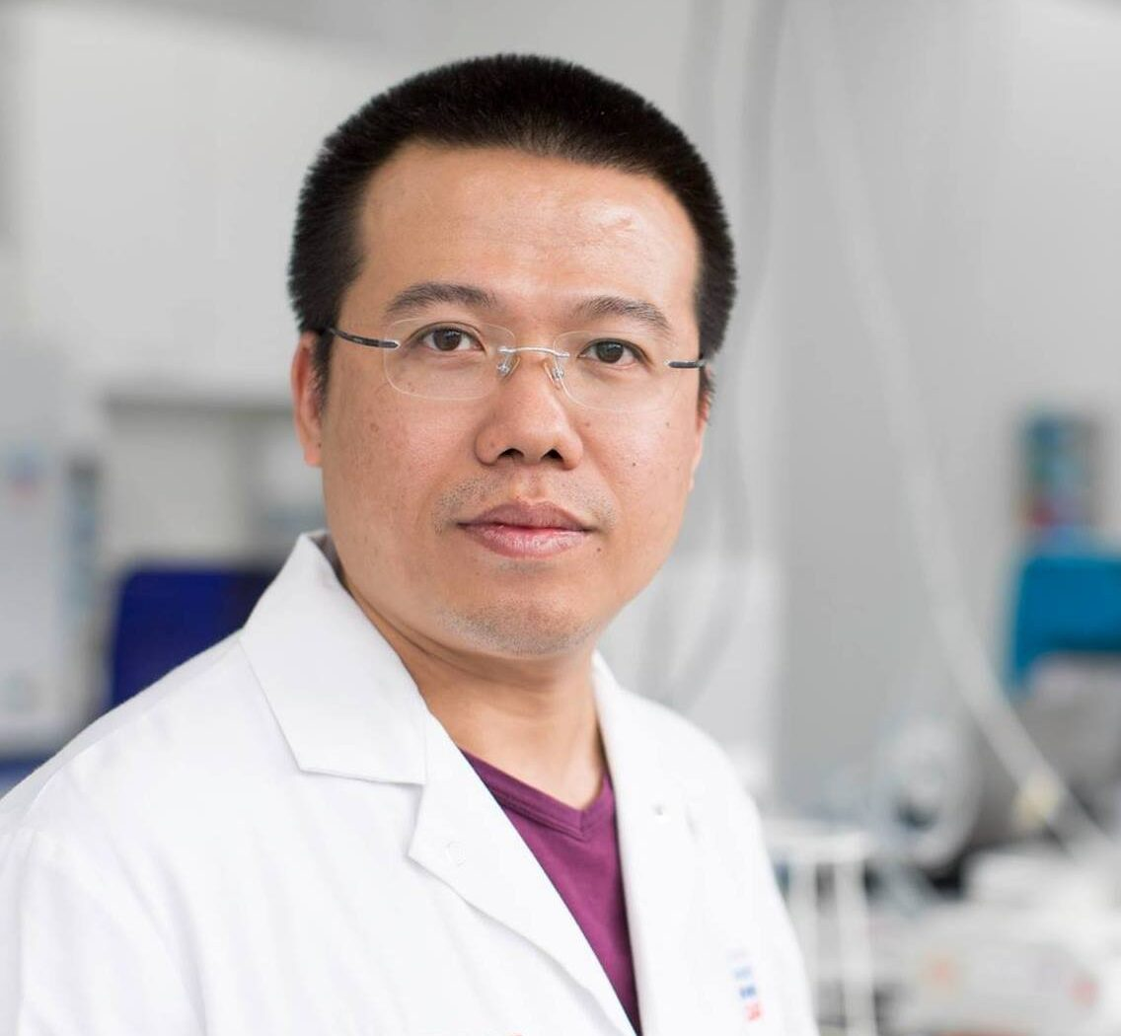
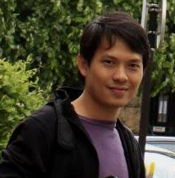
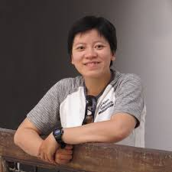
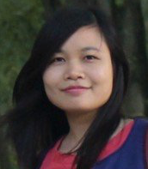
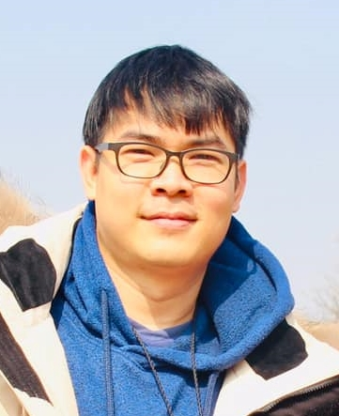
VSOB Organizing & Program Committees
Dr. Tran Thanh Son
ICISE, Quy Nhon
Assoc. Prof. Dr. Nguyen Bao Quoc
Nong Lam University, HCMC
Dr. Nguyen Cuong
Chief Scientific Officer,
LOBI Vietnam
Dr. Vu Minh Thiet
Nguyen Tat Thanh Uni.
Dr. Nguyen Thuy Vy
Uni. of Natural Sciences,
Vietnam National University, HCMC
Dr. Tran Thi Thanh Tam
University of Science and Technology Hanoi (USTH), VAST
Dr. Do Hoang Dang Khoa
NTT Hi-Tech Institute,
Nguyen Tat Thanh University

Slide 5
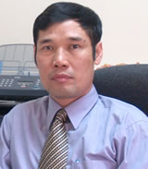
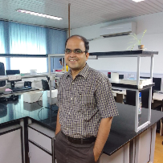
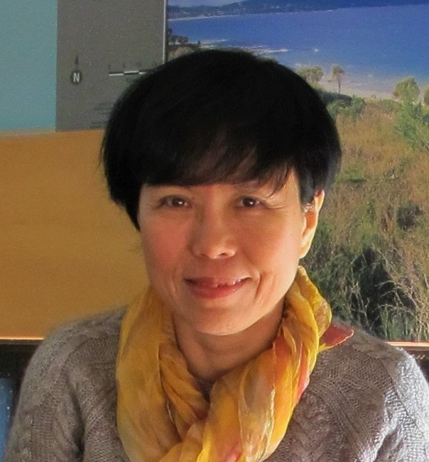
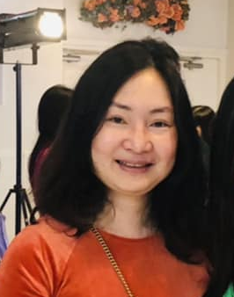
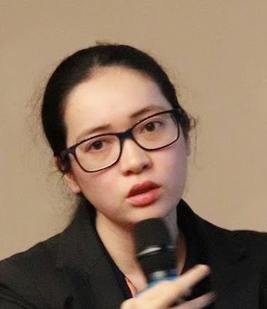
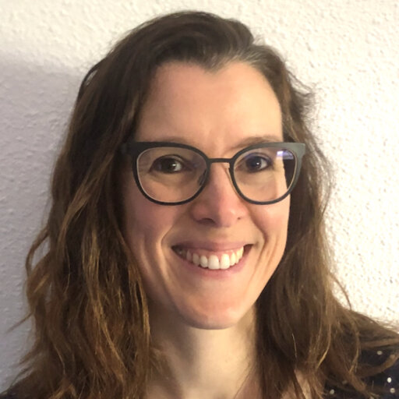
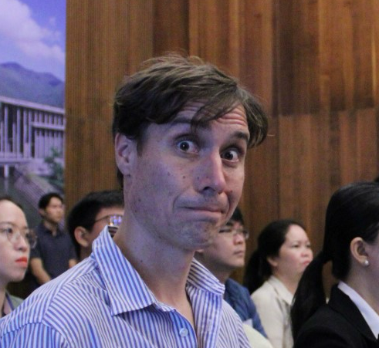
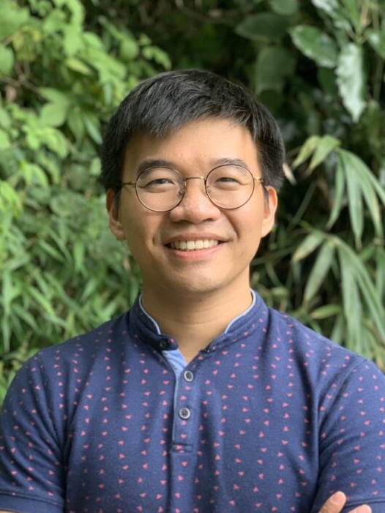
VSOB: Invited Speakers and Lecturers
Prof. Dr. Truong Nam Hai
Institute of Biotechnology, VAST
Prof. Dr. Rajesh Pandey
Institute of Genomic and
Integrative Biology
New Dehli, India
Assoc. Prof. Ho H. T. Duong
Uni. of Science, VNUHCM
Dr. Dương Vũ,
Westerdijk Fungal
Biodiversity Institute,
The Netherlands
Mrs. Pham T. T. Tam
BCE Company Ltd.
Dr. Juliette Hayer
IRD
Dr. Etienne Loire
CIRAD
Dr. Chung The Hao
OUCRU

Slide 6
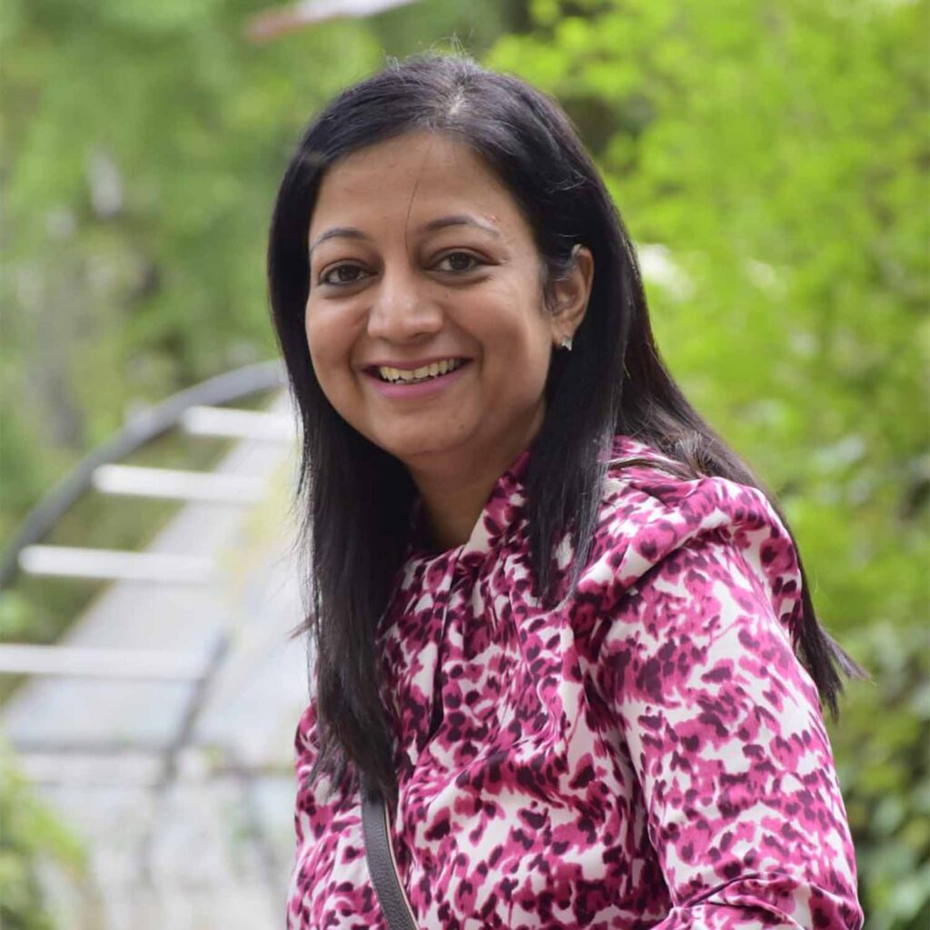
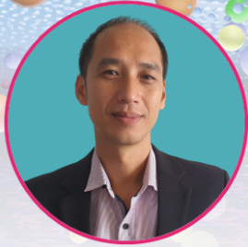

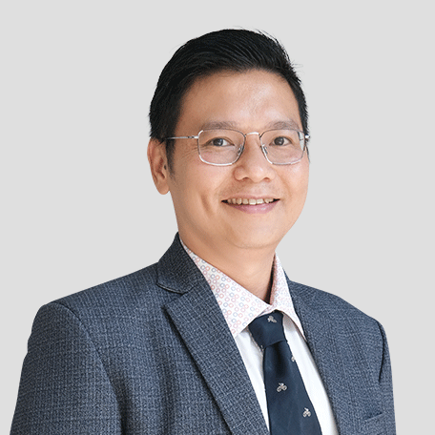
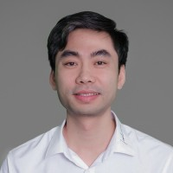
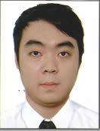

VSOB: Invited Speakers and Lecturers
Dr. Deeksha Bhartiya
Founder/CEO
Genomiki Solutions, India
Dr. Cong Luan Nguyen
Business Manager,
APAC, Vizgen
Dr. Nguyen Thi Lien Hanh
Institute of Malariology, Parasitology and Entomology (IMPE) Quy Nhon
Dr. Luu Phuc Loi
Tam Anh Research Institute (TamRI), HCMC
Dr. Vo Sy Nam
Chief Scientist, Co-Founder, GeneStory
Director, Center for Biomedical Informatics, Vingroup Big Data Institute
Phd. Candidate Pham Quang Huy
Kyungpook University, Korea
Teaching Assistants

Slide 7

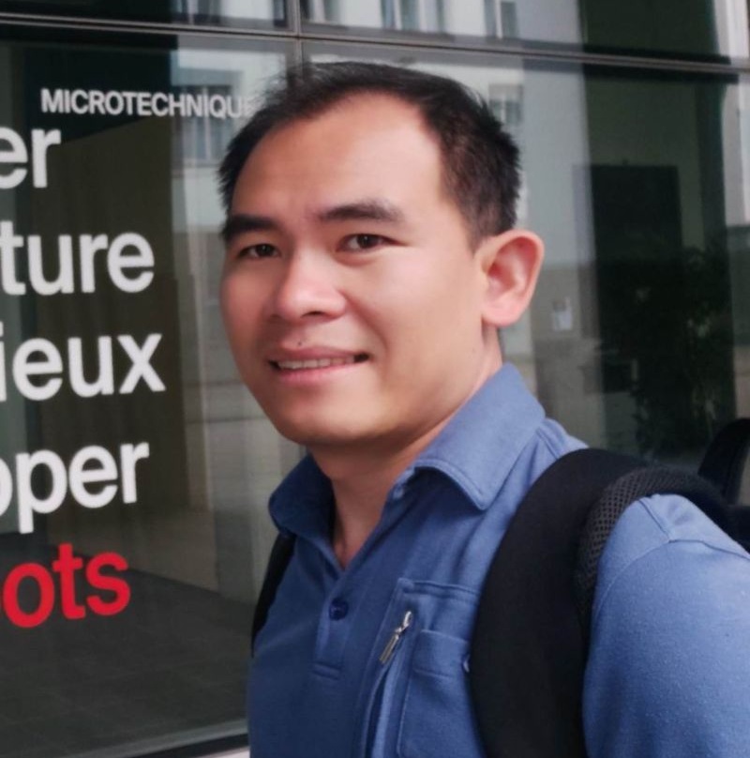
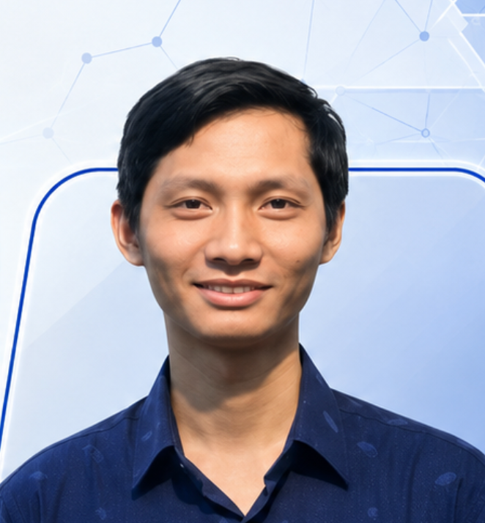
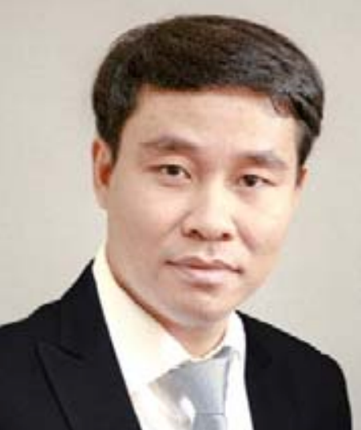
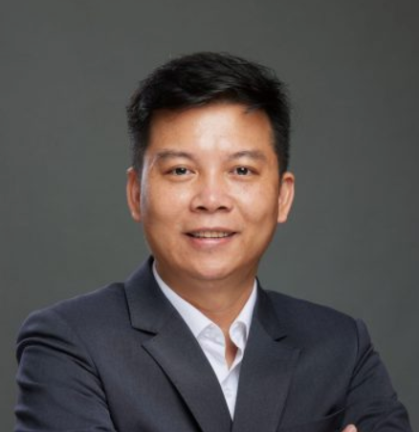
VSOB: Invited Speakers and Lecturers
TS. Trần Thương Văn Du
Swiss Institute of Bioinformatics
TS. Bùi Văn Thạch
Khoa CNTT, Trường ĐH Khoa học Tự nhiên, ĐHQG-HCM
PGS.TS. Nguyễn Hoàng Hải
Đại học Quốc gia Hà Nội
PGS.TS. Chu Đình Tới
Trưởng khoa Khoa học Ứng dụng, Trường Quốc tế, ĐHQGHN
Thao My Nguyen
Founding Member, Head of Product Design & Business Development, Drylab, Inc.

Slide 8
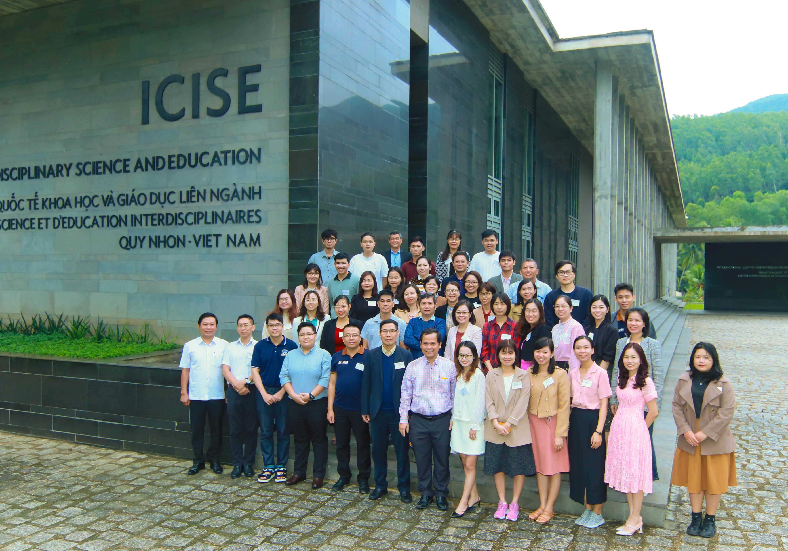
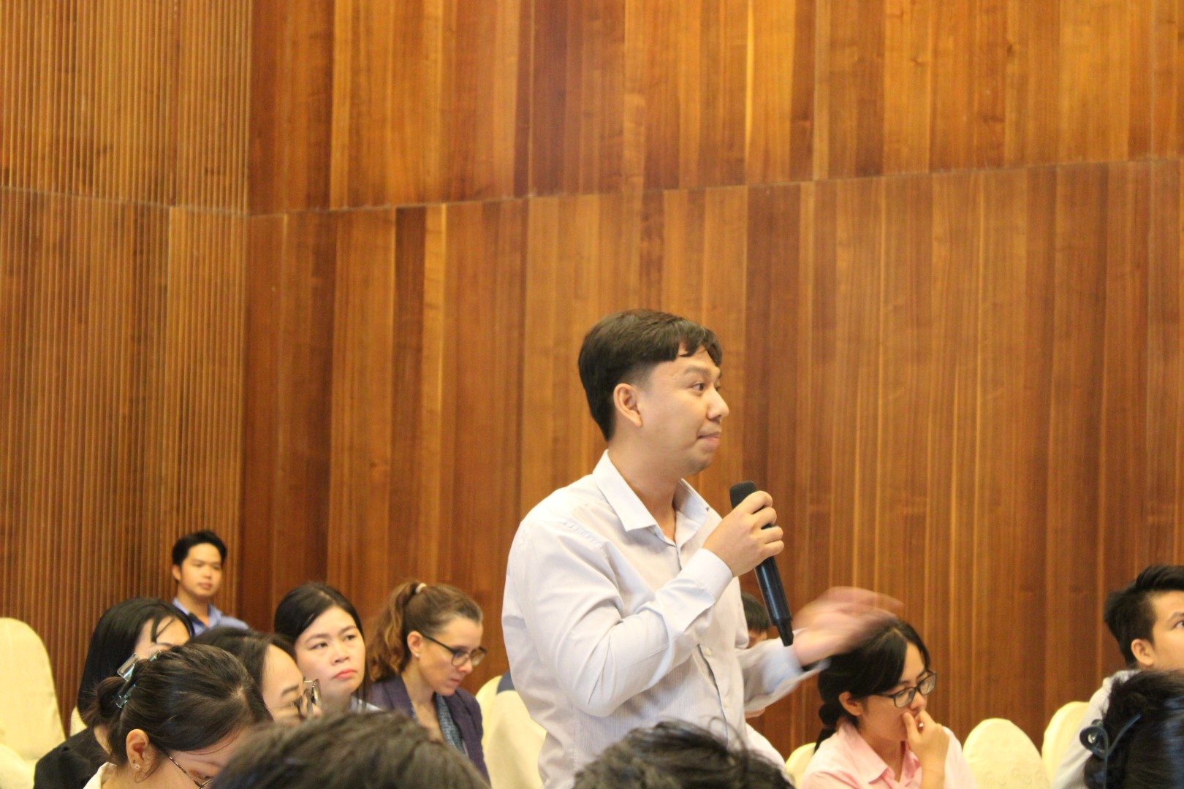
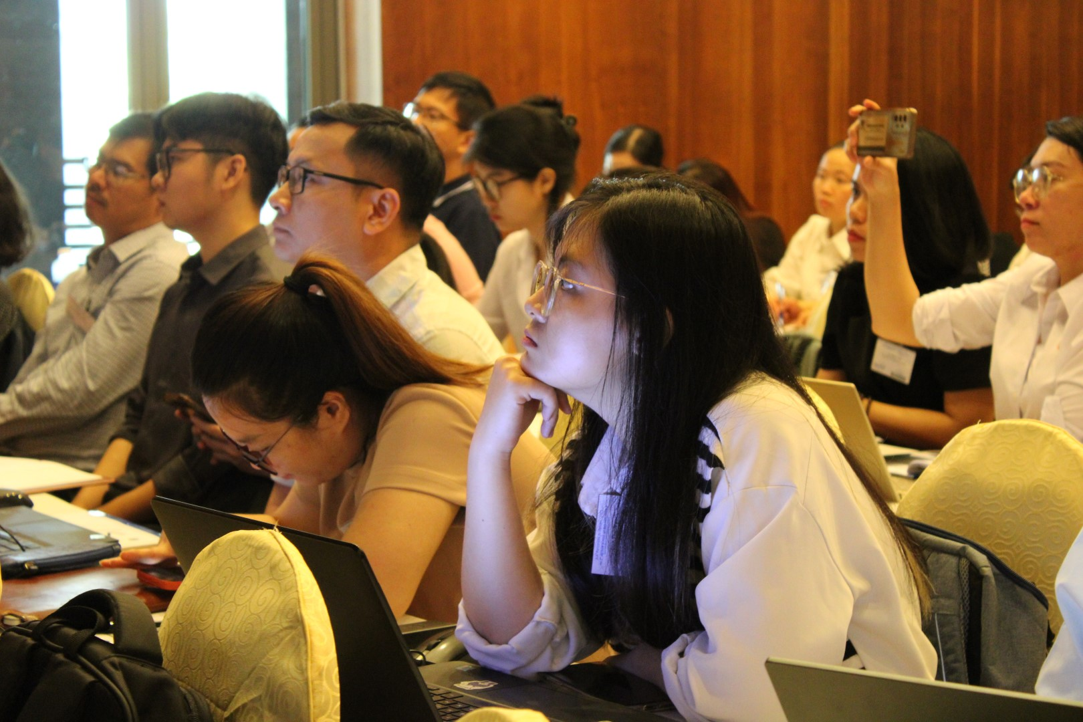
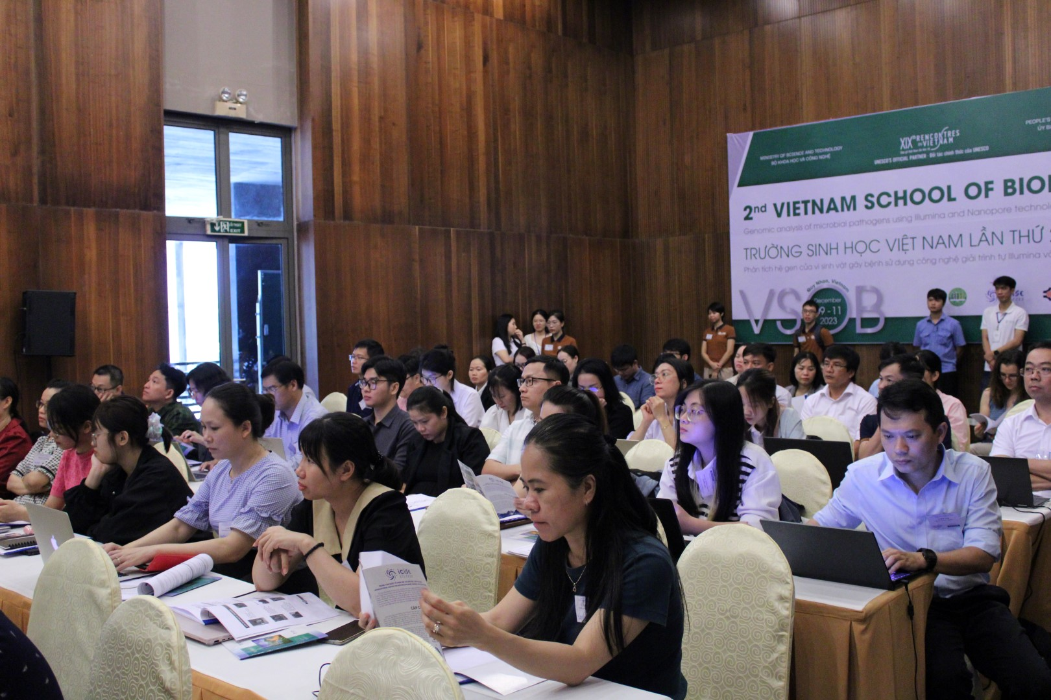
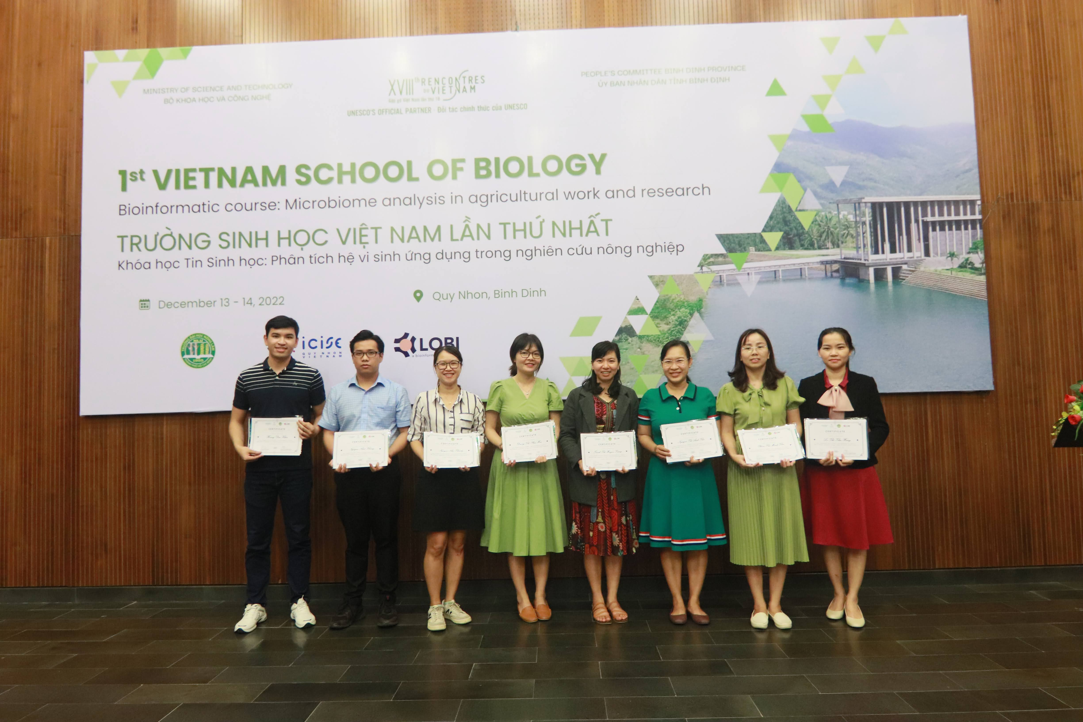
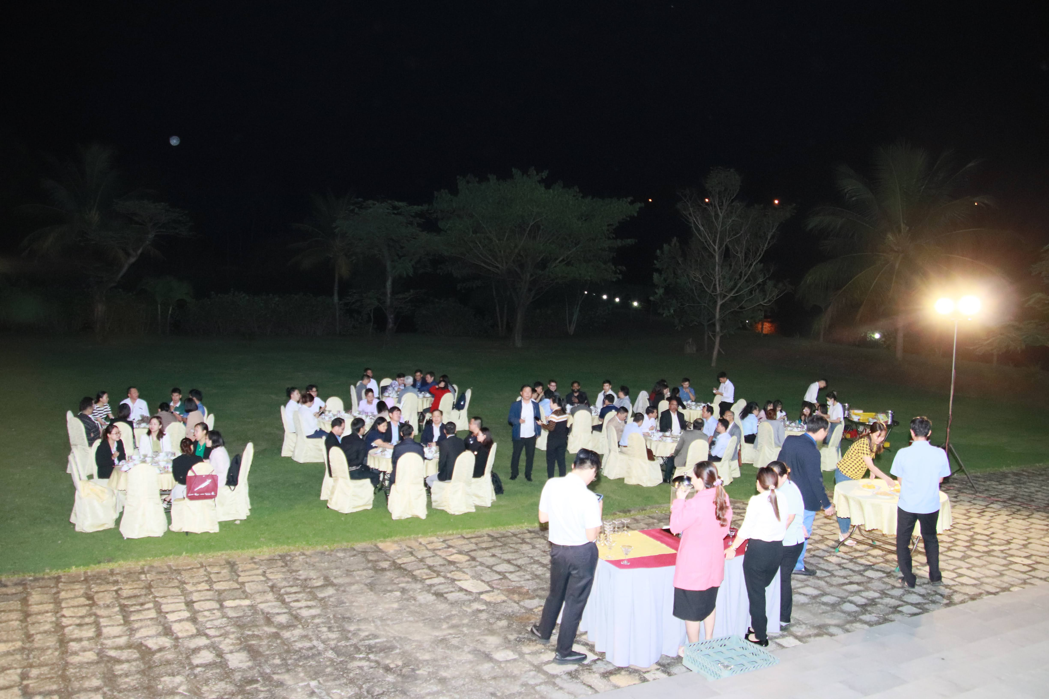
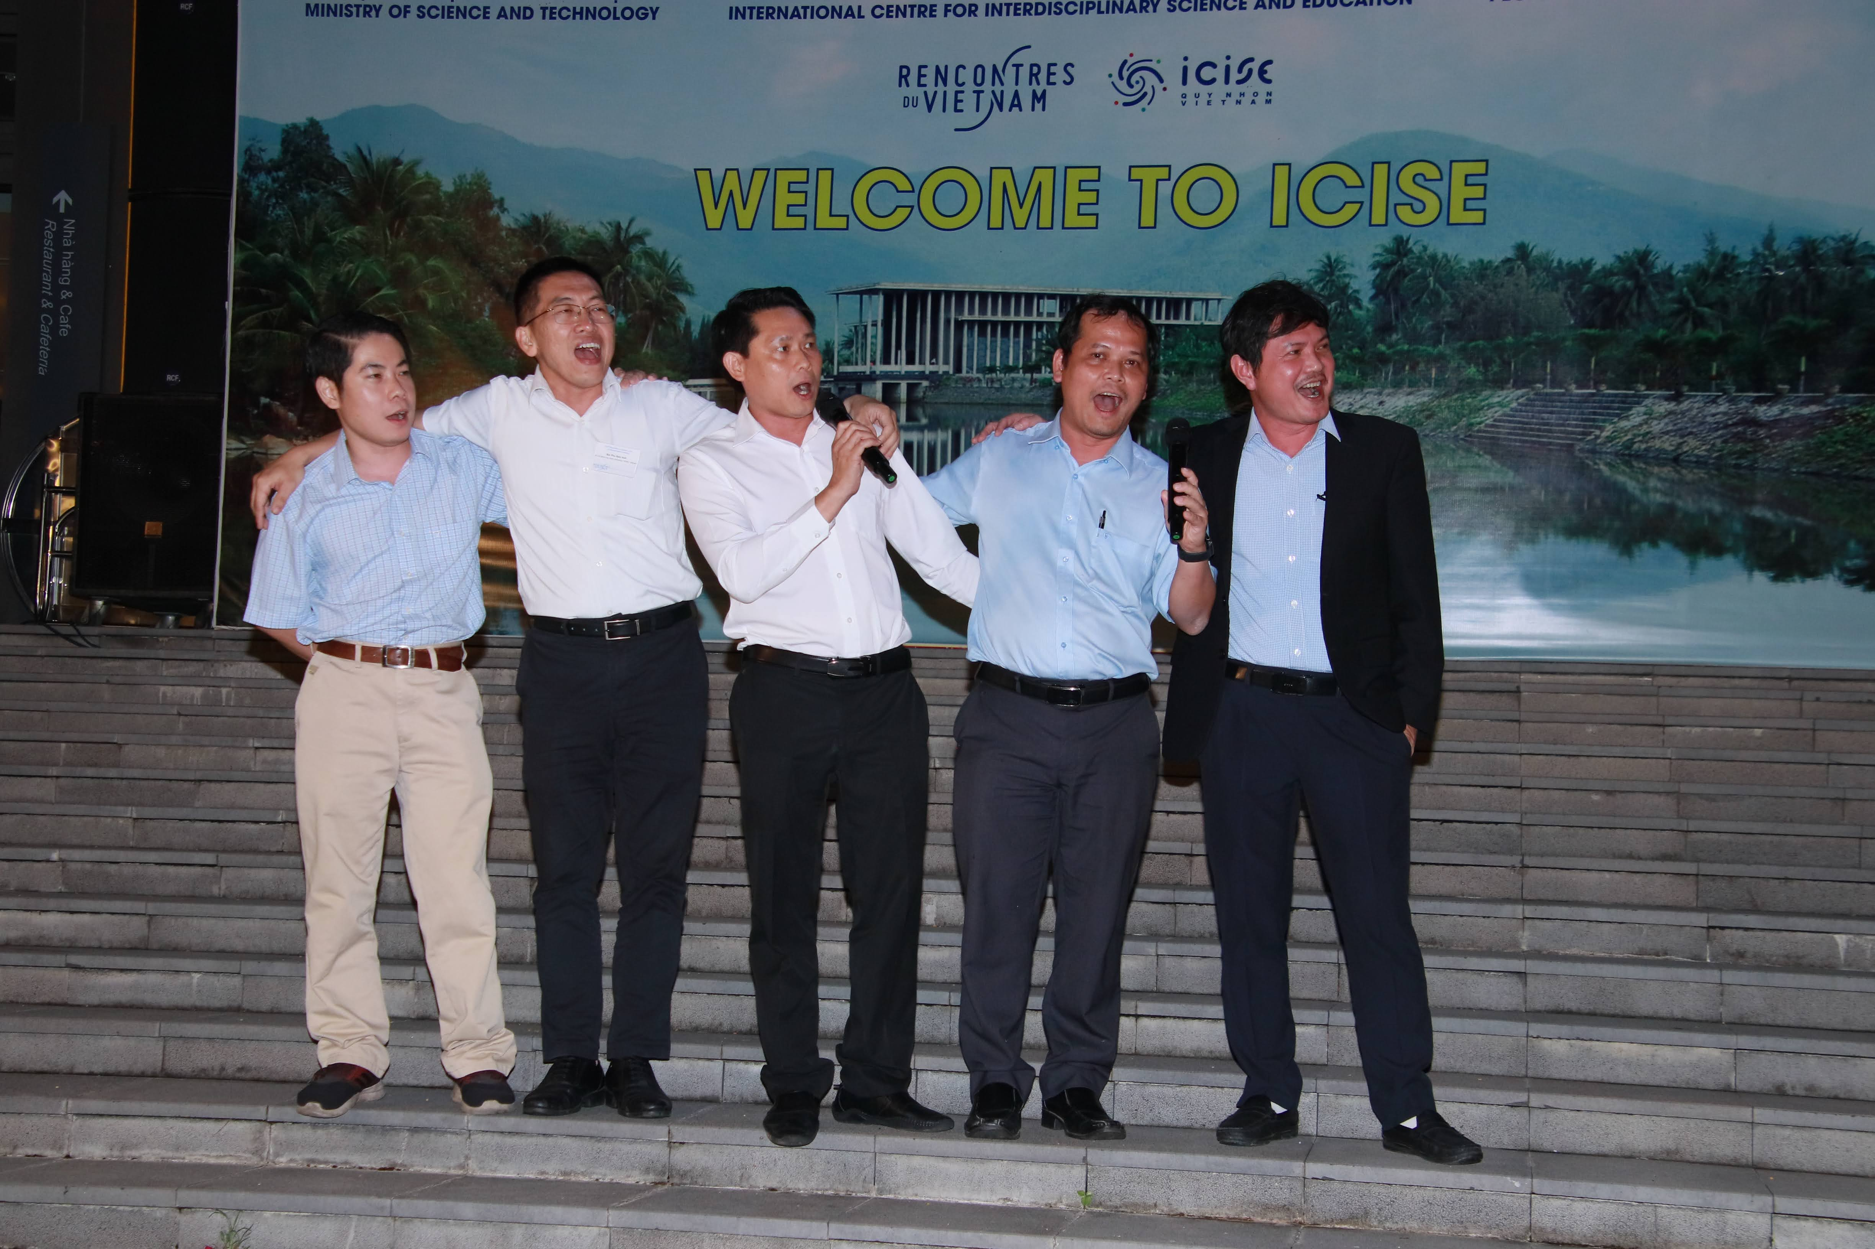

Slide 9
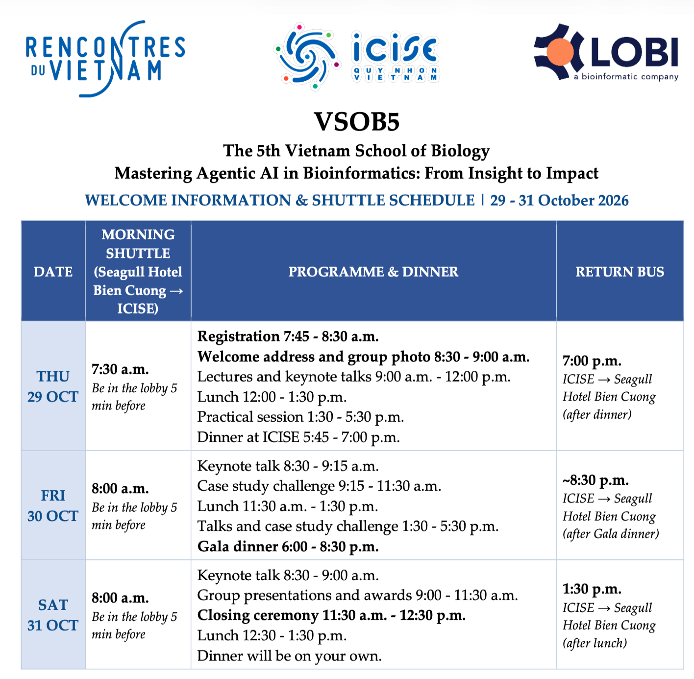
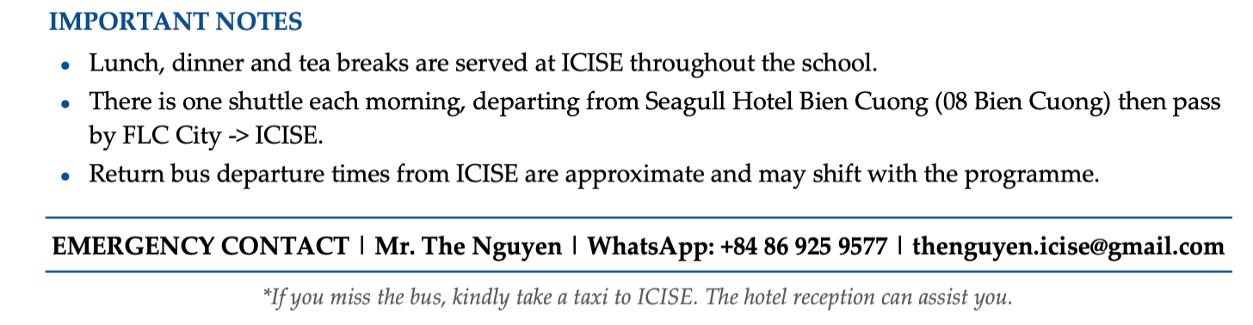

Slide 10

VSOB

Slide 11
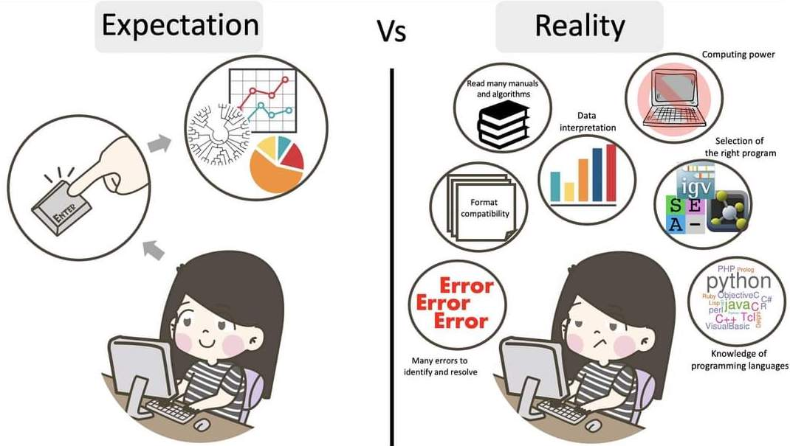

Slide 12

Trong quá trình thực hành, vì một lý do nào đó, có thể có người nhanh, có người chậm, vì vậy mọi người sẽ đợi để cùng nhau hoàn thành phần thực hành.

Slide 13


