Slide 1

Sprocket Central Pty Ltd
Data analytics approach
JUI ROY

Slide 2
Agenda
Introduction
Data Exploration
Model Development
Interpretation

Slide 3
Introduction
Identify & Recommending high-value Customers
Outline of Problems
Approach to Data analysis
Sprocket Central is a company that specializes in high-quality bikes and accessories.
The marketing team is looking to boost sales
To target 1000 new customers that bring the highest value to the business
Bike related Purchases for the last 3 years based on gender.
Top Industries contribute the maximum profile and bike-related sales.
Wealth Segment by Age Category.
Number of Cars owned in each state.
Customer classification.

Slide 4
Data Exploration
Dataset | Accuracy | Completeness | Consistency | Currency | Relevancy
(Dataset 1) Customer Demographics | DOB inaccurate Age missing | Job title blank Customer Id Incomplete | Gender Formatting | Out of date: deceased customer | Default column deleted
(Dataset 2) Customer Address |  |  | State Inconsistency
(Dataset 3) Transactions | Missing: profits (cost - price) | Customer Id: incomplete Online Oder: blanks Brands: Blanks | Formatting: list price, standard cost |  | Filtered: Cancelled orders
(Dataset 4) New Customer |  | Missing: DOB, job title, job industry |  |  | Irrelevant: unnamed columns
Data Quality Assessment
Key issues deal with data quality

Slide 5
Data Exploration
Bike-related purchases over the last 3 years based on gender.
Data Shows on average females have made more bike-related purchases in the last 3 years compared to male
On average Females have had 1% higher bike-related purchases compared to men in the last 3 years

Slide 6
Note: The data and information in this document is reflective of a hypothetical situation and client. This document is to be used for KPMG Virtual Internship purposes only.
Data Exploration
Top job industry contributing to the maxing profit & bike-related purchases
The Top 3 industry sectors bringing in the highest profit are: financial services, health & Manufacturing
These can be obvious as most of these industry sectors are based within the city or on the outskirts of the city therefore consumers prefer bikes for commuting
Most of the. Industry sectors have returned less than $1,000,000 in profit

Slide 7
Data Exploration
Profit of Wealth segment by Age Cluster
Overall Mass customer segmentation makes the highest profit across the different age clusters
Mass customer Age 50 is likely to bring profit for the. The company compared to other age clusters.

Slide 8
Data Exploration
Number of cars owned in each state
NSW, QLD & Vic could be potential market opportunities for the company
NSW, has the highest potential as the number of people own car is almost equal to the people who don’t own cars which shows that there is an opportunity to find value customers there.

Slide 9
Model Development
RFM Analysis and customer Classification
RFM analysis is used to determine which customers a business should target to increase its revenue and value.
The RFM (Recency, Frequency, Monetary) model shows customers that have displayed high levels of engagement with the business in the three categories mentioned.

Slide 10
Model Development
Customer Classification – Target High Value Customer
These are the high-value customers that should be targeted from the new list
Most of the high-value customers will be female compared to male
Working in the Financial Services, health, and manufacturing industry
Who is currently living in NWS, QLD

Slide 11
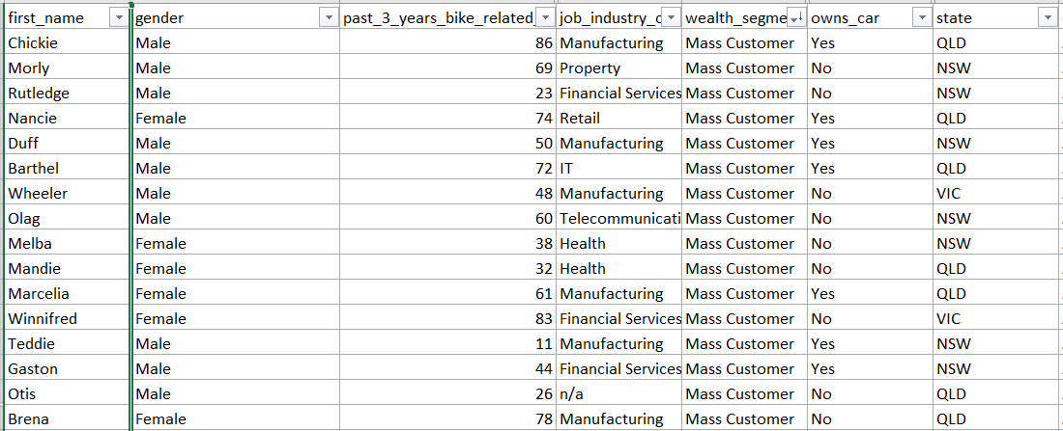
Interpretation
Summary table for Target High-Value Customer
Here is a snapshot of a few customers that will come under the high-value classification

Slide 12
THANK YOU

