Slide 1
Team Name : team9 Members : Jui Thombre
XENOX FANTASTIC FIVE HACKATHON

Slide 2
Problem Statement
In big teams, members can feel left out and hence a platform to help them interact with others can act as a catalyst to enhance team spirit and avoid miscommunications.

Slide 3
Solution :
An incentive based strategy to encourage people to participate and open up about the problems they face during work can be fruitful.
Github : https://github.com/narender2031/stackoverflow-teams

Slide 4
User scenarios
Users can signup and login to the Team Stack app, where he can post, edit and delete questions.
Users can also answer some questions, as well as edit and delete answers.
Person who posted the question can mark any number of answers as the correct answer and thus that question will be marked as ‘answered’.
Apart from this, a user can like/dislike any question as per his choice.
A user can also tag a person(eg: @username), and the tagged person will receive the respective notification.
Activities like posting questions, answering them, receiving likes for a question, and disliking a question will contribute to an incentive in form of an overall score for the user.
According to these activities, the position of a user in the leaderboard will be affected.
A user can also browse through all the users on the app and visit their profiles.
A user can also edit his own profile and view a timeline of all his activities.

Slide 5
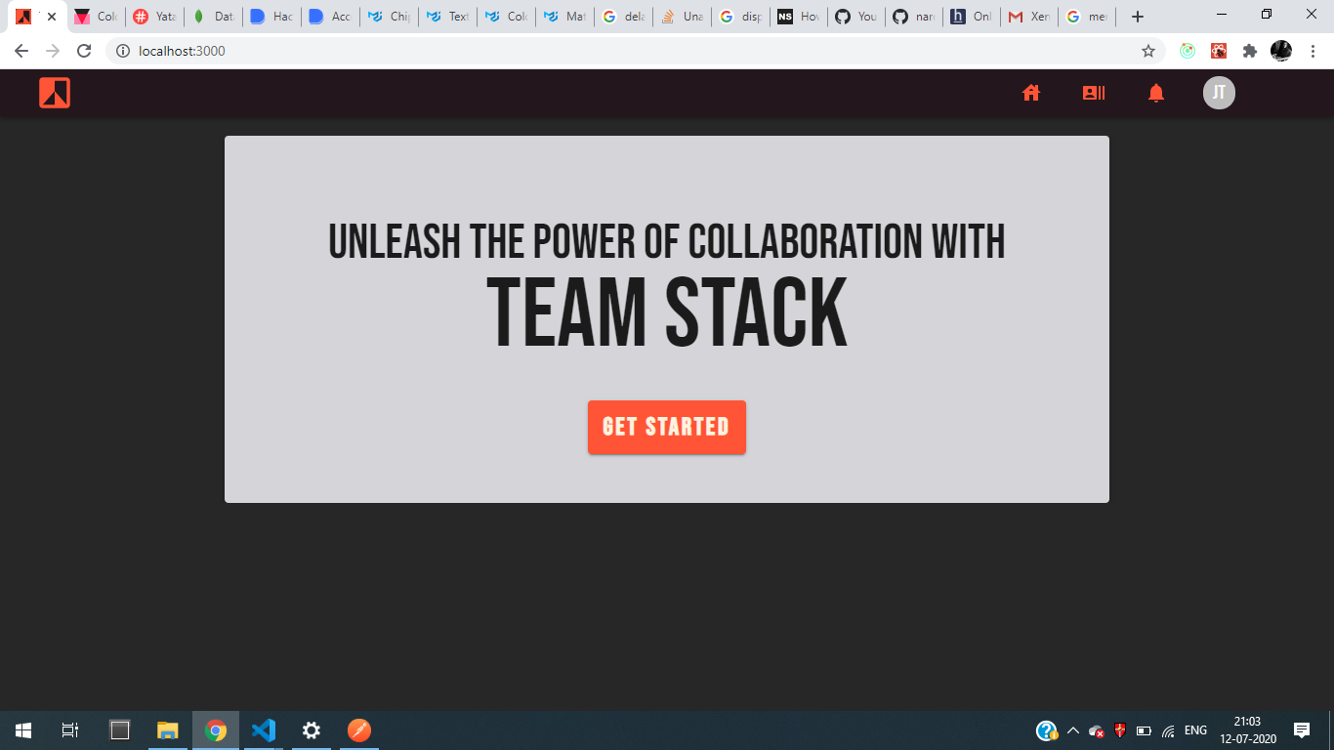

Slide 6
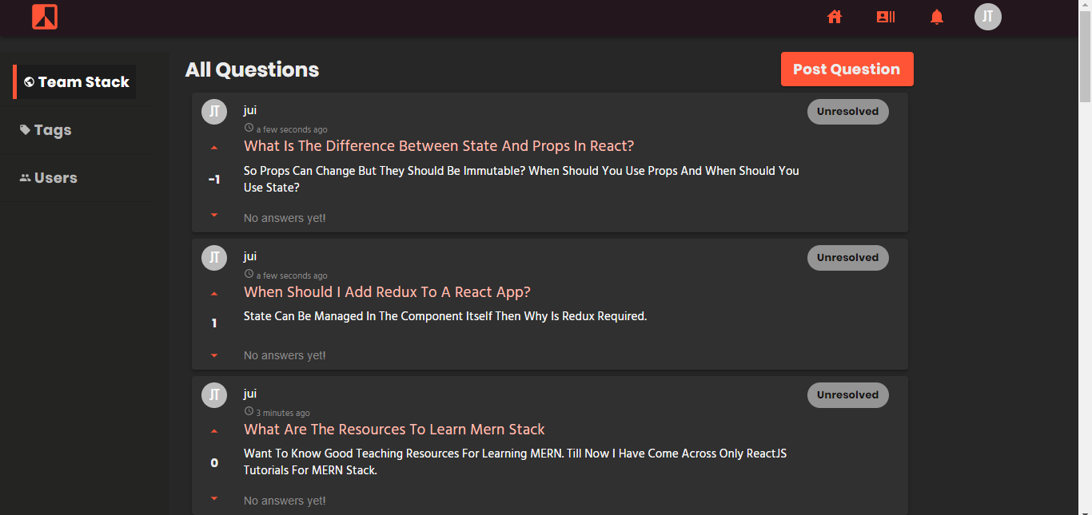

Slide 7
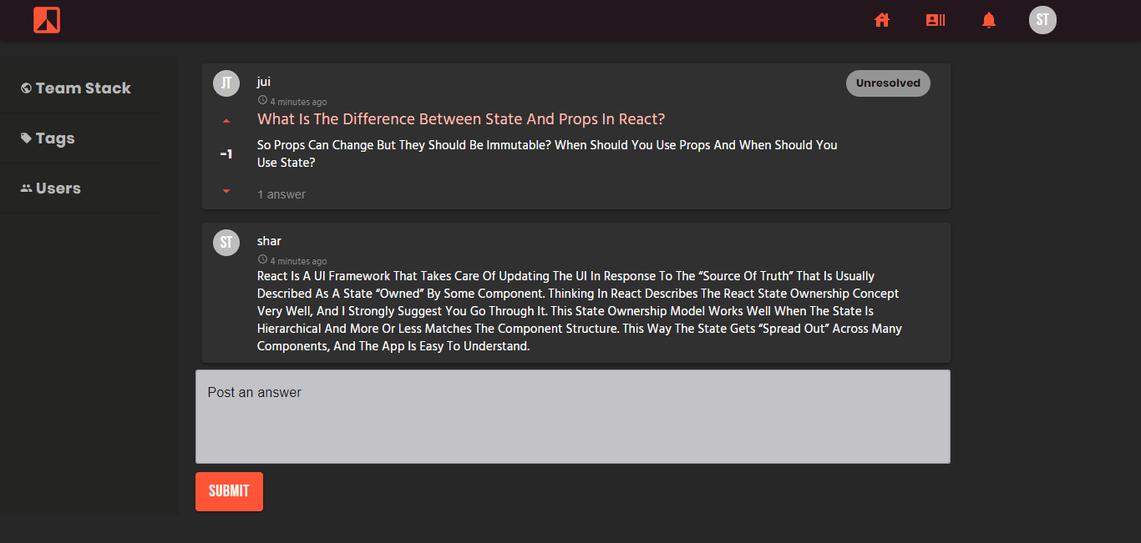

Slide 8
Future prospects
Additional features like adding tags pertaining to a question can be incorporated.
Adding a feature of private chat can also be useful.

Slide 9
Core tech stack: Frameworks, technology and platforms to build the solution
Web console : The web app is made with React and state management is done with help of Redux.
Backend & Database : The MongoDB enabled backend with Express, the rest API is used to maintain the information related to users, questions, answers posted and the relevant notifications.

Slide 10
Team composition & Experience
Jui Thombre : Currently working as Data Analyst in Edelweiss Financial Services since June 2018 https://www.linkedin.com/in/jui-thombre/

Slide 11
Thank you!

