Slide 1
Backend Programming
M. Yauri M. Attamimi

Slide 2
Foundation Class - WEEK 3 (Session 2) -

Slide 3
Go Object Oriented Design

Slide 4
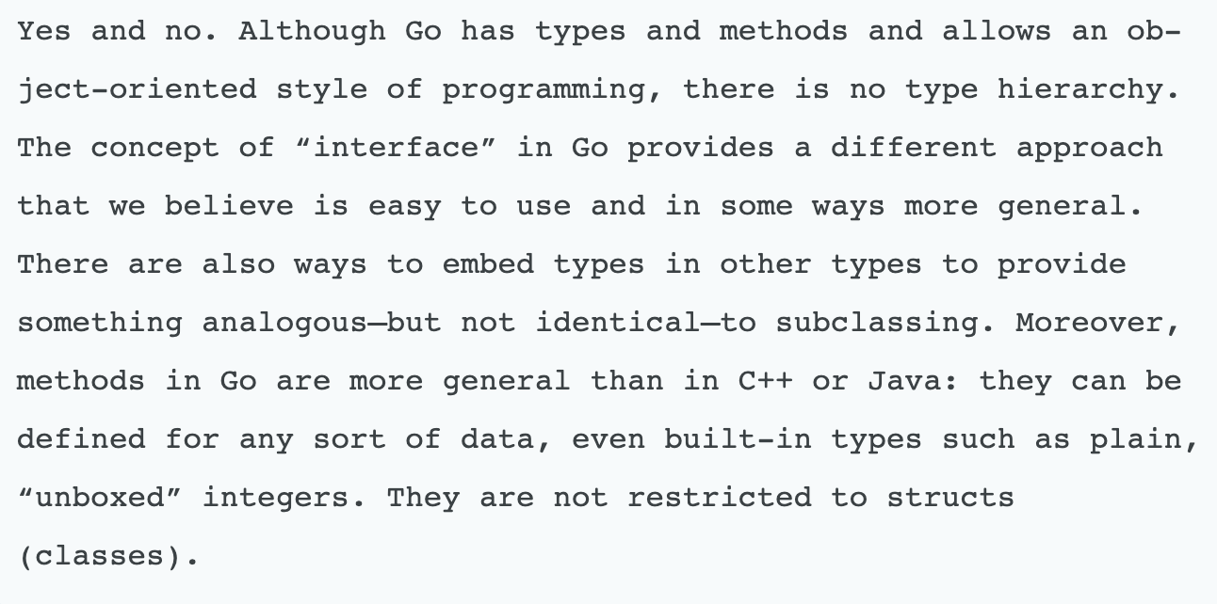
Is Go Object Oriented ?

Slide 5
OO Design in Go
Go has types and values rather than classes and objects.
No inheritance, think about OO design in terms of Composition (composition over inheritance)

Slide 6
Inheritance VS Composition
Inheritance is about when you design your types around what they are.
Composition is about when you design your types around what they do (can do)

Slide 7
Inheritance Big Problem
With Inheritance, you are encouraged to predict the future
Inheritance encourages you to build the taxonomy of objects very early in your project, which you are most likely going to make a mistake on your design, because humans cannot predict the future and one thing that we all know is that software always change

Slide 8
Struct Over Classes
Go does not provide classes but it does provide structs.
Methods can be added on structs. This provides the behaviour of bundling the data and methods that operate on the data together akin to a class.

Slide 9
New() function instead of Constructors
Go doesn't support constructors. If the zero value of a type is not usable, it is the job of the programmer to unexport the type to prevent access from other packages and also to provide a function named NewT(parameters) which initialises the type T with the required values. It is a convention in Go to name a function which creates a value of type T to NewT(parameters). This will act like a constructor. If the package defines only one type, then it's a convention in Go to name this function just New(parameters) instead of NewT(parameters).

Slide 10
Go’s Best Practices

Slide 11
“A best practice is a method or technique that has consistently shown results superior to those achieved with other means.” - Wikipedia -

Slide 12
Goals
Techniques to write Go code that is:
Simple
Readable
Maintainable
Easy to reason about

Slide 13
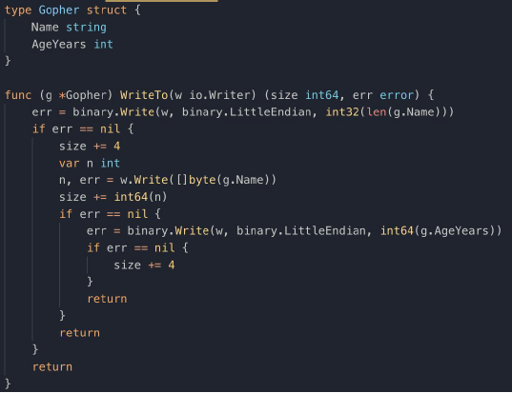
Some Examples

Slide 14
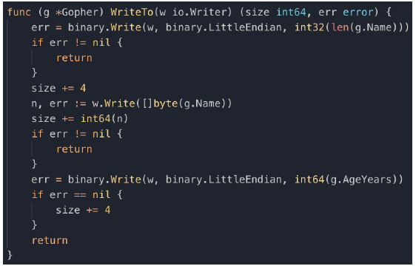
Avoid nesting by handling error first
Less nesting means less cognitive load on the reader

Slide 15
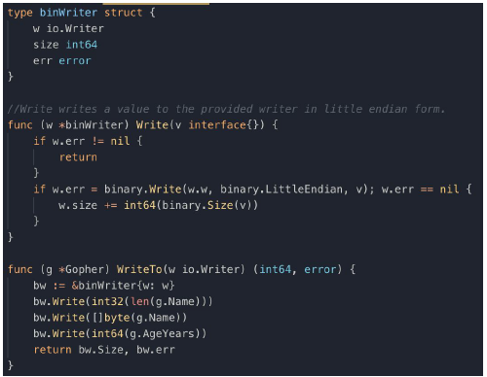
Avoid repetition when possible
Deploy one-off utility types for simpler code if needed

Slide 16
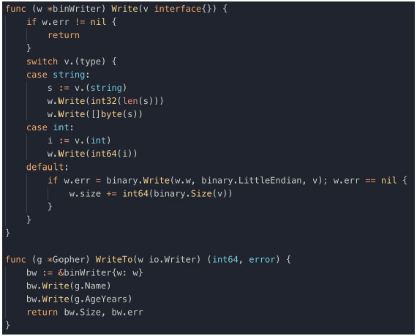
Type switch to handle special cases

Slide 17
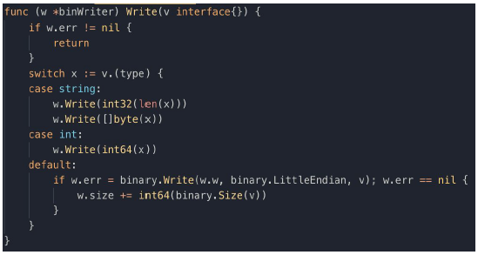
Type switch with short variable declaration

Slide 18
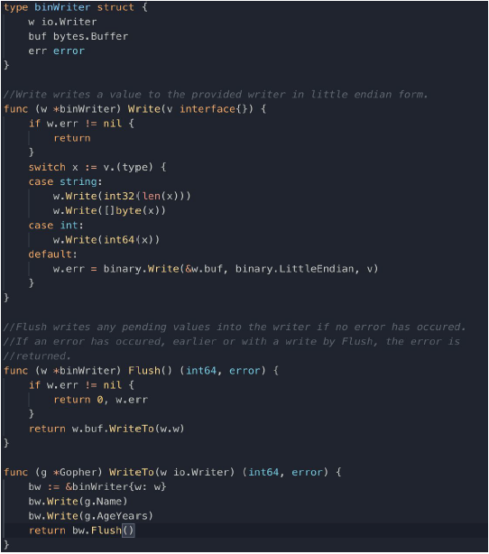
Writing Everything or Nothing

Slide 19
Organizing Your Code

Slide 20
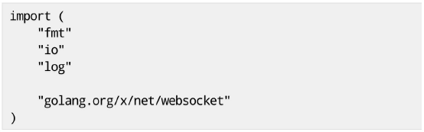
Important Code Goes First
License information, build tags, package documentation. Import statements, related groups separated by blank lines.
The rest of the code starting with the most significant types, and ending with helper function and types.

Slide 21

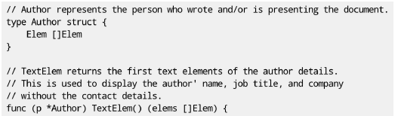
Document your Code
Package name, with the associated documentation before.
Exported identifiers appear in godoc, they should be documented correctly.

Slide 22
Shorter is Better
Try to find the shortest name that is self explanatory.
e.g. : prefer to MarshalIndent rather than MarshalWithIndentation
Don’t forget that the package name will appear before the identifier you chose.
in package encoding/json we find the type Encoder, not JSONEncoder.
it is referred as json.Encoder

Slide 23
Packages with Multiple Files
Should you split a package into multiple files ?
Avoid very long files The net/http package from the standard library contains 15734 lines in 47 files
Separate code and tests net/http/cookie.go and net/http/cookie_test.go are both part of the http package. Test code is compiled only at test time.
Separated package documentation

Slide 24
Make your Package “go get”-able
Some packages are reusable while others are not.
For packages which are reusable, make sure that it can be easily get through go get command.

Slide 25
Twelve Best Practices:
1. Avoid nesting by handling errors first. 2. Avoid repetition when possible. 3. Important code goes first. 4. Document your code. 5. Shorter is better. 6. Package with multiple files. 7. Make your packages “go get”-able. 8. Ask for what you need. 9. Keep independent packages independent. 10. Avoid concurrency in your API. 11. Use goroutine to manage state. 12. Avoid goroutine leaks.

Slide 26
Decorator / Middleware
The decorator pattern is a design pattern that allows behaviour to be added to an individual object, without affecting the behavior of other objects from the same class. In go this means that we extend the functionality of a function or method(s) of a struct without changing the original functions or method(s). ~ Wikipedia
-- Decorators essentially allow you to wrap existing functionality and append or prepend your own custom functionality on top. --
-- By applying decorators, the “open-closed principle” is maintained, code becomes easier to extend and easier to adjust. --

Slide 27
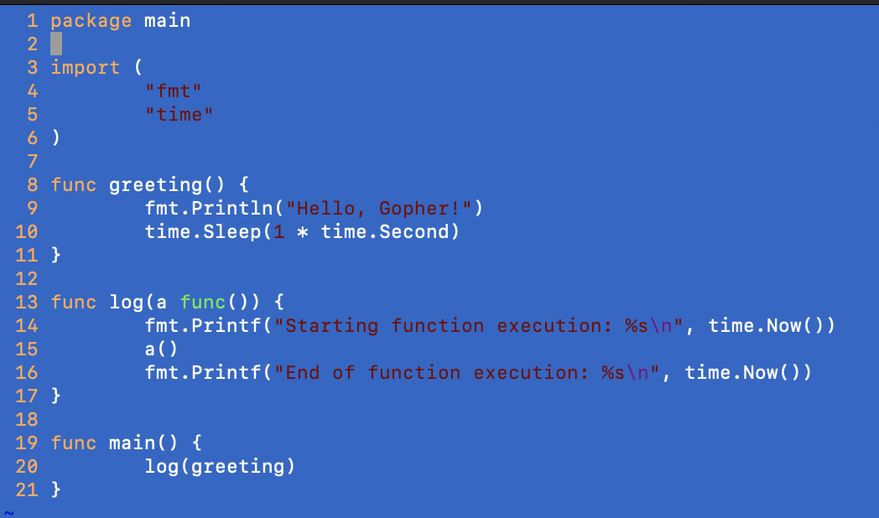
Example (I)

Slide 28
Check the exercises at https://exercism.io

Slide 29
SUMMARY
You have learned about Object Oriented Design in Go and some best practices those you can use within your daily activity as developer/engineer.
The best practices will give a strong distinction between a good engineer and the bad one.

