Slide 1
Backend Programming
M. Yauri M. Attamimi

Slide 2
Foundation Class - WEEK 4 (Extra Session) -

Slide 3
Basic Concurrency Concepts

Slide 4
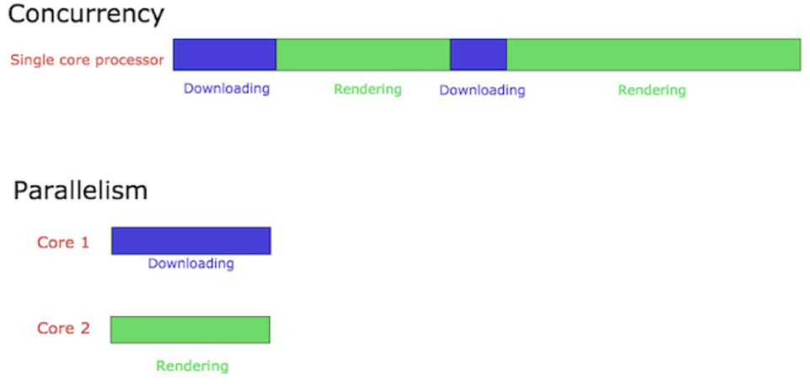
Concurrency vs Parallelism

Slide 5
Program vs Process vs Threads

Slide 6
Program
A program is a set of instructions and associated data that resides on the disk and is loaded by the operating system to perform some task. An executable file or a python script file are examples of programs. In order to run a program, the operating system's kernel is first asked to create a new process, which is an environment in which a program executes.

Slide 7
Process
A process is a program in execution. A process is an execution environment that consists of instructions, user-data, and system-data segments, as well as lots of other resources such as CPU, memory, address-space, disk and network I/O acquired at runtime. A program can have several copies of it running at the same time but a process necessarily belongs to only one program.

Slide 8
Thread
Thread is the smallest unit of execution in a process. A thread simply executes instructions serially. A process can have multiple threads running as part of it. Usually, there would be some state associated with the process that is shared among all the threads and in turn each thread would have some state private to itself. The globally shared state amongst the threads of a process is visible and accessible to all the threads, and special attention needs to be paid when any thread tries to read or write to this global shared state. There are several constructs offered by various programming languages to guard and discipline the access to this global state, which we will go into further detail in upcoming lessons.

Slide 9
Program ~ Process
Note a program or a process are often used interchangeably but most of the times the intent is to refer to a process. There's also the concept of "multiprocessing" systems, where multiple processes get scheduled on more than one CPU. Usually, this requires hardware support where a single system comes with multiple cores or the execution takes place in a cluster of machines. Processes don't share any resources amongst themselves whereas threads of a process can share the resources allocated to that particular process, including memory address space. However, languages do provide facilities to enable inter-process communication.

Slide 10
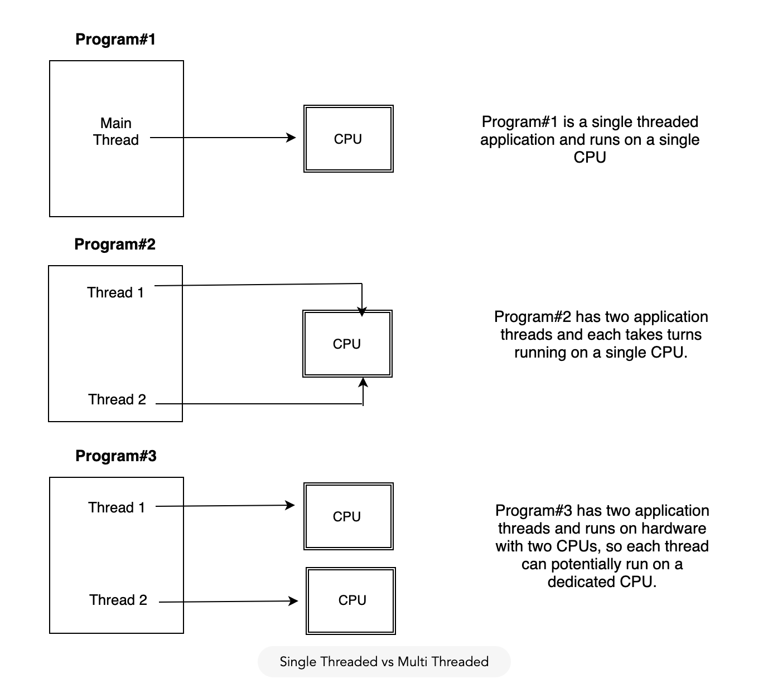

Slide 11
Concurrency in Go

Slide 12
1. Goroutines 2. Goroutines vs Threads

Slide 13
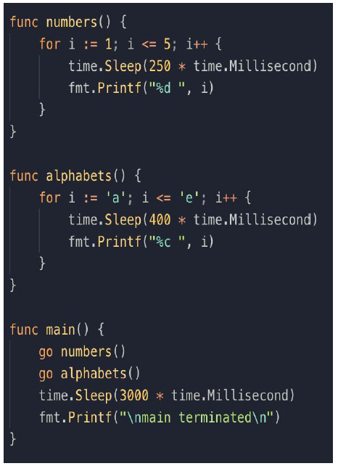
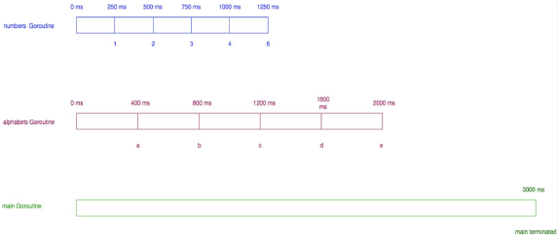
Example

Slide 14
3. Channels - Bidirectional - Unidirectional

Slide 15
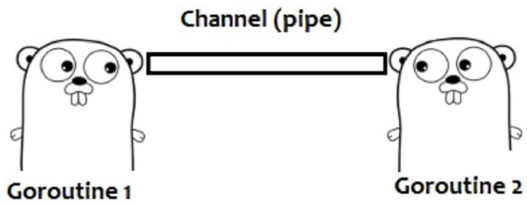
What is Channel ?

Slide 16

Creating Channel
a := make(chan<- int) // unidirectional channel
a := make(chan int) // bidirectional channel (send only)
a := make(<-chan int) // unidirectional channel (received)

Slide 17
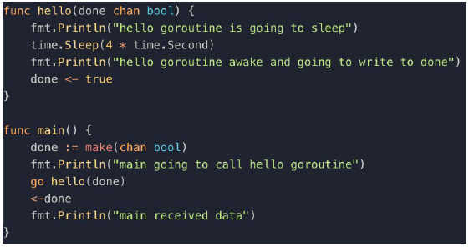
Example 1

Slide 18
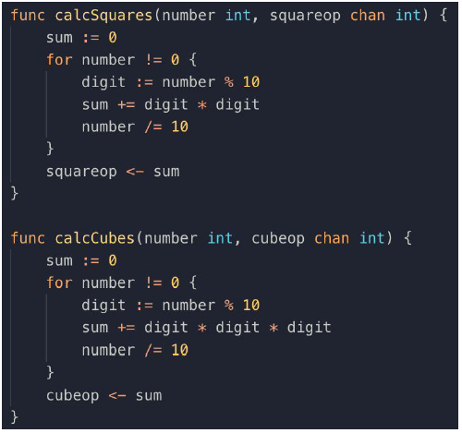
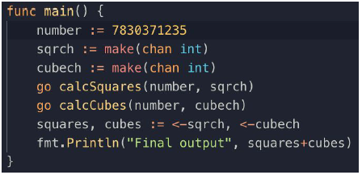
Example 2

Slide 19
Check the exercises at https://exercism.io

Slide 20
SUMMARY
You have learned about basic concepts of concurrency and how we handle concurrency things in Go.
Go has two ways to handle concurrency either by using traditional locking from sync package or via goroutines and channels.

