Slide 1
Backend Programming
M. Yauri M. Attamimi

Slide 2
Foundation Class - WEEK 4 (Session 1) -

Slide 3
net/http

Slide 4
Package “net/http”
Golang comes with built-in net/http package (standard library) which can be used both for HTTP client and HTTP server !

Slide 5
HTTP Client
The net/http package offers convenient functions such as GET, POST, HEAD for common HTTP requests.
All HTTP requests use the http.Client struct to manage the internal of communicating over HTTP|HTTPS (see the godoc).
Clients are concurrency-safe objects that contain configuration, manage TCP state, handle cookies, etc.
When http.Get is used, it uses the http.DefaultClient, a package variable that defines the default configuration for a client (see the godoc).

Slide 6
HTTP Client (Example 1)
Using GET
func main() {
resp, err := http.Get(“https://httpbin.org/get”)
if err != nil {
log.Fatalln(err)
}
defer resp.Body.Close()
body, err := ioutil.ReadAll(resp.Body)
if err != nil {
log.Fatalln(err)
}
log.Println(string(body))
}

Slide 7
HTTP Client (Example 2)
Using GET
func main() {
resp, err := http.Get(“https://httpbin.org/get”)
if err != nil {
log.Fatalln(err) //yields message to stdout & call os.Exit (terminate)
}
defer resp.Body.Close()
log.Println(“Response Status:”, resp.Status)
scanner := bufio.NewScanner(resp.Body)
for i:= 0; scanner.Scan() && i < 5; i++ {
log.Println(scanner.Text())
}
if err = scanner.Err(); err != nil {
panic(err)
}
}

Slide 8
HTTP Client (Example)
Using POST
func main() {
reqBody, err := json.Marshal(map[string]string{
“name”: “Yauri Attamimi”,
“email”: “yauritux@gmail.com”
})
if err != nil {
log.Fatalln(err)
}
resp, err := http.Post(“https://httpbin.org/post”,
“application/json”, bytes.NewBuffer(reqBody))
defer resp.Body.Close()
if err != nil {
log.Fatalln(err)
}
body, err := ioutil.ReadAll(resp.Body)
if err != nil {
log.Fatalln(err)
}
log.Println(string(body))
}

Slide 9
HTTP Client (Example)
Posting Form & Decoding JSON
import (
“net/url”
“net/http”
“log”
“encoding/json”
)
func main() {
formData := url.Values{
“name”: {“yauritux”}
}
resp, err := http.PostForm(“https://httpbin.org/post”, formData)
if err != nil {
log.Fatalln(err)
}
var result map[string]interface{}
json.NewDecoder(resp.Body).Decode(&result)
log.Println(result[“form”])
}

Slide 10
HTTP Client (Best Practices)
Define with a sensible timeout (GET request)
var netClient = &http.Client{
Timeout: time.Second * 10
}
resp, err := netClient.Get(“https://httpbin.org/get”)
if err != nil {
log.Fatalln(err)
}

Slide 11
HTTP Client (Best Practices)
Define with a sensible timeout (POST request)
reqBody, _ := json.Marshal(map[string]string{“name”: “Yauri Attamimi”,“email”: “yauritux@gmail.com”})
client := &http.Client{
Timeout: 5 * time.Second,
}
request, err := http.NewRequest(“https://httpbin.org/post”, bytes.NewBuffer(reqBody))
request.Header.Set(“Content-Type”, “application/json”)
if err != nil {
log.Fatalln(err)
}
resp, _ := client.Do(request)
defer resp.Body.Close()
body, err := ioutil.ReadAll(resp.Body)
if err != nil {
log.Fatalln(err)
}
log.Println(string(body))

Slide 12
HTTP Client (Best Practices)
Custom Transport and Dialer
For finer-grained control over the request lifecycle, we can specify a custom net.Transport and net.Dialer.
A Transport is a struct used by clients to manage the underlying TCP connection.
A Dialer is a struct that manages the establishment of the connection.
Go’s net package has a default Transport and Dialer, yet you can also use your own custom implementation.
var netTransport = &http.Transport{
Dial: (&net.Dialer{
Timeout: 5 * time.Second,
}).Dial,
TLSHandshakeTimeout: 5 * time.Second,
}
This will cap the TCP connect and TLS Handshake timeouts, as well as establishing an end-to-end request timeout.

Slide 13
HTTP Server
A fundamental concept in net/http server is handlers.
A handler is an object that implementing the http.Handler interface.
A common and easy way to write a handler is by using the http.HandlerFunc adapter on function with the correct function signature (see the godoc).
Functions serving as handlers take a http.ResponseWriter and a http.Request as their function arguments. The ResponseWriter is used to fill in the HTTP response while the Request contains the HTTP request (request made by the user/client).
We register our handlers on server routes using the http.HandlerFunc convenience function. It sets up the default router in the net/http package and takes a function as an argument.
Finally, we call ListenAndServe along with the port. nil tells to use the default router we’ve just set up.

Slide 14
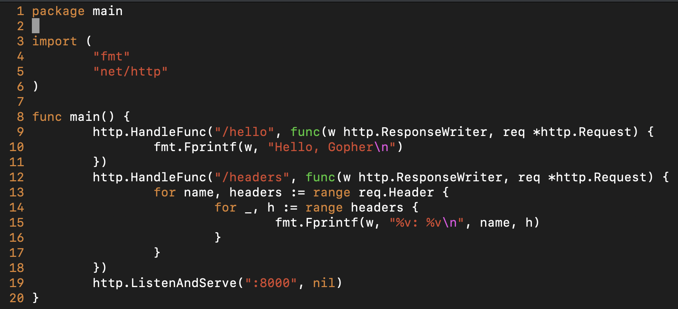
HTTP Server (Example)

Slide 15
REST API

Slide 16
REST : An Architectural Paradigm
Client
Request
Server
Response

Slide 17
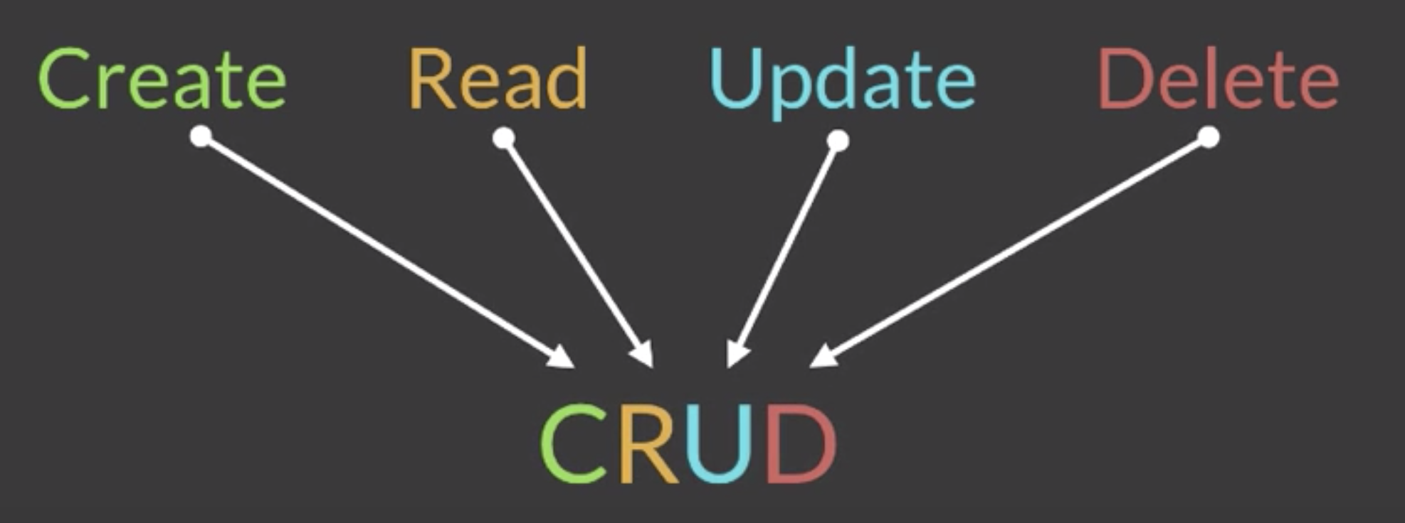
Basic REST Operations

Slide 18
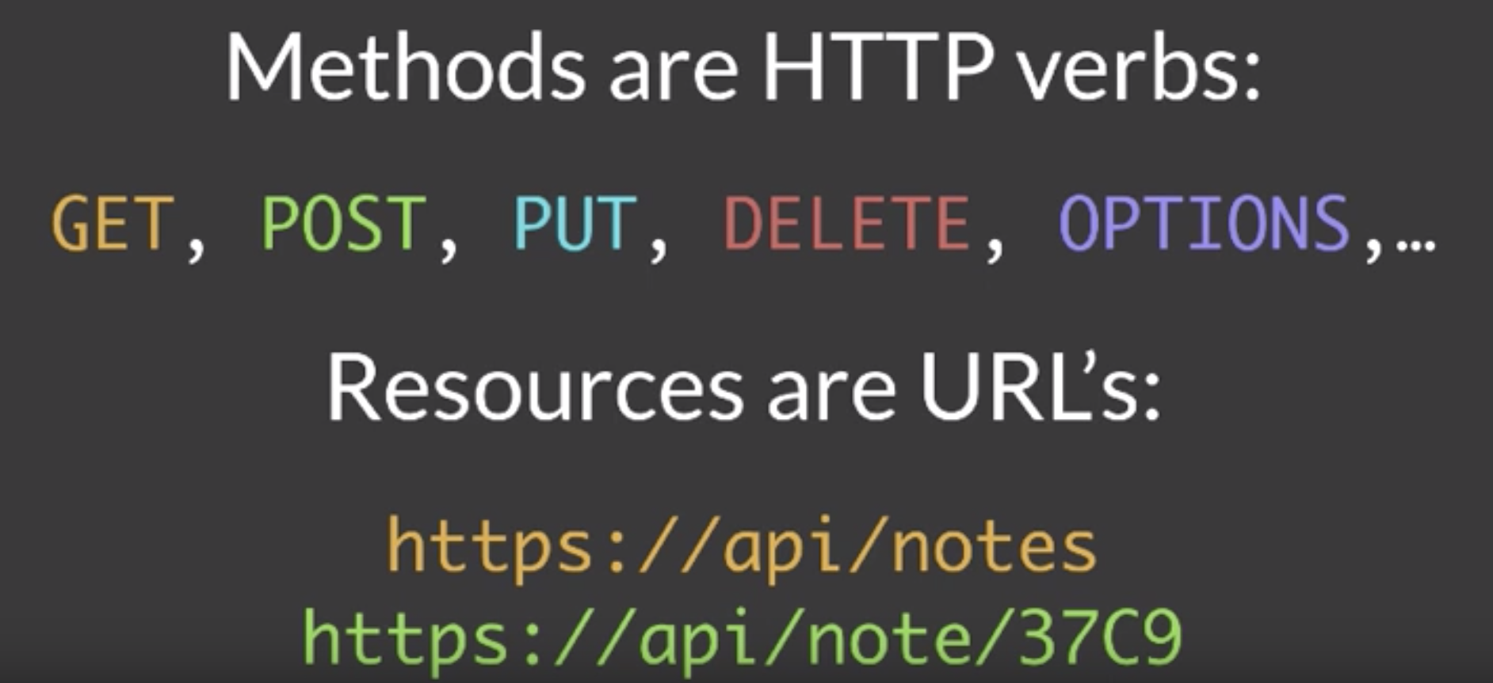
REST and HTTP

Slide 19
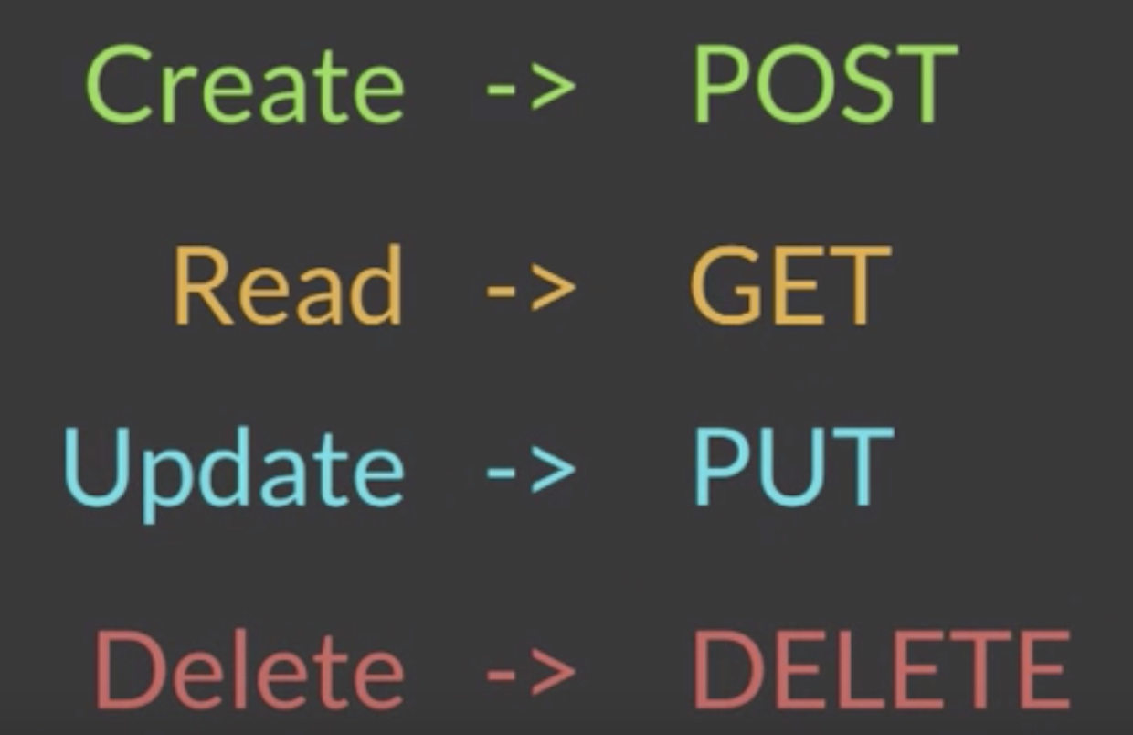
CRUD → HTTP Verbs

Slide 20
Resources → URLs
The resources representated in noun-form rather than verb-form
the noun-form written in plural rather than singular
e.g.:
Collection:
https://api.example.com/notes
Element:
https://api.example.com/notes/12345

Slide 21
Check the exercises at https://exercism.io

Slide 22
SUMMARY
You have learned about built-in net/http package including when and how to use it.
You’ve also learned how to build RESTful APIs by using Golang as your primary backend language.

