Slide 1
Backend Programming
M. Yauri M. Attamimi

Slide 2
Foundation Class - WEEK 4 (Session 2) -

Slide 3
JWT
(JSON Web Token)

Slide 4
JWT
(Introduction)
Stands for “JSON Web Token”
Open standard for passing claims (security information) between two parties
Self Contained: carries all the information necessary within itself
JSON Object on its own
Mainly used in web applications / services
Agnostic (i.e. supported in many languages such as JavaScript/NodeJS, Java, Python, Ruby, Go, etc)
Can be used/passed as part of URL (query string), form body parameter, cookie, or HTTP Header (x-access-token)
Great for single-sign-on context

Slide 5
JWT
(Structure)
Three sections separated with dots
comprises of header, payload, and signature
all are base-64 encoded
Header usually contains 2 part, in the form of JSON
typ - should be JWT
alg - hashing algorithm (HS256, RS512, ES384, etc)
Payload
contains:
the main information which we need to transmit
the information related to token itself
information is JSON representation of claims (key:value)
Signature
A hash of header and payload using a secret
var s = base64Encode(header) + “.” + base64Encode(payload)
var signature = hashAlgHs256(s, “secret_key”)

Slide 6
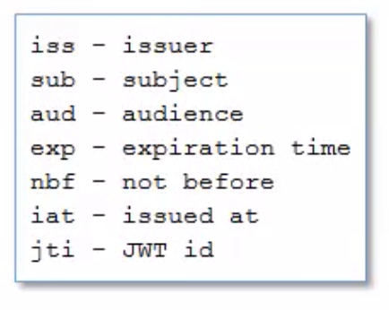
JWT
(Payload)
Default Key of Payloads :
Nevertheless, you can also add your own key that represents your claims (security information), e.g. :
{
iss: “G2Academy”,
name: “Yauri Attamimi”,
admin: true
}

Slide 7
JWT
(Signature)
A hash of header and payload using a secret
var s = base64Encode(header) + “.” + base64Encode(payload)
var signature = hashAlgHs256(s, “secret_key”)
JWT = Header + Payload + Signature
var jwt = s + “.” + base64Encode(signature)

Slide 8
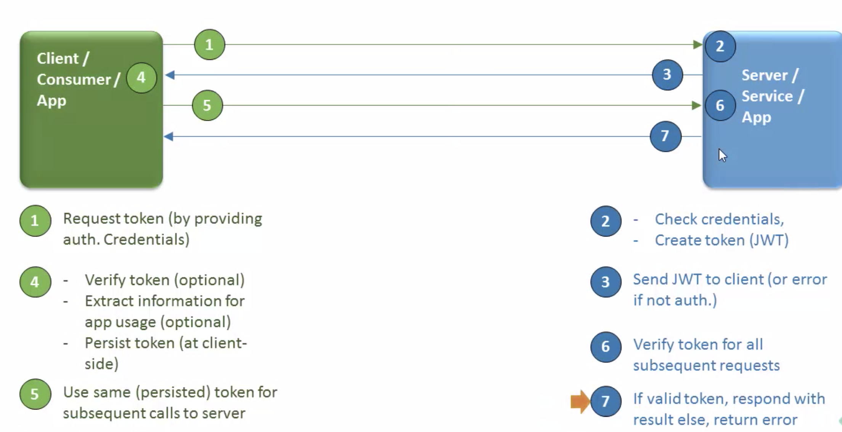
JWT
(Flow)

Slide 9
JWT
(Some Helpful Links)
Create JWT online
https://jwtbuilder.jamiekurtz.com
Verify JWT
https://jwt.io
Base64 Encode and Base64 Decode
https://www.base64encode.org
https://www.base64decode.org

Slide 10
SUMMARY
You have learned about JWT (JSON Web Token) as part of your API security in a stateless mode.
You will often find/use this kind of way in your daily activity as an API developer.

