Slide 1
Large Scale Probabilistic and Multi-output Benthic Habitat Mapping
Honours Thesis
Presented by
Justin Ting, School of Enginnering and IT
Supervisor: Simon O’Callaghan

Slide 2
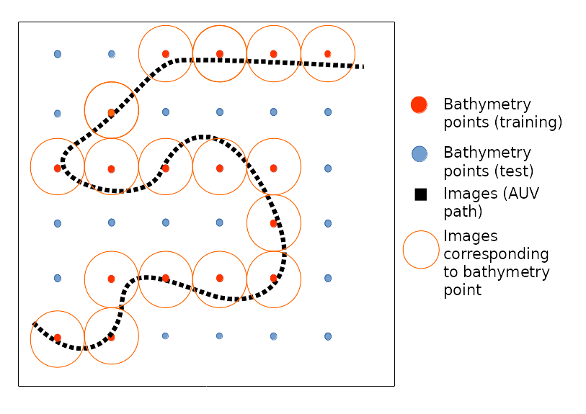
Motivation
Benthic Habitat Mapping – creating predictive maps of the ocean floor
Gain a better understanding of our marine habitats

Slide 3
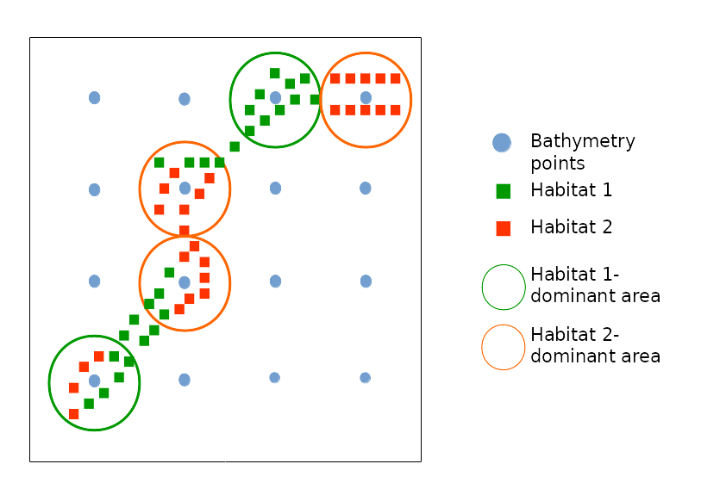
Motivation cont.
Predictions often deal with predictions in absolutes - one label per coordinate

Slide 4
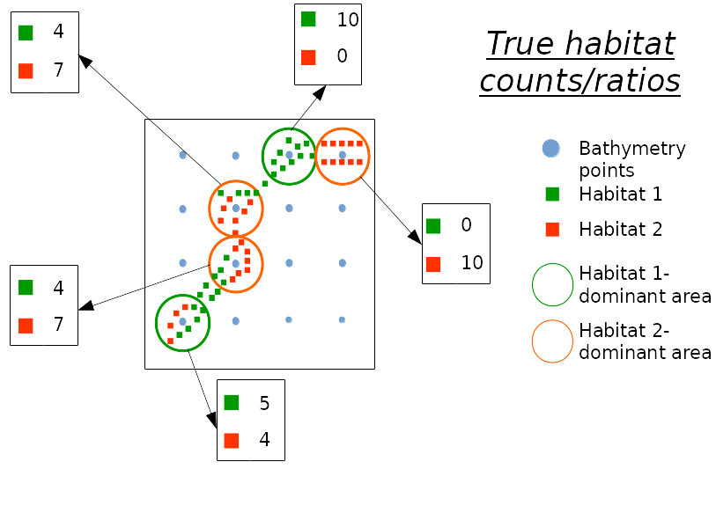
Motivation cont.
However, the data collection process does not often align exactly with this

Slide 5
Motivation cont.
Aims:
  Capture the probability of label membership
  Account for bathymetry points having multiple labels
Why?
  Quantify level of risk from taking actions based on predictions
  Fully utilise the data

Slide 6
Related Literature
Deterministic Machine Learning Methods in Benthic Habitat Mapping
Random Forests
Support Vector Machines
Lack of analysis on the actual predictive maps in some studies

Slide 7
Related Literature
Probabilistic Machine Learning Methods in Benthic Habitat Mapping
Limited studies compared to deterministic maps
Gaussian Processes – Probabilistic Targets Least Squares Classification
  Encapsulates GP variance using both cluster labels and cluster probabilities
  Required small subsample for testing

Slide 8
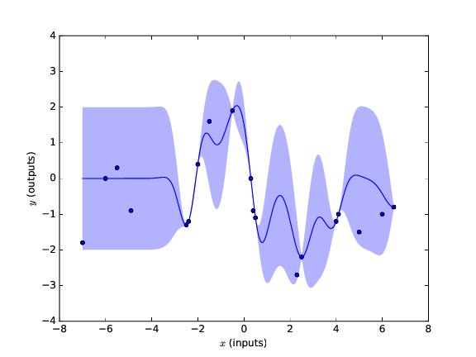
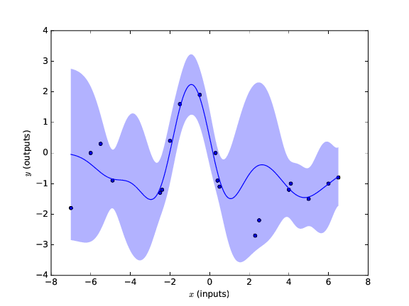
Approach
Gaussian Process Approximations
Product of Gaussian process experts (PoGPE)
Generalised product of Gaussian process experts (GPoGPE)
PoGPE
GPoGPE

Slide 9
Approach
Multi-Output Predictions
Dirichlet multinomial regression
<todo – choose appropriate image to explain>

Slide 10
Results
Performance of GP vs Deterministic Methods
These result show the performance of the GP (TODO – graph instead of table, too hard to tell what’s happening here as only a small amount of time will be spent on this slide)
 |  | SVM | Random Forest | Logistic Regression | K-Nearest Neighbour | Gaussian Process Classification | Generalised Product of Gaussian Process Experts
Aggregated (4) labels | Accuracy | 0.75 | 0.79 | 0.77 | 0.78 | 0.83 | 0.75
 | F-score | 0.21 | 0.47 | 0.34 | 0.47 | 0.53 | 0.33
Full (24) labels | Accuracy | 0.29 | 0.35 | 0.31 | 0.33 | 0.39 | 0.21
 | F-score | 0.10 | 0.22 | 0.13 | 0.26 | 0.32 | 0.19

Slide 11
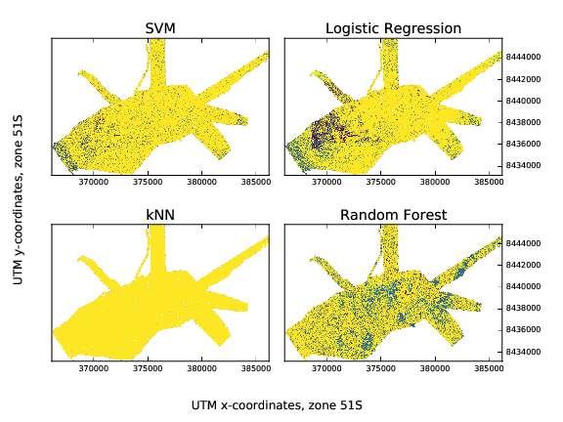

Results
Deterministic Maps
<todo – maybe show the ‘rank’ in the cross-val results alongside each map

Slide 12
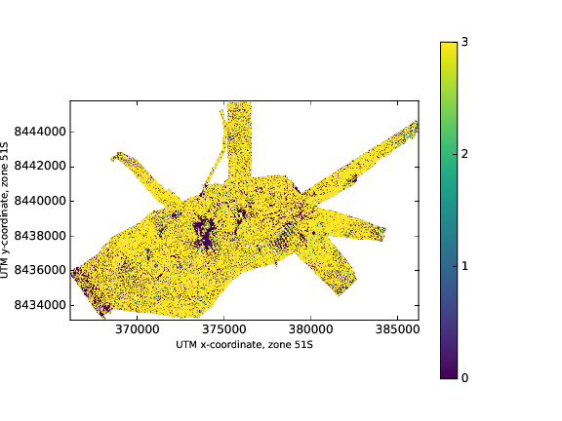
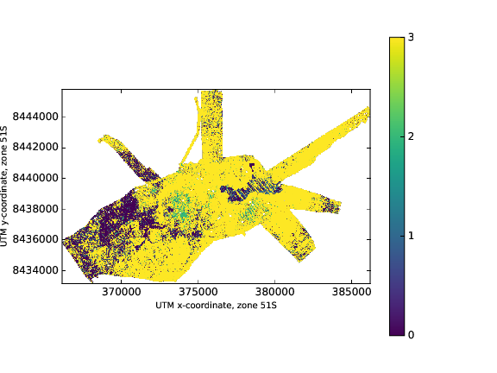
Results, Discussion – Gaussian Process and Approximations
GP
GPoGPE

Slide 13
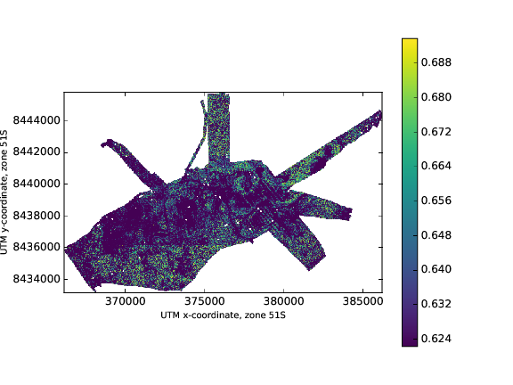
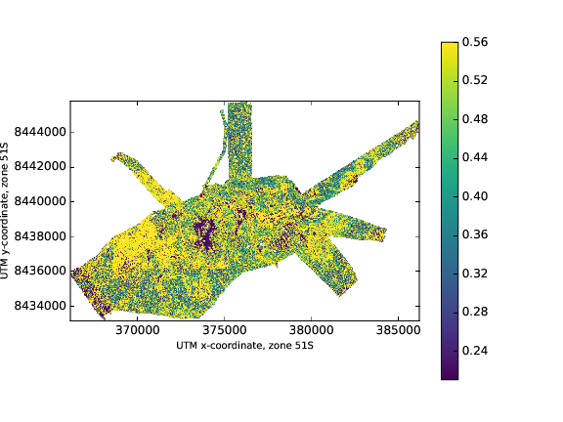
Results
Gaussian Process Probabilistic Maps – Probability and Variance
Probabilities of most likely label per point

Slide 14
Results
Dirichlet Multinomial Label Distributions

Slide 15
Results
Dirichlet Multinomial Entropy

Slide 16
Results
Time of GP vs approx GP vs DM
Time taken to perform model fitting and predictions on 4-habitats, with 4700 training points, and 500,000 test points
Heading 1 | Gaussian Process Classification | Generalised Product of Gaussian Process Experts | Dirichlet Multinomial Regression
Model fitting | 47:41 | 00:23 | 00:01
Predictions | 20:41 | 03:35 | 00:05

Slide 17
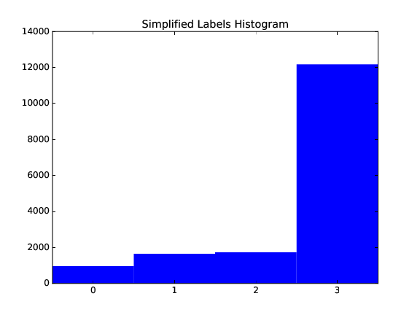
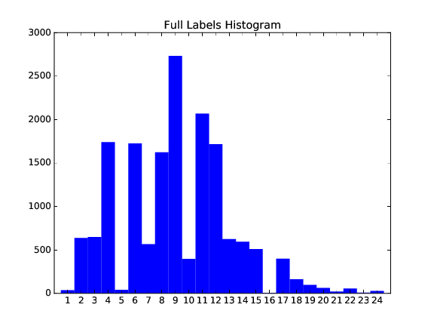
Discussion
Class imbalance
Lack of expert opinion on habitat maps
Label
counts
Label number
Label number

Slide 18
Conclusion

Slide 19
Template
Sub-heading bold… 24pt
Body copy… 24pt
Bullet point… 24pt
Bullet point
Heading 1 | Heading 2 | Heading 3
Body copy
xxx
xxx
xxx

Slide 20
Slide title… 28pt font size
Please use this graph to ensure the colour theme is consistent.
Place caption here if required

