Slide 1

FORENSIC TOOL – Timeline Generation tool for Autopsy database.
GPCSSI 2024 INTERN
CW-201 Jui Kalan
juikalan21@gmail.com

Slide 2
What does this tool do?
Automated timeline generation.
I believe it can be useful for generating automated forensic timelines which can be very helpful for investigators to visualize the sequence of events in a case.

Slide 3
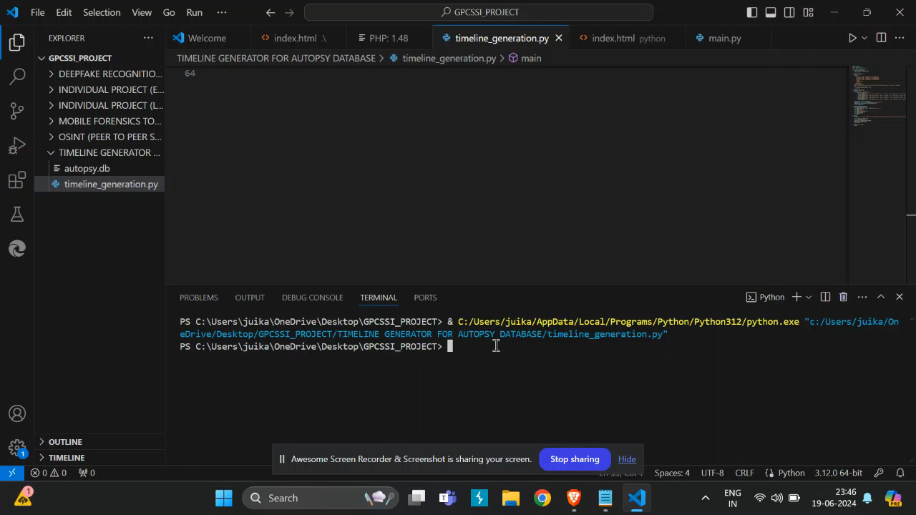

Slide 4
The technical stack:
The code is purely in Python.
Libraries used:
Matplotlib – To process the extracted data to create a timeline Dataframe and plots the timeline (data visualization).
Pandas – Provides a convenient method to execute SQL queries and load the results.
sqlite3 – As we know Autopsy stores case data in sqlite database, so then we can use the sqlite3 module in Python to interact with the database.

Slide 5

Thank you GPCSSI for giving me the opportunity to grow my skills. Jai Hind.

