Slide 1
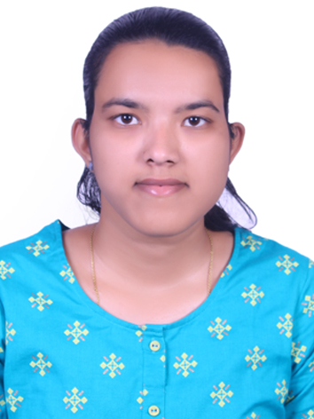

Jui Kshirsagar
Master OF Technology:
Computer Science-2019 - 2021
Skills
Java
Spring Boot
Spring MVC
MongoDB
BackEnd
Java
Spring Boot/Spring Security
REST API
DataBase
MongoDB
Web Technologies
HTML5
CSS3
Angular
AddOns
Git and Github
Postman
Additional Details
Communication Skills
Team management
Analyst/Software Engineer
N/A
jui.satish-kshirsagar@capgemini.com
+91 7776895481
A4
A self driven learner with Front-End and Back-End knowledge. Passionate about implementing and launching new projects.
Ready to learn new technologies/Frameworks and implement them to further improve my knowledge.
A team player with good communication skill always ready to work for the enrichment of knowledge.
Has working knowledge on Java Microservice Development using Spring framework on an intermediate level. Also Implemented Eureka Server in case study and upskilling day by day.
Software Engineer who is Strong in design and integration with intuitive problem-solving skills. Passionate about implementing and launching new projects.
Laboratory Management System
Developed the Laboratory Management System application on JAVA using spring framework and microservices. Used Postman and the client software for the first stage of the case study assessment during training program.
In that for backend I make use of spring boot and microservices to perform operations and secured it using JWT authentication. And uses MongoDB database. Angular used for user interface.
2.Capgemini Degreed Platform
Learnt the concepts of Git and GitHub, simultaneously applied the concepts for better learning. Developing the website for case study using Angular.

