Slide 1

AIRLINE DATA ANALYSIS OF SOUTHEAST AIRLINES
IST 687 PROJECT | GROUP 4

Slide 2
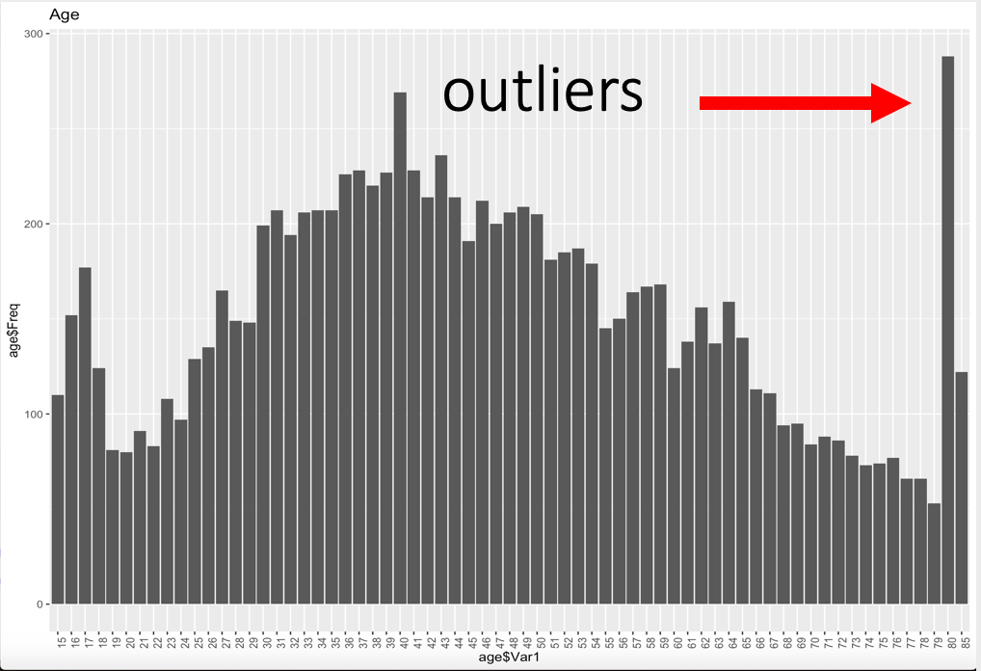
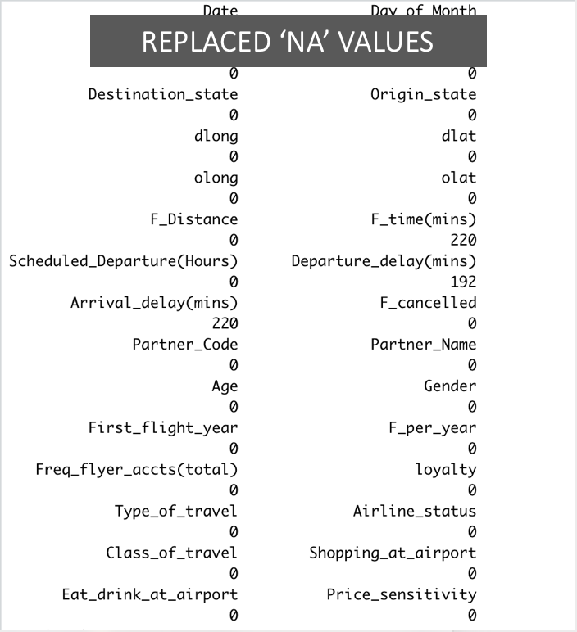
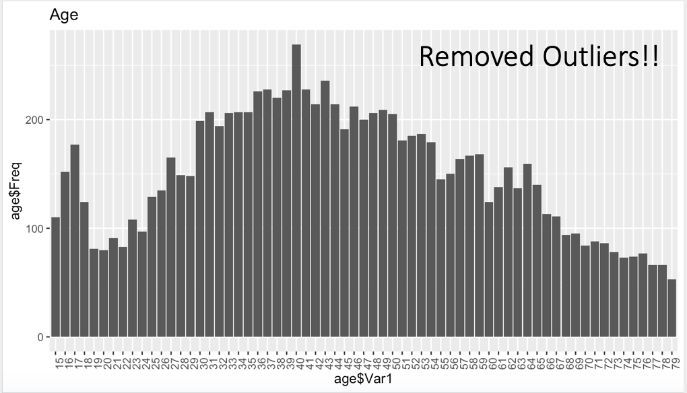
UNDERSTANDING THE DATA SET
32 COLUMNS
10282 CUSTOMER ENTRIES
10632 MISSING VALUES

Slide 3

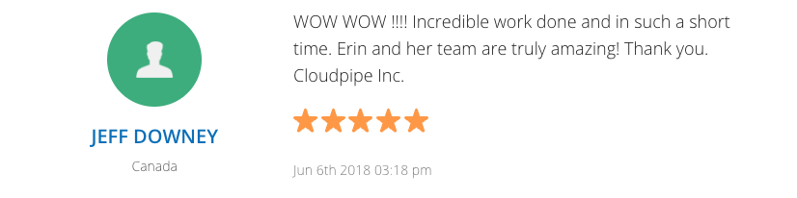



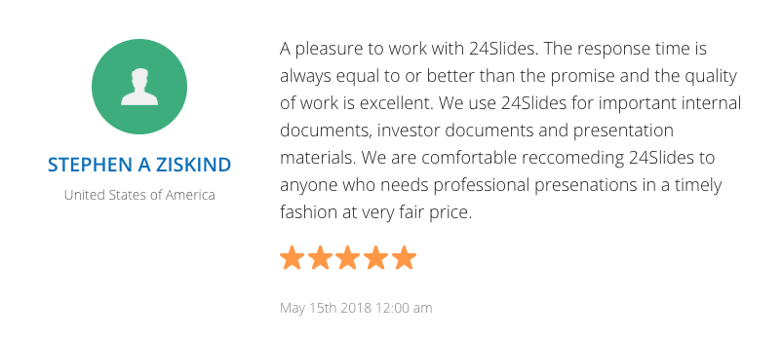


Watch out for those quick transfers: The flight out was delayed slightly and the flight took a little longer so I only had minutes to catch my connecting flight and the gate was no where in sight. I had to grab my things and run from one terminal wing to another and just made it. Man was I out of breadth.
PASSIVE
23rd Feb 2014
"trip: Had a great flight, as with my previous flights. I like Southeast as they usually have the most direct fight options that work for my schedule."
Net Promoter is both a loyalty metric and a discipline for using customer feedback to fuel profitable growth.
PROMOTER
NPS
"Worst airline company: The worst airline experience ever. The worst airline company ever as well. If we could give this Airline a -10 we so would!! We understand planes can break...but when you rebook an entire day later and screw up a well planned vacation because they have a crappy airline, it is unacceptable. When they tell us our luggage will be late."
Net Promoter Score takes the percentage of customers who are Promoters and subtract the percentage who are Detractors
DETRACTOR!!

Slide 4
Proposed Plan
To Increase the NPS of an Airline, We Propose:
Analyse the promoter data and how different it is from the detractor data which will help us convert a detractor into a promoter.
Arrive at the variables which have optimum impact on the Likelihood to Recommend of a traveller.
Figure out associations to study groups of travellers and their Likelihood to recommend.

Slide 5
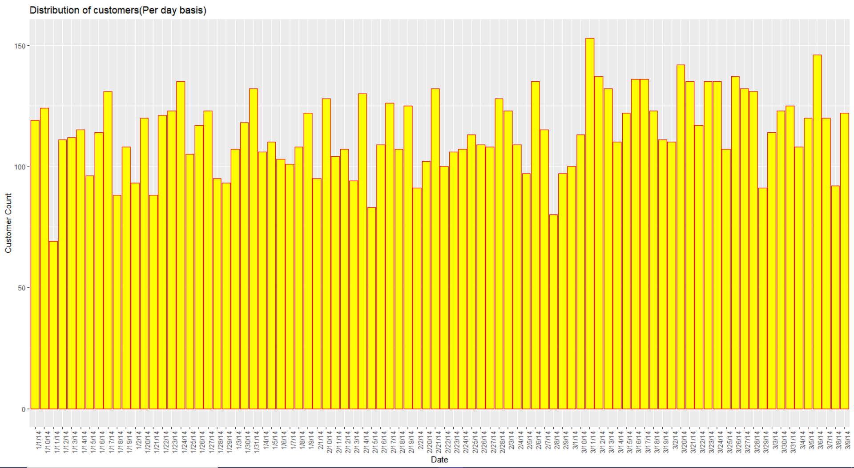
DATA ANALYSIS
Average Customer per day: 114

Slide 6
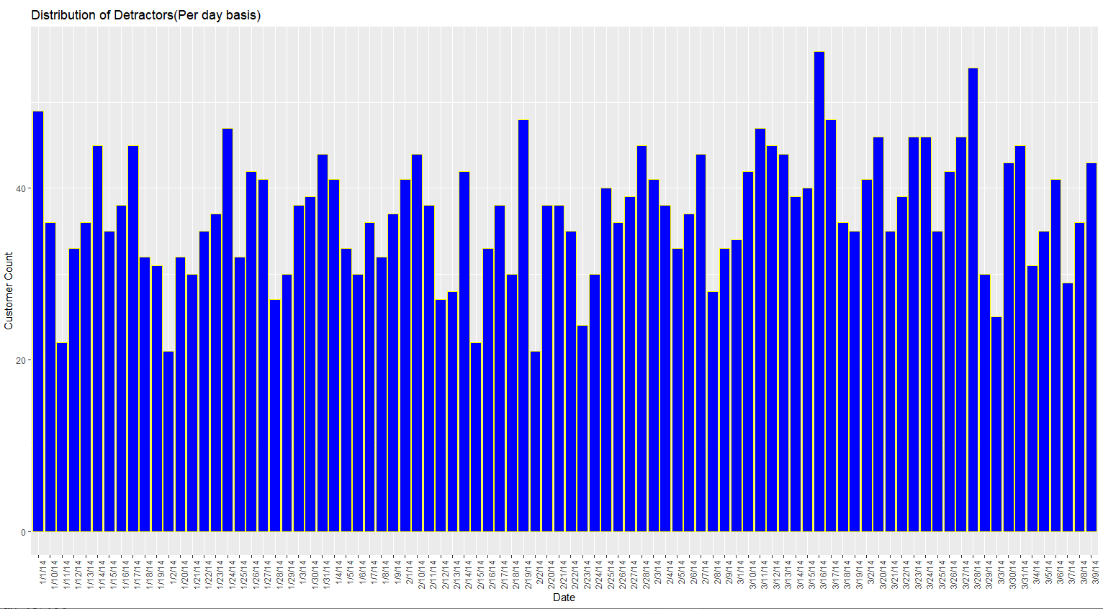
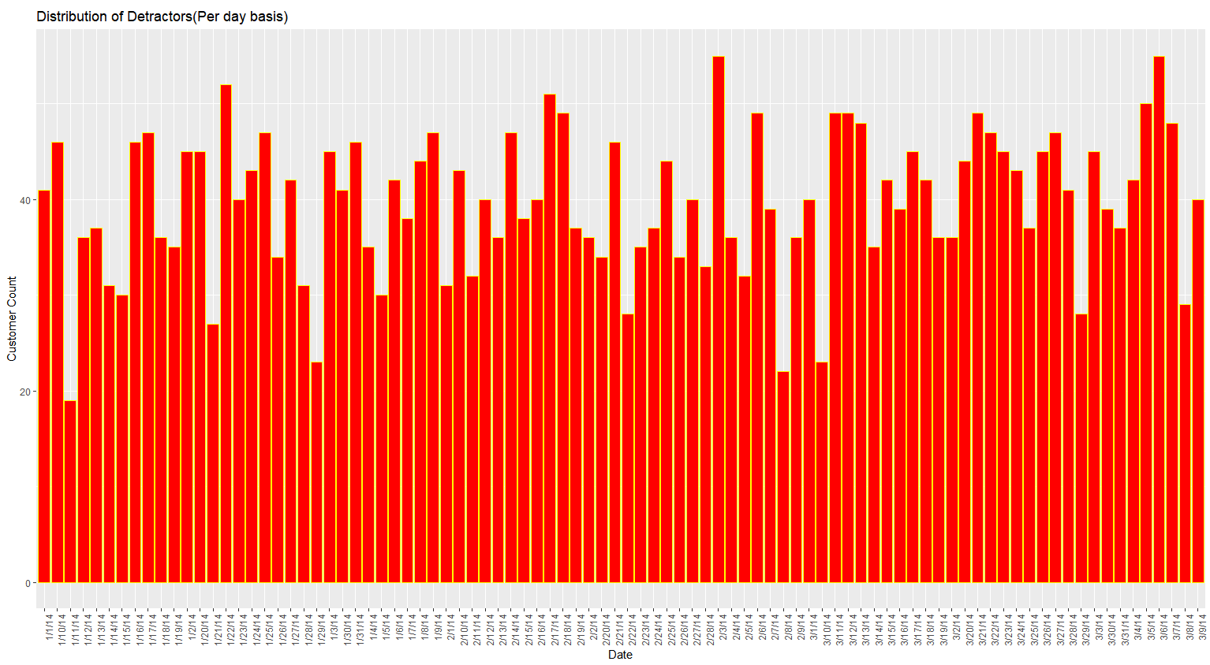
DATA ANALYSIS
Average Promoters per day: 37
Average Passive per day
: 38
Average Detractors per day: 40
Divide the Passives:
Avg. Promoters: 37+19 = 56
Avg. Detractors: 40+19 = 59
Percentage of Daily Detractors:
59∕115 * 100 = 51.30%

Slide 7
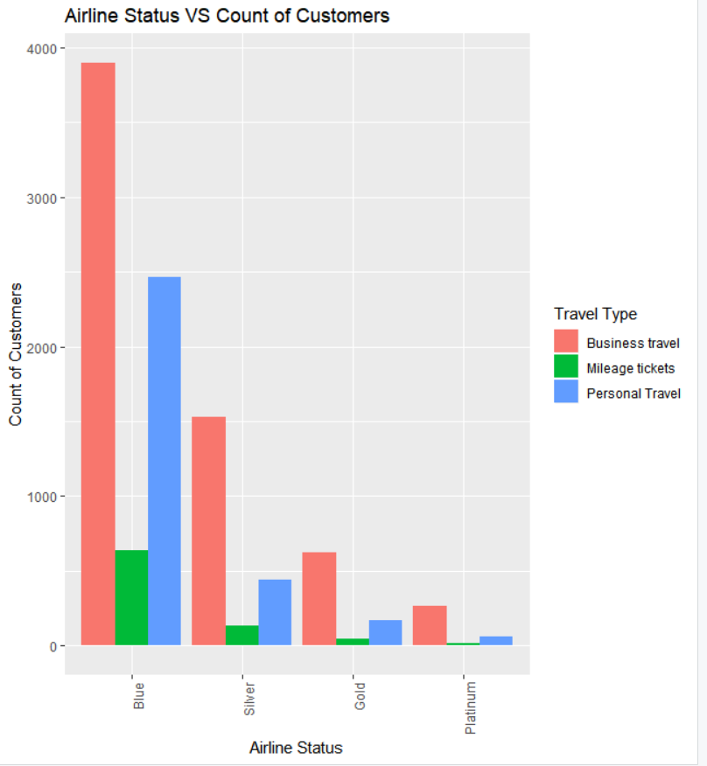
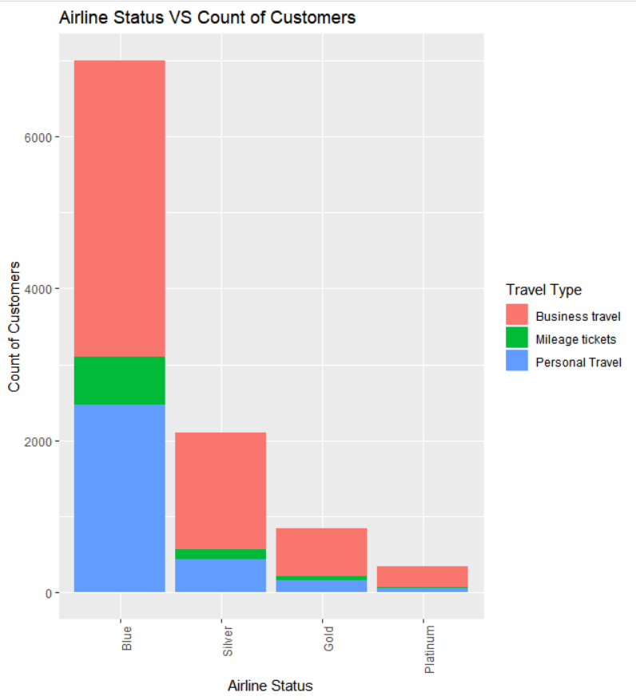
Data Analysis
Business Travel: 6323 Mileage Tickets: 829 Personal Travel: 3130

Slide 8
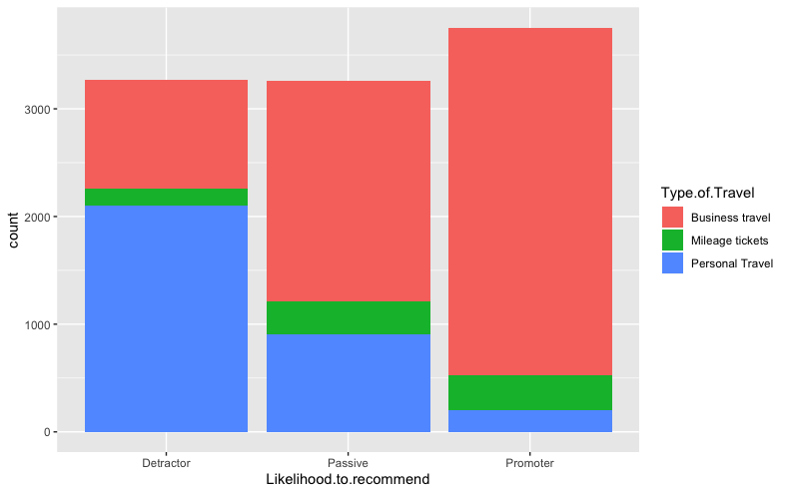
Data Analysis

Slide 9
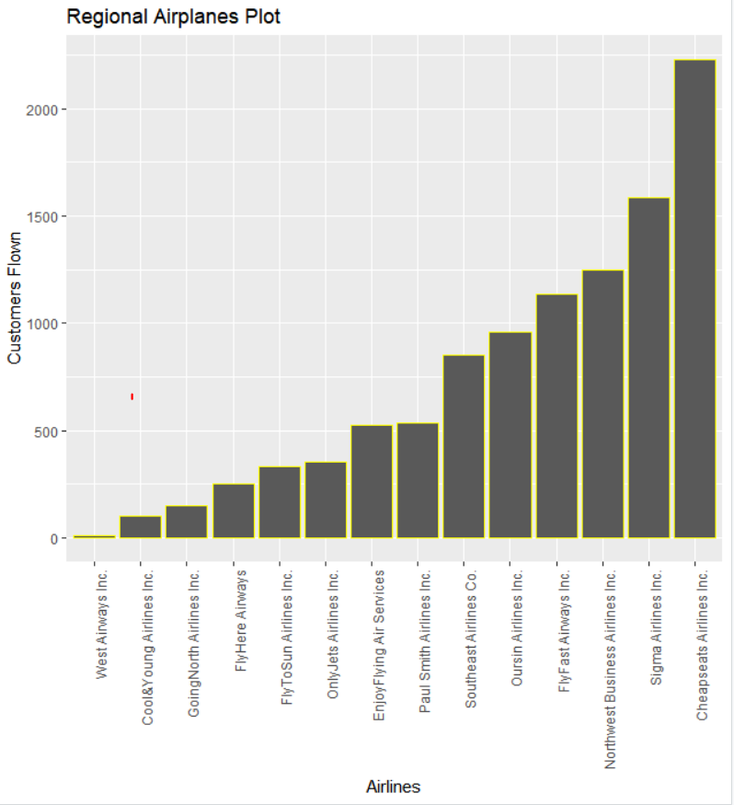
DATA ANALYSIS
Partner Airlines:
Top three partner airlines:
Cheap seats Airlines
Sigma Airlines
Northwest Business Airline

Slide 10
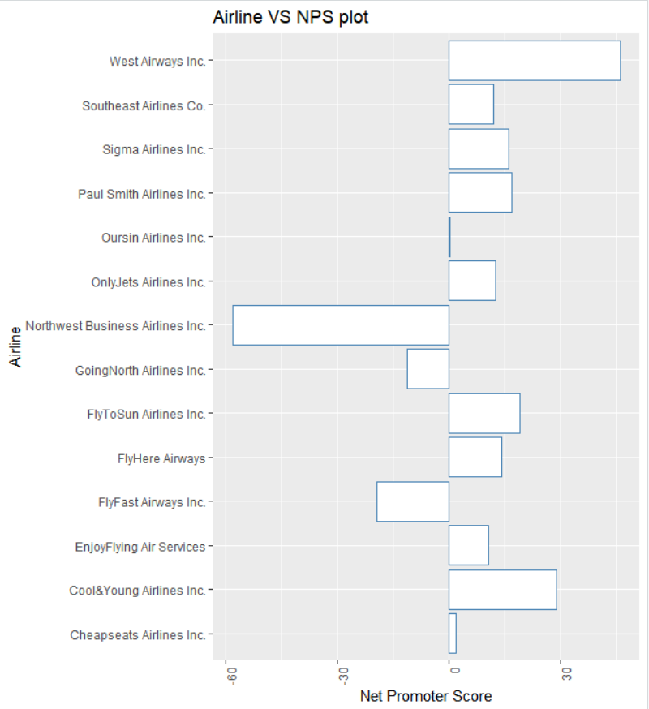
DATA ANALYSIS
Best performing partner Airlines:
West Airways
Cool & Young Airlines
Fly to Sun Airlines
Worst performing partner Airlines:
Northwest Business Airline
Going North Airline
Fly Fast Airways
Percentage detractor per top three airline:
Cheap seats Airlines: 32.70%
Sigma Airlines: 26.83%
Northeast Business Airline: 58.73%

Slide 11
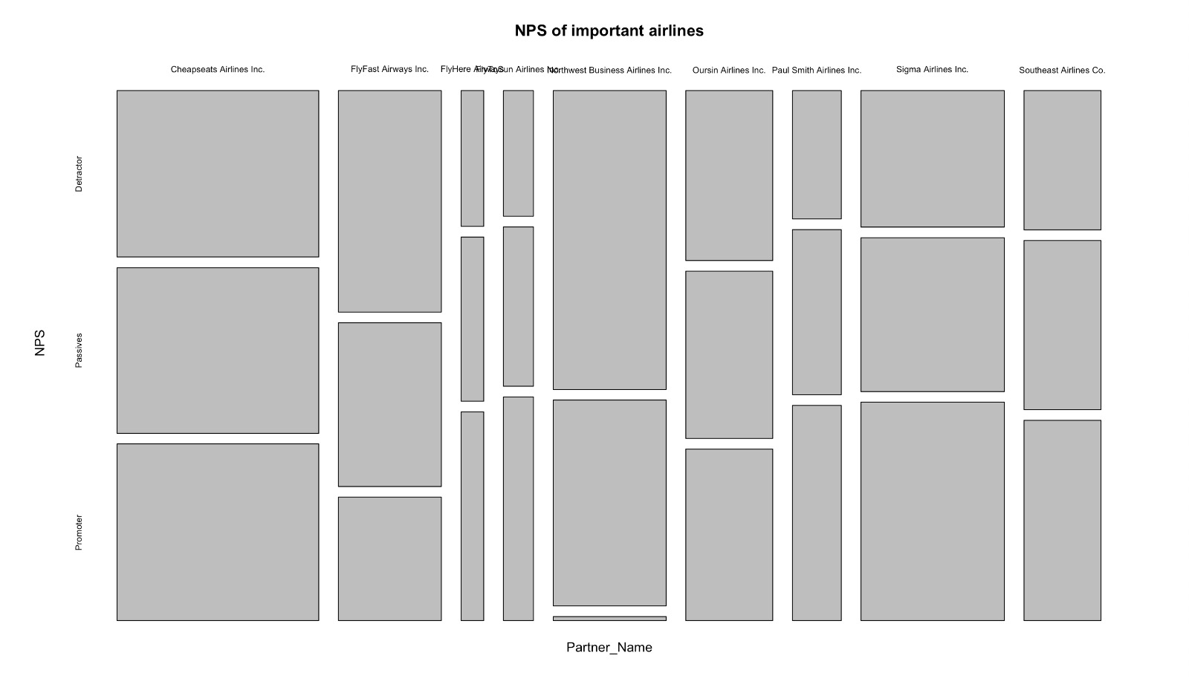
DATA ANALYSIS

Slide 12
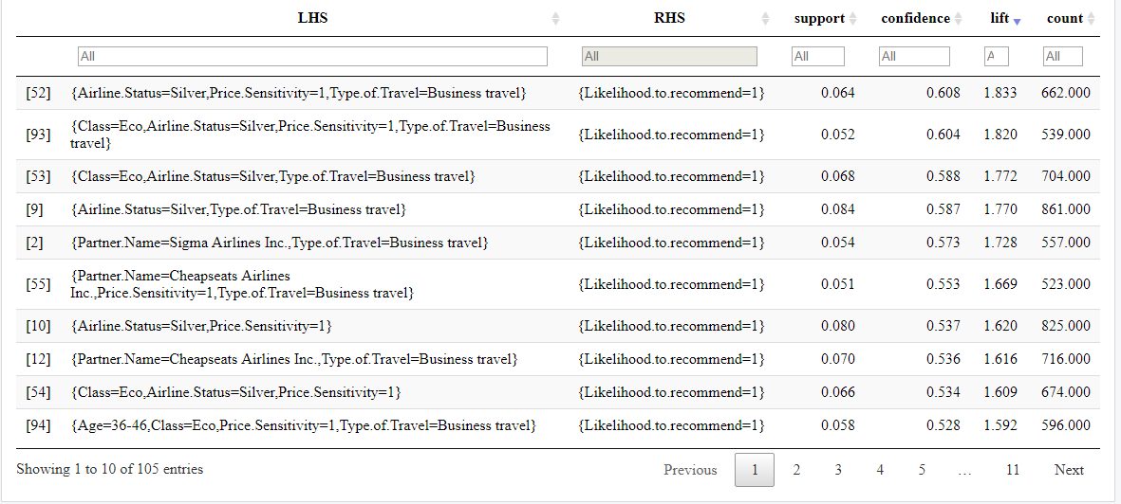
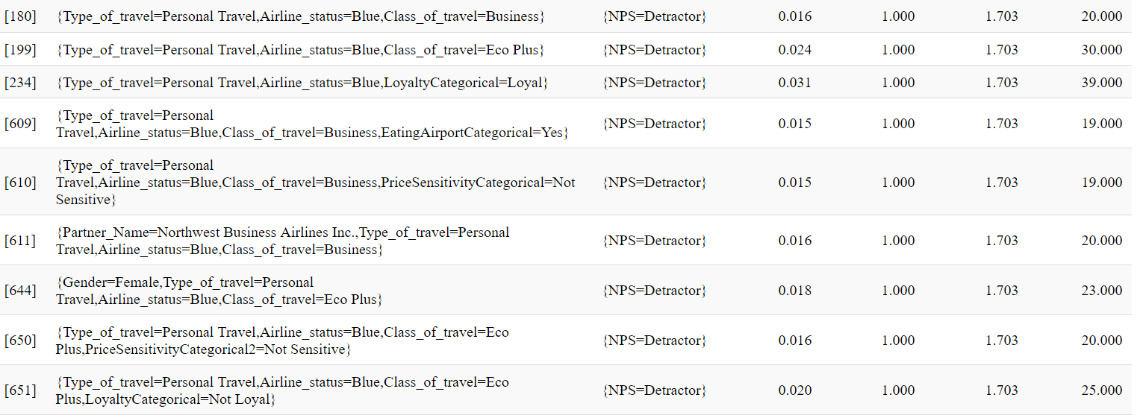
Promoter Analysis
Factors leading to a customer becoming a detractor:
Personal Travel, Airline Status is Blue, He/she is travelling in Eco plus class

Slide 13
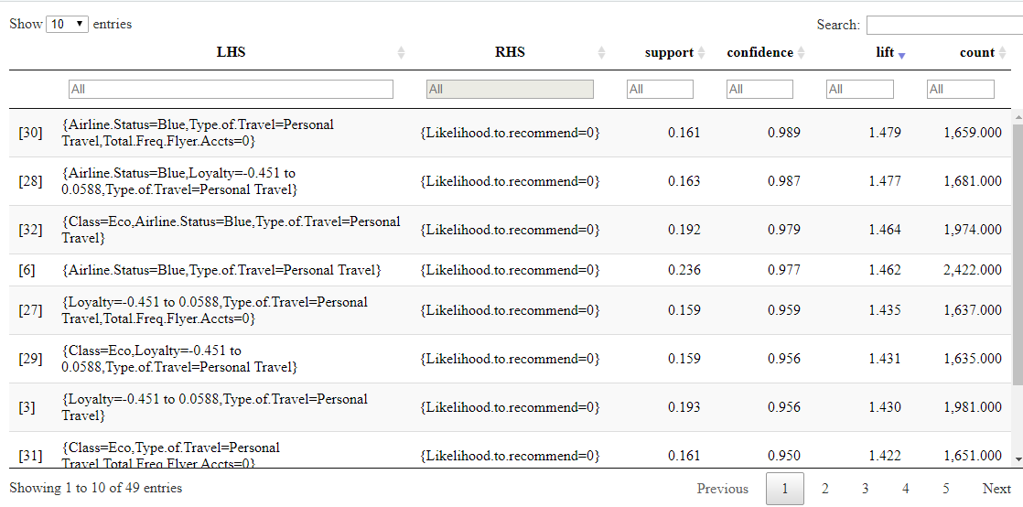
Detractor Analysis

Slide 14
Detractor Analysis
Northwest Airlines
Factors leading to a customer becoming a detractor:
Personal Travel, Airline Status is Blue, He/she is travelling in Eco plus class

Slide 15
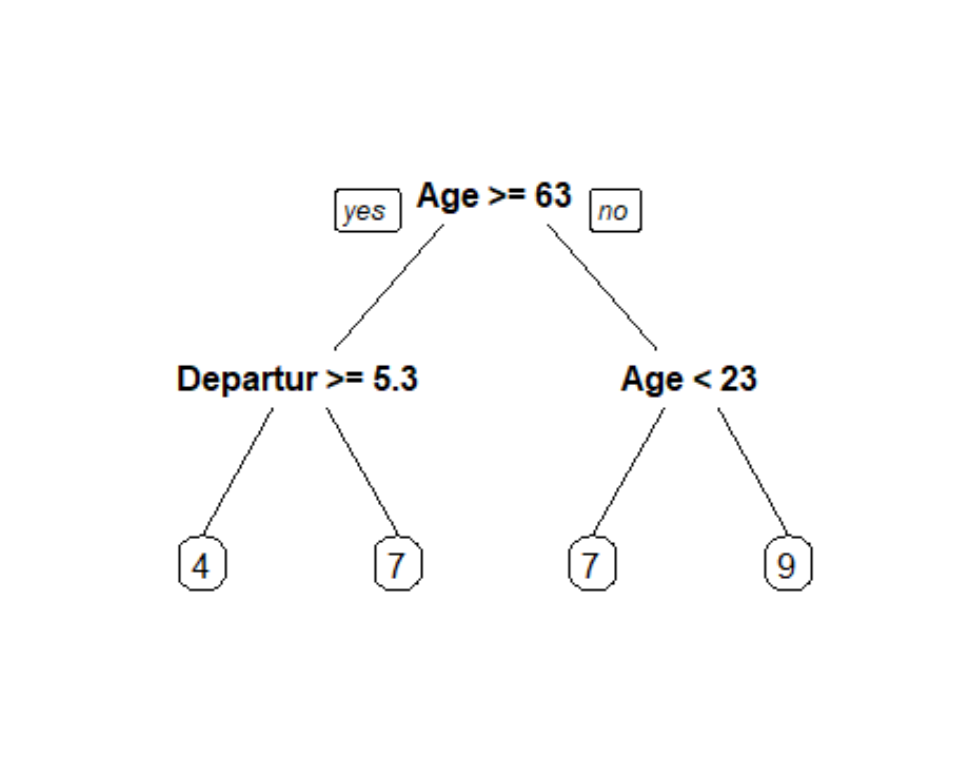
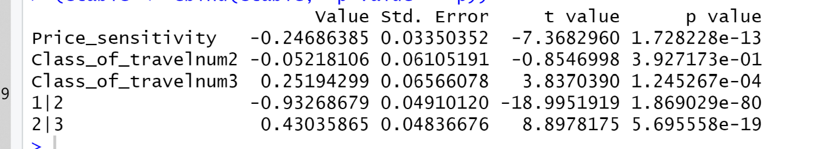
Decision Tree Analysis

Slide 16
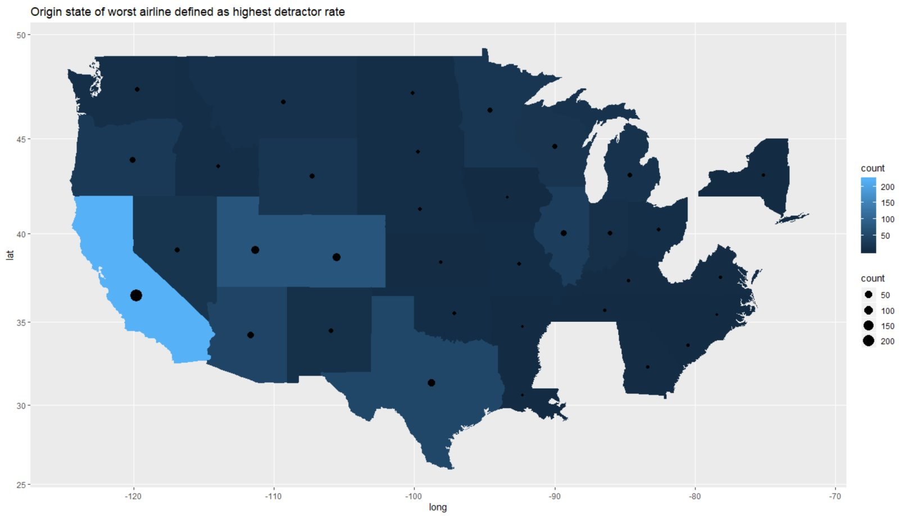
Data Analysis
Origin State of worst airline as highest detractor rate

Slide 17
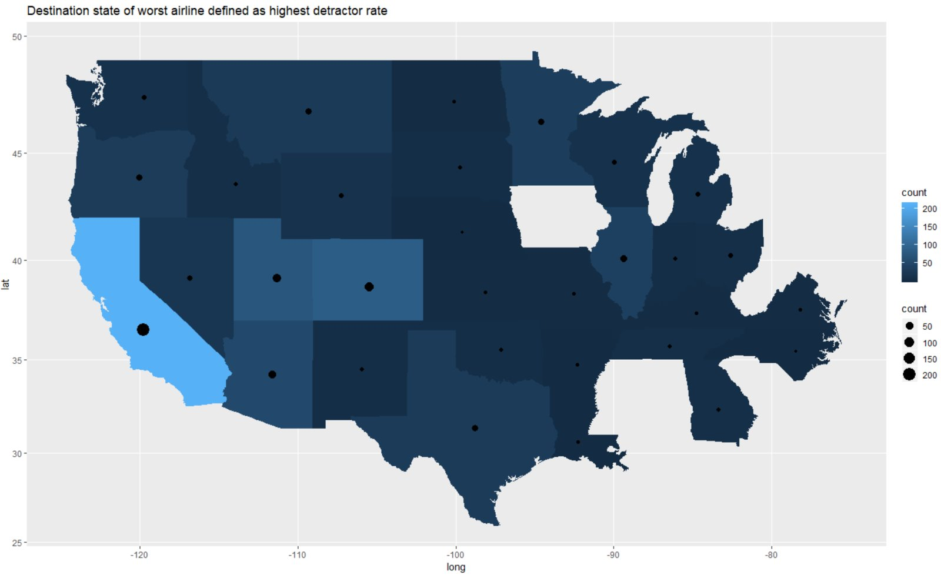
Data Analysis
Destination State of worst airline as highest detractor rate

Slide 18
Proposed Solution
Business travellers and not price sensitive customers are more likely to recommend Southeast Airlines.
Try to promote blue class to silver class as they are more likely to be a promoter.
Northwest Business Airline Travellers has been failing in comparison to other partners so the contract with them should not be extended.
Age based price discrimination may help decrease the number of detractors for 18-24 and 63+ years age groups.
A ‘first impression’ price discount may help decrease detractors who are Blue class flyers.
Improve service for customers in California state.
Eco Plus seems to be an effective offering to increase the likelihood to recommend.

Slide 19
THANKYOU
Questions Please

