Slide 1
Crime Prediction
Junjie Ouyang
Xing Liu
Yi Dang
Yi Li

Slide 2
Objective
To develop placed-based crime forecasting based on existing data

Slide 3
Raw data format
CATEGORY: STREET CRIMES, BURGLARY, MOTOR VEHICLE THEFT, OTHER
occ_date: 10/1/2016
x_coordinate: 7624068
y_coordinate: 7100192

Slide 4
Data preprocessing
x_coordinate ~ (7547902, 7757364)
y_coordinate ~ (602723, 787753)
Split map into small cells 55x46
Count the number of crimes occurred in one month in each cell

Slide 5

Street crime heatmap

Slide 6
Data split
Training: 2012.3 - 2016.2 ~ 80%
Test: 2016.3 - 2016.12 ~ 20%

Slide 7
Prediction method
Multinomial logistic regression
Gaussian process
Baseline: mean of past data

Slide 8
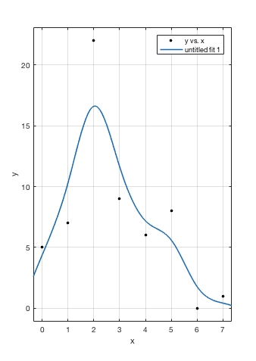
Gaussian process
Anscombe transform: transform a random variable with Poisson distribution into one with an approximately standard Gaussian distribution

Slide 9

Prediction result for STREET CRIME in March (Real)

Slide 10

Prediction result for STREET CRIME in March (Mean)

Slide 11

Prediction result for STREET CRIME in March (Logistic Regression)

Slide 12

Prediction result for STREET CRIME in March (Gaussian process)

Slide 13
Prediction result for STREET CRIMES
forcast_spot_ratio=0.005
 | Gaussian Process |  | Predict by Mean |  | Logistic Regression
 | PAI | PEI | PAI | PEI | PAI | PEI
March | 29.6497 | 0.8430 | 33.1982 | 0.9439 | 0.0122 | 0.0015
April | 29.9460 | 0.8239 | 32.6138 | 0.8972 | 0.0206 | 0.0026
May | 27.2885 | 0.8095 | 32.4252 | 0.9619 | 0.0099 | 0.0012
June | 29.1985 | 0.8912 | 30.3664 | 0.9268 | 0.0095 | 0.0012
Jul | 29.2963 | 0.8339 | 32.5900 | 0.9276 | 0.0089 | 0.0012
Aug | 26.8535 | 0.8059 | 31.8048 | 0.9545 | 0.0060 | 0.0008
Sep | 30.7960 | 0.8471 | 34.8212 | 0.9578 | 0.0098 | 0.0012
Oct | 29.4364 | 0.8195 | 33.3710 | 0.9290 | 0.0075 | 0.0009
Nov | 26.4013 | 0.7848 | 30.7764 | 0.9148 | 0.0116 | 0.0015
Dec | 25.8421 | 0.7694 | 31.9028 | 0.9499 | 0.0130 | 0.0016

Slide 14
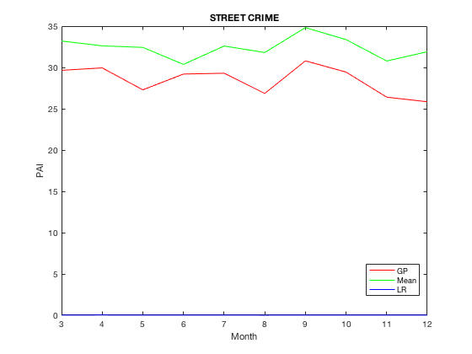
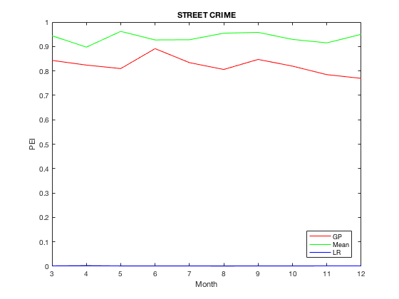
Prediction result for STREET CRIMES
forcast_spot_ratio=0.005

Slide 15
Prediction result for Burglary
forcast_spot_ratio=0.005
 | Gaussian Process |  | Predict by Mean |  | Logistic Regression
 | PAI | PEI | PAI | PEI | PAI | PEI
March | 11.4480 | 0.2000 | 17.1719 | 0.3000 | 0.0000 | 0.0000
April | 8.9822 | 0.1875 | 8.9822 | 0.1875 | 0.0000 | 0.0000
May | 6.0817 | 0.1000 | 27.3678 | 0.4500 | 0.0000 | 0.0000
June | 2.8205 | 0.0625 | 2.8205 | 0.0625 | 0.0000 | 0.0000
Jul | 4.8654 | 0.1000 | 26.7596 | 0.5500 | 0.0000 | 0.0000
Aug | 4.4739 | 0.0800 | 15.6587 | 0.2800 | 0.0000 | 0.0000
Sep | 2.2630 | 0.0476 | 15.8408 | 0.3333 | 0.0000 | 0.0000
Oct | 0.0000 | 0.0000 | 2.3734 | 0.0556 | 0.0000 | 0.0000
Nov | 2.0486 | 0.0476 | 14.3401 | 0.3333 | 0.0000 | 0.0000
Dec | 2.2630 | 0.0435 | 13.5778 | 0.2609 | 0.0000 | 0.0000

Slide 16
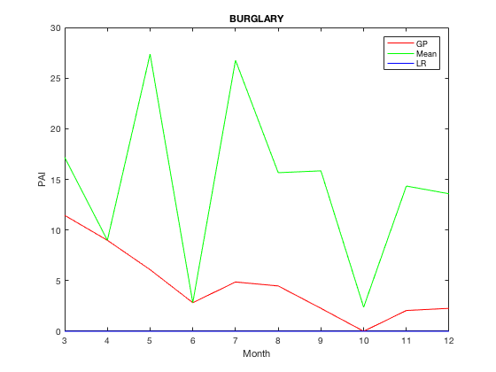
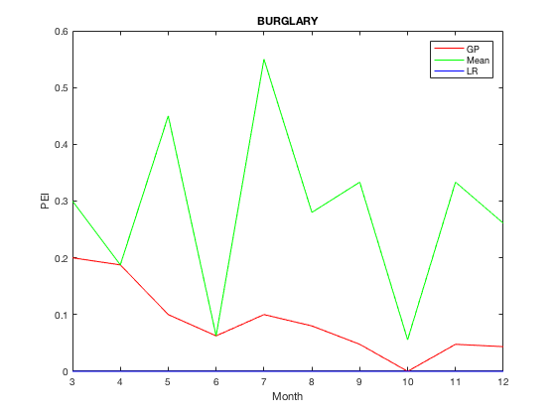
Prediction result for Burglary
forcast_spot_ratio=0.005

Slide 17
Prediction result for Motor Vehicle Theft
forcast_spot_ratio=0.005
 | Gaussian Process |  | Predict by Mean |  | Logistic Regression
 | PAI | PEI | PAI | PEI | PAI | PEI
March | 9.1226 | 0.2727 | 16.2179 | 0.4848 | 0.0000 | 0.0000
April | 10.6640 | 0.2424 | 18.6617 | 0.4242 | 0.0000 | 0.0000
May | 4.4484 | 0.1212 | 10.0088 | 0.2727 | 0.0000 | 0.0000
June | 10.5200 | 0.2857 | 15.7796 | 0.4286 | 0.0000 | 0.0000
Jul | 9.2674 | 0.2424 | 15.0595 | 0.3939 | 0.0000 | 0.0000
Aug | 5.8974 | 0.1818 | 7.8632 | 0.2424 | 0.0000 | 0.0000
Sep | 5.5080 | 0.1818 | 11.9340 | 0.3939 | 0.0000 | 0.0000
Oct | 6.9505 | 0.2647 | 10.8120 | 0.4118 | 0.0000 | 0.0000
Nov | 2.1624 | 0.0811 | 11.5328 | 0.4324 | 0.0000 | 0.0000
Dec | 5.7664 | 0.2000 | 16.5783 | 0.5750 | 0.0000 | 0.0000

Slide 18
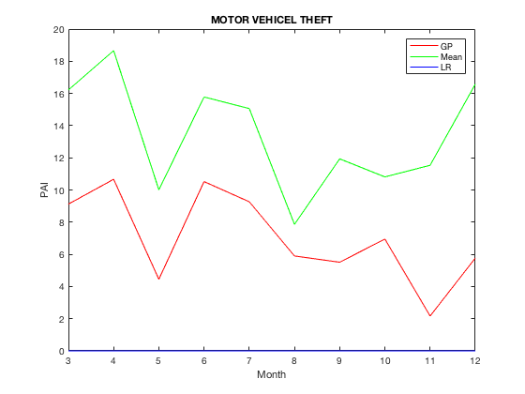
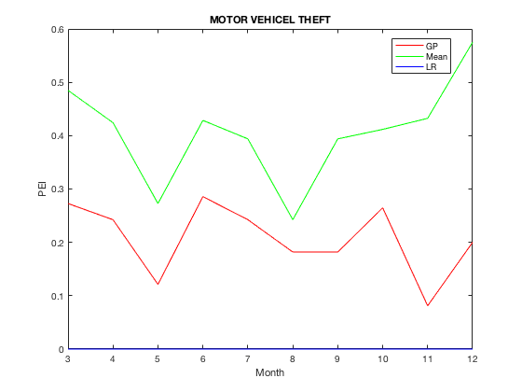
Prediction result for Motor Vehicle Theft
forcast_spot_ratio=0.005

Slide 19
Prediction result for Other
forcast_spot_ratio=0.005
 | Gaussian Process |  | Predict by Mean |  | Logistic Regression
 | PAI | PEI | PAI | PEI | PAI | PEI
March | 23.1515 | 0.8631 | 26.1955 | 0.9766 | 0.0184 | 0.0027
April | 22.5706 | 0.8751 | 25.4242 | 0.9858 | 0.0119 | 0.0017
May | 22.9394 | 0.8618 | 25.7738 | 0.9683 | 0.0176 | 0.0026
June | 21.8032 | 0.8725 | 24.4169 | 0.9771 | 0.0158 | 0.0024
Jul | 21.4449 | 0.8653 | 24.7060 | 0.9969 | 0.0137 | 0.0020
Aug | 23.1847 | 0.8774 | 25.9669 | 0.9827 | 0.0140 | 0.0021
Sep | 22.8861 | 0.8765 | 25.5421 | 0.9783 | 0.0152 | 0.0023
Oct | 23.1720 | 0.8632 | 26.1811 | 0.9753 | 0.0191 | 0.0028
Nov | 23.0831 | 0.8630 | 25.6058 | 0.9575 | 0.0101 | 0.0015
Dec | 22.8235 | 0.8481 | 26.6177 | 0.9891 | 0.0196 | 0.0029

Slide 20
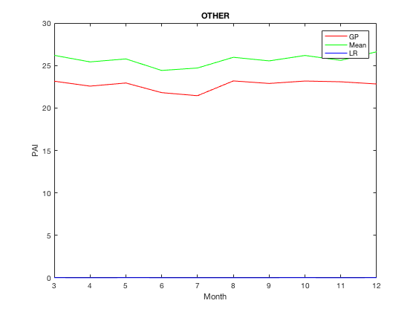
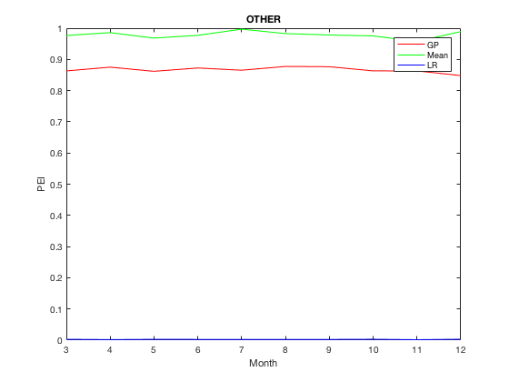

Slide 21
Conclusion

