Slide 1
Pins
Controller Board Pin | RP Pico Pin | Color | Purpose | Controller board pins cross connections | Harness
3 |  | Red | VCC+ Power to the boards
4 |  | Black | GND. Power to the boards
6 | 38 (GND) | Black
7 | 39 (VSYS) | Red | Supplies power to RP board
8 | 26 (GP20) | White | Motion sensor or bypass switch |  | RP
9 | 25 (GP19) | Yellow | Limit switch 2 |  | RP
10 | 24 (GP18) | Blue | Limit switch 1 |  | RP
11 | 23 (GP21) | Red | Motion sensor |  | RP
12 | 22 (GP17) | Green | GPIO Out to DPDT trigger |  | RP
13 | 21 (GP16) | Black | GPIO out SPST trigger |  | RP
15 |  | Black | To common pin of bypass switch |  | Bypass switch
16 |  | Red | Trigger voltage (1M pull-up resistor to VCC+) |  | Bypass switch
2* |  | Red | Trigger voltage (1M pull-up resistor to VCC+) | 10 | Limit Switch 1
3* |  | Red | Trigger voltage (1M pull-up resistor to VCC+) | 9 | Limit Switch 2
4* |  | Black | GND to both limit switches.
5* |  | White | Trigger from motion sensor connects to Pin 6 of controller board. | 11 | Motion sensor
6* |  | Red | VCC |  | Motion sensor
7* |  | Black | GND |  | Motion sensor
8* |  | Red | A diode and resistor will be connected directly on the LED | 13* | Eyes
9* |  | Black | GND |  | Eyes
10* |  | Red | VCC |  | SPST
11 |  | Black | GND |  | SPST
12* |  | Blue | Relay trigger. Triggered by GP16. | 13 | SPST
13* |  | White | NO of SPST connects to DPDT Relay | 14*,8* | SPST
14* |  | Red | VCC in from SPST relay | 13* | DPDT
15* |  | Black | GND |  | DPDT
16* |  | Blue | DPDT relay trigger. Triggered by GP17. | 12 | DPDT
Last modified 2/17/2025

Slide 2
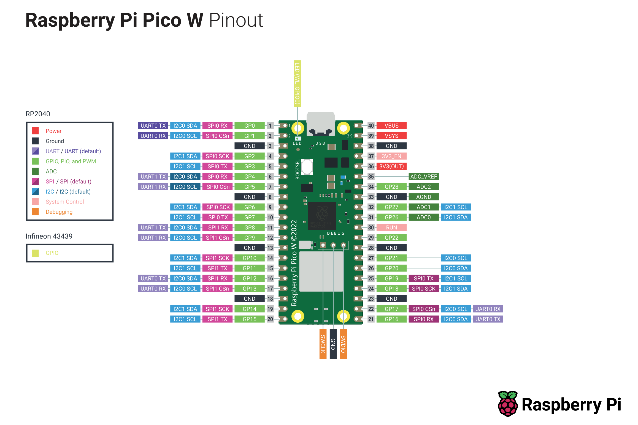

Slide 3


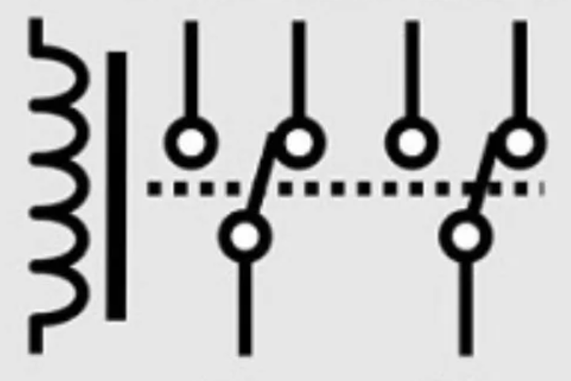
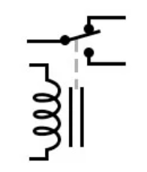

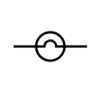


Electrical Circuit Diagram
Top Limit Switch
VCC+
VCC+
GPIO (Out) If Opening
GND
GPIO (IN)
GPIO (Out)
If Starting || Opening ||
Closing
Actuator
Bottom Limit Switch
VCC+
GND
GND
GND
GPIO (IN)
GND
Lights for eyes and mouth
VCC+
GND
GND
GPIO (IN)
Motion sensor bypass

Slide 4
States and Actions (Events)
Bottom LS pressed
Closing
Bottom LS on
Starting
No LS on
Opening
Idle
Top LS on
Top LS pressed
Motion sensor on
Motion sensor off

