Slide 1
States and Actions (Events)
Bottom LS pressed
Closing
Bottom LS on
Starting
No LS on
Opening
Idle
Top LS on
Top LS pressed
Motion sensor on
Motion sensor off

Slide 2


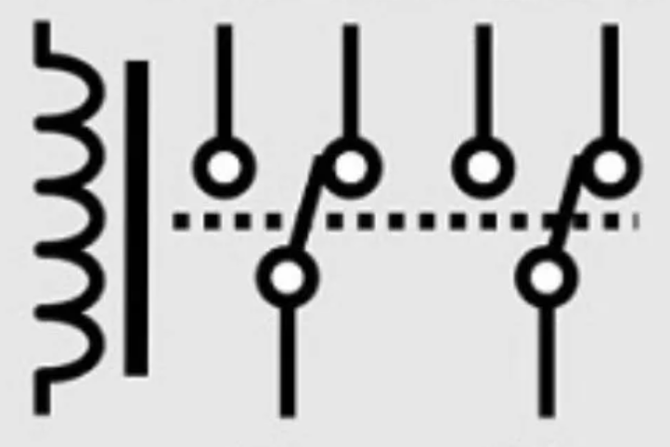
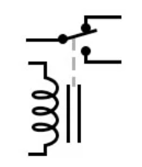

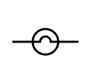


Electrical Circuit Diagram
Top Limit Switch
VCC+
VCC+
GPIO (Out) If Opening
GPIO (IN)
GPIO (Out)
If Starting || Opening ||
Closing
Actuator
Bottom Limit Switch
VCC+
GPIO (IN)
GND
GND
GND
GND
GPIO (IN)
Lights for eyes and mouth
VCC+
GND
Motion sensor bypass

Slide 3
Pins
Controller Board Pin | RP Pico Pin | Color | Purpose | Connects to controller board pin | Harness
1 | 21 | White | GPIO out SPST trigger | 20 | RP
2 | 22 | Green | GPIO Out to DPDT trigger | 24 | RP
3 | 23 | Red | Not used (GND on RP) |  | RP
4 | 24 | Blue | Limit switch 1 | 7 | RP
5 | 25 | Yellow | Limit switch 2 | 9 | RP
6 | 26 | White | Motion sensor or bypass switch | 12 | RP
7 |  | Black | To RP Pin 4 of controller board | 4 | Limit Switch 1
8 |  | Red | Trigger voltage (1K resistor) 3V to NO pin of limit switch |  | Limit Switch 1
9 |  | Black | To RP Pin 5 of controller board | 5 | Limit Switch 2
10 |  | Red | Trigger voltage (1K resistor) 3V to NO pin of limit switch |  | Limit Switch 2
11 |  | Black | GND |  | Motion sensor
12 |  | White | Trigger from motion sensor connects to Pin 6 of controller board. | 6 | Motion sensor
13 |  | Red | VCC |  | Motion sensor
14 |  | Black | To common pin of bypass switch |  | Bypass switch
15 |  | Red | Trigger voltage (1K resistor) 3V to NO open pin of bypass switch |  | Bypass switch
16 |  | Black | GND |  | Eyes
17 |  | Red | VCC in Connects to pin 21 of controller board | 21 | Eyes
18 |  | Black | GND |  | SPST
19 |  | Red | VCC |  | SPST
20 |  | Blue | Relay trigger. Connects to pin 1 of controller board. | 1 | SPST
21 |  | White | VCC out to DPDT Relay | 17 | SPST
22 |  | Black | GND |  | DPDT
23 |  | Red | VCC in Connects to pin 21 of controller board | 21 | DPDT
24 |  | Blue | DPDT relay trigger. Connects to pin 2 of controller board. | 2 | DPDT

