Slide 1
Can we predict
Heart Disease?
MIDS W200 W630 Huang
Haibi Lu, Jinsoo Chung, Sunitha Haraginadoni
Notes:
Jinsoo
Hello everyone. Welcome to our presentation, Can we predict Heart Disease, by Haibi, Jinsoo, and Sunitha

Slide 2

Background
Number one leading cause of death in the United States - 23% of all deaths (2019)
Comes in many forms
Heart arrhythmias
Heart valve disease
Need a system to effectively prevent and manage the disease
Research Question:
Can we build a prediction model for Heart Disease?
What are key variables correlated with Heart Disease?
Notes:
Jinsoo
Heart disease is a serious condition that accounts for 23% of all deaths in the United States. In 2019, heart disease was the leading cause of death in the US. Coming in various forms, such as heart arrhythmias and heart valve disease, heart disease can manifest in our population in various and unexpected ways with multiple causal reasons. As such, it is critical for us to understand key factors that lead to this heart disease and come up with a system to predict and prevent the disease. Given this background, we developed two research questions: Can we build a prediction model for Heart Disease? What are key variables correlated with Heart Disease?

Slide 3
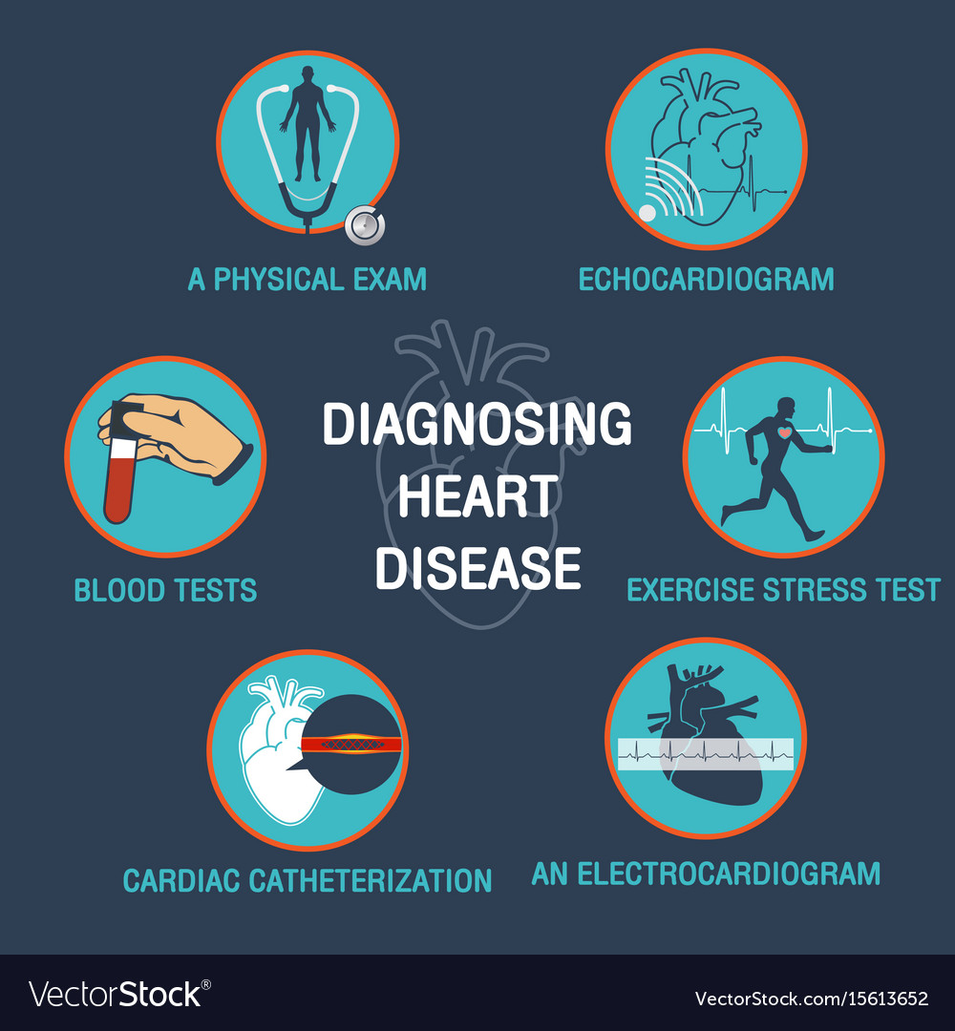
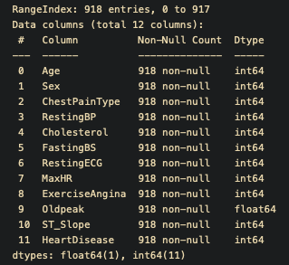
Bringing multiple diagnostic factors into Prediction Model
Many factors in diagnosing heart disease
Key Variables for Prediction Model
Notes:
Jinsoo
Diagnosis of heart disease requires examination from multiple angles. Doctors typically use physical exams, electrocardiograms, blood tests, stress tests, cardiac catheterization to understand a patient’s condition and diagnose the disease. Our data set included many of the parameters relating to the diagnosis of the heart disease. As seen from the columns in the right, there were 8 specific diagnosis related features in the data set with 2 demographic feature. The last column included the diagnosis of the heart disease.

Slide 4
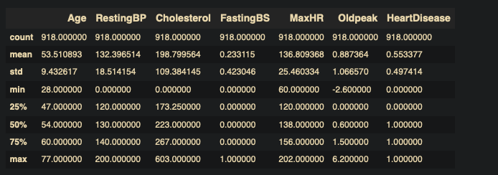
Account for Missing Data
Missing data found
Cholesterol --- 172 “0”s
Resting BP --- one “0”
Replaced missing data with mean
Cholesterol (0) -> Mean
Resting BP (0) -> Mean
Replaced categorical values with numerical values
Sex/Chest Pain Type/Resting ECG/Exercise Angina/ST_Slope/Heart Disease

Slide 5
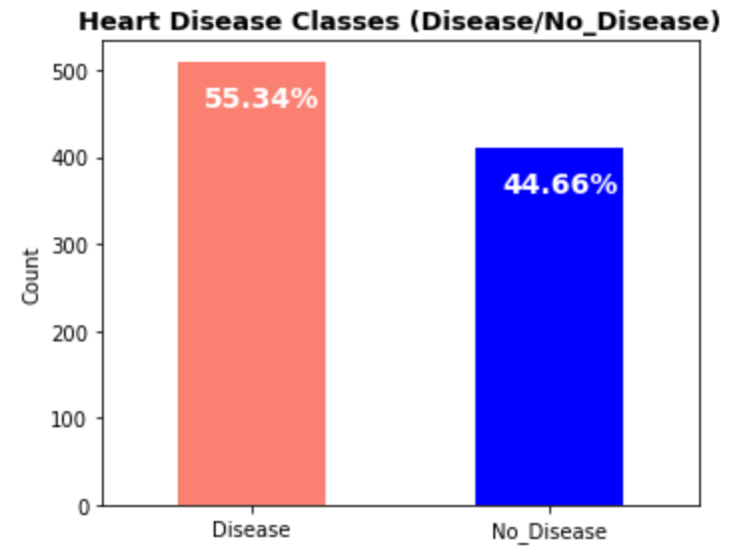
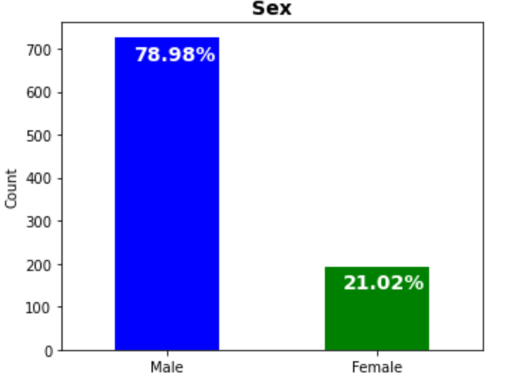
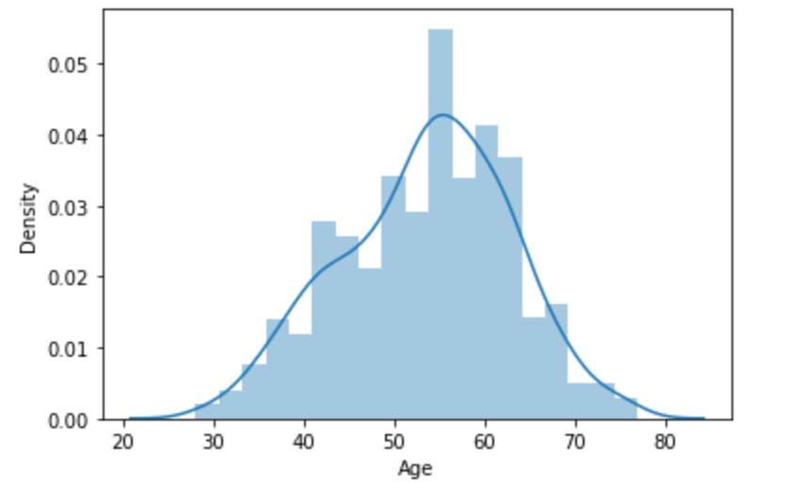
Demographics represented in data set
Age
Dataset has more patients with heart Disease.
Age group from 28-77 represented in data set
Dataset has more male patients than women.
Notes:
Sunitha
Data exploration:
Target value distribution : there are more heart disease patients than healthy
Age: Age are normally distributed from 28-77 yrs.
Sex: There are more men than women in our data sample.

Slide 6
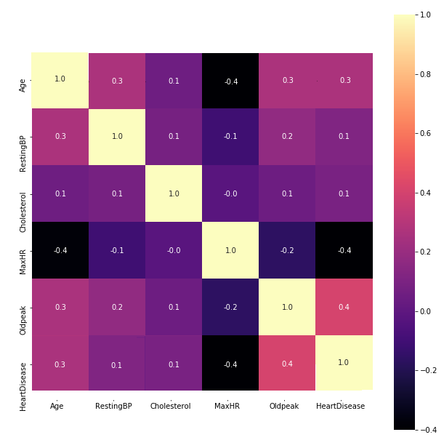
Correlation Heatmap for Numeric Variables
Max Heart Rate has Negative Correlation
Old Peak Has the Highest Compelling Positive Correlation
Notes:
Haibi

Slide 7
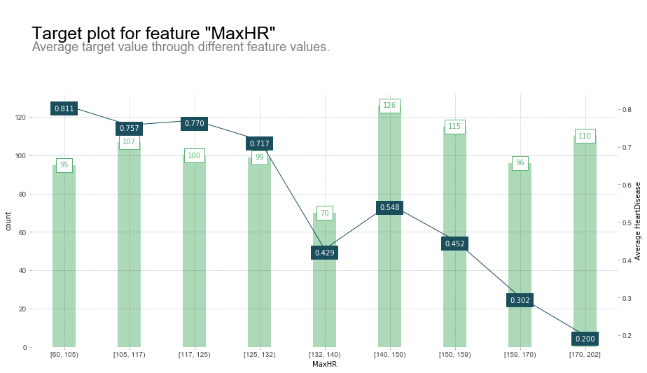
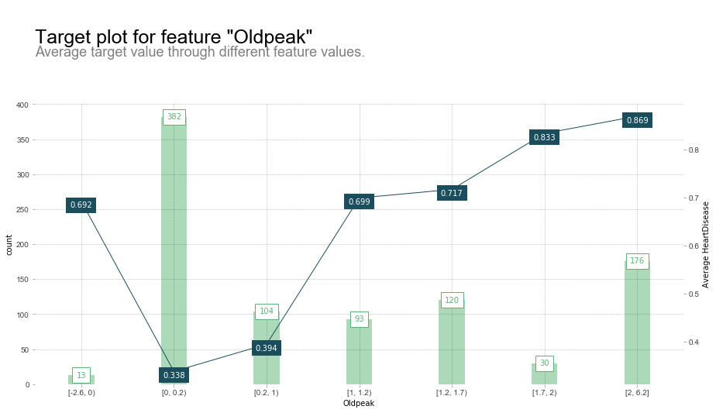
Pdpbox Target Plot With One-Hot Encoding
Higher max heart rate -> lower heart disease
Higher old peak -> higher heart disease
Notes:
Haibi

Slide 8
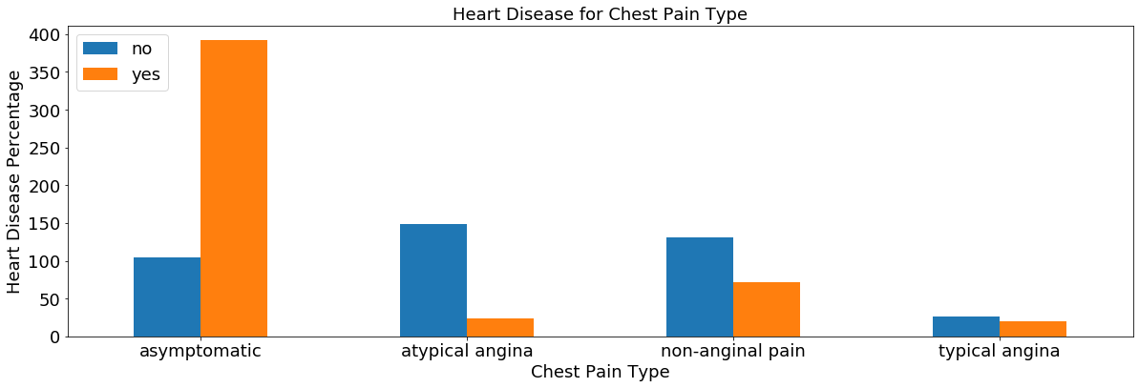
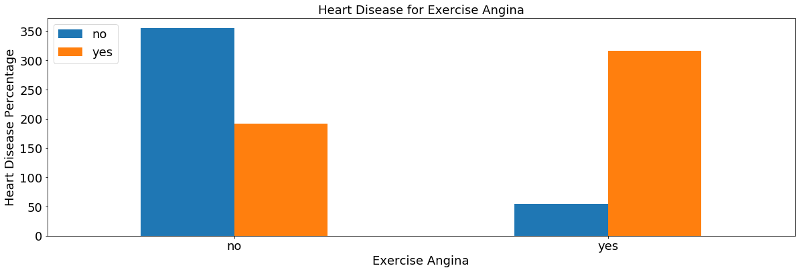
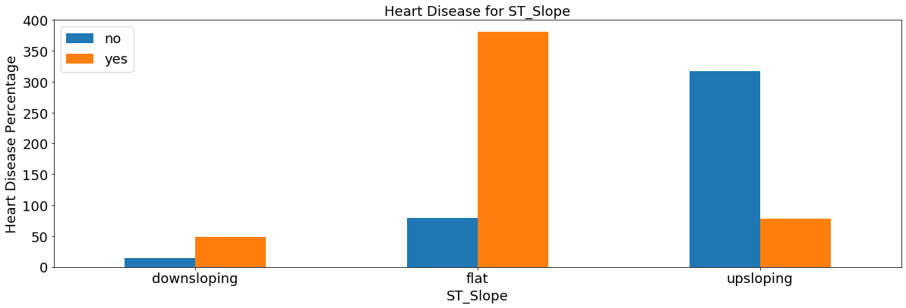
Data Exploration For Categorical Variables
Asymptomatic patients associated with high prevalence of heart disease
Exercise Angina = ‘Yes’ has high prevalence of heart disease
Flat and downsloping ST_slope type has high prevalence of heart disease
Upsloping ST_slope type has low prevalence of heart disease
Notes:
Haibi

Slide 9
RandomForestClassifier selected as Machine Learning Prediction Model
Initial model comparison & selection
No hyperparameter tuning
Performance evaluation based on f1 score
RandomForestClassifier (Decision Tree) rendered highest mean score
Model Type | CV1 | CV2 | CV3 | CV4 | CV5 | Mean
RandomForestClassifier | 0.909 | 0.855 | 0.864 | 0.855 | 0.818 | 0.860
SupportVectorMachine | 0.745 | 0.700 | 0.682 | 0.700 | 0.609 | 0.687
LogisticRegression | 0.882 | 0.800 | 0.855 | 0.845 | 0.818 | 0.840
Notes:
Jinsoo
Before choosing a Machine Learning algorithm, we explored three different types of algorithms: Random Forest Classifier, Support Vector Machine, and Logistic Regression. Initial analysis showed that the randomforestclassifier, which is a decision tree based model, rendered the highest mean f1 score. Based on this data, we decided to tune the RandomForestClassifier model to build a robust prediction model based on our dataset.

Slide 10
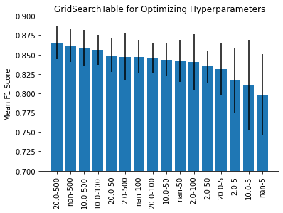
Optimization & Test Results for Prediction Models
Max_Depth of 10 and N_Estimators of 500 selected as final model
Data suffers from the high presence of false negatives - lower recall value
Useful for positive prediction as shown by high precision
Adequate accuracy for initial prediction model
Test Type | max_depth | n_estimators | Accuracy | Precision | Recall
Final Test | 10.0 | 500 | 0.853 | 0.93 | 0.823
Notes:
Jinsoo
We optimized the two main hyperparameters, which were max_depth and n_estimators. Based on our training, validation, and test data set, we found that the max_depth of 10 and n_estimator of 500 were the best hyperparameters for the ML model. Using this, we were able to characterize the performance of the prediction model. As seen from the table, the accuracy of 85.3% showed that the model accurately predicted most heart disease with some errors. This would be adequate for an initial model. Also, as seen from the high precision, the model was great at predicting true values for heart disease. However, the model suffered from false negatives as shown by the lower recall value.

Slide 11
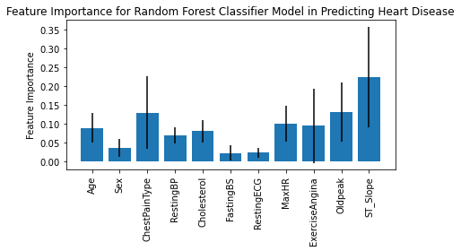
Understanding the Major Features in the Prediction Model
Major predictors:
ST_Slope
Old peak
Chest pain Type
Minimal predictors:
Sex
Fasting Blood Sugar
Resting Electrocardiogram
Notes:
Jinsoo
To understand our ML model in more detail, we looked into the major features that contributed to the model. As seen from the plot, the major features were ST_Slope, Oldpeak, ChestType, and MaxHR. These were all features seen previously to have high correlation with heart disease. On the other hand, sex, Fasting blood sugar, and Resting ECG did not seem to have much influence in the model.

Slide 12
Conclusion
Successfully built a Machine Learning tool using RandomForestClassifier to predict heart disease
Identified top three contributing factors to our prediction model
ST_Slope
Old peak
Chest pain Type
Good starting point to build prediction model for early detection of heart disease
Need further fine-tuning based on heart disease types & more patient data for an accurate model
Notes:
Heart disease is too general of a category
Pathology is dependent on the type of heart disease
Proportional representation of types necessary for model building
Model might not be suitable in other data sets
Sunitha

