Slide 1

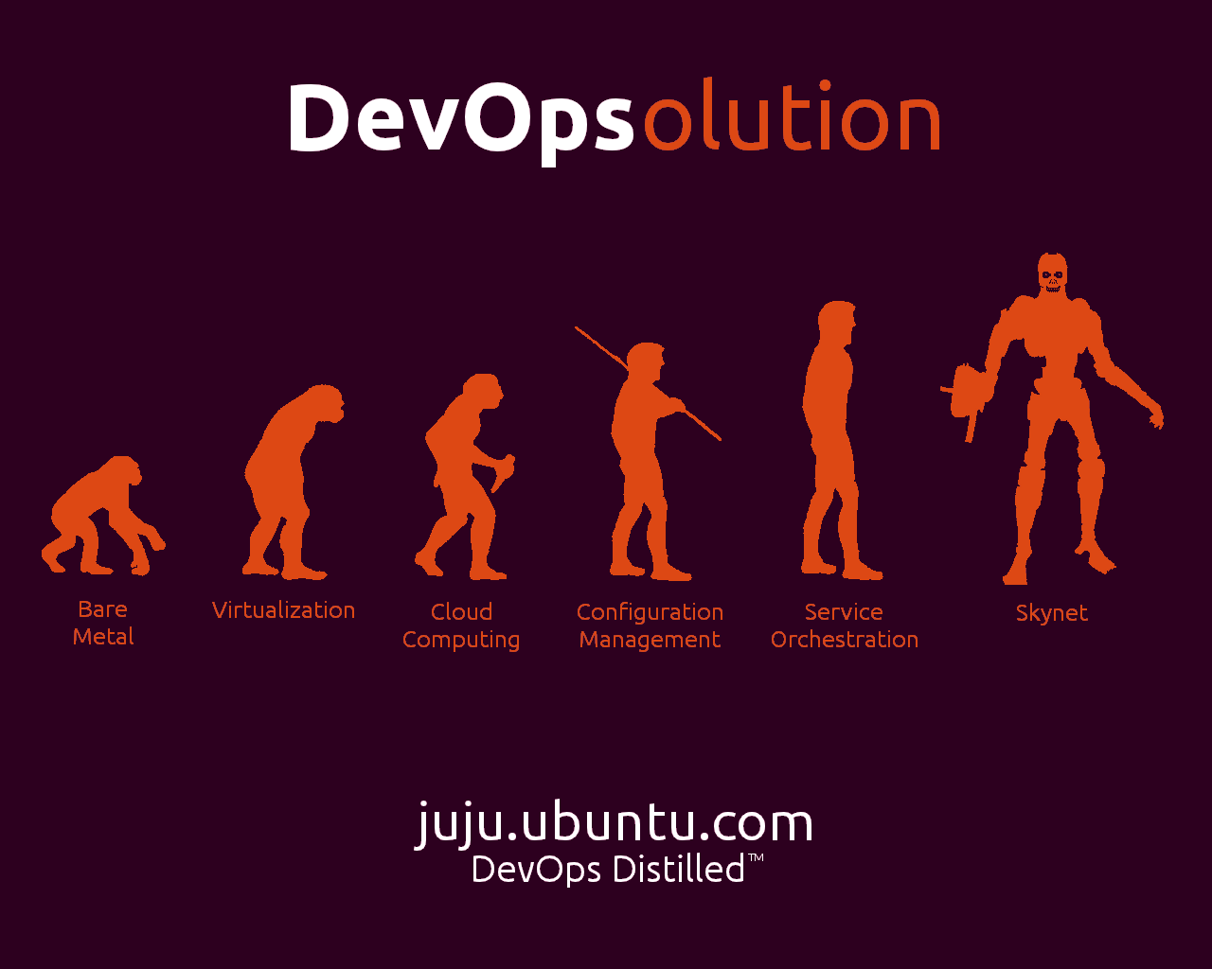
juju
Service Orchestration and Deployment
James Page
james.page@ubuntu.com
juju.ubuntu.com
July 2012
Notes:
Introduce myself;
Technical Lead
Ubuntu Server & Cloud Workloads Team
Ubuntu Core Dev
Debian Maintainer
Long Time Java Developer
Python Novice
Juju Charmer
NOT a Juju Developer....
Introduce talk:
Read title!!!!

Slide 2
The Plan
Juju and Charm 101
Example Deployment

Slide 3
Juju and Charm 101

Slide 4
Juju: Service Orchestration
High Level Orchestration
Service Coordination
Scale up; and down
Provider Abstraction...
Notes:
What is Juju?
High Level Orchestration
Python/Twisted
Coordinates deployment of services onto Ubuntu Server instances – semantics at service level, not machine level
NOT configuration management
Coordinates relationships between services
Wiki → Needs a Database backend
Allows easy scale up and down
Follow through to next slide for provider abstraction.
…...

Slide 5





Juju: Provider Abstraction
Public and Private Cloud
Bare Metal
Local
Bare metal
Public Cloud
Private Cloud
Notes:
Provider Abstraction; I can take a charm and deploy it on any provider that Juju supports -
Public/Private cloud using ec2 and Openstack API's
DataCenter → Bare Metal using MaaS – Metal as a Service
Or using the local provider using lightweight LXC containers on my laptop... fantastic for development of charms.....
Lead in to what is a charm.

Slide 6
Juju: Charms
DevOps Knowledge Distilled
Any language
Metadata
Configuration
Hooks
.
├── config.yaml
├── copyright
├── hooks
│ ├── install
│ ├── mongodb-relation-changed
│ ├── mongodb-relation-departed
│ ├── start
│ ├── stop
│ ├── upgrade-charm -> install
│ └── website-relation-changed
├── metadata.yaml
├── README.markdown
└── revision
Notes:
Charm
Distillation of Developer and Operations knowledge into a service which can be repeatably deployed, scaled and related to other services
Any language (within reason):
Shell, python, php
Structure of a charm:
Metadata – name, relations provided and required.
Configuration – deployment specific configuration that users of a charm and specify
Hooks – the actuall details of how to deploy the service - install, configure, stop, start -relation-*

Slide 7








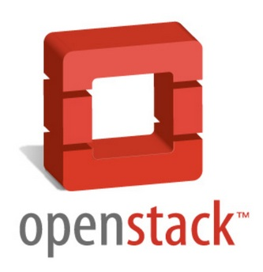



Charm Store
Easy deploy with Juju
http://jujucharms.com
Notes:
Charm Store
Community developed charms which have been reviewed by the Core Charmers team.
Easily deployable using juju with no extra download steps.
Automatically tested with multiple providers on a regular basis
80+ charms now in the charm store with more landing weekly.

Slide 8
Deploying and Debugging a Django Application using Juju
Notes:
Walkthrough of deploying a set of charms using the local development provider.
NOT demo – sorry chicken

Slide 9
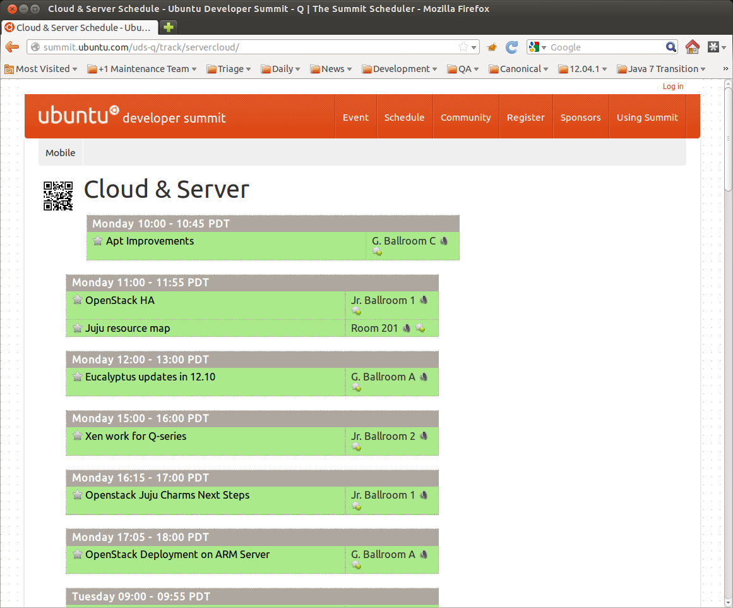
The Application - Summit
Conference Management
UDS and Linux Plumbers
Web, Database + Cache
Notes:
Background
- Summit
- Conference management tool for registration, meeting/session scheduling, customized schedules for participates etc..
- Python Django application with Database and Cache tiers
- Used at the Ubuntu Developer Summit for a number of years and will also support this years Linux Plumbers conference in August.

Slide 10
The Charm - Summit
Written by Mark Mims
Generic Django Charm (Michael Nelson)
Bash
Puppet
.
├── config.yaml
├── files
│ ├── CollapsedFieldsets.js
│ ├── createadmin.py
│ ├── favicon.ico
│ └── robots.txt
├── hooks
│ ├── cache-relation-changed
│ ├── db-relation-changed
│ ├── install
│ ├── start
│ ├── stop
│ ├── upgrade-charm -> install
│ └── website-relation-joined
├── lib
│ ├── ch-file.sh
│ └── summit.sh
├── manifests
│ ├── apache-wsgi.pp
│ ├── database_settings.pp
│ └── initial_state.pp
├── metadata.yaml
├── revision
└── templates
├── django.wsgi.erb
├── httpd.conf.erb
├── local.cfg.erb
├── local_settings.py.erb
└── vhost.conf.erb
~/src/charms/oneiric/summit$ cat metadata.yaml
name: summit
summary: Apache+wsgi+Django Conference Scheduling Application
description: |
Deploy your Django project as an Apache mod_wsgi app.
requires:
db:
interface: pgsql
cache:
interface: memcache
Notes:
- Contrib Author(s).
- Good example of making use of configuration mangement solutions.
- Uses puppet in headless mode for configuration of services with integration between juju and puppet delivered through the hooks/shell scripts.
- Futher customization of the Summit application through its own management tool.
- Key Message: Its not about re-writing how you deploy an application – its just about distilling what you already do into something that can be re-used and re-deployed on multiple infrastructure platforms.

Slide 11
Environment Bootstrap
~/pycon-demo$ juju bootstrap
2012-06-29 12:30:15,211 INFO Bootstrapping environment 'loneiric' (origin: ppa type: local)...
2012-06-29 12:30:15,212 INFO Checking for required packages...
2012-06-29 12:30:15,946 INFO Starting networking...
2012-06-29 12:30:16,048 INFO Starting zookeeper...
2012-06-29 12:30:16,070 INFO Starting storage server...
2012-06-29 12:30:19,991 INFO Initializing zookeeper hierarchy
2012-06-29 12:30:20,113 INFO Starting machine agent (origin: ppa)...
2012-06-29 12:30:20,664 INFO Environment bootstrapped
2012-06-29 12:30:20,664 INFO 'bootstrap' command finished successfully
Local Provider
Dependencies
Configuration
Zookeeper
Storage server
Notes:
Restate local provide – using lightweight LXC containers.
'juju bootstrap' – same for all providers – deploys the first node from which all other services are then deployed
In this case – checks that the required dependencies are installed.
Kicks off the required daemons -
- Zookeeper – state of the juju deployment and monitoring of unit state, storage of charms
- Storage server – s3 like storage for minimal configuration during startup.
- Machine Agent – provisioner of units to support deployed services.

Slide 12
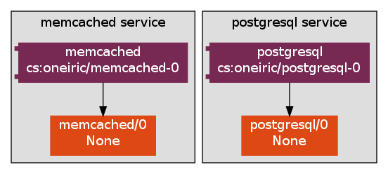
Deploy - Infrastructure Services
~/pycon-demo$ juju deploy postgresql
2012-06-29 12:46:08,814 INFO Searching for charm cs:oneiric/postgresql in charm store
2012-06-29 12:46:09,612 INFO Charm deployed as service: 'postgresql'
2012-06-29 12:46:09,612 INFO 'deploy' command finished successfully
~/pycon-demo$ juju deploy memcached
2012-06-29 12:46:16,594 INFO Searching for charm cs:oneiric/memcached in charm store
2012-06-29 12:46:20,079 INFO Charm deployed as service: 'memcached'
2012-06-29 12:46:20,079 INFO 'deploy' command finished successfully
Charm Store
Downloaded; cached
Notes:
Lets deploy some infrastructure services to support our summit application
Using the charm store we can just 'deploy' them – charms are automatically downloaded and pushed into Zookeeper and cached for subsequent use.
Service units get created using LXC and services are deployed by juju using the charms.

Slide 13
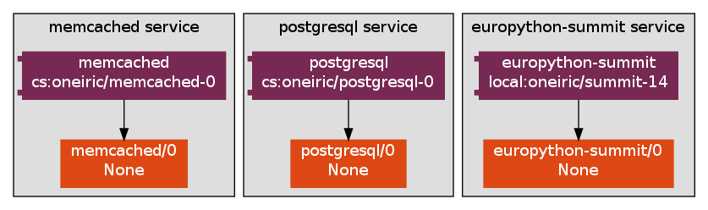
Deploy - Summit
~/pycon-demo$ juju deploy --config europython.yaml local:summit europython-summit
2012-06-29 12:49:06,407 INFO Searching for charm local:oneiric/summit in local charm repository: /home/jamespage/src/charms
2012-06-29 12:49:06,825 INFO Charm deployed as service: 'europython-summit'
2012-06-29 12:49:06,825 INFO 'deploy' command finished successfully
Local Charm
Configuration
Notes:
Next – summit
This charm is not in the store – its quite specific so does not have that much re-use potential yet
So we grab this from the local filesystem by using the local prefix for the charm name.
Lead into configuration on next slide....

Slide 14
Deploy - Summit
~/pycon-demo$ juju deploy --config europython.yaml local:summit europython-summit
2012-06-29 12:49:06,407 INFO Searching for charm local:oneiric/summit in local charm repository: /home/jamespage/src/charms
2012-06-29 12:49:06,825 INFO Charm deployed as service: 'europython-summit'
2012-06-29 12:49:06,825 INFO 'deploy' command finished successfully
~/pycon-demo$ cat europython.yaml
europython-summit:
service-hostname: europython.summit
app-source: lp:summit/production
app-source-type: bzr
app-source-package-name: summit
app-source-project-location: summit
app-theme-branch: https://code.launchpad.net/~lpc-organizers/ubuntu-community-webthemes/light-django-plumbers-theme
Local Charm
Configuration
Notes:
The charm configuration allows us to specialize the application as its deployed – in this example we tell the charm where to pull the code from and which them to use.
Juju supports most basic primitive types.

Slide 15
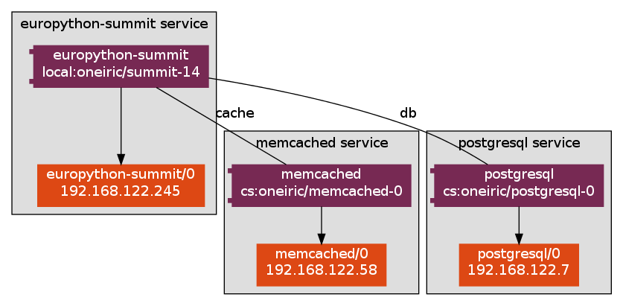
Relate
~/pycon-demo$ juju add-relation europython-summit postgresql:db
2012-06-29 12:53:51,364 INFO Added pgsql relation to all service units.
2012-06-29 12:53:51,365 INFO 'add_relation' command finished successfully
~/pycon-demo$ juju add-relation europython-summit memcached
2012-06-29 12:53:53,868 INFO Added memcache relation to all service units.
2012-06-29 12:53:53,869 INFO 'add_relation' command finished successfully
Hooks Fire!
Inter-service Configuration
Notes:
Now we are in a position to relate the services with each other.
As the relations are added hooks are fired in service participating the the relationship which allows the services to exchange information to support re-configuration.
These same hooks will fire if we add more units as well – for example we could scale up the memcached service – the summit service would be notified of these additional units once started through its hooks.

Slide 16
Expose
~/pycon-demo$ juju expose europython-summit
2012-06-29 12:59:54,905 INFO Service 'europython-summit' was exposed.
2012-06-29 12:59:54,905 INFO 'expose' command finished successfully
TCP/22 by default
Inter-service Configuration
'open-port'
Notes:
Final step is to actually expose the application
Although this does not have context with the local provider its pretty important – in cloud deployments by default the only port that is public ally accessible is the SSH port (which is use by juju for management).
Exposing the service allows your users to access it.
Charm authors can tell juju which ports to expose by using the open-port command in their charms.
Lead in to status display....

Slide 17
Expose
~/pycon-demo$ juju expose europython-summit
2012-06-29 12:59:54,905 INFO Service 'europython-summit' was exposed.
2012-06-29 12:59:54,905 INFO 'expose' command finished successfully
~/pycon-demo$ juju status europython-summit
machines:
0:
agent-state: running
dns-name: localhost
instance-id: local
instance-state: running
services:
europython-summit:
charm: local:oneiric/summit-14
exposed: true
relations:
cache:
- memcached
db:
- postgresql
units:
europython-summit/0:
agent-state: started
machine: 0
open-ports:
- 80/tcp
public-address: 192.168.122.245
2012-06-29 13:39:13,038 INFO 'status' command finished successfully
TCP/22 by default
Inter-service Configuration
'open-port'
Notes:
One deployed/running summit charm....
With the http port exposed....
However

Slide 18
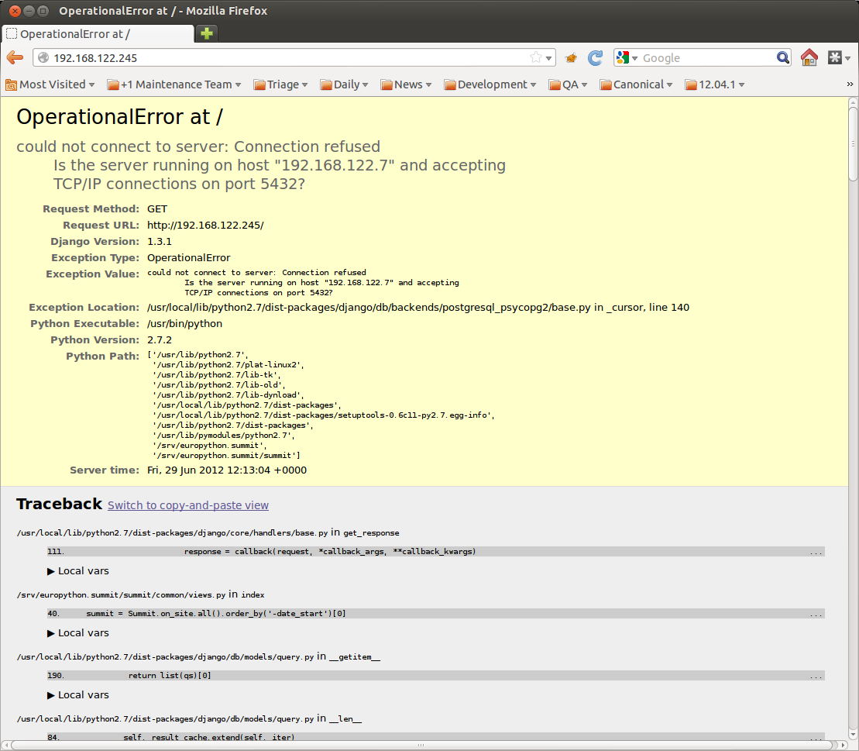
Expose
~/pycon-demo$ juju expose europython-summit
2012-06-29 12:59:54,905 INFO Service 'europython-summit' was exposed.
2012-06-29 12:59:54,905 INFO 'expose' command finished successfully
TCP/22 by default
Inter-service Configuration
'open-port'
Notes:
Its not working quite so well....

Slide 19
Debugging – 'juju debug-log'
~pycon-demo$ juju debug-log
[…]
File "/usr/local/lib/python2.7/dist-packages/django/db/models/query.py", line 1436, in insert_query
return query.get_compiler(using=using).execute_sql(return_id)
File "/usr/local/lib/python2.7/dist-packages/django/db/models/sql/compiler.py", line 791, in execute_sql
cursor = super(SQLInsertCompiler, self).execute_sql(None)
File "/usr/local/lib/python2.7/dist-packages/django/db/models/sql/compiler.py", line 734, in execute_sql
cursor = self.connection.cursor()
File "/usr/local/lib/python2.7/dist-packages/django/db/backends/__init__.py", line 250, in cursor
cursor = self.make_debug_cursor(self._cursor())
File "/usr/local/lib/python2.7/dist-packages/django/db/backends/postgresql_psycopg2/base.py", line 140, in _cursor
self.connection = Database.connect(**conn_params)
OperationalError: could not connect to server: Connection refused
Is the server running on host "192.168.122.7" and accepting
TCP/IP connections on port 5432?
2012-06-29 11:57:45,189: hook.output@INFO: >>> >>>
2012-06-29 11:57:45,427: unit.hook.api@DEBUG: opened 80/tcp
2012-06-29 11:57:45,494: hook.output@INFO: * Restarting web server apache2
2012-06-29 11:57:45,553: hook.output@ERROR: Warning: DocumentRoot [/srv/europython.summit/www/root] does not exist
apache2: Could not reliably determine the server's fully qualified domain name, using 127.0.0.1 for ServerName
2012-06-29 11:57:45,554: hook.output@INFO: ... waiting
2012-06-29 11:57:46,556: hook.output@INFO: .
2012-06-29 11:57:47,580: hook.output@ERROR: Warning: DocumentRoot [/srv/europython.summit/www/root] does not exist
2012-06-29 11:57:47,580: hook.output@ERROR: apache2: Could not reliably determine the server's fully qualified domain name, using 127.0.0.1 for ServerName
2012-06-29 11:57:47,587: hook.output@INFO: ...done.
2012-06-29 11:57:47,589: hook.output@DEBUG: hook db-relation-changed exited, exit code 0.
2012-06-29 11:57:47,668: hook.executor@DEBUG: Hook complete: /var/lib/juju/units/europython-summit-0/charm/hooks/db-relation-changed
2012-06-29 11:57:47,671: hook.executor@DEBUG: Running hook: /var/lib/juju/units/europython-summit-0/charm/hooks/cache-relation-changed
2012-06-29 11:57:48,353: hook.output@DEBUG: hook cache-relation-changed exited, exit code 0.
2012-06-29 11:57:48,405: hook.executor@DEBUG: Hook complete: /var/lib/juju/units/europython-summit-0/charm/hooks/cache-relation-changed
Notes:
Fortunately juju provides some tools to help diagnose issues with charms
First is the debug-log.
This allows you to monitor hook execution and other agent activity within a juju environment – useful for identifying hook failures

Slide 20
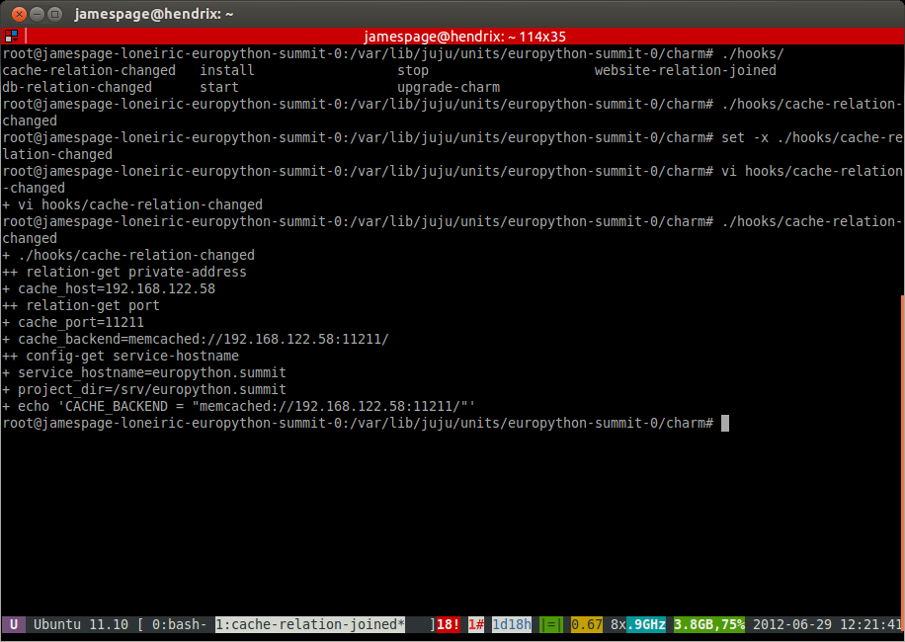
Debugging – 'juju debug-hooks'
Notes:
Which you can then debug with the debug-hooks command which allows you to intercept hook executions and run them manually/fix them up etc...

Slide 21
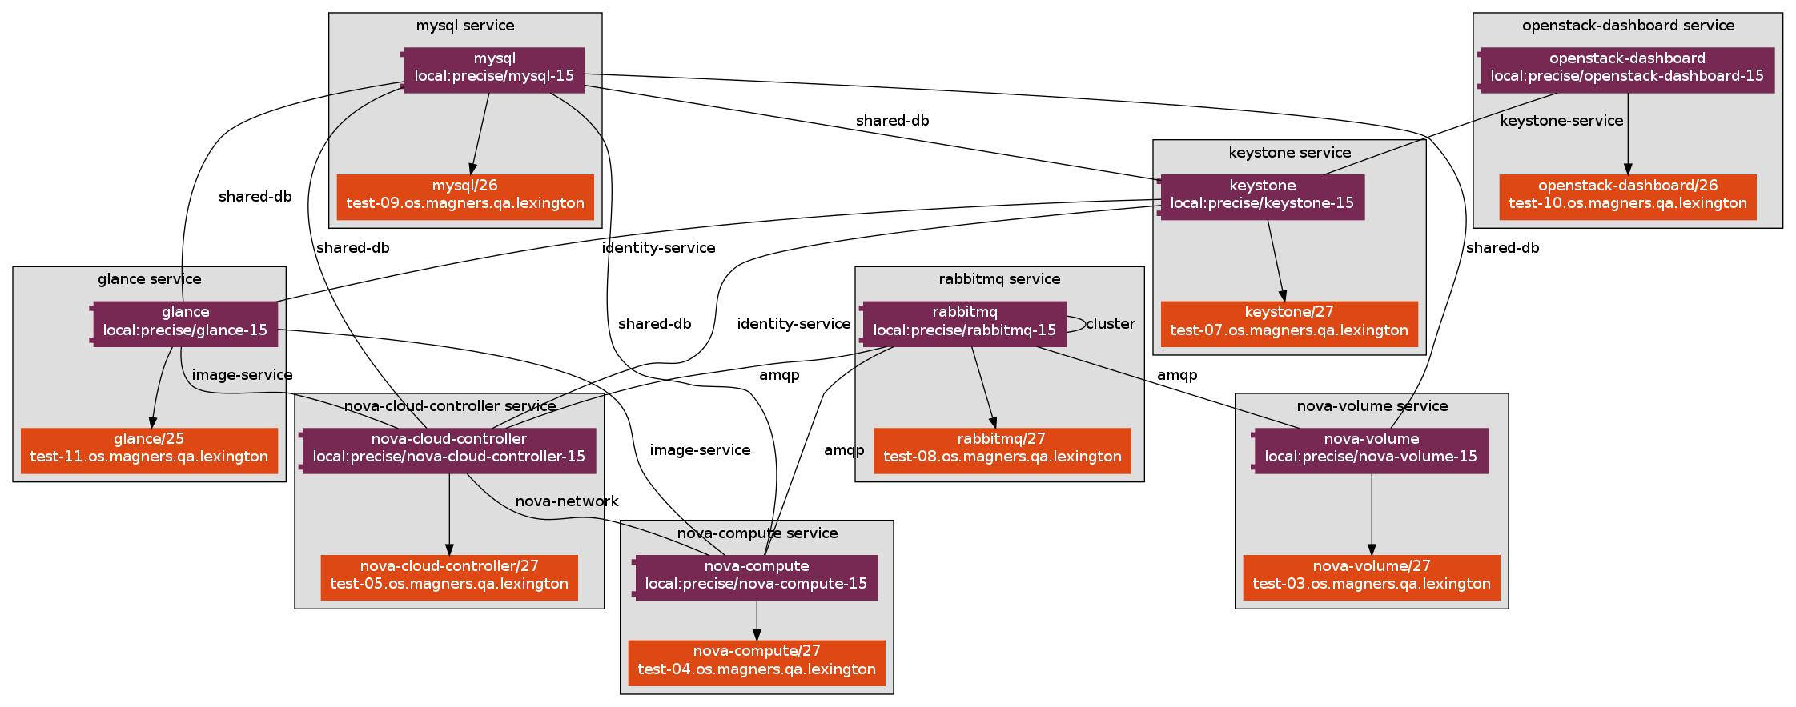
Taking this further....
http://tinyurl.com/juju-openstack
Notes:
Juju can manage complex deployments
Ubuntu Server Team → Openstack Charms → MaaS → Per commit testing on hardware.

Slide 22
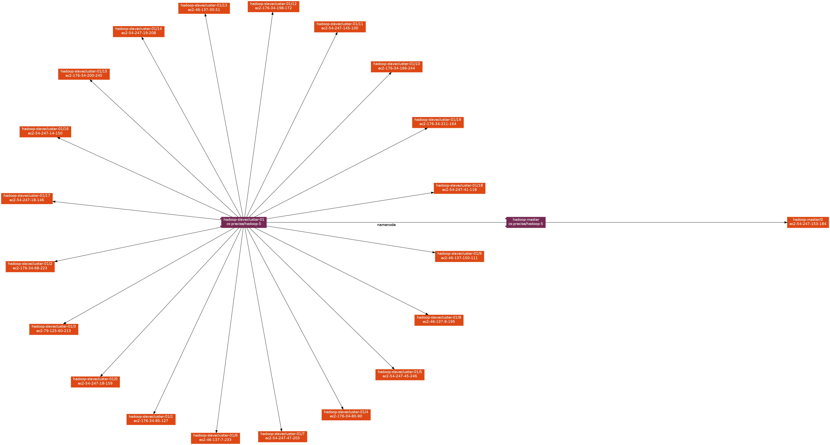
And even further...
http://tinyurl.com/juju-at-scale
Notes:
Juju can management large environments.
Hadoop – simple but BIG scale-out.
Tested to 2000 nodes in ec2 using Juju.

Slide 23
Summary
Sand boxed testing
Developer tooling
Repeatable deployment
Repeatable scale up/down
Repeatable complexity
Switching provider; easy...
jamespage on Freenode IRC
#juju
Thanks for Listening!
Notes:
Juju provides a great sandboxed environment using LXC for developing and testing charms – can also be used for trying charms before you deploy them into a cloud or onto hardware.
Developer tooling is good and really helps diagnose and fix charm issues.
By distilling DevOps knowledge early you get repeatable deployments with repeatable scale-up/down which developers can actually test themselves.
Switching provider after development is easy due to the abstractions provided by Juju through Charms.
You can find me.....

