Slide 1

Global Trade
Jose Mejia
Julian Wilson
Maria Soares
Miraj Patel
Skyllar Baron
Umair Ali
Walter Gonzalez

Slide 2
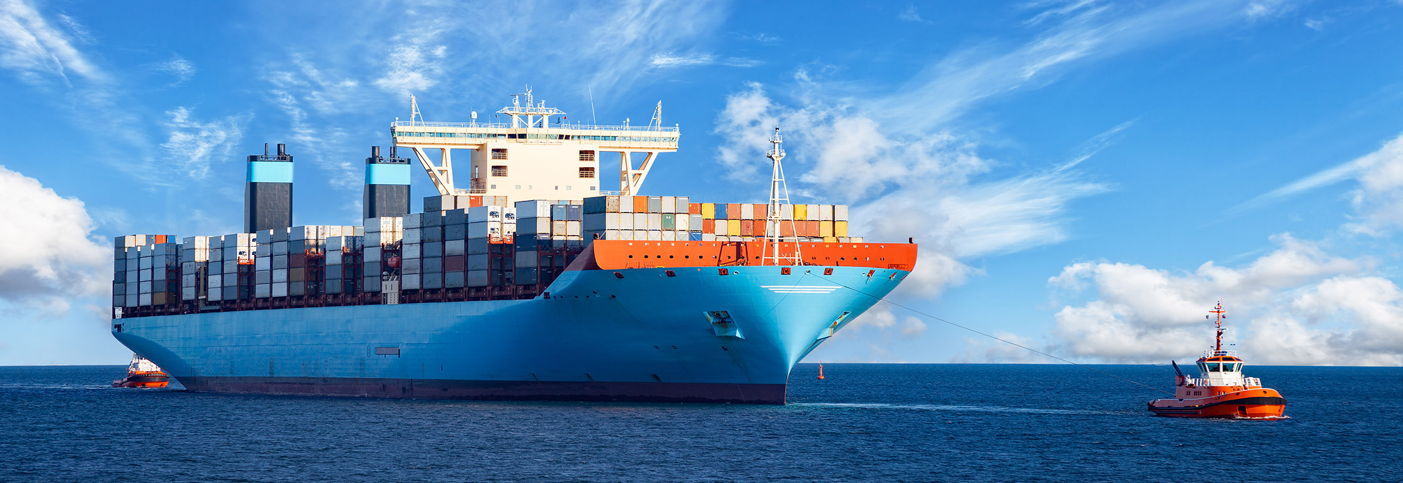
Elevator pitch
Concept
Process
Direction for Future Development
Links
Demo

Slide 3


Concept
Description :
Global Trade is a Single Page E-commerce Web Application. It allows user to search for
products based on categories, add product to the cart and process credit card payment.
Motivation for development :
Curiosity and the urge of creating e-commerce website with the knowledge gained in
bootcamp
User story :
Students from bootcamp were put together to work on a project.
While working together they realized that the Information they have learned in this project is a well supporting to move their career in Web Development Business.
With all that had work they had put in bootcamp and with a hope to achieve something on their own in the coming future, they decided to open their IT company.
After bootcamp completed, they all took few months of break and collected Information on establishing an LLC and doing new business start-up.

Slide 4
Process
Tasks & Roles
Jose, Julian, Walter – Developed Back End
Miraj, Umair, Maria – Footer and Sidebar Items
Jose, Skyllar – Main Layout Functionality and Sign in/Sign Up Functionality
Julian, Walter – Added World Map and Sidebars Routes
Challenges
- Communicating in a group of 7 and splitting work
- Late night zoom meetings and helping each other with feedback or making changes in code
Success
- Learning from each-other is
something we can count as success
- Creating functional Single Page application in 1-2 weeks of short period
Technologies Used
- HTML
- CSS
- Javascript
- MongoDB Database
- Express.js
- React
- Node
- Apollo Client
- Apollo Server
- Material UI
- graphQL
- Mongoose
- Json Web Token
- Semantic UI

Slide 5

Directions for Future Development
Adding
Admin setup
Adding
User Profile interface
Adding
Live-chat feature

Slide 6


Links
heroku Link : Global-Trade Live !!
GitHub repo : Global-Trade

Slide 7

All the Pictures used in this presentation and project are from public source.
We do not claim any ownership of any digital picture.
The sole intention is to use it for learning purpose only.

Slide 8

Demo
Global Trade

Slide 9
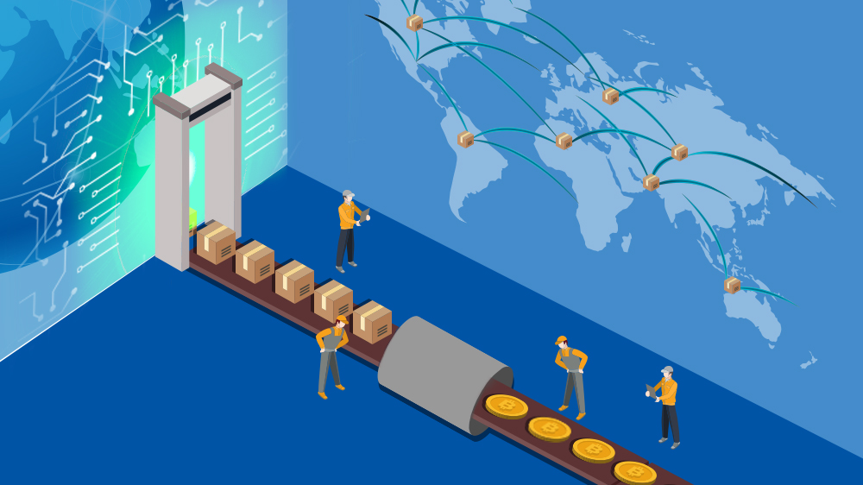

Questions ??

