Slide 1
OpenCL project accelerating defocus magnification
B00901016簡邦宇
B00901018張宇方
B00901072蕭瑋琳

Slide 2
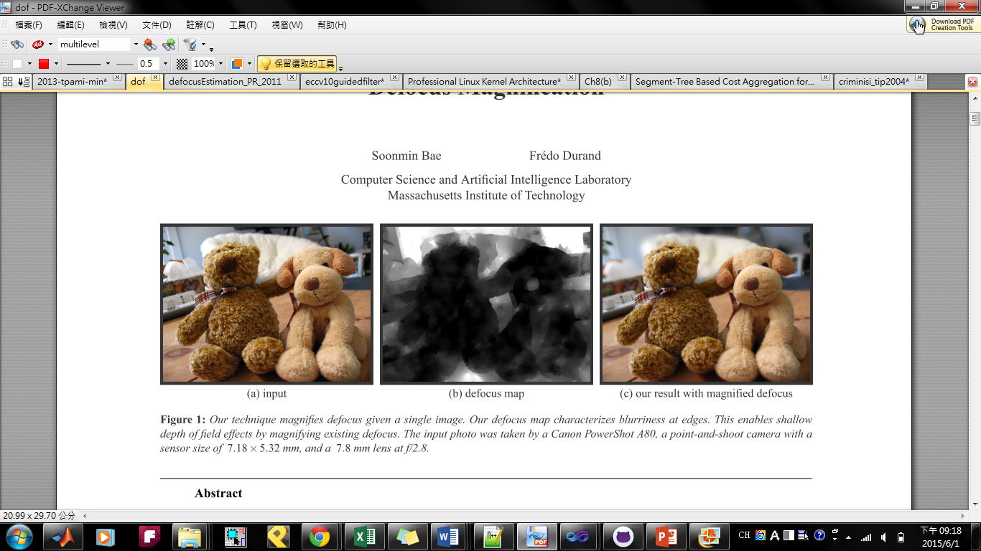
introduction
What is defocus magnification?

Slide 3
introduction
What is defocus magnification?
Estimate amount of blur

Slide 4
introduction
What is defocus magnification?
Increase defocus

Slide 5
reference
Local Scale Control for Edge Detection and Blur Estimation
James H. Elder, Member, IEEE , and Steven W. Zucker, Fellow, IEEE
IEEE TRANSACTIONS ON PATTERN ANALYSIS AND MACHINE INTELLIGENCE, VOL. 20, NO. 7, JULY 1998
Defocus Map Estimation from a Single Image
Shaojie Zhuo Terence Sim
Pattern Recognition, volume 44, number 9, pages 1852-1858, 2011

Slide 6
Bottleneck of defocus magnification
1. Detect blurred edges and estimate their scale of blur
2. Propagate the blur measures on the edges to the rest of the image to create a defocus map
Image filtering, vector scaling/addition/subtraction/inner-product/…
=> (measure time….)
3. Use the defocus map as a depth map to magnify blur
Our Goal
Use OpenCL to accelerate:
Image filtering, vector scaling/addition/subtraction/inner-product…

Slide 7
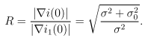
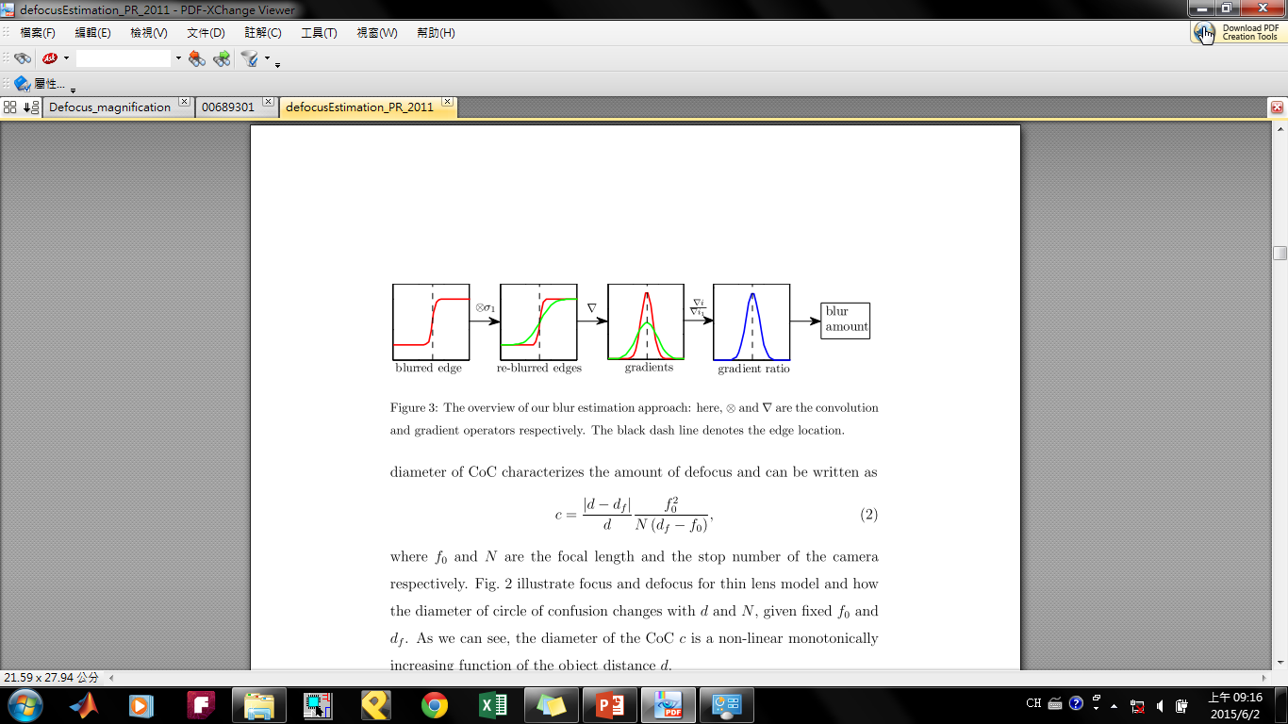
What we have done
1. Detect blurred edges and estimate their scale of blur
Blurred edge i(x) = f(x) convolute gaussain(x, σ), σ= kc
c: diameter of circle of confusion, k: blur amount
An edge modeled as a step function in intensity
Blur at the edge modeled as Gaussian blurring kernel
Reblur the edges and find the ratio between the gradient magnitude of the step edge and its reblurred version
The ratio is maximum at the edge location

Slide 8
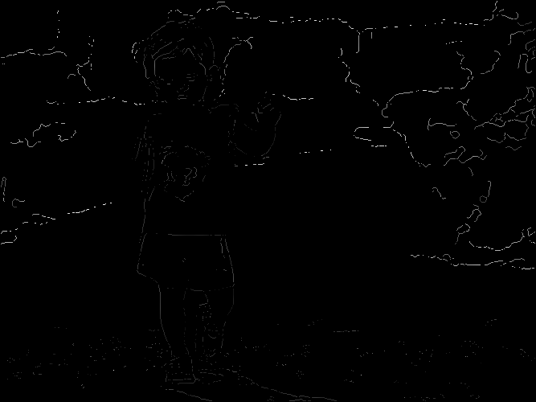
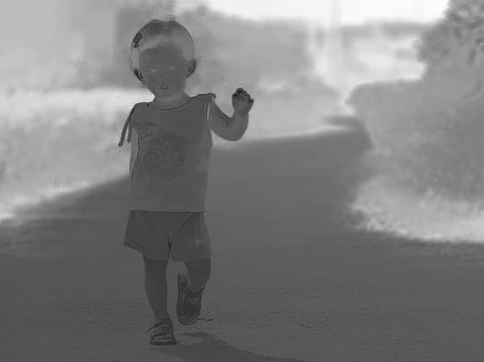
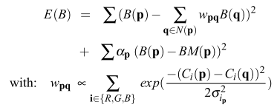
What we have done
2. Propagate the blur measures on the edges to the rest of the image to create a defocus map
So far, we only have blur measures for edges only
We need to propagate these values to the remaining regions of the image
Assumption: amount of defocus is smooth when intensity and color are smooth
Can be solved as an optimization problem:
BM(p): blur measure for edges
B(p): blur estimation

Slide 9
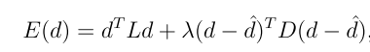
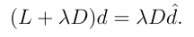
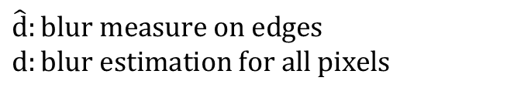

What we have done
2. Propagate the blur measures on the edges to the rest of the image to create a defocus map
$$\hat{d}:blur measure on edges$$
$$d:blur estimation for all pixels$$
λ : balancing between smoothness & data
L : Matting Laplacian matrix
D: a diagonal matrix,
$$\left\{\begin{aligned}1, D_{ii} is on the edge location \\ 0, otherwise\end{aligned}\right.$$

Slide 10
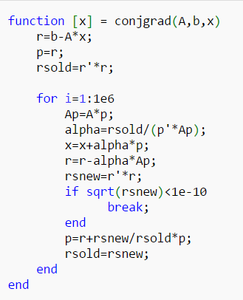
What we have done
2. Propagate the blur measures on the edges to the rest of the image to create a defocus map
Solve by conjugate gradient method:

Slide 11
What we are going to do
Implement this problem with OpenCl
Comparison of the amount of time each step spent w/ & w/o OpenCl
Apply our project to real image defocus magnification

