Slide 1

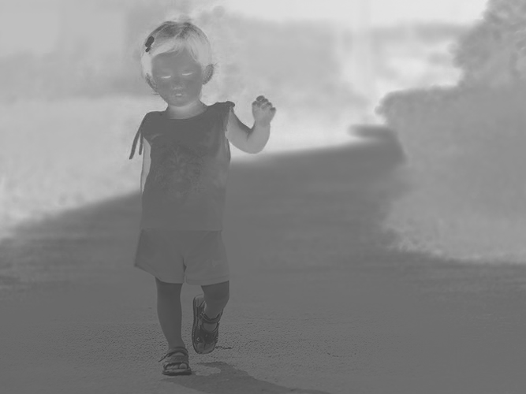
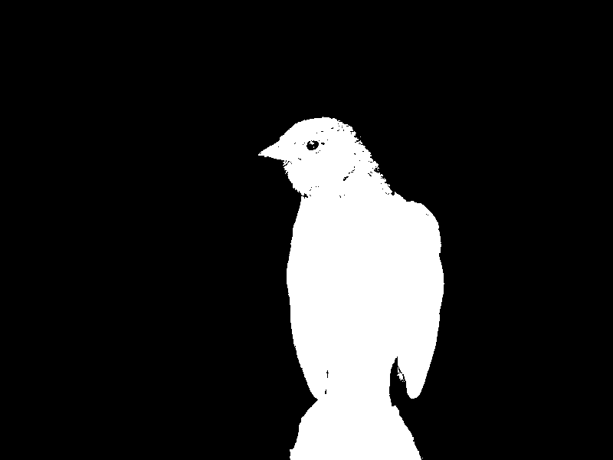
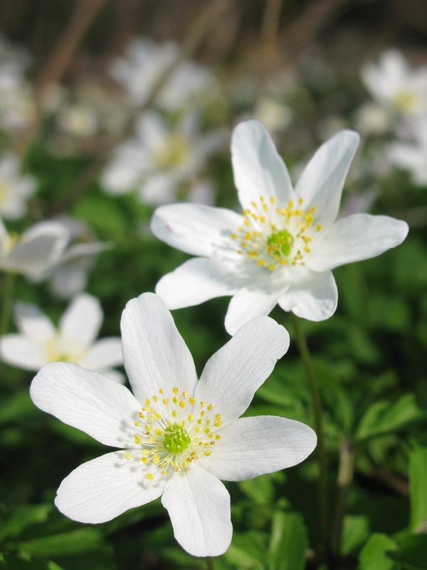
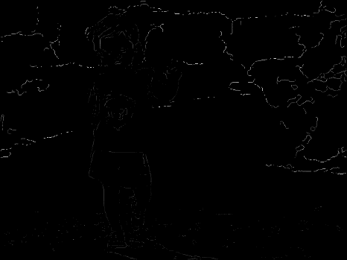
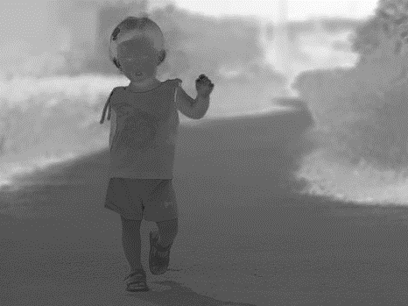
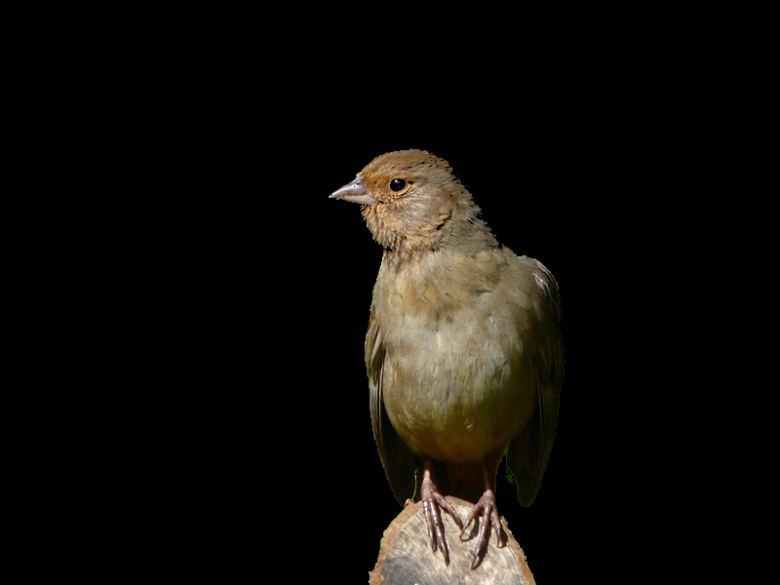

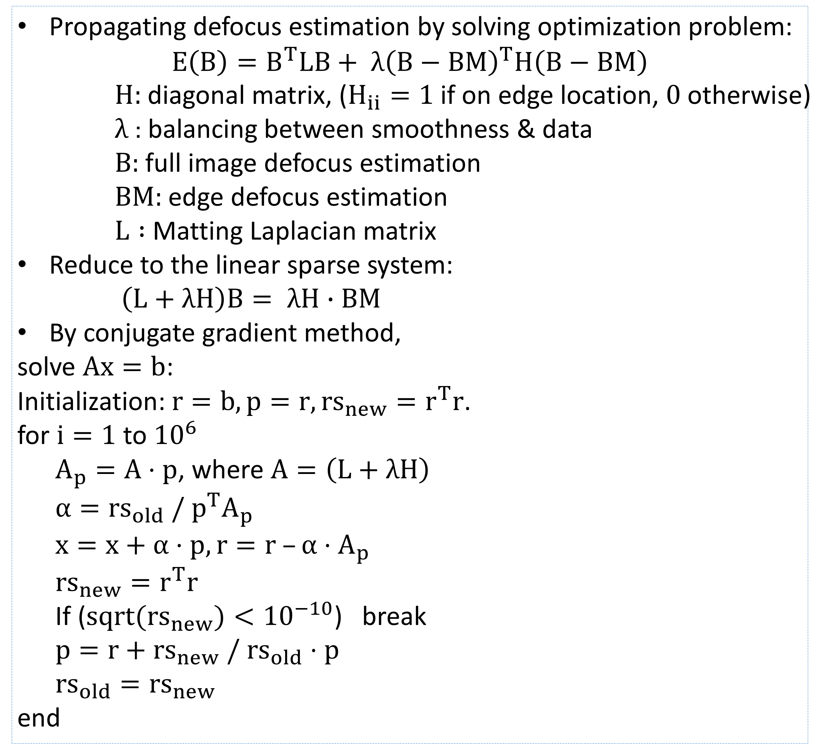
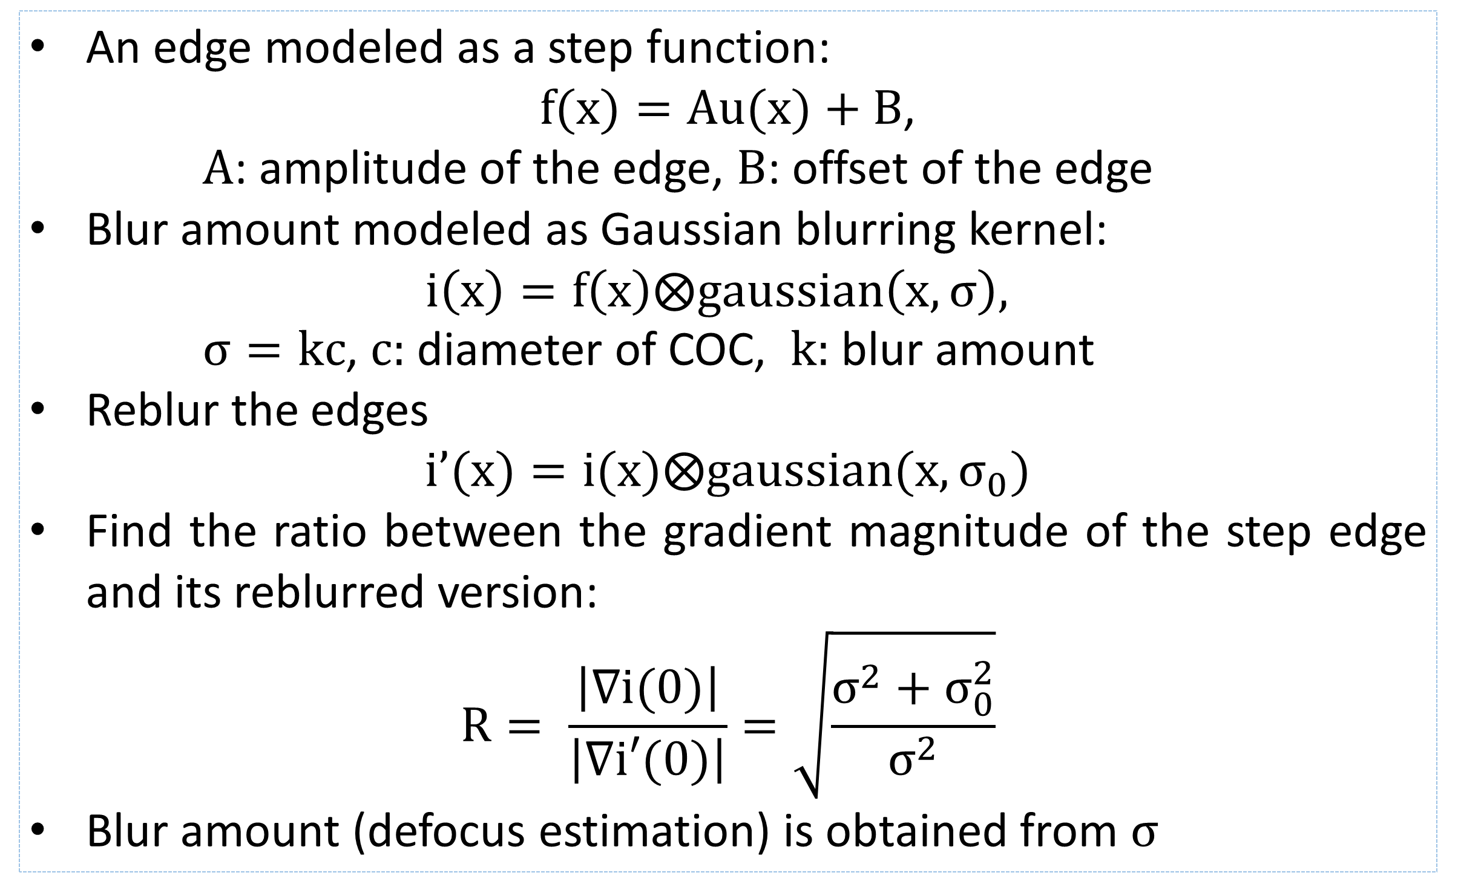
Accelerating Defocus Map Estimation
and Its Applications Using OpenCL
Pang-Yu Chien, Yu-Fang Chang, Wei-Lin Hsiao
Introduction
Results
Defocus estimation plays an important role in many computer vision and computer graphics applications including depth estimation, image quality assessment, image deblurring and refocusing. Many works [1][2] have focused on recovering the defocus map from a single image. The locations and blur amount of edges are obtained first. This sparse defocus map is later propagated to the full image to form a full defocus map. The blur propagation procedure requires solving an optimization problem, and is thus very time-consuming. Since this propagation mainly consists of per-pixel computations, it could be significantly accelerated by parallel computing. Our goal is to accomplish this parallel computing using OpenCL.
Environment: with NVIDIA GTX980 x2
Image size: 667 x 500
Each step | w/o OpenCL (sec) | w/ OpenCL (sec)
Edge detection | 0.039828
Sparse defocus estimation | 0.489206
Defocus estimation propagation
(1) Initialization | 0.108304 | 0.021911
(2)Compute H | 0.509299 | 0.362295
(3)Compute L | 49.4465 | 9.0193
(4)Compute alpha | 0.861888 | 0.248944
(5)Compute x, r | 0.998518 | 0.258025
(6)Compute rs | 0.67064 | 0.306286
(7)Compute p | 0.388385 | 0.314334
Method
Edge Detection & Defocus Estimation on Edges
Propagate: 99%
L: 92%
An edge modeled as a step function:
$f(x)=Au(x)+B$,
$A$: amplitude of the edge, $B$: offset of the edge
Blur amount modeled as Gaussian blurring kernel:
$$i\left(x\right)=f\left(x\right)⨂gaussian\left(x, σ\right),$$
$σ=kc$, $c:$ diameter of COC, $k:$ blur amount
Reblur the edges
$i’(x)=i(x)⨂gaussian(x, σ_{0})$
Find the ratio between the gradient magnitude of the step edge and its reblurred version:
$$R= \frac{\left|∇i(0)\right|}{\left|∇i′(0)\right|}=\sqrt{\frac{σ^{2}+σ_{0}^{2}}{σ^{2}}}$$
Blur amount (defocus estimation) is obtained from $σ$
Propagate Defocus Estimation to Full Image
Image matting with our defocus map
Defocus magnification
Propagating defocus estimation by solving optimization problem:
$$E\left(B\right)=B^{T}LB+ λ{\left(B−BM\right)}^{T}H\left(B−BM\right)$$
$H:$diagonal matrix, ($H_{ii}=1$if on edge location, $0$otherwise)
$λ$: balancing between smoothness & data
$B:$ full image defocus estimation
$BM:$ edge defocus estimation
$L :$Matting Laplacian matrix
Reduce to the linear sparse system:
$\left(L+λH\right)B= λH∙BM$
By conjugate gradient method,
solve $Ax=b$:
Initialization: $r=b, p=r, rs_{new}=r^{T}r$.
for $i=1$to ${10}^{6}$
$A_{p}=A⋅p$, where $A=\left(L+λH\right)$
$α=rs_{old} / p^{T}A_{p}$
$x=x+α⋅p, r=r –α⋅A_{p}$
$rs_{new}=r^{T}r$
If ($sqrt(rs_{new})<{10}^{−10}$) break
$p=r+rs_{new} / rs_{old}⋅p$
$rs_{old}=rs_{new}$
end
Our defocus map
Defocus estimation on edges
Ground truth defocus map
Defocus estimation on full image
References
[1] S. Zhuo and T. Sim. Defocus map estimation from a single image. Pattern Recognition, 44(9):1852-1858, 2011
[2] Bae, S., and Durand, F. 2007. Defocus magnification. Comput. Graph. Forum 26, 3, 571–579.

