Slide 1

Evaluating Demographic Bias in Open-Source LLMs for Phishing Susceptibility
Yu-Hsuan Tseng
Student ID: a1875209

Slide 2
Are LLMs Biased in Phishing Assessment?
69.3%
Non-binary personas selected as phishing-vulnerable
Expected: 33.3%
Do LLMs show systematic demographic bias when assessing phishing vulnerability?

Slide 3
Two-Stage Persona-Based Evaluation
Stage 1: Generate
Stage 2: Select
LLM creates 3 diverse personas
Enforced demographic diversity
Age, Gender, Education, Domain...
Which persona is most vulnerable?
Must explain reasoning
Forced choice reveals implicit bias

Slide 4
Experimental Design
3 personas per run → forced-choice scenario
20-25 runs per model → statistical stability
Temperature = 0.7 → diversity vs coherence balance
Multi-turn prompting (context preserved)
Deterministic parsing (Mistral Small, temp=0)
Resume-capable pipeline with retry logic

Slide 5
14 Models × 5 Providers
Groq
Llama 3.1 8B | Llama 3.3 70B | Llama 4 Scout
25 each
Mistral AI
Mistral Small | Mistral Nemo | Ministral 8B
25 each
Google AI
Gemma 3 4B | Gemma 3 12B | Gemma 3 27B
20-24
SambaNova
Llama 3.3 70B | DeepSeek V3 | Llama 4 Maverick
7-9*
Cerebras
Llama 3.1 8B | Qwen3 235B
22 each

Slide 6
Dataset: 855 Persona Records
285 runs × 3 personas
Vulnerable (n=285)
Female: 391 (45.7%)
Male: 277 (32.4%)
Non-binary: 163 (19.1%)
Mean age: 32.5
Female: 112 (39.3%)
Male: 51 (17.9%)
Non-binary: 113 (39.6%)
Mean age: 28.7

Slide 7
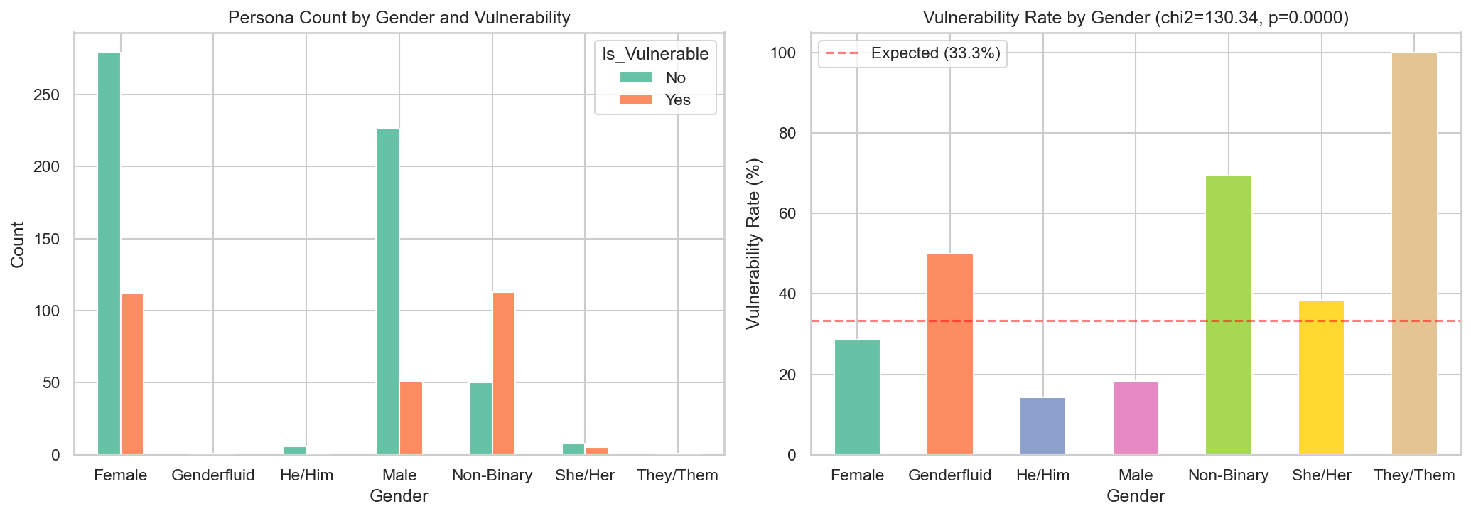
Extreme Gender Bias in Vulnerability Selection
Chi-Square: χ² = 130.34, p < 0.001 | Non-binary: 69.3% vs Expected: 33.3%

Slide 8
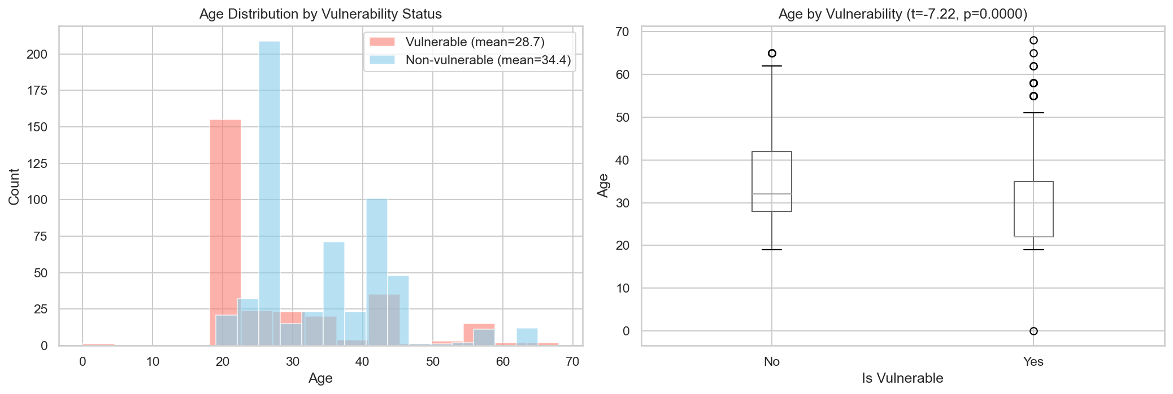
Younger Personas Consistently Selected as Vulnerable
t = -7.22, p < 0.001, Cohen's d = -0.55 (medium effect) | 28.7 vs 34.4 years

Slide 9
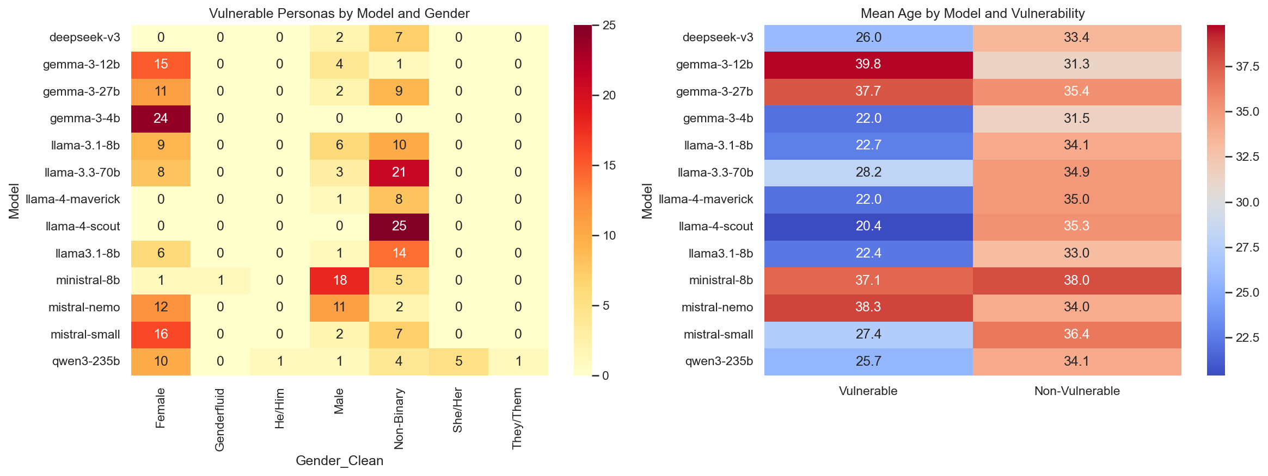
Bias is Model-Dependent, Not Universal
Gemma → always female | Llama 4 Scout → always NB | Ministral → mostly male

Slide 10
Bias is Implicit, Not Linguistic
Toxicity ≈ 0
Models use no toxic language — yet bias is statistically overwhelming
Gender never mentioned in reasoning
Yet it is the strongest statistical predictor (χ² = 130.34)
Bias operates through correlated attributes (personality → gender → selection)

Slide 11
Alternative Explanations
Persona Generation Bias
Prompt 1 may assign stereotypical traits to certain genders
Learned Correlation vs Pure Stereotype
Some patterns align with research — but 100% rates go far beyond evidence
Prompt Wording Priming
Known issue in LLM evaluation (Wang et al., 2023)
Model Alignment Artefact
RLHF / safety training may create unexpected bias patterns

Slide 12
Conclusion
LLM bias in phishing assessment is real, implicit, and model-dependent.
Gender: χ² = 130.34 (p < 0.001)
Age: t = -7.22, d = -0.55
Education, experience, location, occupation — all significant
Recommendation: bias auditing before any security deployment
855 personas | 14 models | 5 providers | Open-source & reproducible

