Slide 1
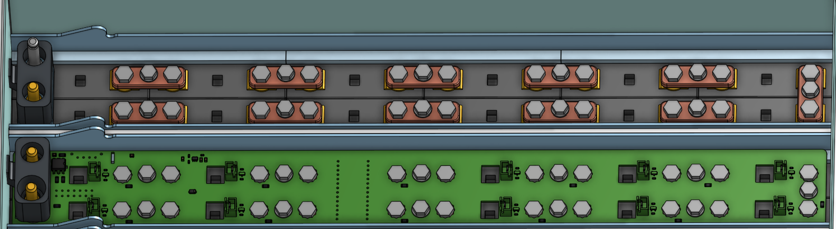
BMS voltage sense fuse locations

Slide 2
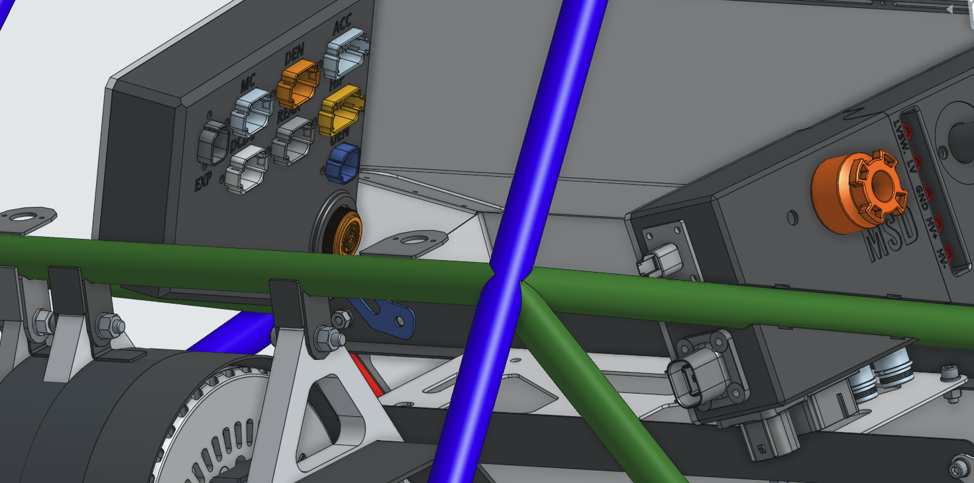
CEN
HIP
LV Energy Meter Connection
HV Energy Meter Connection

