Slide 1
INDEPENDENT MARKET ANALYSIS · MID-2026
The No-Code
Agent Builder Market
A two-axis independent scoring of 27 enterprise vendors — who leads, who disrupts, and why the no-code persona decides the standings.
Market Shapers
Pace Setters
Pioneers
Specialists
Jukka Niiranen Power Platform Advisor & Owner
June 2026 · Source: Claude Fable 5 Research · vibes.jukkan.com/ncab-quadrant.html

Slide 2
ORIENTATION
How to read this report
Independent, not a reprint
EVIDENCE GRADING
Original scoring calibrated in June 2026. It does not reproduce Gartner's or Forrester's placements — it is a transparent, evidence-graded point of view.
Earnings-grade
SEC filings & earnings calls. Microsoft org counts, Salesforce Agentforce ARR / deal counts.
Scored for one persona
Highest trust
Every score targets the no-code / business-user buyer. Developer-first strength (AWS AgentCore, Vertex ADK, SAP's pro-code tooling) is deliberately discounted.
Disclosed / investor
Company press releases, funding rounds, investor letters. Glean ARR, challenger valuations.
Use with care
Evidence is graded, not assumed
Vendor marketing
Headline adoption numbers are flagged by source quality. Earnings filings outrank press releases, which outrank marketing claims.
“Tens of thousands of customers,” “millions of agents,” MAU counts — unaudited and directional only.
Treat as claim
THE NO-CODE AGENT BUILDER MARKET · INDEPENDENT ANALYSIS, MID-2026
02

Slide 3
EXECUTIVE SUMMARY
Incumbents who pair distribution with consumption pricing lead the market
Microsoft and Salesforce sit highest on execution; with Google and ServiceNow they form the “Market Shapers” who set the agenda. The most disruptive innovation comes from AI-native challengers — but they lack the install base, governance, and channel to match on execution.
THE BEST-SOURCED STORY IN THE CATEGORY
Two leaders are quantitatively validated by earnings disclosures — everyone else is reacting to them.
01
02
03
04
Distribution beats novelty
Governance is table stakes
Pricing is going consumption
Persona is decisive
Agents win where employees already work — Teams, Slack, the CRM, the ServiceNow portal — not where they are smartest.
The entire 2026 product cycle is about agent inventory, permissions, evaluation and cost control — “shadow agents” is the top CIO fear.
Per-seat licensing is being displaced by per-action / per-credit / per-outcome models — flexible, but with real bill-shock risk.
Scoring the business-user buyer rewards Microsoft, Salesforce, ServiceNow & Atlassian and discounts developer-first platforms.
THE NO-CODE AGENT BUILDER MARKET · INDEPENDENT ANALYSIS, MID-2026
03

Slide 4
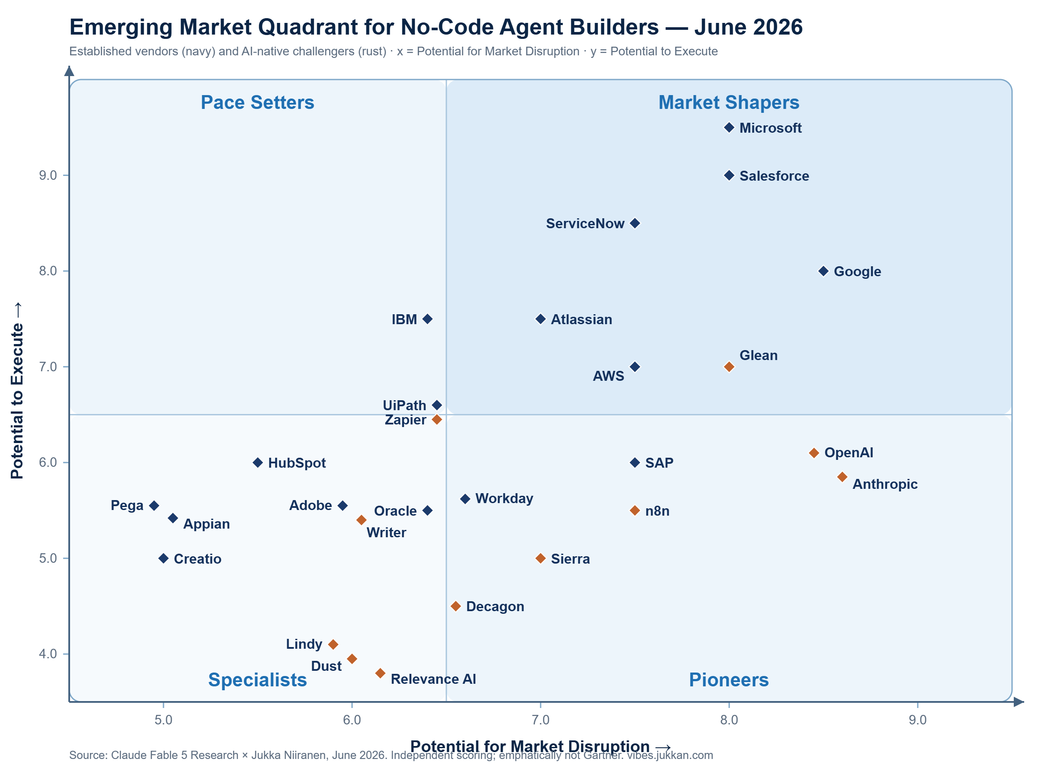
THE 2026 MARKET MAP
Twenty-seven vendors, two axes, four quadrants
7
Market Shapers
High execute · high disrupt. Microsoft, Salesforce, Google, ServiceNow set the pace; Atlassian, AWS & Glean ride the border.
4
Pace Setters
High execute · lower disrupt. IBM, SAP, UiPath, Oracle — strong delivery, repositioning rather than redefining.
10
Pioneers
Lower execute · high disrupt. OpenAI, Anthropic, n8n, Sierra — the innovation edge, gated by install base & governance.
6
Specialists
Lower execute · lower disrupt. HubSpot, Adobe, Pega, Appian — deep in a niche, narrow on general business-user agents.
Axis convention: x = Potential for Market Disruption · y = Potential to Execute. Threshold ≈ 6.5 on each axis.
THE NO-CODE AGENT BUILDER MARKET · INDEPENDENT ANALYSIS, MID-2026
04

Slide 5
SCORING METHODOLOGY
What each axis measures
Y · Potential to Execute
EXECUTE →
Pace Setters
Market Shapers
Can a business user ship a governed agent today?
Enterprise install base & distribution
Governance / security / admin depth
Pricing clarity & connector ecosystem
Partner network & financial resources
Evidence of business-user agents in production
Specialists
Pioneers
X · Potential for Market Disruption
How fast is it redefining how agents get built?
Pace of innovation & novel capabilities
Autonomous / multi-agent orchestration, computer use
MCP / A2A interoperability
Pricing-model disruption
Developer & community momentum, mindshare
DISRUPTION →
Threshold ≈ 6.5 / 10 on each axis. Scores are calibrated to the no-code business-user persona — pure pro-code strength does not transfer.
THE NO-CODE AGENT BUILDER MARKET · INDEPENDENT ANALYSIS, MID-2026
05

Slide 6
MARKET SHAPERS
The four who set the agenda
Highest execution paired with high disruption. These four combine the largest install bases with the most aggressive consumption pricing — everyone else reacts to them.
Microsoft
Salesforce
Google
ServiceNow
Copilot Studio · Agent 365
Agentforce · Agent Builder
Gemini Enterprise · Agent Designer
Now Assist · Otto
230,000+ orgs
$1.2B ARR
200+ models
~$1.5B ACV
Execute / Disrupt 9.5 / 8.0
Execute / Disrupt 9.0 / 8.0
Execute / Disrupt 8.0 / 8.5
Execute / Disrupt 8.5 / 7.5
Deepest distribution + governance; Copilot Credits consumption.
CRM data moat + Slack; Flex Credits; +205% YoY growth.
Biggest 2026 platform move; frontier-model pace tops disruption.
Control-tower narrative; Moveworks front door; sticky in IT/HR.
Borderline Shapers: Atlassian (Rovo), AWS (Bedrock AgentCore / Quick Suite) and Glean ride the threshold — strong, but each gated on the strict no-code lens.
THE NO-CODE AGENT BUILDER MARKET · INDEPENDENT ANALYSIS, MID-2026
06

Slide 7
MARKET SHAPER · EXECUTE 9.5 / DISRUPT 8.0
Microsoft — the default the others react to
Copilot Studio · Agent 365 · Power Platform
230,000+
~90%
$0.01
$15 / $99
organizations on Copilot Studio
of the Fortune 500 with active low-code agents
per Copilot Credit · $200/mo = 25,000 credits
Agent 365 per user · E7 “Frontier” suite
Why it leads
Copilot Studio — Agent Builder
Deepest governance estate — Agent 365 reached GA on May 1, 2026 ($15/user/mo) with identity, inventory and cost controls.
Consumption pricing by default — moved from per-message to Copilot Credits; credit consumption up nearly 2x quarter-over-quarter.
Computer-use agents reached GA in May 2026, extending reach beyond connectors.
Disruption is capped at 8.0 only because Microsoft is the incumbent others position against.
“Describe what this agent should do…”
Trigger
→
Knowledge
→
Action
◉ Governed by the admin control plane — identity, permissions, cost & audit
THE NO-CODE AGENT BUILDER MARKET · INDEPENDENT ANALYSIS, MID-2026
07

Slide 8
MARKET SHAPER · EXECUTE 9.0 / DISRUPT 8.0
Salesforce — the best-sourced growth story
Agentforce · Agent Builder · Agentforce Command Center
$1.2B
+205%
29,000+
3.8B
Agentforce ARR (Q1 FY27 8-K)
year-over-year ARR growth
Agentforce deals closed
Agentic Work Units, +111% Q/Q
Why it leads
Agentforce — Agent Builder
A CRM data moat plus Slack distribution puts agents inside the system of record sellers and service reps already use.
Aggressive Flex Credits consumption ($500 / 100,000 credits; ~$0.10 per action) plus a $2/conversation option.
ARR and deal counts come from an 8-K filing — the most rigorously sourced adoption story alongside Microsoft.
Friction: pricing complexity and a Data Cloud dependency raise the cost of entry.
“Describe what this agent should do…”
Trigger
→
Knowledge
→
Action
◉ Governed by the admin control plane — identity, permissions, cost & audit
THE NO-CODE AGENT BUILDER MARKET · INDEPENDENT ANALYSIS, MID-2026
08

Slide 9
MARKET SHAPERS · DEEP DIVE
Google & ServiceNow — the other two shapers
Google
8.0 / 8.5
ServiceNow
8.5 / 7.5
Gemini Enterprise Agent Platform · Agent Designer
Now Assist · AI Agent Studio · Otto
Biggest platform move of 2026
The control-tower narrative
Rebranded Vertex AI to the Gemini Enterprise Agent Platform at Cloud Next '26 (Apr 22).
Now Assist tracking toward $1.5B 2026 ACV, up from a prior $1B target.
No-code for business users
A conversational front door
Agent Designer ships inside the Gemini Enterprise app; 200+ models including Anthropic's Claude.
Closed the $2.85B Moveworks acquisition (Dec 15, 2025); rebranded the combined stack as Otto.
Open & funded
Governed by design
Production A2A protocol, Workspace distribution, and a $750M partner fund.
AI Control Tower governs the estate; natural-language building in AI Agent Studio.
The caveat
The caveat
Frontier-model pace tops disruption; business-user execution is younger than Microsoft's.
Workflow-centric and extremely sticky in IT/HR/CS — but bounded to that gravity.
THE NO-CODE AGENT BUILDER MARKET · INDEPENDENT ANALYSIS, MID-2026
09

Slide 10



MARKET DYNAMICS
Three forces shaping the market
01
02
03
Distribution beats novelty
Governance is table stakes
Pricing converges on consumption
Incumbents win not because their agents are smartest, but because agents surface where employees already work — Teams, Outlook, Slack, the CRM, the ServiceNow portal. Internal-software adoption is a distribution problem masquerading as a training problem.
“Agent sprawl” and “shadow agents” are the dominant CIO anxiety. The entire 2026 product cycle — Agent 365, AI Control Tower, Glean Protect, watsonx control plane — is about inventory, permissions, evaluation and cost forecasting.
Per-seat licensing is giving way to per-action / credit / conversation / outcome models — flexibility plus “bill shock” risk, which itself spawned new tooling (Microsoft's usage estimator, Salesforce's Digital Wallet).
THE NO-CODE AGENT BUILDER MARKET · INDEPENDENT ANALYSIS, MID-2026
10

Slide 11
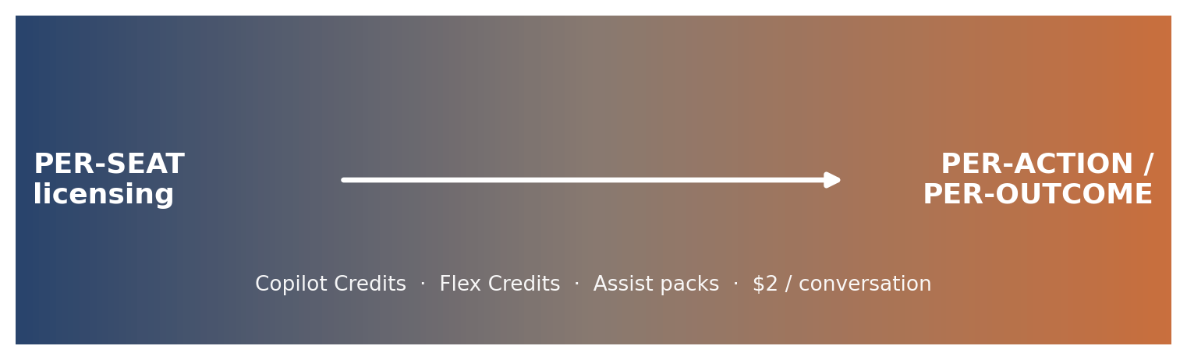
THE PRICING REVOLUTION
Per-seat is being structurally displaced
THE SINGLE BIGGEST COST LEVER
$0.01 PAYG per credit
vs.
$200/mo capacity pack
Vendor | Consumption model
Microsoft | Copilot Credits — $0.01 / credit; $200/mo = 25,000 credits
Salesforce | Flex Credits — $500 / 100,000; ~$0.10 / action; or $2 / conversation
ServiceNow | Consumption “Assist packs”
Google · AWS · IBM | Usage- / MAU-based metering
Real-world adoption routinely overshoots forecasts.
Budget for 1.5–3x projected volume, then pre-commit capacity once you have 30 days of actual usage.
The dynamic a Power Platform licensing expert will scrutinize most.
THE NO-CODE AGENT BUILDER MARKET · INDEPENDENT ANALYSIS, MID-2026
11

Slide 12
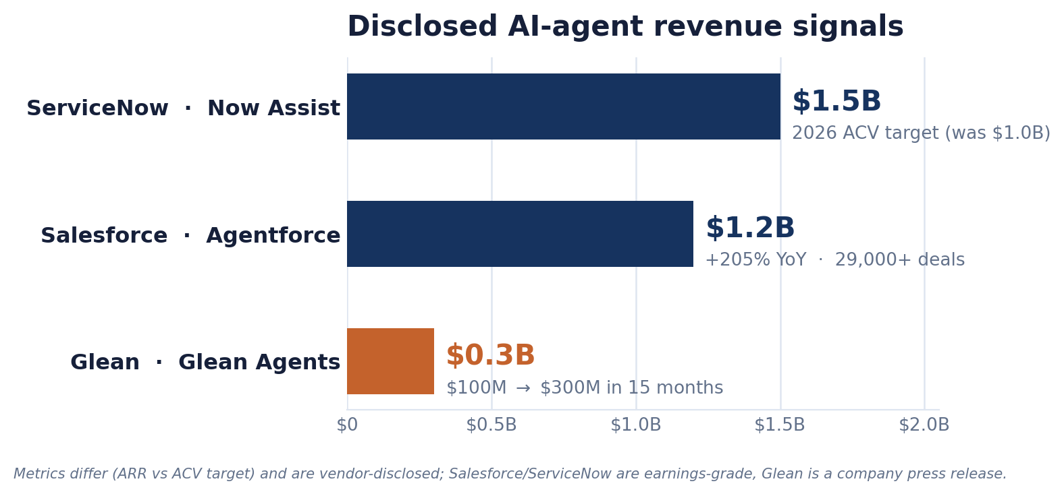
ADOPTION SCOREBOARD
Read the numbers by the quality of their source
What is rock-solid
Microsoft's org count & Fortune 500 penetration (FY26 Q3 earnings).
Salesforce's Agentforce ARR & deal counts (Q1 FY27 / Q4 FY26 8-Ks).
What needs a pinch of salt
Challenger ARR and valuations are company- or investor-sourced.
“Tens of thousands of customers,” “millions of agents” and MAU counts are unaudited marketing.
The circulating “$750M Q1 Now Assist ACV” figure could not be confirmed in official disclosures.
Glean reached $300M ARR just 15 months after $100M — fast, but a press-release figure.
THE NO-CODE AGENT BUILDER MARKET · INDEPENDENT ANALYSIS, MID-2026
12

Slide 13
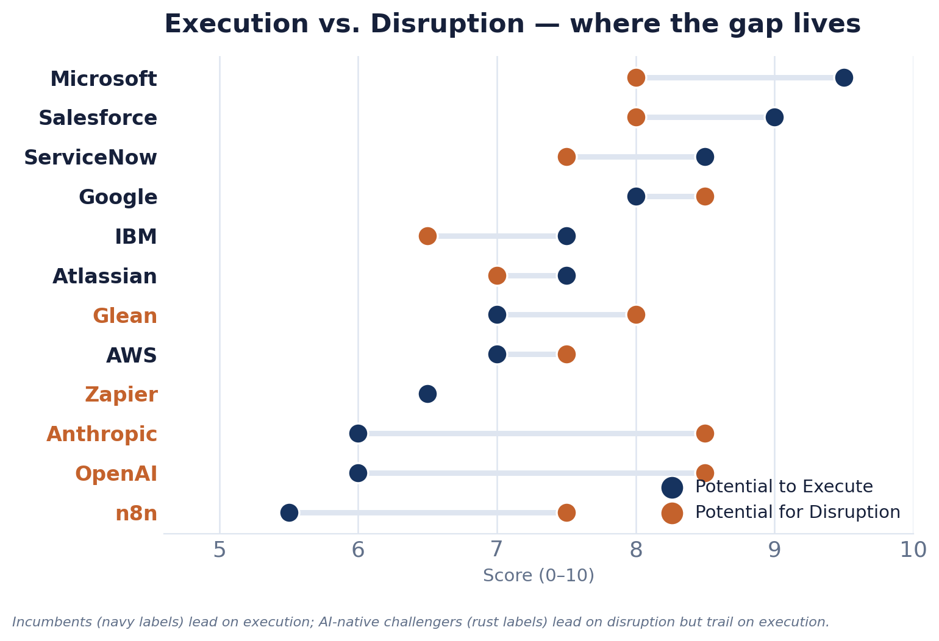
WHERE THE GAP LIVES
Execution vs. disruption — the defining tension
The pattern
Incumbents cluster top-right on execution; AI-native challengers stretch right on disruption but sink on execution. The wider the bar, the bigger the gap between what a vendor can imagine and what a business user can safely ship today.
Microsoft & Salesforce
Tight bars — execution and disruption move together at the top.
OpenAI & Anthropic
The widest gap: disruption 8.5, execution only 6.0 — thin enterprise governance.
n8n
Disruptive on price & control, but developer-leaning keeps no-code execution low.
THE NO-CODE AGENT BUILDER MARKET · INDEPENDENT ANALYSIS, MID-2026
13

Slide 14
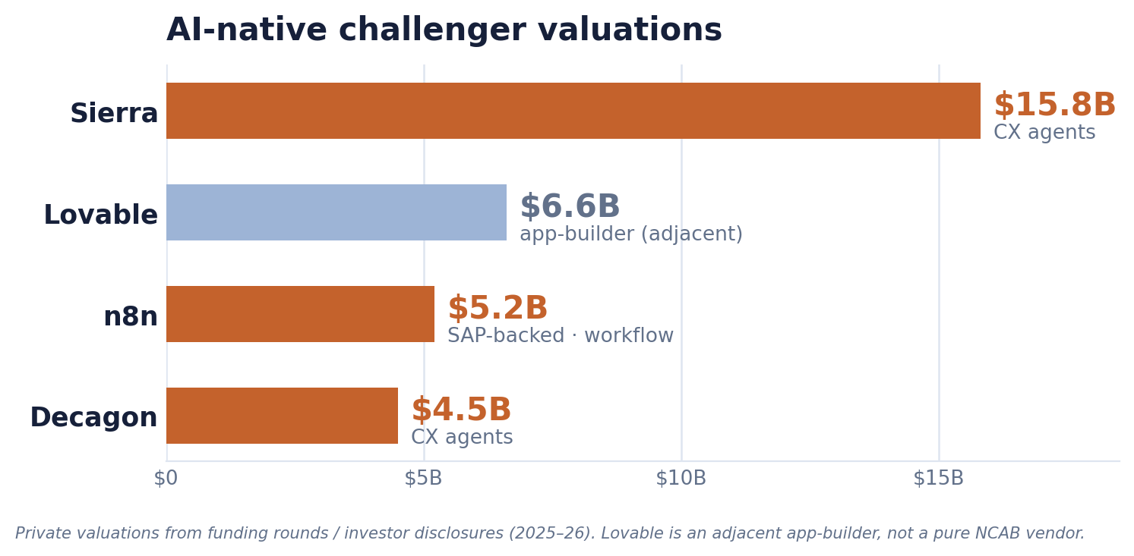
PIONEERS & CHALLENGERS
Scaling fast — but narrow
The most disruptive innovation comes from AI-native challengers and workflow players. Most lack the install base, governance maturity and channel to score high on execution.
OpenAI
Anthropic
Glean
n8n
Zapier
Sierra
Decagon
Writer
Glean — $300M ARR, natural-language Auto Mode builder, strong Glean Protect governance; lacks a captive install base.
n8n — $5.2B valuation (SAP-backed), 230k+ active users, multi-agent orchestration; more developer-leaning than true no-code.
Sierra (~$15.8B) & Decagon (~$4.5B) — genuine production CX deployments, but guided/configured rather than open citizen-developer builders.
⚠ Churn signal: OpenAI's Agent Builder is being wound down (sunset Nov 30, 2026) in favor of Workspace Agents + the Agents SDK.
THE NO-CODE AGENT BUILDER MARKET · INDEPENDENT ANALYSIS, MID-2026
14

Slide 15
THE HARD CALLS
Most contested placements
Google
AWS
OpenAI / Anthropic
Shaper vs Pioneer
Execution score
Execution score
Frontier disruption is real, but business-user execution is younger. Disclosed seat/agent counts would lock in Shaper.
AgentCore is best-in-class infrastructure but developer-first; Quick Suite is unproven for citizen developers.
Huge mindshare, thin enterprise governance. The Agent Builder sunset injects real uncertainty about no-code commitment.
Glean
n8n vs Zapier
SAP Joule Studio
Shaper vs Pace Setter
No-code purity
Persona mismatch
$300M ARR argues up; no captive install base argues for caution. Fortune 500 penetration is the tiebreaker.
n8n scores higher on disruption; Zapier is the truer business-user tool. Reasonable analysts could swap their x-values.
Agent Builder is GA but developer-skewed. The managed, zero-infra no-code version only GAs in Q3 2026.
THE NO-CODE AGENT BUILDER MARKET · INDEPENDENT ANALYSIS, MID-2026
15

Slide 16
RECOMMENDATIONS
What to do about it
1
For a Microsoft-centric enterprise
2
For Salesforce / ServiceNow shops
Standardize on Copilot Studio + Agent 365. Model costs in Copilot Credits from day one — the $0.01 PAYG vs $200/mo pack decision is the biggest lever. Track the E7 “Frontier” suite ($99/user/mo) as the consolidation SKU.
Use the native builder — data gravity and unified governance outweigh best-of-breed. Negotiate Flex Credits / Assist-pack commits by modeling actions-per-workflow; $2/conversation only wins above ~20 actions per interaction.
3
For horizontal needs
4
Treat OpenAI & Anthropic as suppliers
Evaluate Glean (knowledge layer) and n8n or Zapier (orchestration) as complements, not replacements. Pick n8n where you own engineering; pick Zapier where non-technical operators own the workflow.
Pilot Cowork / AgentKit for prosumer productivity, but don't anchor enterprise governance on them until audit features mature — and factor in OpenAI's Agent Builder sunset.
Benchmarks that change the strategy: audited business-user agent counts in production · consumption pricing stabilizing into per-outcome rates · MCP/A2A maturing enough to govern a multi-vendor estate from one control plane.
THE NO-CODE AGENT BUILDER MARKET · INDEPENDENT ANALYSIS, MID-2026
16

Slide 17
APPENDIX
The full vendor scoreboard
All 27 scored vendors. y = Potential to Execute · x = Potential for Market Disruption.
Vendor | y | x | Quadrant
Microsoft | 9.5 | 8.0 | Shaper
Salesforce | 9.0 | 8.0 | Shaper
ServiceNow | 8.5 | 7.5 | Shaper
Google | 8.0 | 8.5 | Shaper
Atlassian | 7.5 | 7.0 | Shaper†
AWS | 7.0 | 7.5 | Shaper†
Glean | 7.0 | 8.0 | Shaper†
IBM | 7.5 | 6.5 | Pace Setter
UiPath | 6.5 | 7.0 | Pace Setter
Oracle | 5.5 | 6.5 | Pace Setter
SAP | 6.0 | 7.5 | Pace Setter
OpenAI | 6.0 | 8.5 | Pioneer
Anthropic | 6.0 | 8.5 | Pioneer
n8n | 5.5 | 7.5 | Pioneer
Vendor | y | x | Quadrant
Zapier | 6.5 | 6.5 | Pioneer†
Sierra | 5.0 | 7.0 | Pioneer
Decagon | 4.5 | 6.5 | Pioneer
Writer | 5.5 | 6.0 | Pioneer†
Workday | 5.5 | 6.5 | Specialist†
Lindy | 4.0 | 6.0 | Pioneer
Dust | 4.0 | 6.0 | Pioneer
Relevance AI | 4.0 | 6.0 | Pioneer
HubSpot | 6.0 | 5.5 | Specialist
Adobe | 5.5 | 6.0 | Specialist†
Pega | 5.5 | 5.0 | Specialist
Appian | 5.5 | 5.0 | Specialist
Creatio | 5.0 | 5.0 | Specialist
† borderline placement. Source: Claude Fable 5 Research · Jukka Niiranen, June 2026.
THE NO-CODE AGENT BUILDER MARKET · INDEPENDENT ANALYSIS, MID-2026
17

Slide 18
METHODOLOGY INTEGRITY
Caveats & how to use this
Vendor-marketing risk
Scores are judgment calls
Many figures are company-reported and unaudited. The most reliable are Microsoft's earnings figures and Salesforce's 8-K ARR/deal counts; challenger ARR and valuations are company- or investor-sourced.
Calibrated to the no-code business-user persona as of June 2026. They are not Gartner's and do not reproduce its anonymized placements.
Short half-life
Scope discipline
The category moves monthly — OpenAI's Agent Builder sunset, SAP's Q3 managed GA, ServiceNow's Otto rebrand. Placements should be revisited each quarter.
Pure pro-code frameworks (LangChain/LangGraph, Agent Framework/AutoGen, CrewAI, Strands, Vertex ADK) are excluded except as context.
Entity status
Moveworks is scored as absorbed into ServiceNow (closed Dec 15, 2025). Lovable is adjacent (an app-builder) — its strategic cloud/model partner is Google Cloud, not Microsoft.
THE NO-CODE AGENT BUILDER MARKET · INDEPENDENT ANALYSIS, MID-2026
18

Slide 19
“The category moves monthly.”
Distribution, governance and consumption pricing are the three axes that will decide the next two quarters. Re-score when a vendor discloses audited business-user agent counts — that is the signal that turns best-of-breed Pioneers into safe bets alongside the incumbent.
Jukka Niiranen · Power Platform Advisor & Owner
Independent analysis · June 2026 · Source: Claude Fable 5 Research
vibes.jukkan.com/ncab-quadrant.html

