Slide 1
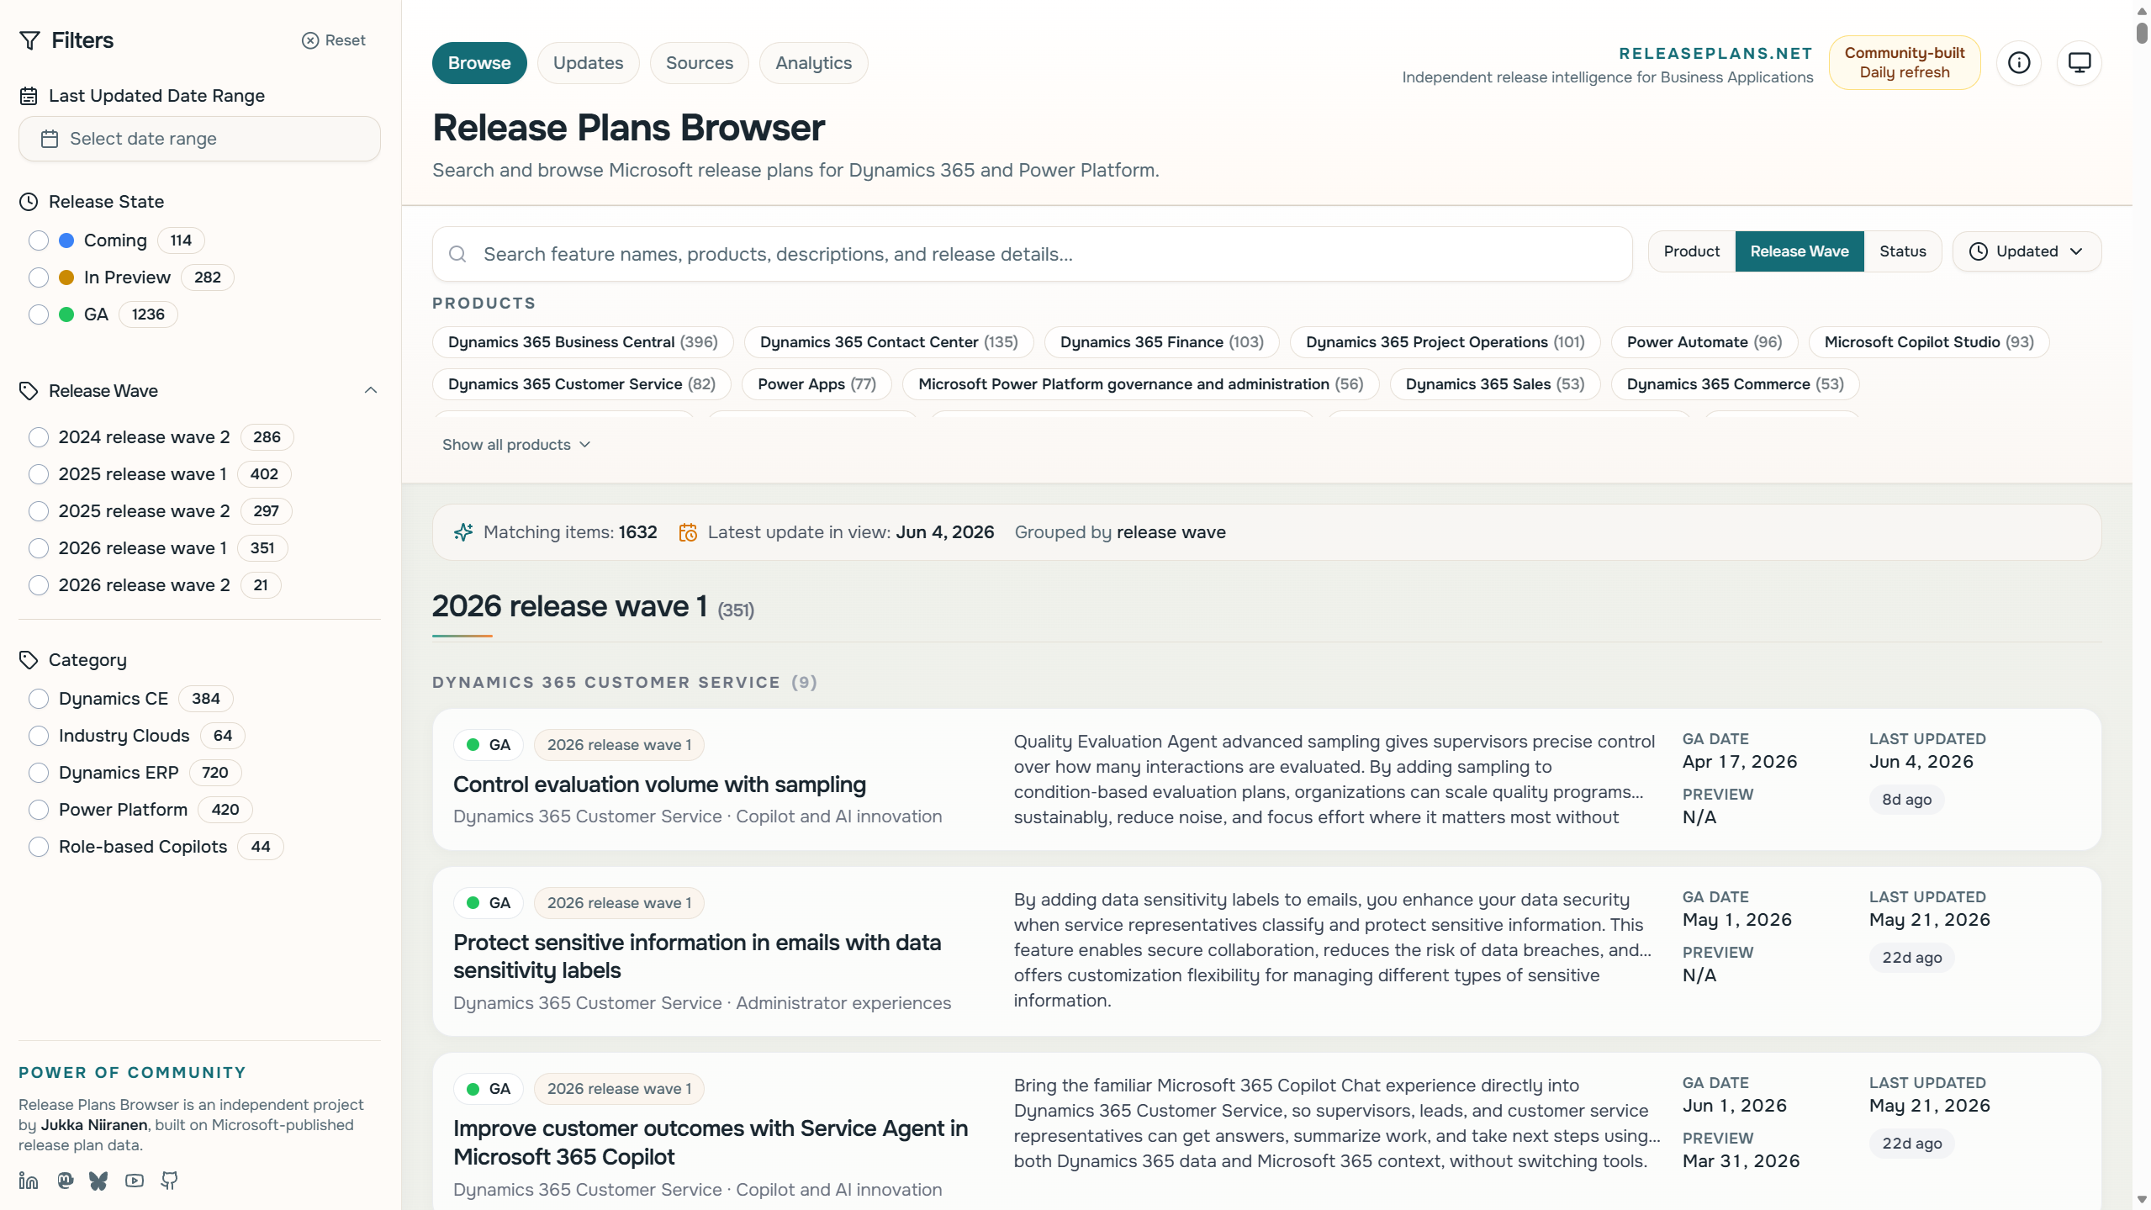
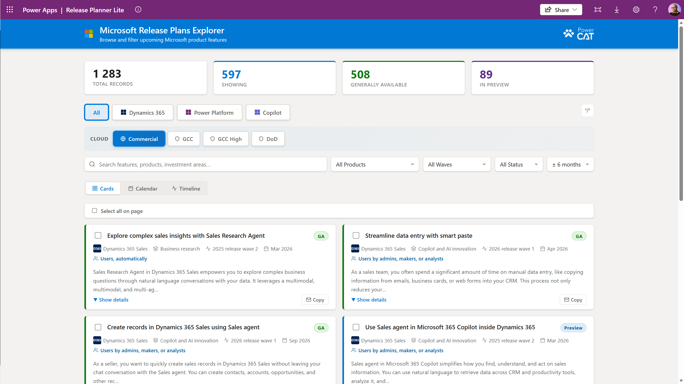


Release Plans Battle
Jukka Niiranen
Reza Dorrani

Slide 2
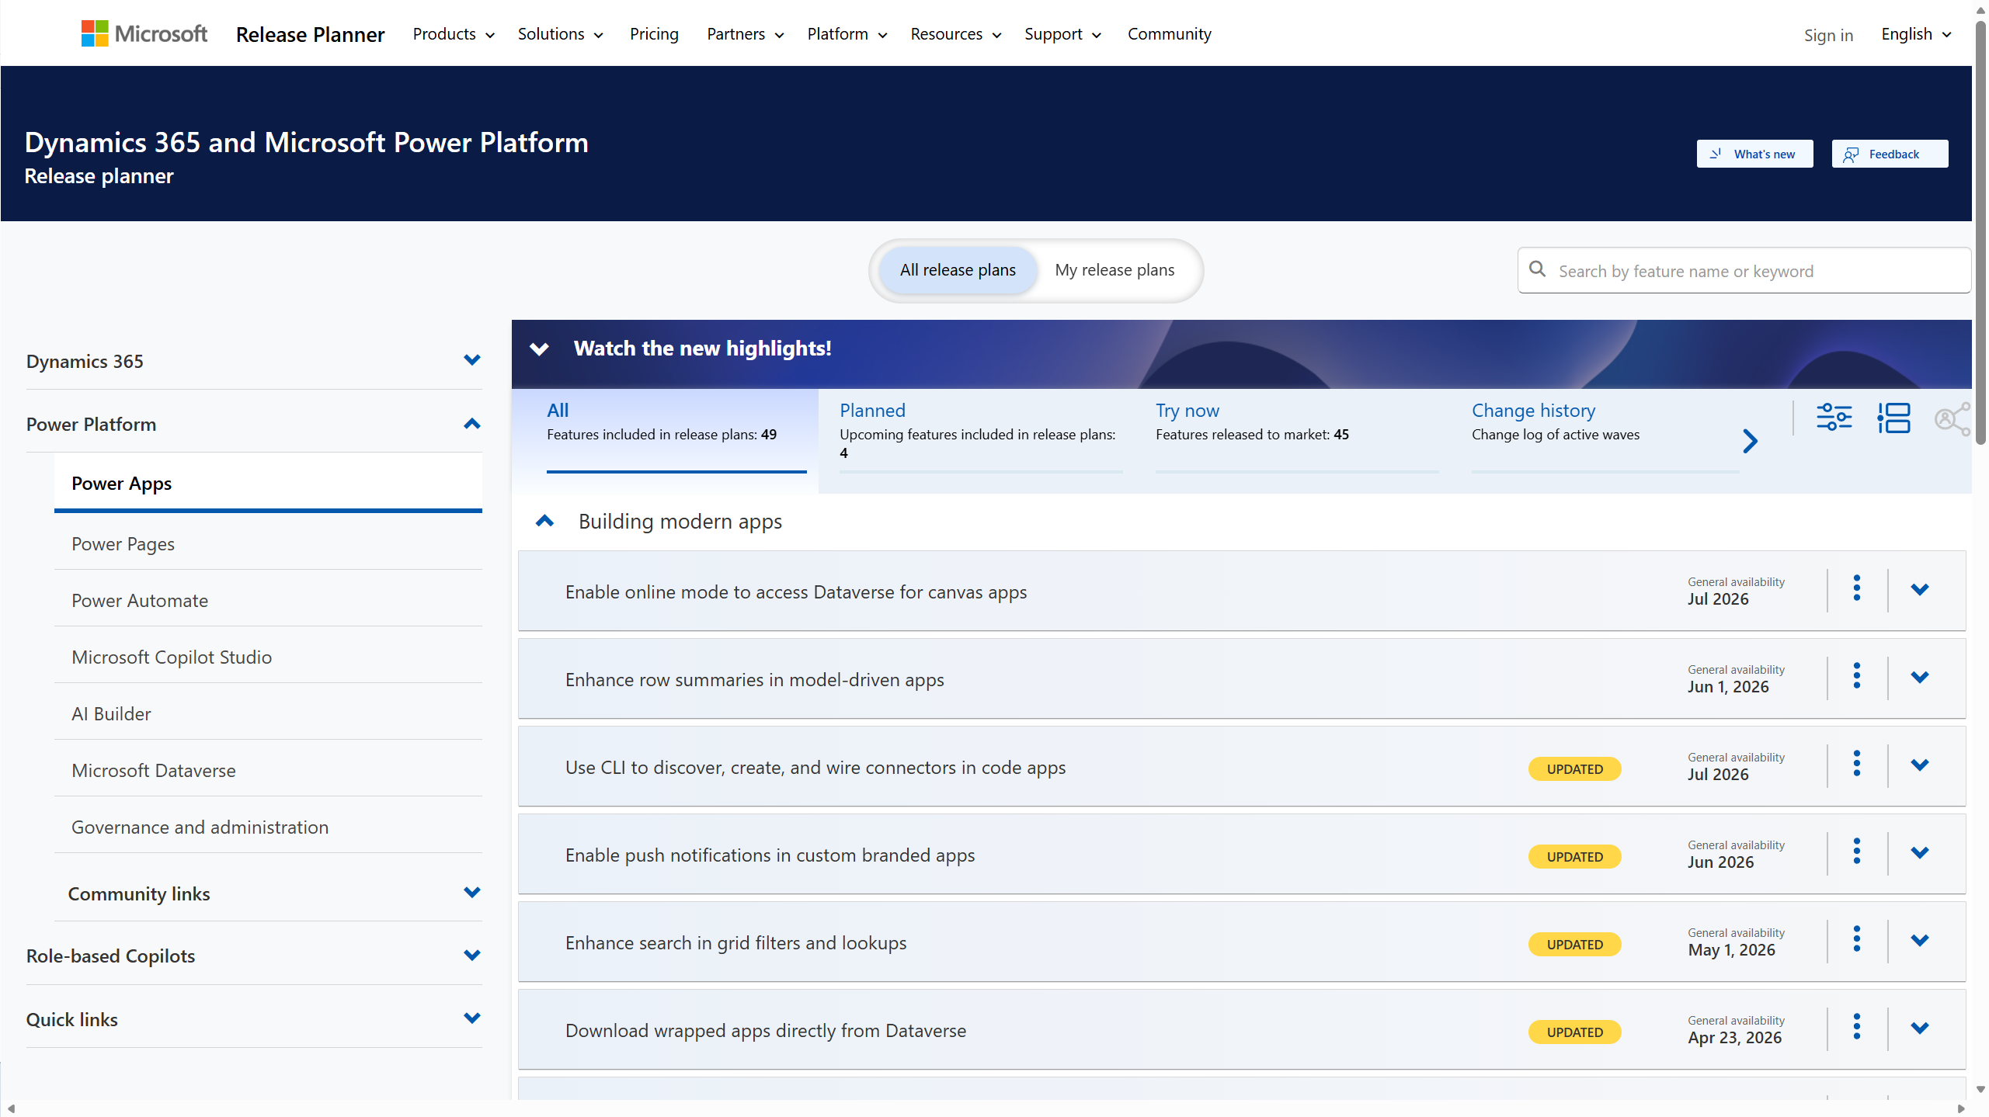
The Power of an API
Microsoft’s official Release planner website presents Dynamics 365 and Power Platform release items via a customized Power Pages UI. It’s… not perfect.
Luckily, there is a JSON API available that offers the same raw data on release plan items.
Let’s look at what has been built from that data.

Slide 3
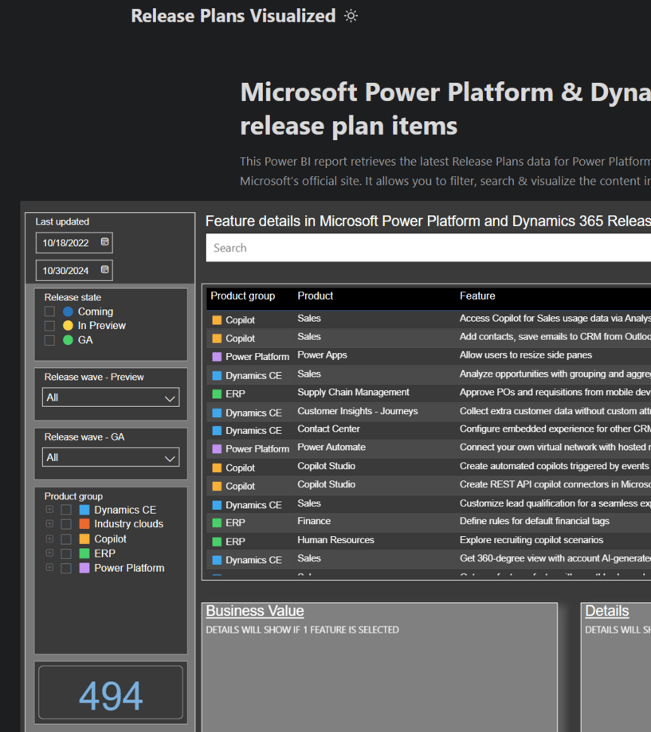
2024 version: Release Plans Visualized
Jukka Niiranen and Wouter Kessener created a Power BI report on top of the Release Planner API data.
Launched as a public report embedded on a simple Hugo static website published at releaseplans.net.
Daily PBI report refresh running in Jukka’s M365 tenant.
Launch announcement.

Slide 4
2026 version: Release Plans Browser
Jukka used Codex CLI and GPT-5.4 (Pro) to vibe code a new React site for browsing the release item data directly on a website.
Running on GitHub Pages as a static site with daily Action on data sync via Python script.
Launch announcement.

Slide 5
2026: MS Power CAT sample app
Reza Dorrani released a sample app called Release Plans Explorer on May 2026.
Implemented as a Power Apps Code App you can install in your environment as a solution.
Retrieves release item data via a custom connector on app launch.
Project repo.

Slide 6
Architecture comparison
ReleasePlans.net
Release Plans Explorer code app
Built with AI, React + TypeScript + Vite
Available online to everyone without any app installation
Runs on GitHub Pages, zero cost for using and running
Current repo is not public
Built with AI, React + TypeScript + Vite
Solution must be deployed to Power Platform environment
Requires Power Apps premium license for app users
Source code available for building your own version

Slide 7
Release Planner: default site https://releaseplans.microsoft.com/

Slide 8
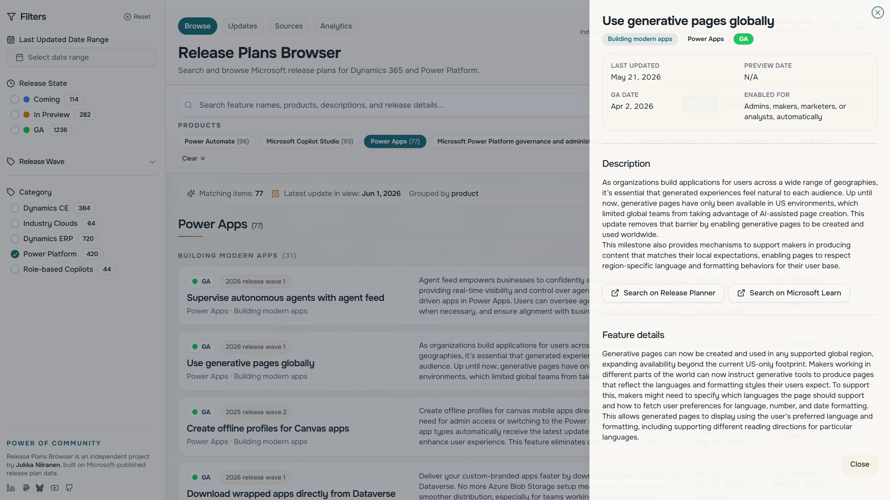
Release Plans Browser: Jukka’s site https://releaseplans.microsoft.com/

Slide 9
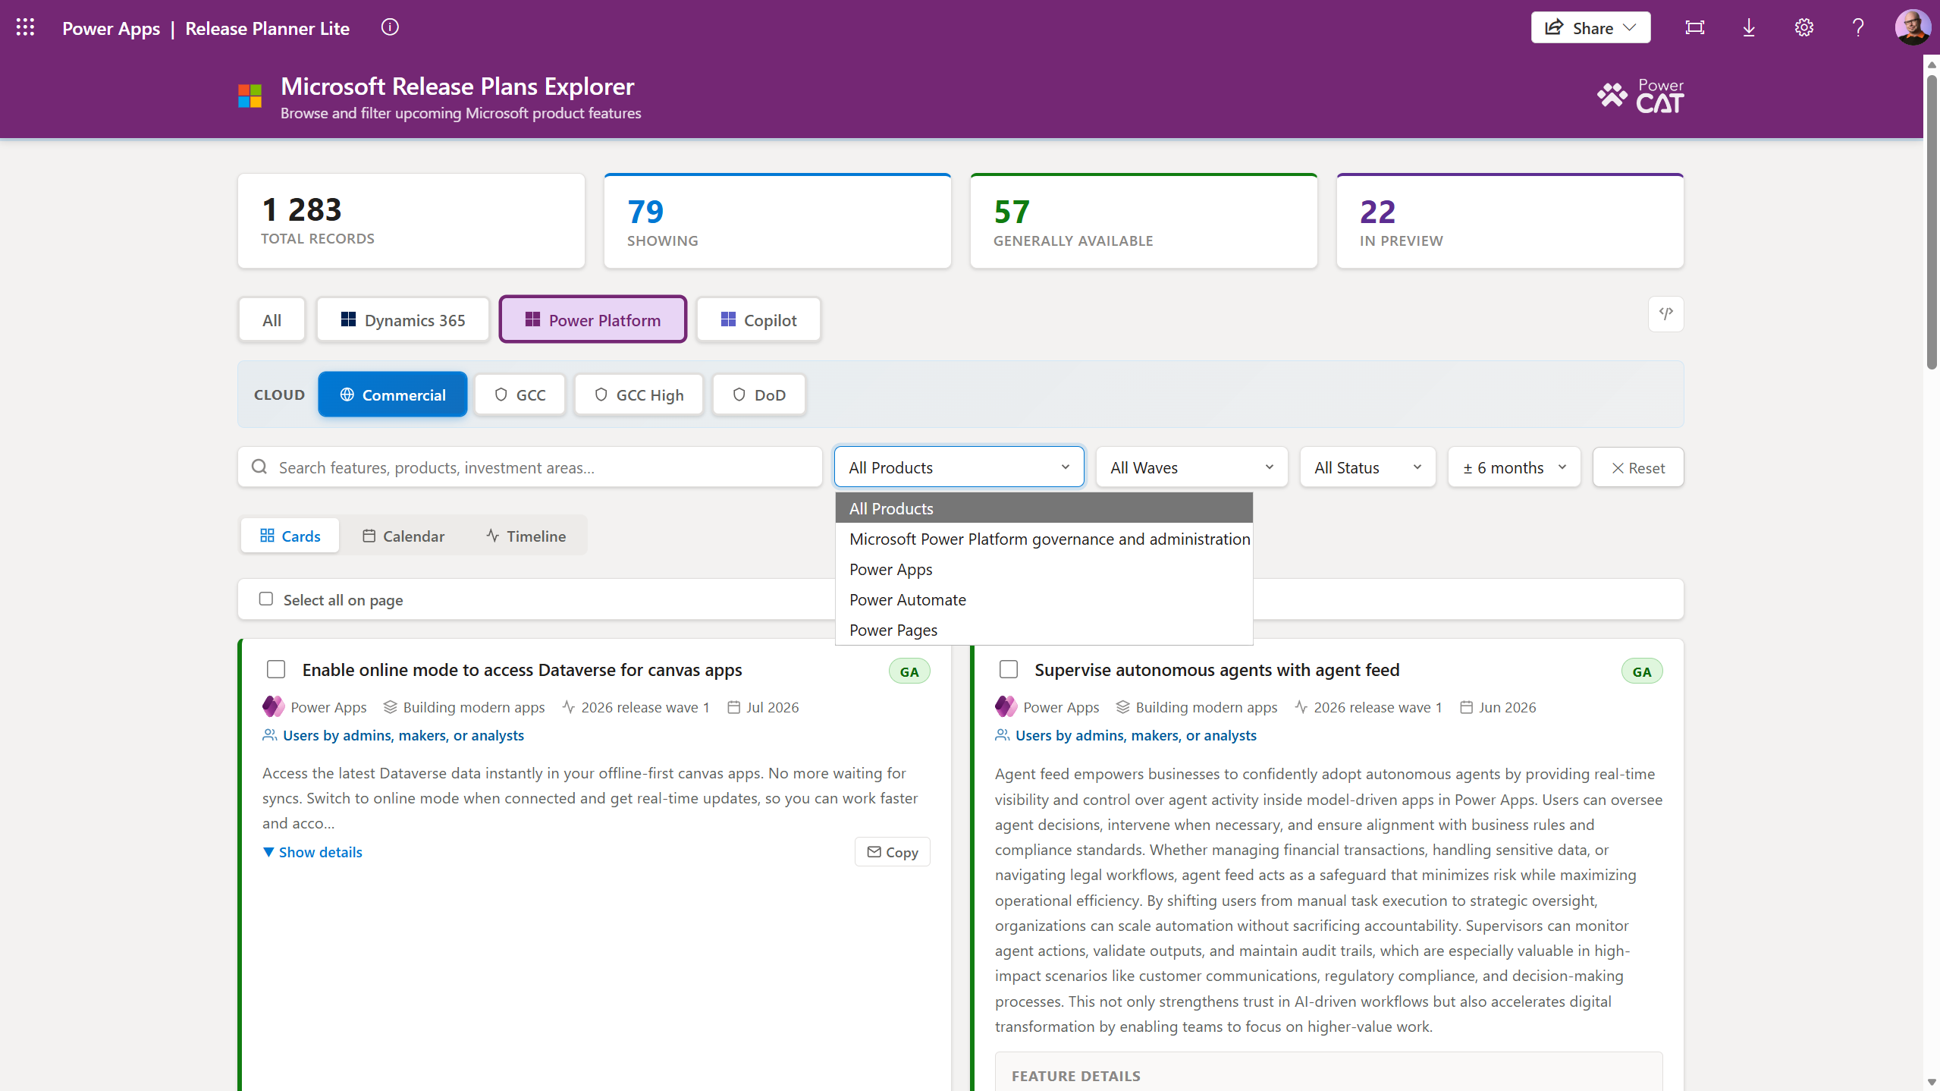
Release Plans Explorer: Reza’s app https://youtube.com/watch?v=eJplUNEGy54

