Slide 1
10 Tips for Designing a Great User Experience in Dynamics CRM
Jukka Niiranen
2014-09-23

Slide 2
What am I going to talk about today?
How to make your users love CRM even more!
  …Or hate it a bit less
Show some design practices I (try to) follow when building CRM solutions
Give you practical customization tips for the latest Dynamics CRM version
Zero lines of code needed for all of these!

Slide 3
Tip 1: Understand what User Experience design means

Slide 4
What is this “UX” thing anyway?

Slide 5
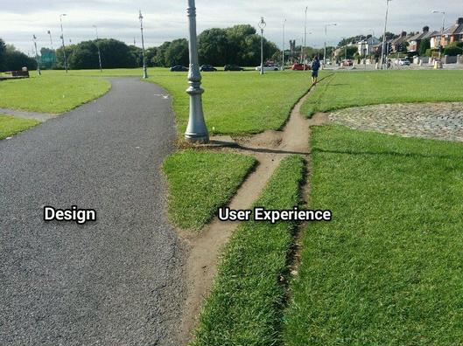
It’s not the same as User Interface design

Slide 6
How UX design makes software better
“User knowing how to use the system” vs. “system knowing what the user wants”
The human brain hates uncertainty – UX design can reduce uncertainty via:
  Choice reduction
  Visual cues
  Adapting to user interaction
  Following the user’s natural process

Slide 7
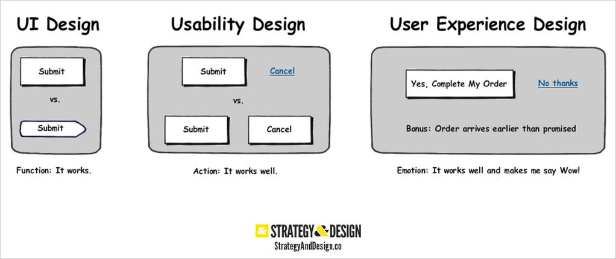
User experience is about the whole process
Looks good
Works well
Feels great!

Slide 8
Why user experience is important for CRM systems
The frequency of user pain
  Online store customer: temporary pain caused during the commercial transaction
  CRM system user: continuous pain through repeated encounters with the day-to-day tools
The variety of use cases and user groups
  People who don’t share the same processes trying to use the same customer information system
  Trying to deliver “something for everybody” will results in monolithic enterprise software

Slide 9
Why it’s especially important with CRM 2013+
Higher user expectations due to relative ease of out-of-the-box functionality
Simplified UI only delivers benefits when the actions visible are the relevant ones
Tons of new components to configure = more potential for UX success AND failure

Slide 10
Tip 2: start from the navigation

Slide 11
What changed with CRM 2013?
Drivers for CRM 2013 UI re-design:
  Single window = global navigation
  Touch enabled = bigger icons
  Content over UI chrome = hidden menus
Casualties:
  Much fever menus immediately visible
  Nav Bar mouseover effect requires cursor precision
  “Vanilla CRM 2013 SiteMap” vs. upgrade experience

Slide 12
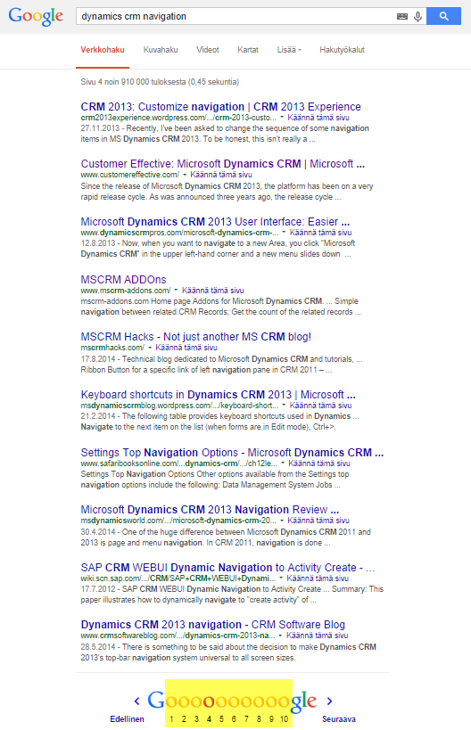
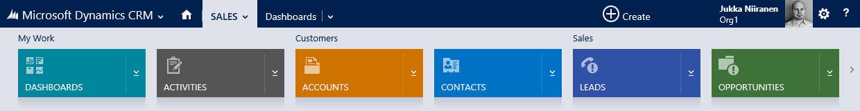
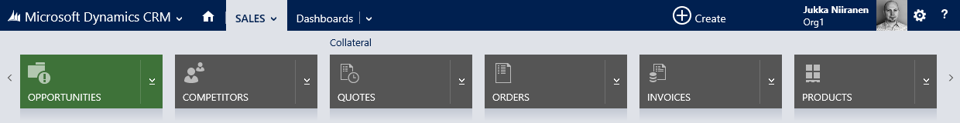
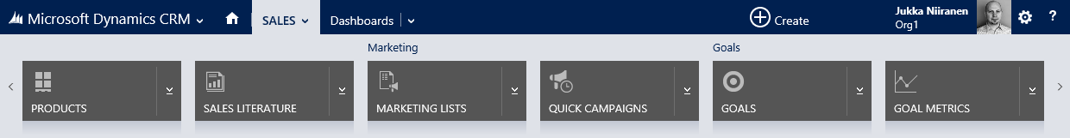
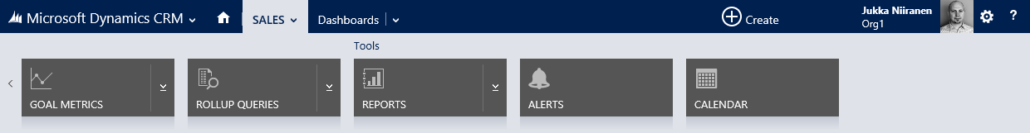
Optimization in the world of Dynamics CRM
Scrolling to the 4th page of CRM 2013 Nav Bar is like…
…Getting to the 4th page on Google.
Not very likely.

Slide 13
Optimization tips for the new navigation
SiteMap
  Make each process specific area self-sustained
    Kill the Workplace while you’re at it
  Don’t be afraid to add more areas
  Configure a “landing page” dashboard for each area
Form Related Records (“the 4th level” in Nav Bar)
  Remove menu items that already have a subgrid on the form
  Prioritize the order based on presumed access frequency

Slide 14
Tip 3: Save clicks with view design

Slide 15
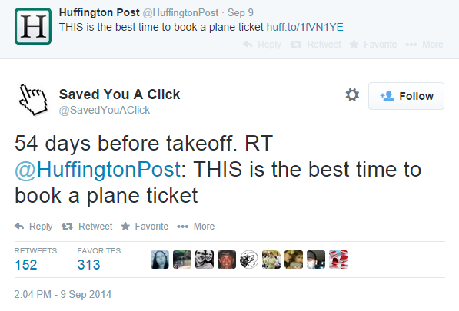
What’s #SavedYouAClick?
Have to click through to a new page to get the information you want
The information you want, right there

Slide 16
CRM views and clicks
Two reasons for clicking a record in a view
  You want to access more information from it (minimum 1 click)
  You need to check if it’s the right record in the first place (1…N clicks)
The best views don’t require a single click
  Columns provide the most important info
  Sorting promotes the most relevant records
    (Btw: 1 scroll/swipe effort < 1 click effort)

Slide 17
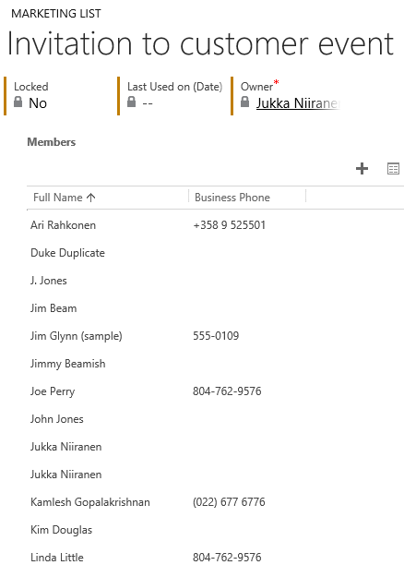
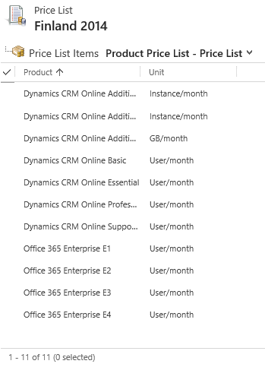
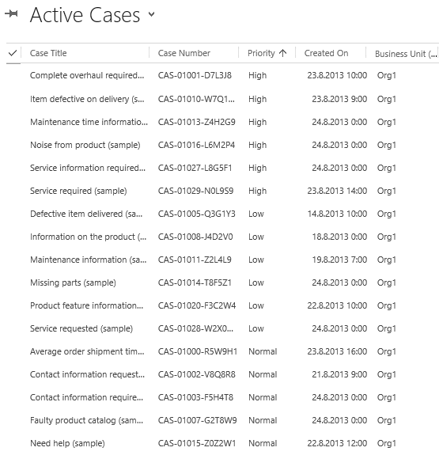
Default views that suck
Marketing list members: which company/address/permission?
Price list items: where’s the product’s price????
Active Cases: who’s the customer? Or case owner?

Slide 18
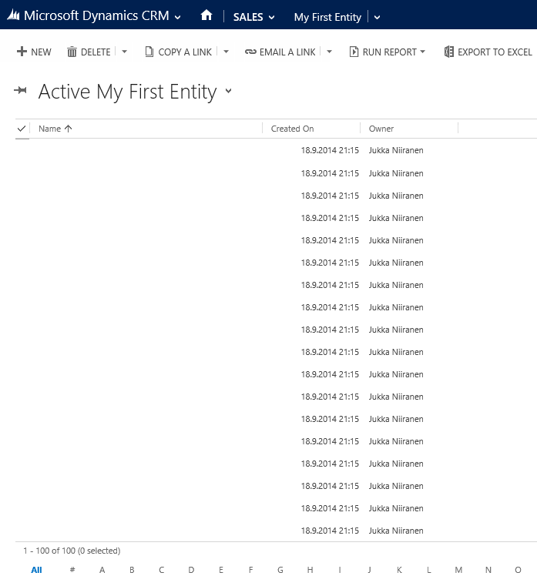
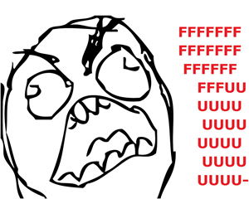
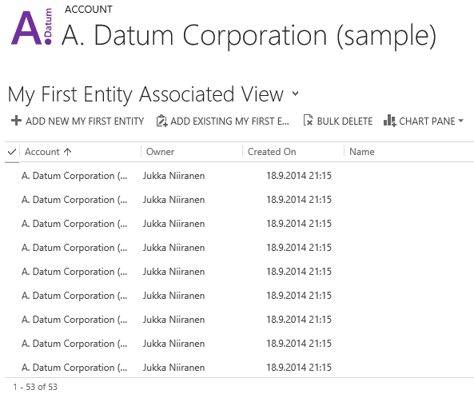
Custom views that suck

Slide 19
Design views that minimize the clicks
Sorting
  Alphabetic sorting almost never makes sense
  Showing last modified/created records almost always makes sense
Columns
  Include relevant fields for visual scanning and manual sorting
  Synchronize column order (and width!) across your views as much as possible
  Avoid using lookup fields to other entities as first columns (because the click will not take you to the record you expected)

Slide 20
Tip 4: Make your forms more responsive

Slide 21
Why so many entity forms suck
The eternal dilemma:
  Process owners would like to have all the data
  Process actors would like to enter none of the data
The varying relevance:
  Some information will never be known by the user upon record create
  Some information is only relevant in conjuction with other information
  Some information becomes irrelevant as the process moves forwards
Entity attributes (data model) and entity presentation (UI) are two different design areas, because the presentation layer has a time dimension

Slide 22
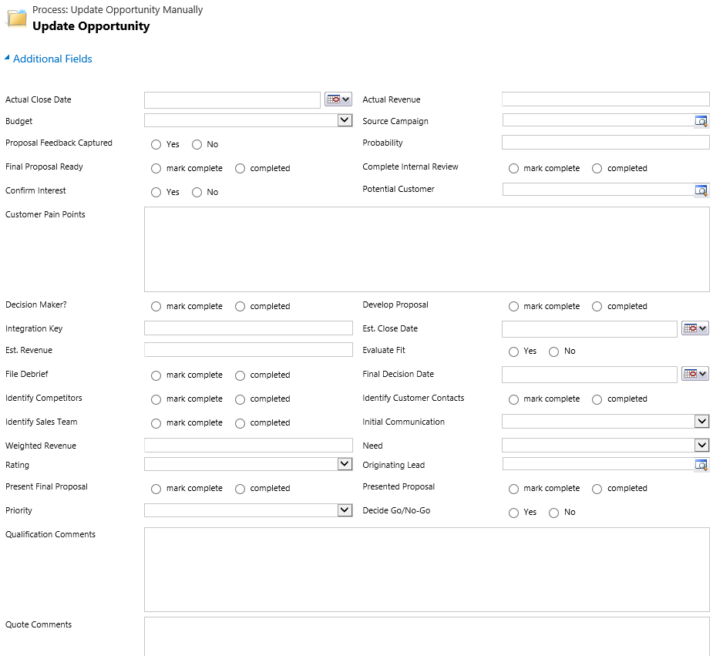
Some things are just better kept hidden
These are all the standard hidden fields for the opportunity entity
Imagine you were being trained to use a new CRM application. Would you want to see a form like this after clicking “add new record”?

Slide 23
Use Business Rules to trim down the forms
Show/hide fields for new/existing record forms
  Conditions for Created On/By field
Hide entire sections by setting all fields as hidden
Target Business Rules to specific forms via hidden fields
  The rule will only run when all fields are present

Slide 24
Tip 5: Automate the business process (flow)

Slide 25
The truth about Business Process Flows
Business Process Flows (BPF) are the opposite of workflows:
  Front & center in the UI vs. behind the scenes
  All manual actions vs. fully automated process
Business Process Flows alone are just a process map
  They show you what should be done next
  They don’t know when it’s time to move on

Slide 26
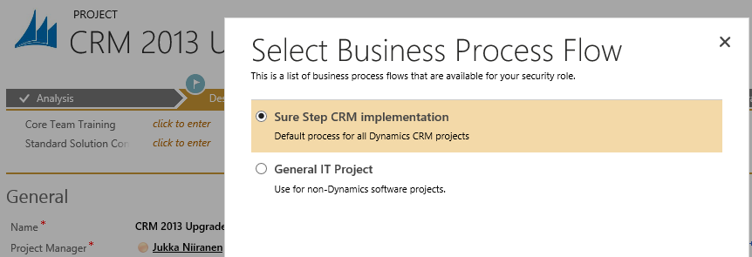
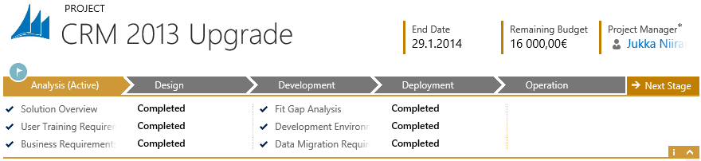
The manual steps
Switch Process: needs to be performed by the user from the Command Bar
Change Stage: needs to be done by the user from the BPF

Slide 27
Tips for smarter processes
Automate the process selection via workflows
  Requires a custom workflow activity, Google for “dynamics crm workflow essentials”
Control process stage changes
  Run a workflow from stageid & stepid field changes to trigger further actions
Use process & stage specific Business Rules to trim the forms
  Copy the stage value onto a custom field, so you can reference it via Business Rule conditions

Slide 28
Tip 6: Show the user what’s going on

Slide 29
CRM: is it just for storing records?
CRM solution design is often focused on planning what information needs to be captured for records (i.e. data entry) and how it is to be queried (views, charts, reports)
This record centric approach is not very good at surfacing the actions performed by CRM users
Yet these actions are a key component when users evaluate the validity and relevance of the data
  Account created today vs. last updated three years ago: which data would you trust more?
  Primary contact for customer account changes: will the account team discover this information on their own?

Slide 30
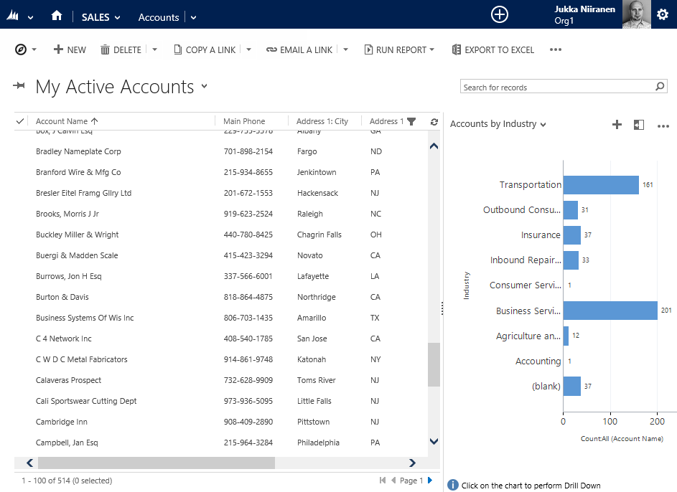
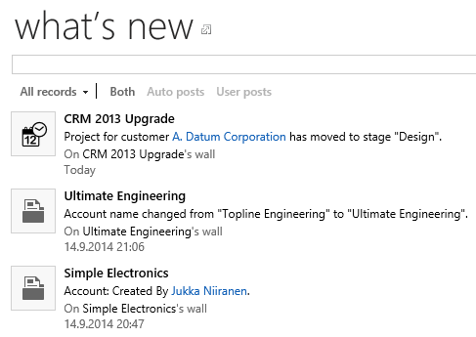
Static vs. dynamic information system
Are we building just a static, glorified address book?
Or can CRM tell the users what is going on RIGHT NOW?

Slide 31
Surfacing actions performed on CRM data
Show the timestamps on who created and modified the record, and when
Identify events that are important enough to raise a special flag, then use a workflow to write the data (activity feed post, note, custom field)
Always provide at least one view per entity that shows the latest created/modified records at the top

Slide 32
Tip 7: Don’t forget your clients

Slide 33
Our twisted reality
System customizers live inside the web client, because opening CRM organizations with other clients requires jumping through hoops
For the past ~10 years CRM Outlook client was the main selling point, today it’s the mobile apps
CRM 2013 web client looks nice & fresh, works great for demos and is the only practical tool for customization work
So, what’s the problem?

Slide 34
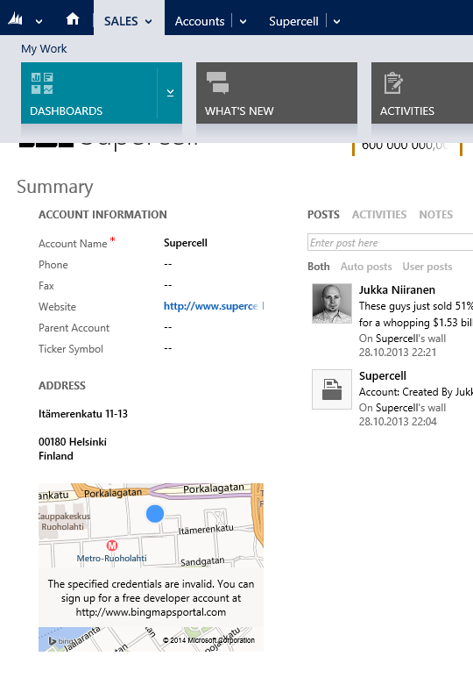
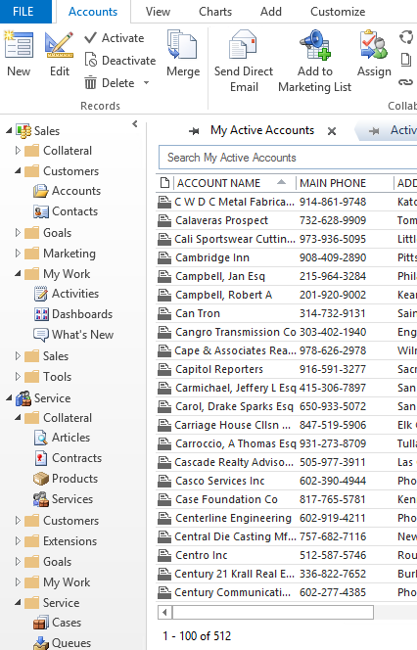
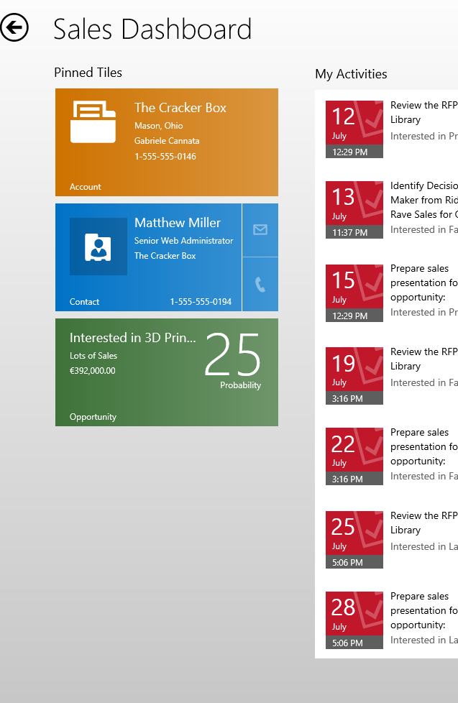
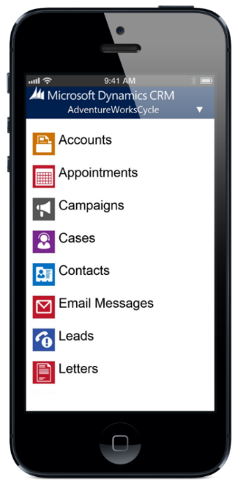
CRM is not just a browser application
Web
Outlook
Tablet
Phone

Slide 35
Know the limitations of each client
Outlook
  Folder based navigation & popup windows
  Reading Pane: single column form with multi-column subgrids
Tablet
  Uses same form definition as web client, single form, “single row” rendering, first 75 fields or 5 tabs
Phone
  Separate Mobile form, single column, no scripts or Business Rules
  No process specific actions available, just “CRUD”

Slide 36
Tip 8: Sweat the little things

Slide 37
What really matters
The longer you work with CRM, the easier it is to become blind to the small glitches
The efforts of the customizer are not necessarily in any proportion to the significance of a design detail
  An expensive custom plugin may perform an action that the users will never actually notice
  A single choice of wording may frustrate and confuse the users every time they use the system
“People use what works – well” (will.i.crm)

Slide 38
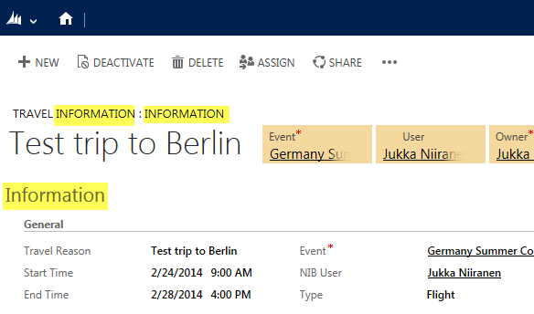
Do you even notice these details anymore?
Do all of your updated CRM forms or custom entity forms say “information” in the header?
Do you have useless tab labels at the start of your form, stealing screen estate?

Slide 39
Details that are A) important and B) cheap to fix
Field names:
  Avoid redundancy: “Case Title” vs. “Title”
  Group fields with (short) prefixes to help usage in Advanced Find
View names: think about the sorting
Field descriptions: provide a tooltip for users
Custom entities: icons are not optional

Slide 40
Tip 9: Clean up after you’re done

Slide 41
The messy construction site of CRM
Rome wasn’t built in a day, neither was your CRM
Rome had a sanitation system, but does your CRM system have one?
The system customization process usually starts with the “add more stuff” stage
You should always include a “take stuff away” stage into that process, too

Slide 42
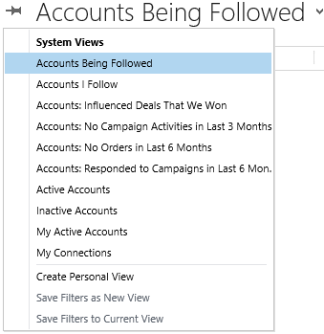
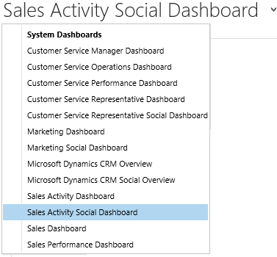
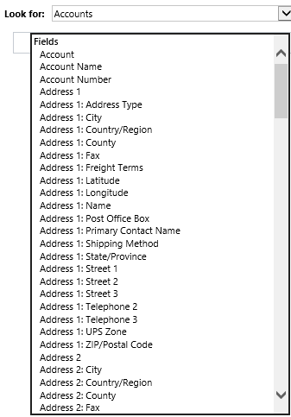
CRM comes with clutter right out of the box
Are you really using that many address fields?
Do all these account views make sense for your business?
Why do you need “social” vs. “non-social” dashboards?

Slide 43
Clean up that clutter
Hide unused fields from Advanced Find
  Use XrmToolBox to find fields not on forms
Remove unused fields from forms
  Use CRM Data Detective for quick statistics
Deactivate unnecessary default components
  Views that don’t make sense to you
  Charts using fields that you are not using
  Dashboards without an audience

Slide 44
Tip 10: Get even more tips!

Slide 45
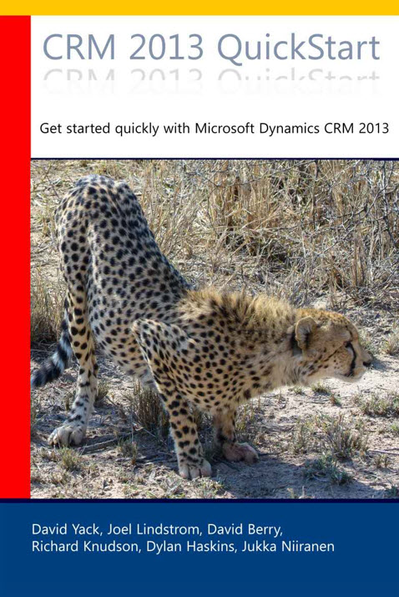
CRM 2013 QuickStart Book
What’s new/different in the CRM 2013 version
For people who already know something about a previous Dynamics CRM version
11 chapters of content from 6 CRM MVPs
Special 20% discount code!
  JukkaNiiranenCRMQuickStartEBook
  http://www.crm2013quickstart.com/

Slide 46
Recap

Slide 47
My 10 tips for better CRM user experience
Understand #UX
Start from the navigation
Save clicks with view design
Make your forms more responsive
Automate the business process (flow)
Show the user what’s going on
Don’t forget your clients
Sweat the little things
Clean up after you’re done
Know where to go for more tips!

Slide 48
Thank you for listening!
You can follow me at: https://twitter.com/jukkan
…or read my Surviving CRM blog: http://niiranen.eu/crm/

