Slide 1
A story of blog content theft
How to fight the copy-paste bloggers in the Microsoft Dynamics CRM community
Jukka Niiranen
Blogger at Surviving CRM (http://niiranen.eu/crm/)
Tweetaholic at @jukkan (https://twitter.com/jukkan/)

Slide 2
Spotting the content theft & the opportunity
I discovered a corporate blog that had stolen a post I wrote on my personal Surviving CRM blog
  Original article: http://niiranen.eu/crm/2011/06/crm-2011-subgrids-aint-what-associated-views-used-to-be/
Lucky for me they had done a pure copy & paste without editing any of the content
This meant that also the images on their blog post were ”hotlinked”, meaning they were being loaded from my blog’s web server
I could have easily blocked the images from being shown anywhere outside my own website by modifying the .htaccess file
I could have even replaced them with a static image saying ”to view this content, please visit Surviving CRM”

Slide 3
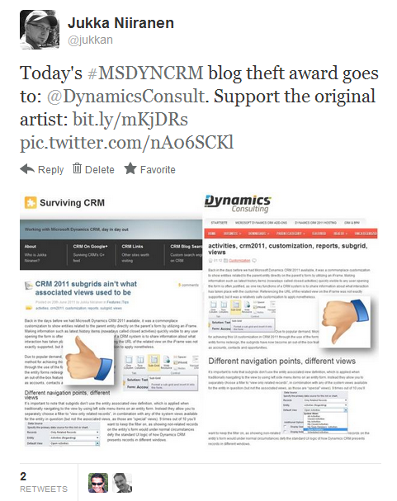
Complaining on Twitter gives a tiny little pleasure, but it doesn’t really address the problem

Slide 4
Plotting the payback
I decided to be a bit more cheeky with my approach and replace the images with tailormade notifications for the blog in question
I created new copies of the images and updated my own blog post to use those
For the original images I added some text boxes into the images. These would be shown to any visitor to the offending blog as long as they were still delivered from my web server
Naturally I also wanted to document the results into this slide deck (and my blog), in case the blog owner spots the modified images and removes the post

Slide 5
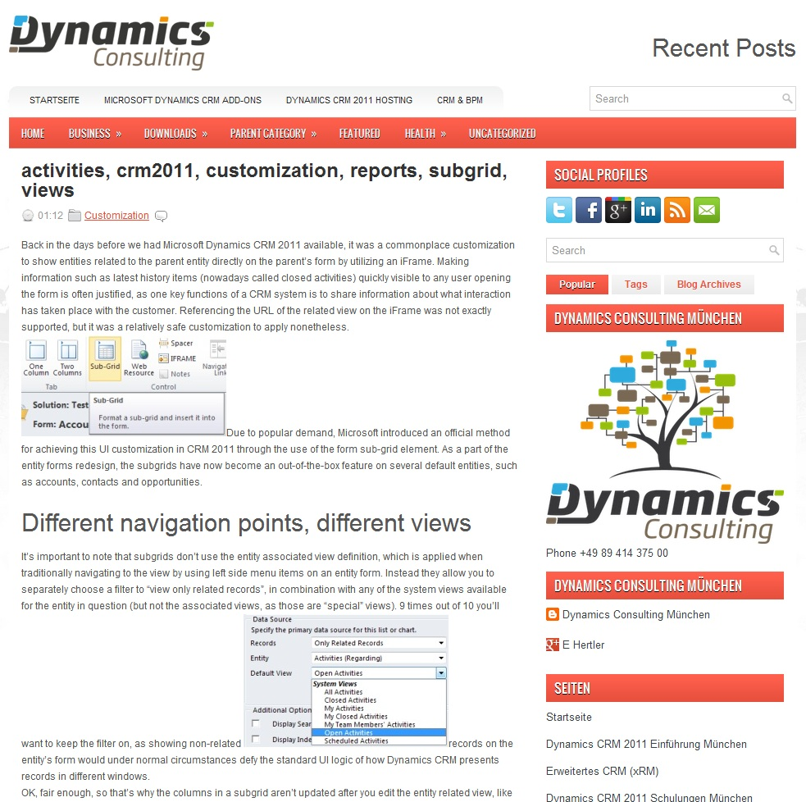
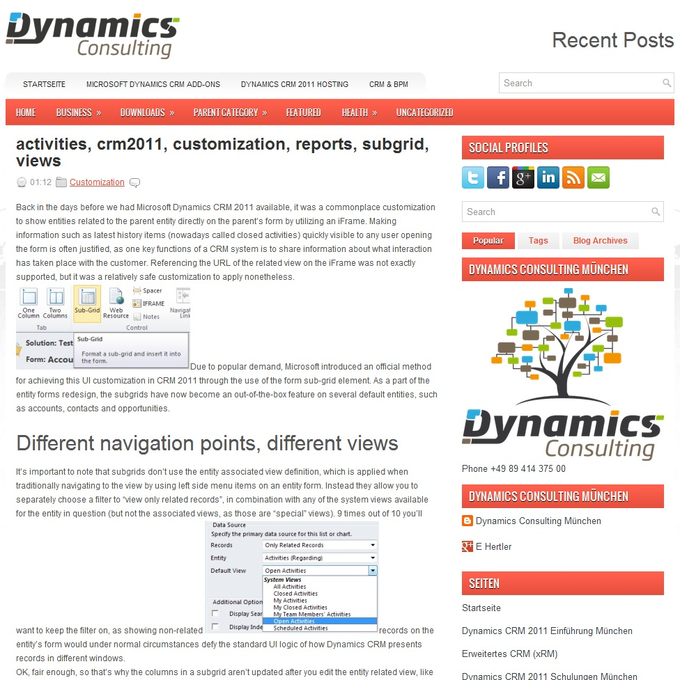
The first images were left as they were. This way anyone who’s just browsing the content and not reading through it (like the blog owner) may not notice the trick

Slide 6
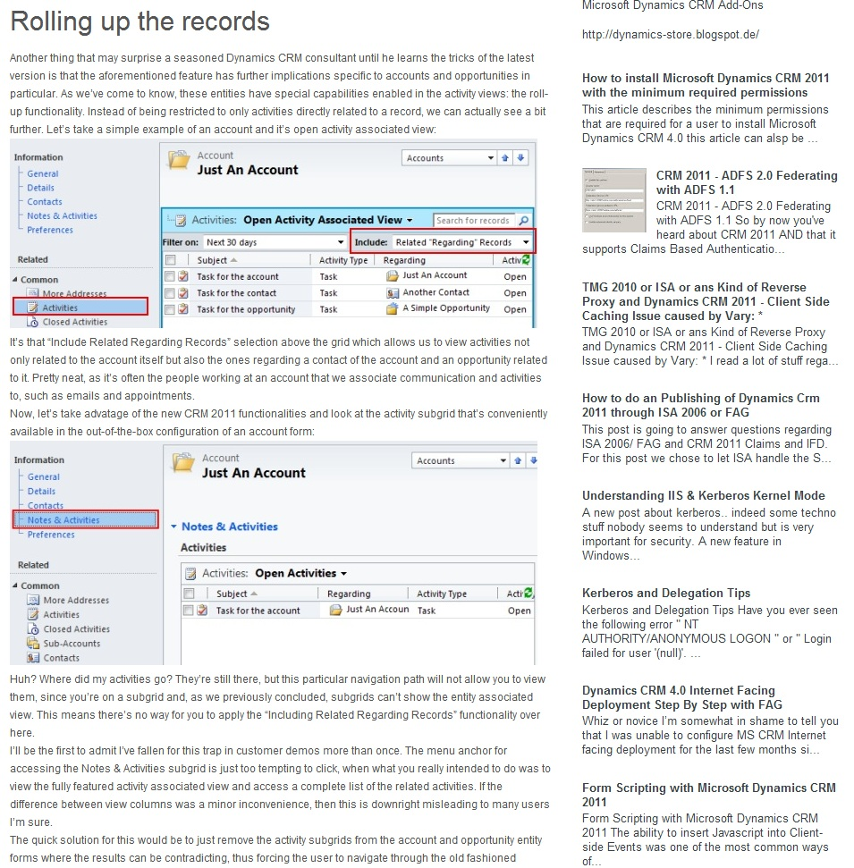
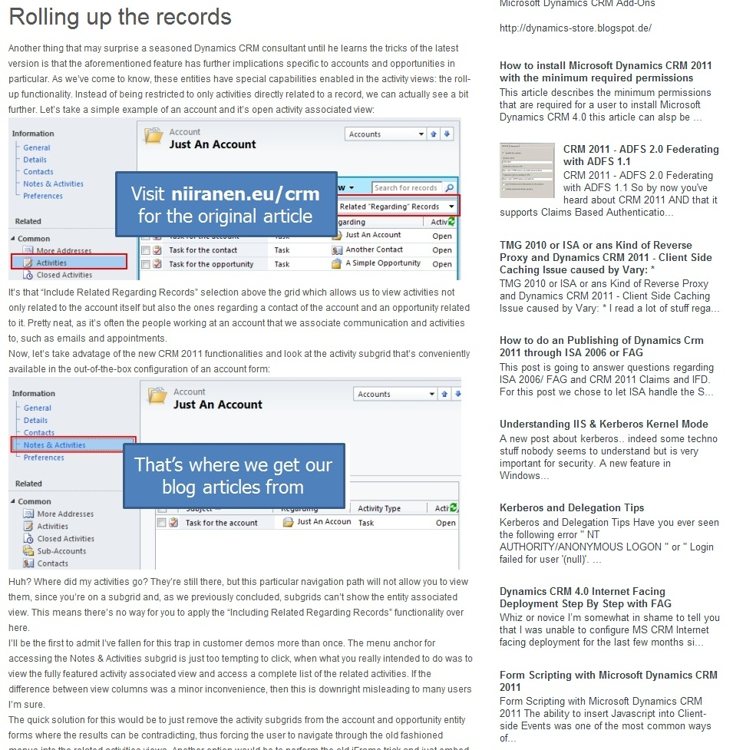
On the next images I added a friendly note telling the reader where the original article is from

Slide 7
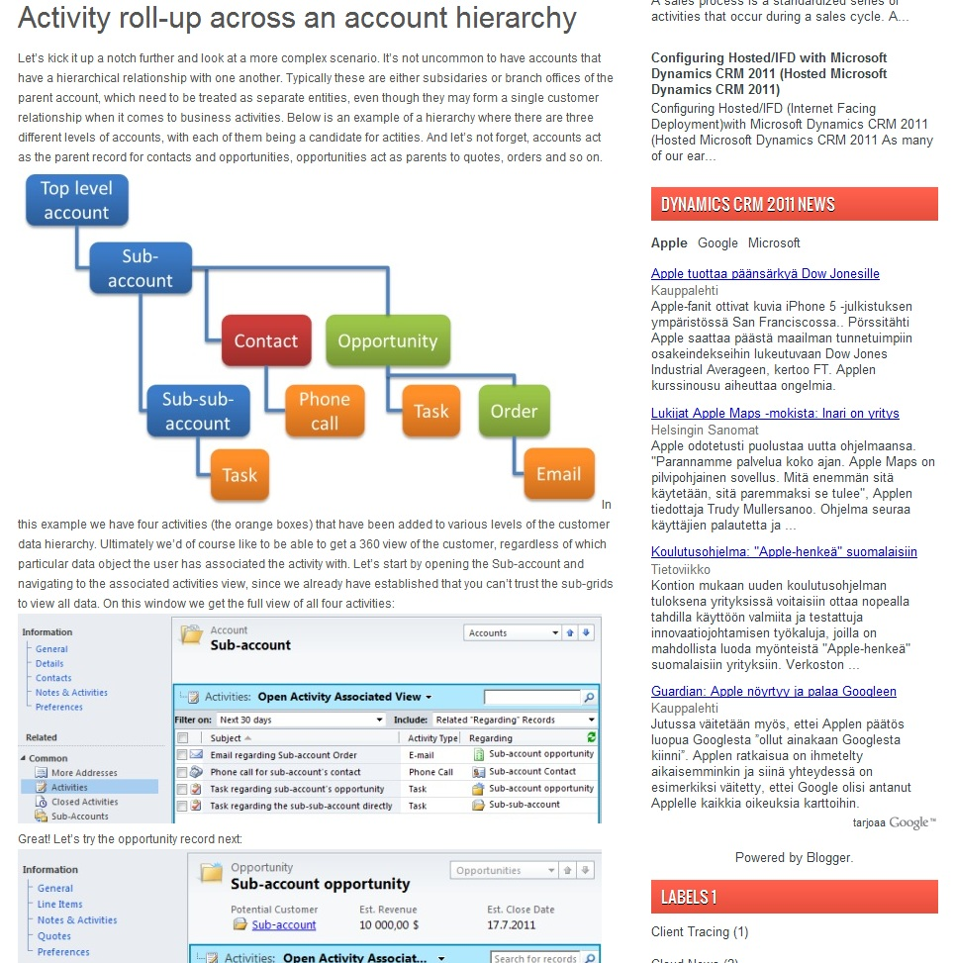
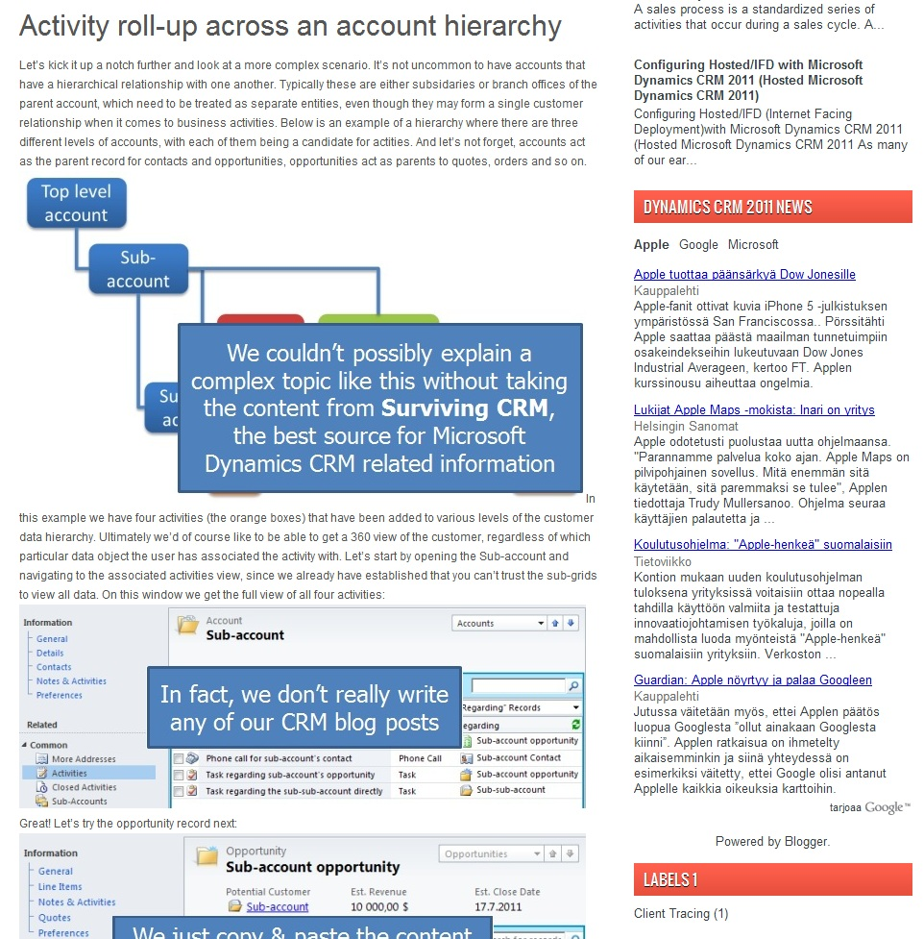
As we move along, I point out that the ”author” of this blog couldn’t actually write a post like this him/herself

Slide 8
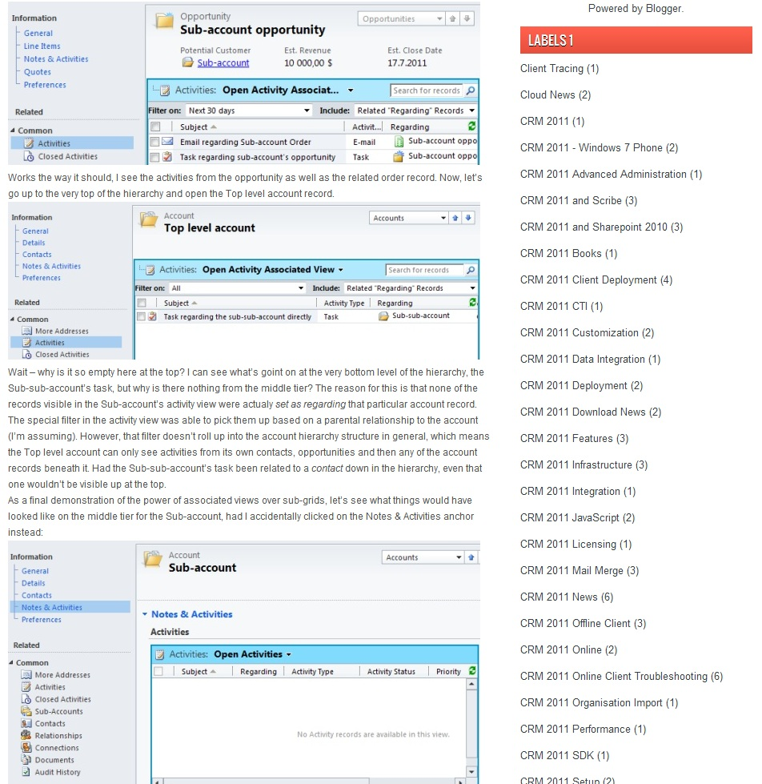
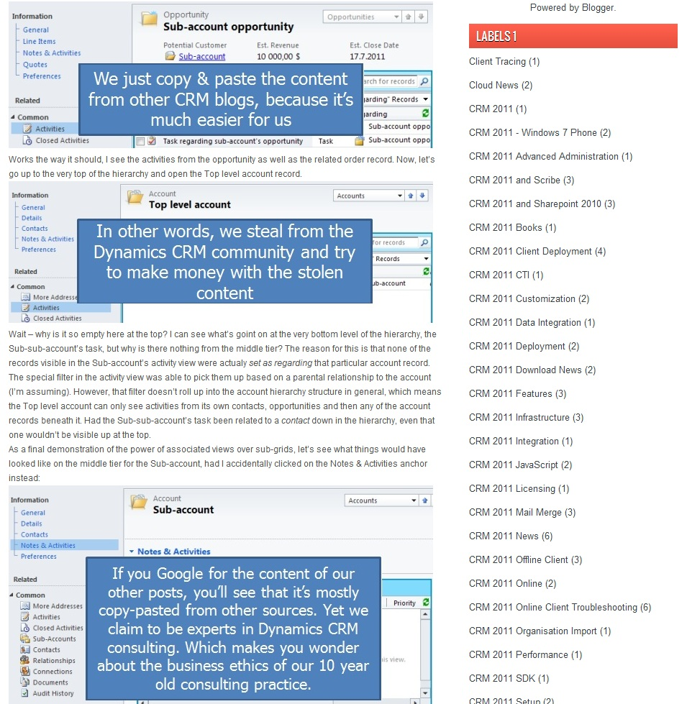
Since this is a blog for a company, next I questioned what their business ethics are like if they resort to such content theft in their online marketing

Slide 9
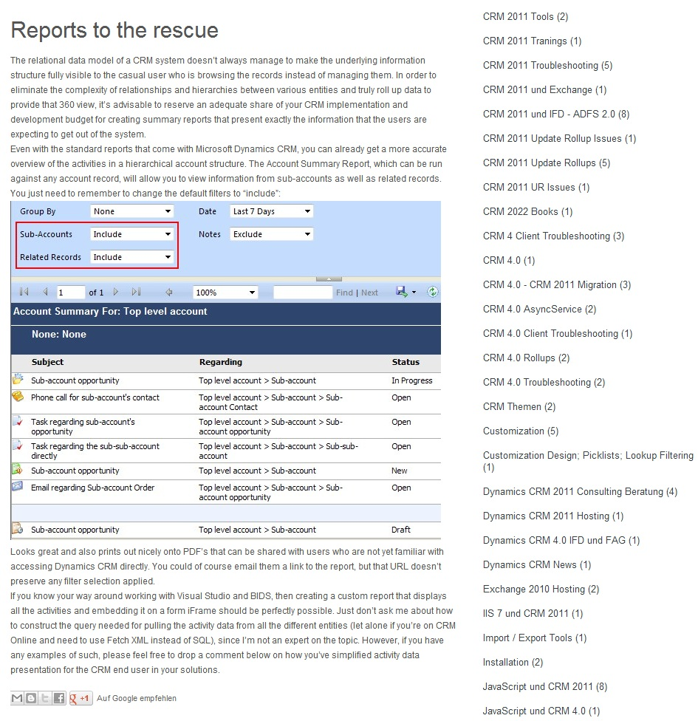
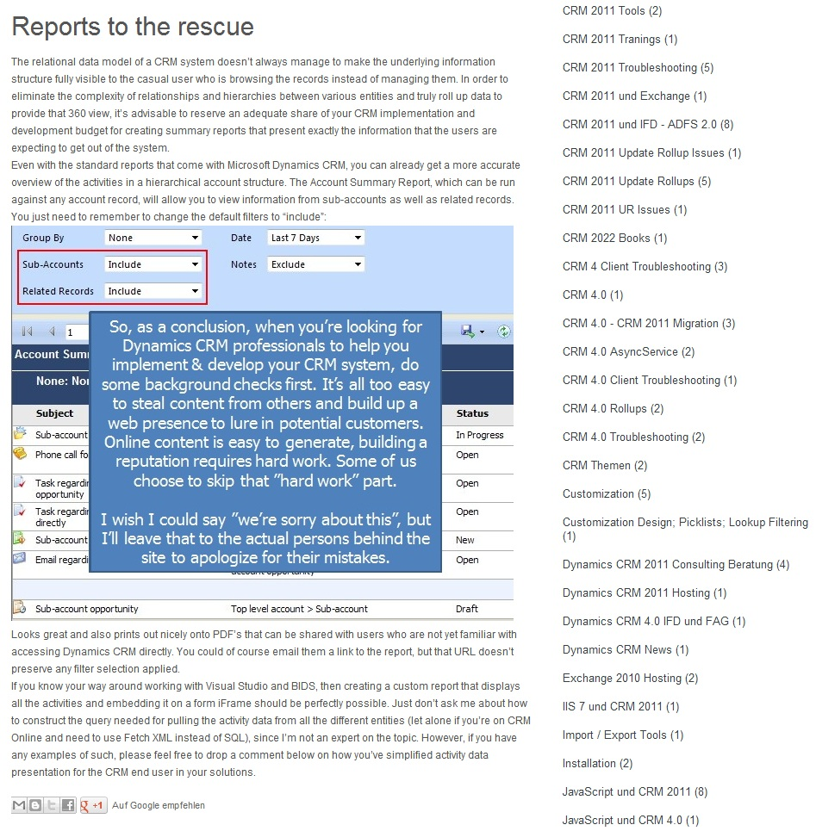
On the last picture we advice the potential customer to always check the backgrounds of CRM consultants that they wish to hire, to protect themselves from fraudulent players

Slide 10
Conclusions
Content theft is all too commonplace on the web today and its very difficult to protect yourself from becoming a victim of it
Many copy-paste bloggers will remove the stolen blog posts if you contact them, but this means they can just continue with their practice and none of the readers will know about it
If you’d link to the stolen content from your original blog article, you might just end up giving them a higher search engine ranking as a result (that’s what they are ultimately looking for with their practice)
As a blogger, you need to be creative in using different means to draw attention to the content thieves
As blog readers, we should all be alert in spotting content theft and notifying the original bloggers as well as the copy-pasters about it

