Slide 1
Dataverse meets Teams:
Low-code app opportunities for everyone
Jukka Niiranen | Power Platform Advisor | MVP

Slide 2
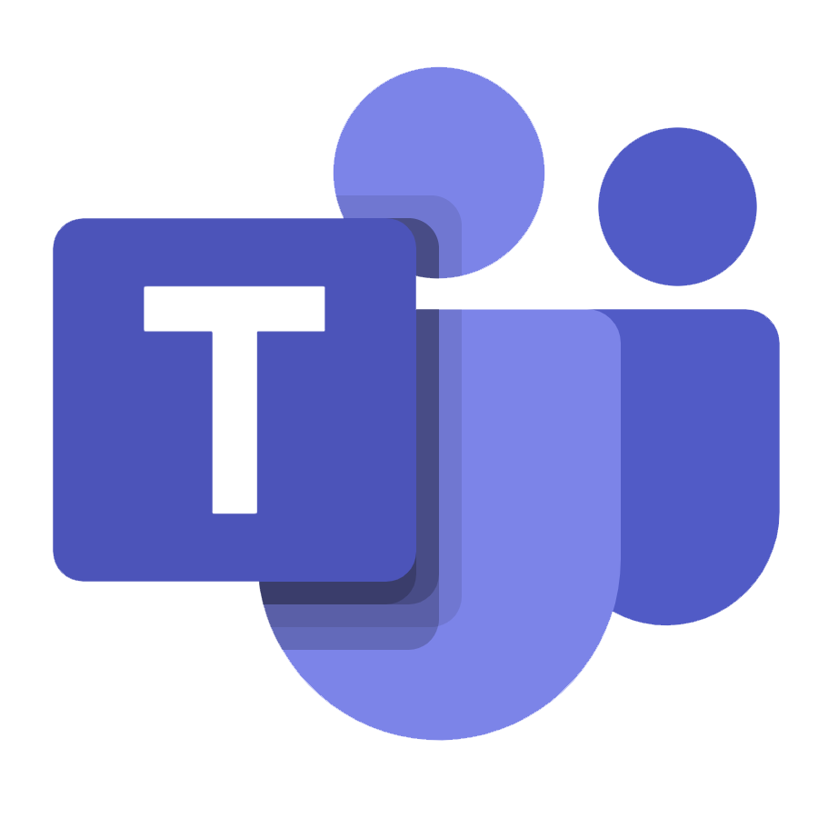

Session objectives
Positioning Microsoft Dataverse into the Microsoft Teams application platform story
Showing app examples of what Dataverse for Teams can do
Helping you evaluate when Dataverse for Teams is a good fit (and when it isn’t)

Slide 3






A quick introduction
Jukka Niiranen: who, what, when, why?
Started working with Microsoft business apps in 2005
Launched my blog in 2008, Microsoft MVP since 2013
Switched my focus from Dynamics 365 to Power Platform around 3 years ago
Working as Power Platform Advisor & Co-founder at Forward Forever
Citizen developer by heart, zero coding skills
Working out loud since 2010 (Yammer😍)
Excited about the Teams as a Platform story – because this could really be the next Microsoft Operating System
jukkaniiranen.com
@jukkan
/in/jukkaniiranen/

Slide 4
Agenda
Dataverse: the big picture
  Where it came from & why it is the center of MS low-code universe
Dataverse for Teams in practice
  3 demo scenarios of real apps
When to use / not to use Dataverse for Teams
  Limitations to keep in mind when architecting your solutions

Slide 5

Dataverse: the big picture

Slide 6
Dataverse: what is it & why should I care?
It’s not just a relational database
  Offers features for managing security, workflows, integration, audit, app lifecycle etc.
Mature platform for enterprise scale business applications
  Available as a MS cloud service since 2011 (just with a different name)
Caters to both citizen developers and code-first developers
  Full GUI for building apps with zero code, extensive APIs for building custom apps and integrations with as much code as you need
Microsoft’s preferred choice for you to build Power Apps on
  While SharePoint may be the most widely used app data source still, MS investments are aiming at making Dataverse work as natively with Power Apps as possible

Slide 7


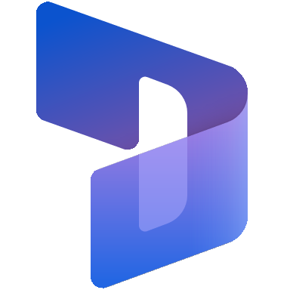
Types of business apps built on Dataverse
Today’s focus
App
Teams apps
Power Apps
Dynamics 365
Dataverse
Platform
Dataverse
for Teams
Included in Microsoft 365 subscriptions
Per App license: $5
Per User license: $20
1st Enterprise App: $95
(allows custom app creation in the context of the originally licensed app)
License

Slide 8

Key benefits of Dataverse for Teams
Available to every Microsoft Teams user
Better foundation for app data model than Microsoft Lists (SharePoint)
Self-service management of Dataverse environment, users are tightly coupled with the team’s roles (owner, member, guest – “OMG”)
Simplified feature set aimed at citizen developers (vs. full Dataverse aimed at enterprise solutions and pro devs)
Can integrate with external systems via Azure API Management (with the help of pro devs…)
Offers an upgrade path to full Dataverse without needing to re-architect the applications

Slide 9
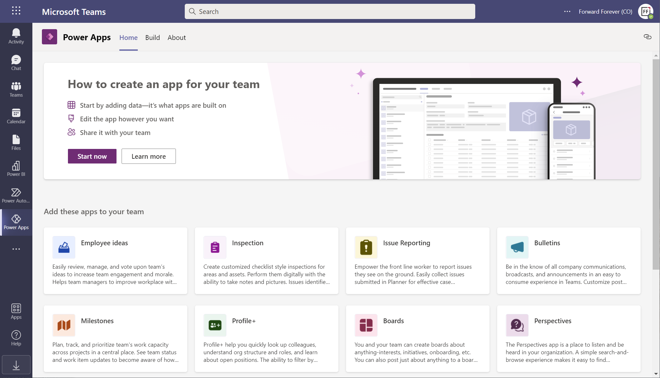
The quickest way to try Dataverse
Use the sample apps from Microsoft Teams store

Slide 10
Everyone can be an app maker in Teams
If you’re a team member, you can provision a new Dataverse for Teams environment by creating a new app (or installing a sample app)
  Unless the Teams admin has explicitly blocked Power Apps + all the MS sample apps
Each DV4T environment gets 2 GB worth of storage capacity – does not affect the tenant level capacity for full Dataverse environments
Each tenant gets 5 environments + 1 additional environment for every 20 eligible Microsoft 365 user licenses
  With 1K users you get 55 environments, with 100K you get 5,005 environments
1 environment per team, but you can have as many apps there as needed

Slide 11
Dataverse for Teams in practice

Slide 12
Example scenarios
1) Basic task management app for a specific process
2) Desktop + mobile apps, including data visualization
3) Responsive app UI + integration + broad distribution

Slide 13
Onboarding app
Scenario
Organization’s need:
  Ensure a smooth experience for handling all necessary tasks when a new employee joins the organization - for both the new employee and those who are responsible for helping in completing the tasks
Starting point:
  OneNote based template list of onboarding tasks
  New copy created to serve as a checklist for each new employee
Solution on Dataverse for Teams:
  Dataverse tables for storing onboarding tasks and employees
  Business logic to copy tasks from a template when new employees are added
  Power Apps UI to show tasks per responsible person and track task completion

Slide 14
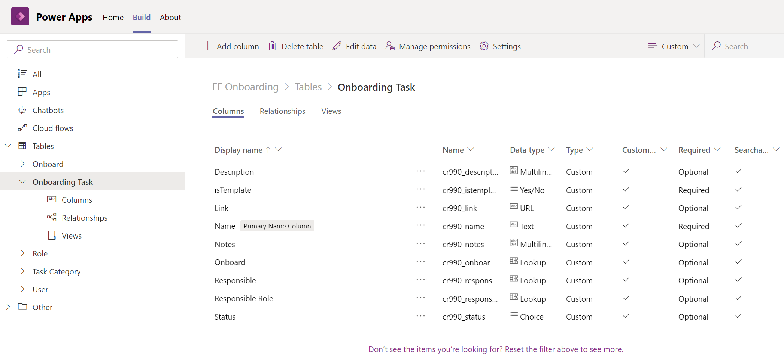
Creating the tables

Slide 15
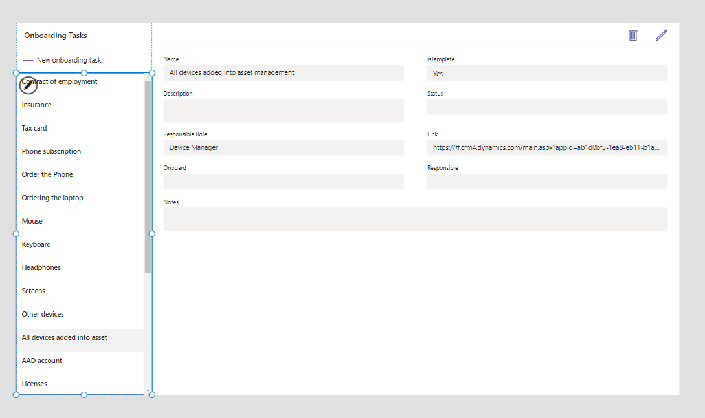
Default UI generated for updating template tasks

Slide 16
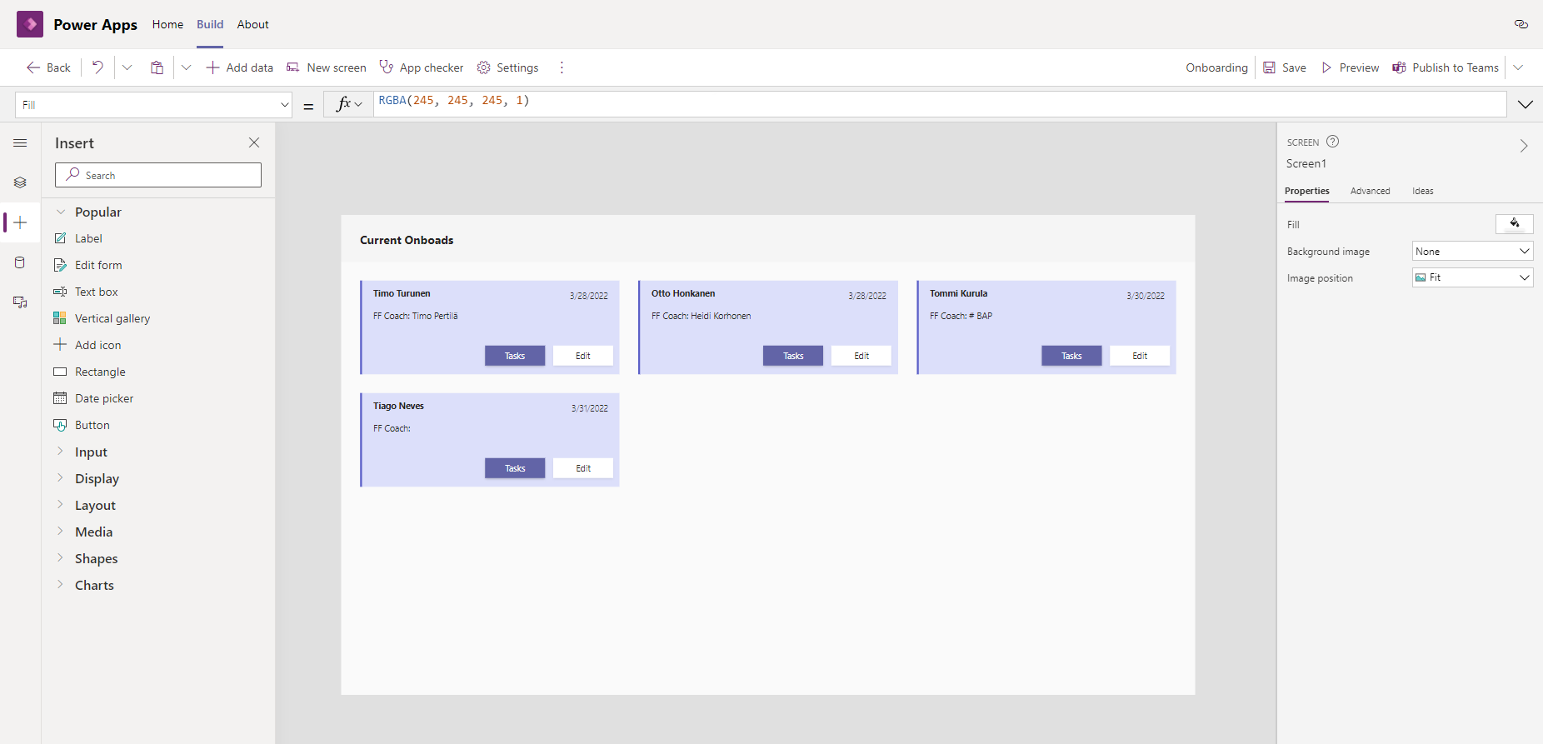
Custom card UI for the employee list

Slide 17
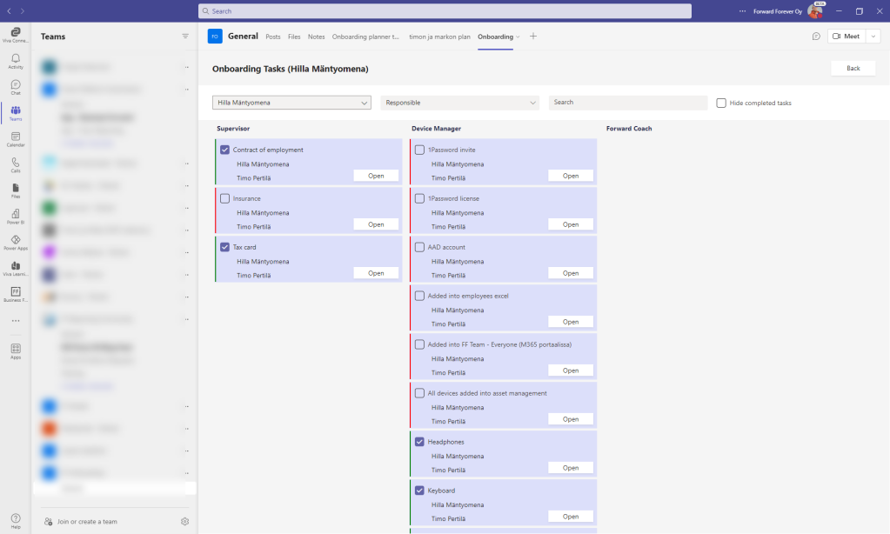
Final app published to a team’s channel

Slide 18
Hospital capacity planning & tracking app
Scenario
Organization’s need:
  Manage the availability of hospital staff required for different categories of visits and activities associated with them
  Create demand estimates through extensive calculation formulas, track actual number of visits + duration of activities
Starting point:
  Common Excel workbook that contained all the planning calculations as well as actual visit and activity duration data
  Infrequent and inaccurate entry of data by the hospital personnel, due to having to open the Excel workbook on a PC at the end of the shift
Solution on Dataverse for Teams:
  Capacity elements modelled into Dataverse tables, with required calculation logic
  Dedicated UIs for capacity planning, actual data entry and results analysis

Slide 19
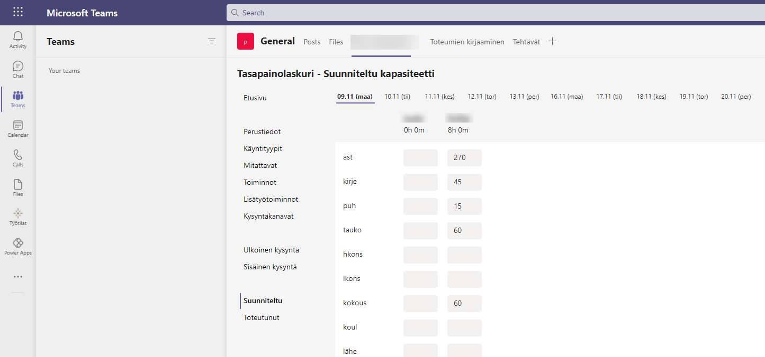
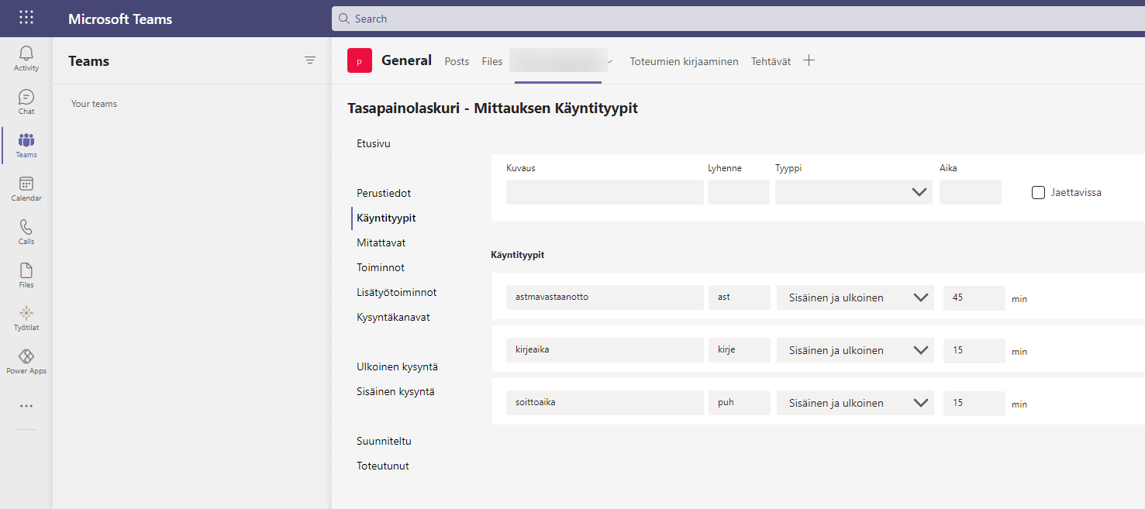
Hospital capacity planning & tracking app
1) Capacity planning app for Teams desktop client

Slide 20
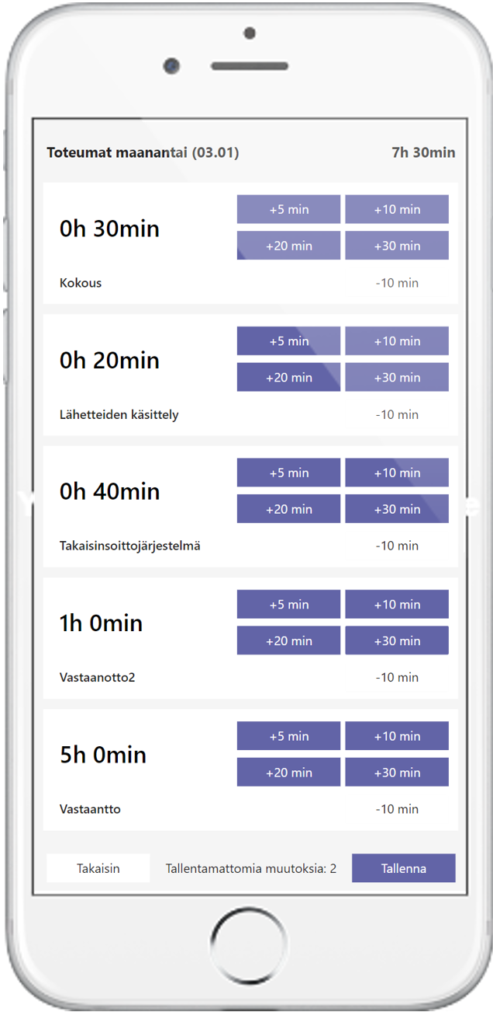
Hospital capacity planning & tracking app
2) Capacity tracking app for mobile devices

Slide 21
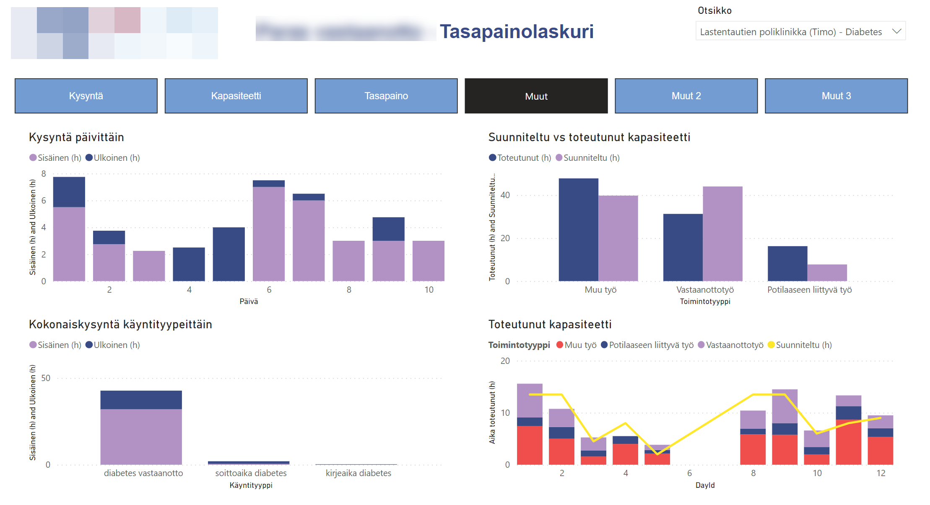
Hospital capacity planning & tracking app
3) Power BI report for tracking planned vs. actual capacity

Slide 22
IT Self-service app
Scenario
Organization’s need:
  Allow employees to request services from IT, such as local admin rights to PC, installation of additional software, access to specific cloud services
Starting point:
  No formal intranet instructions page or forms for submitting requests, process handled via email, no central visibility to requests/approvals/delivery
Solution on Dataverse for Teams:
  Dataverse tables + IT Admin app developed into a team accessible by IT only
  Employee facing IT Requests app published from that same team to the whole organization, pinned as a tab in common Teams channels
  Request approval process managed via native MS Approvals app inside Teams, triggered and monitored via Power Automate cloud flows

Slide 23
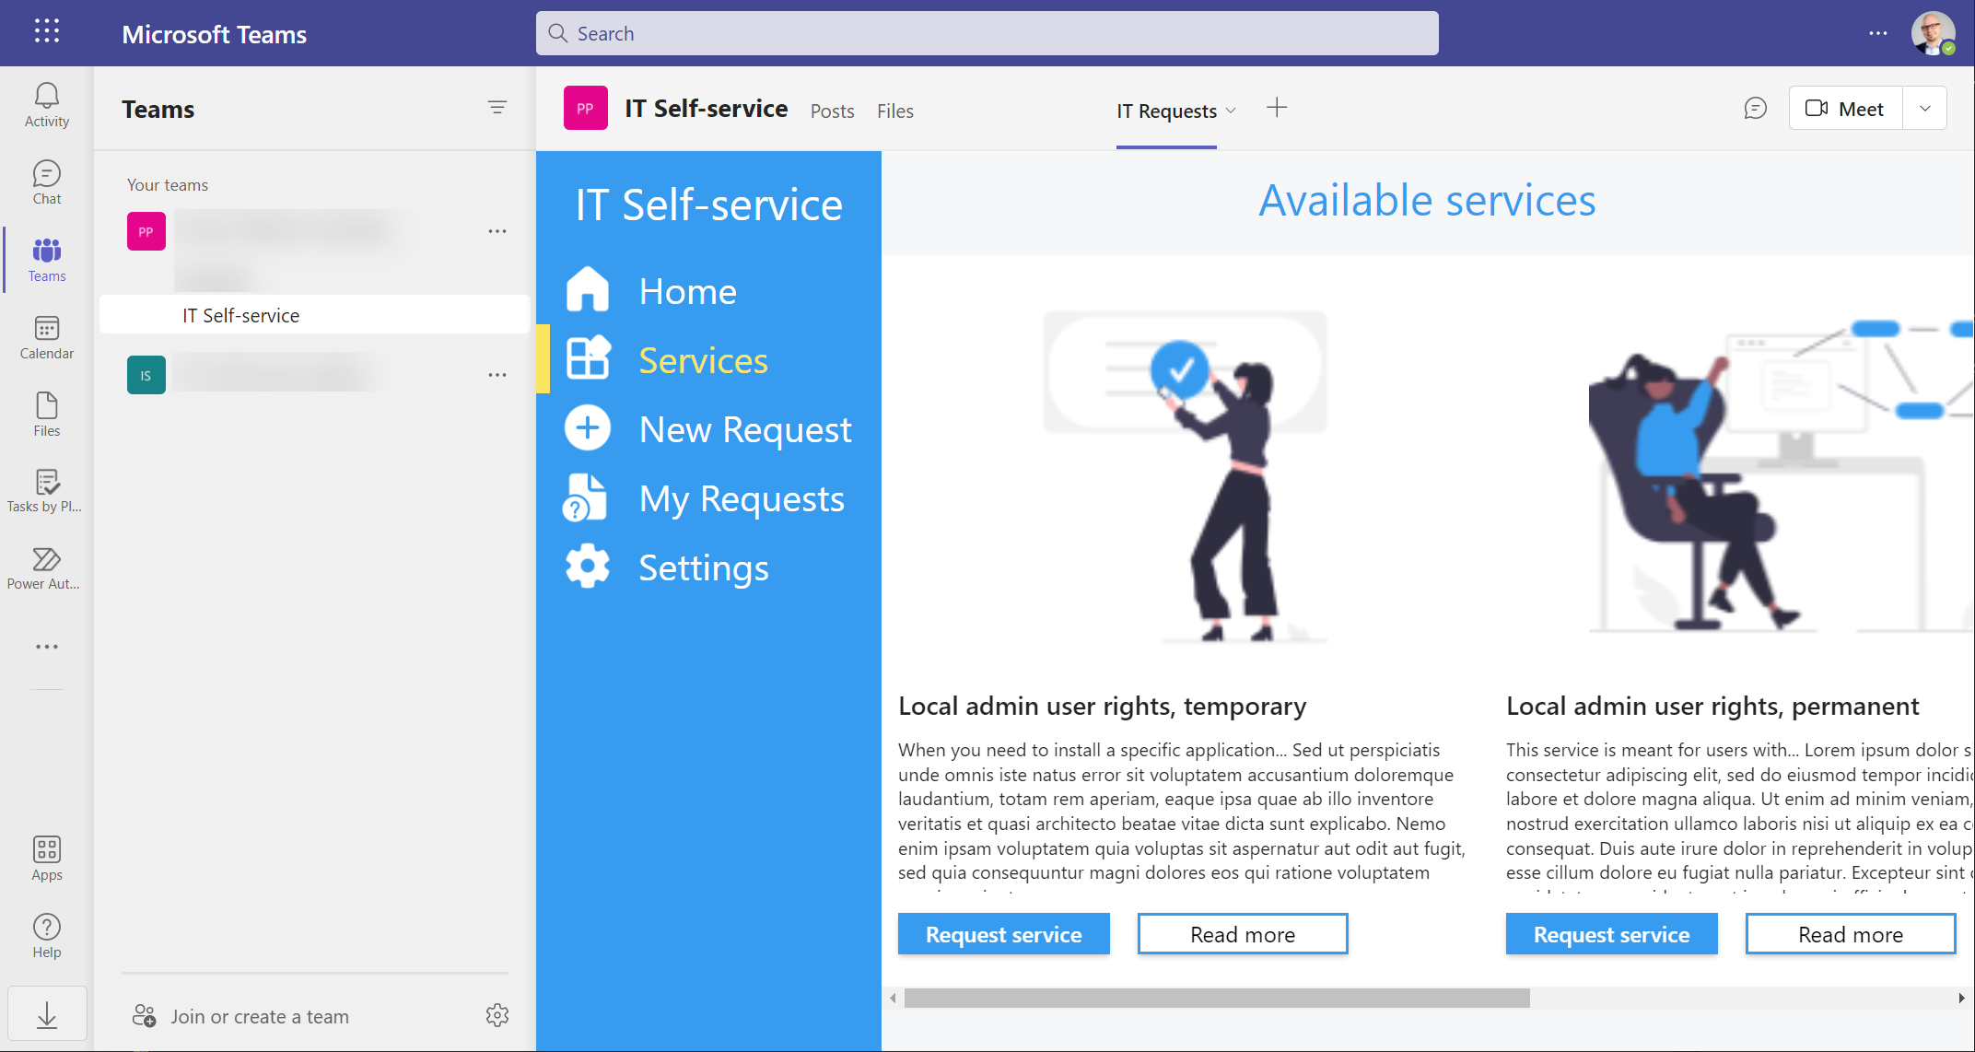
IT Self-service app: employee
1) Employee browses the service catalog and selects a service

Slide 24
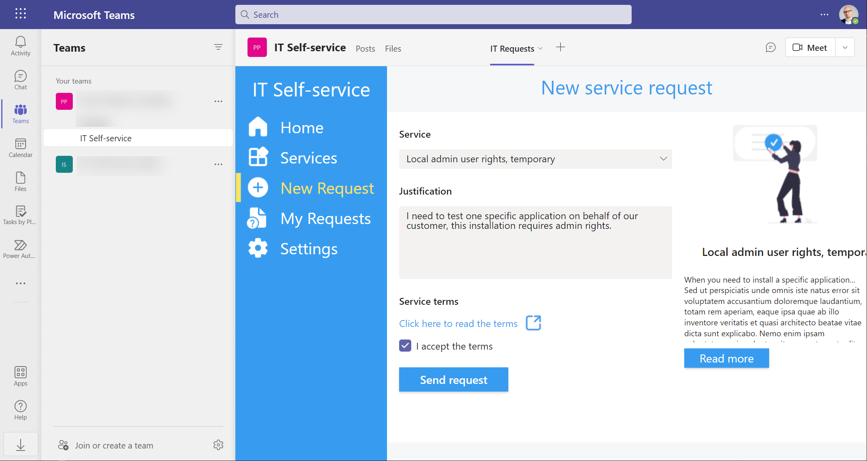
IT Self-service app: employee
2) Employee fills the service request form with justification details & accepts the terms

Slide 25
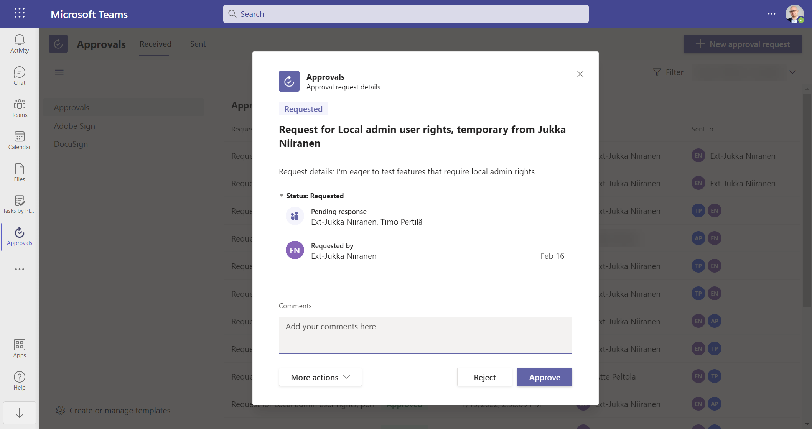
IT Self-service app: approval team member
3) Members of the approval team for the service get the employee’s request for review

Slide 26

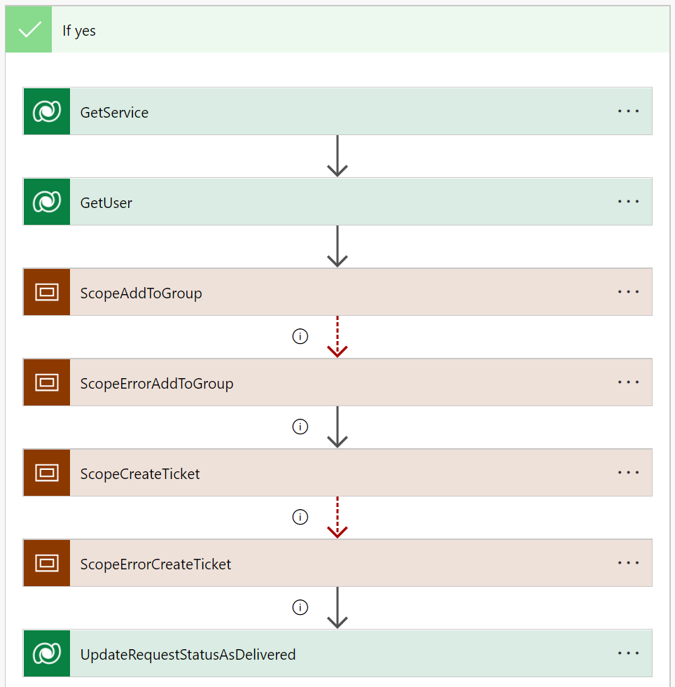




IT Self-service app: service delivery
4) Approved request results in either Azure AD group membership or email ticket to helpdesk

Slide 27
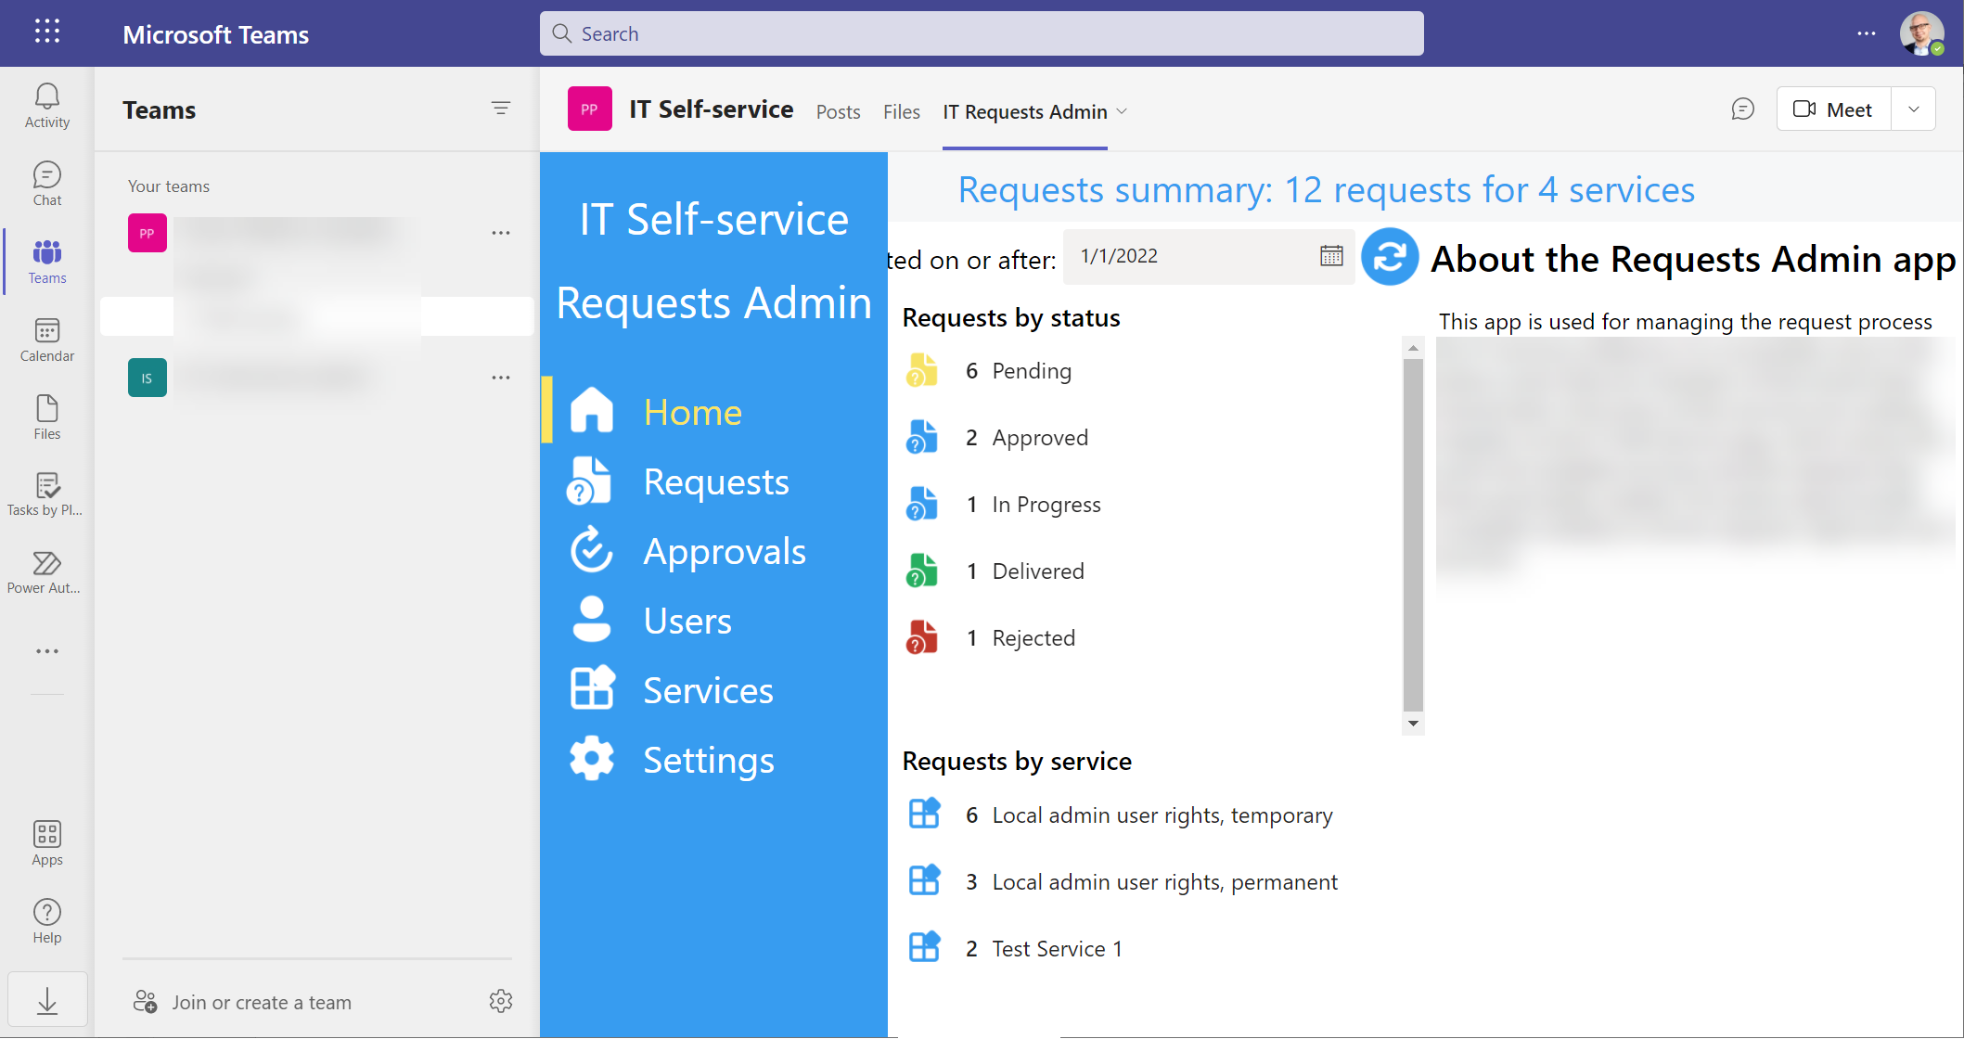
IT Self-service app: IT admin
5) Admin app provides overview and details of all request by status, service, user

Slide 28
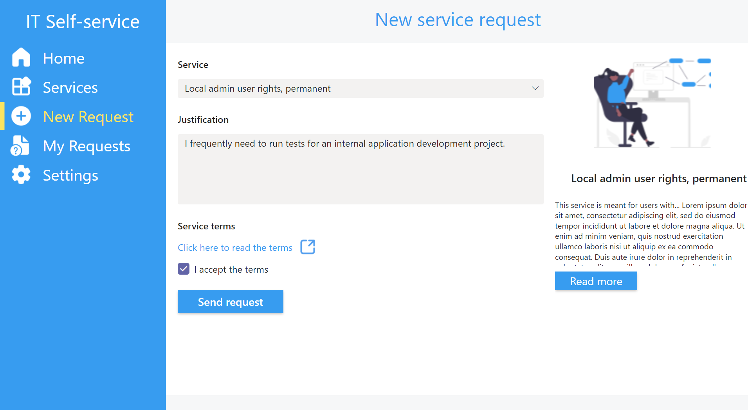
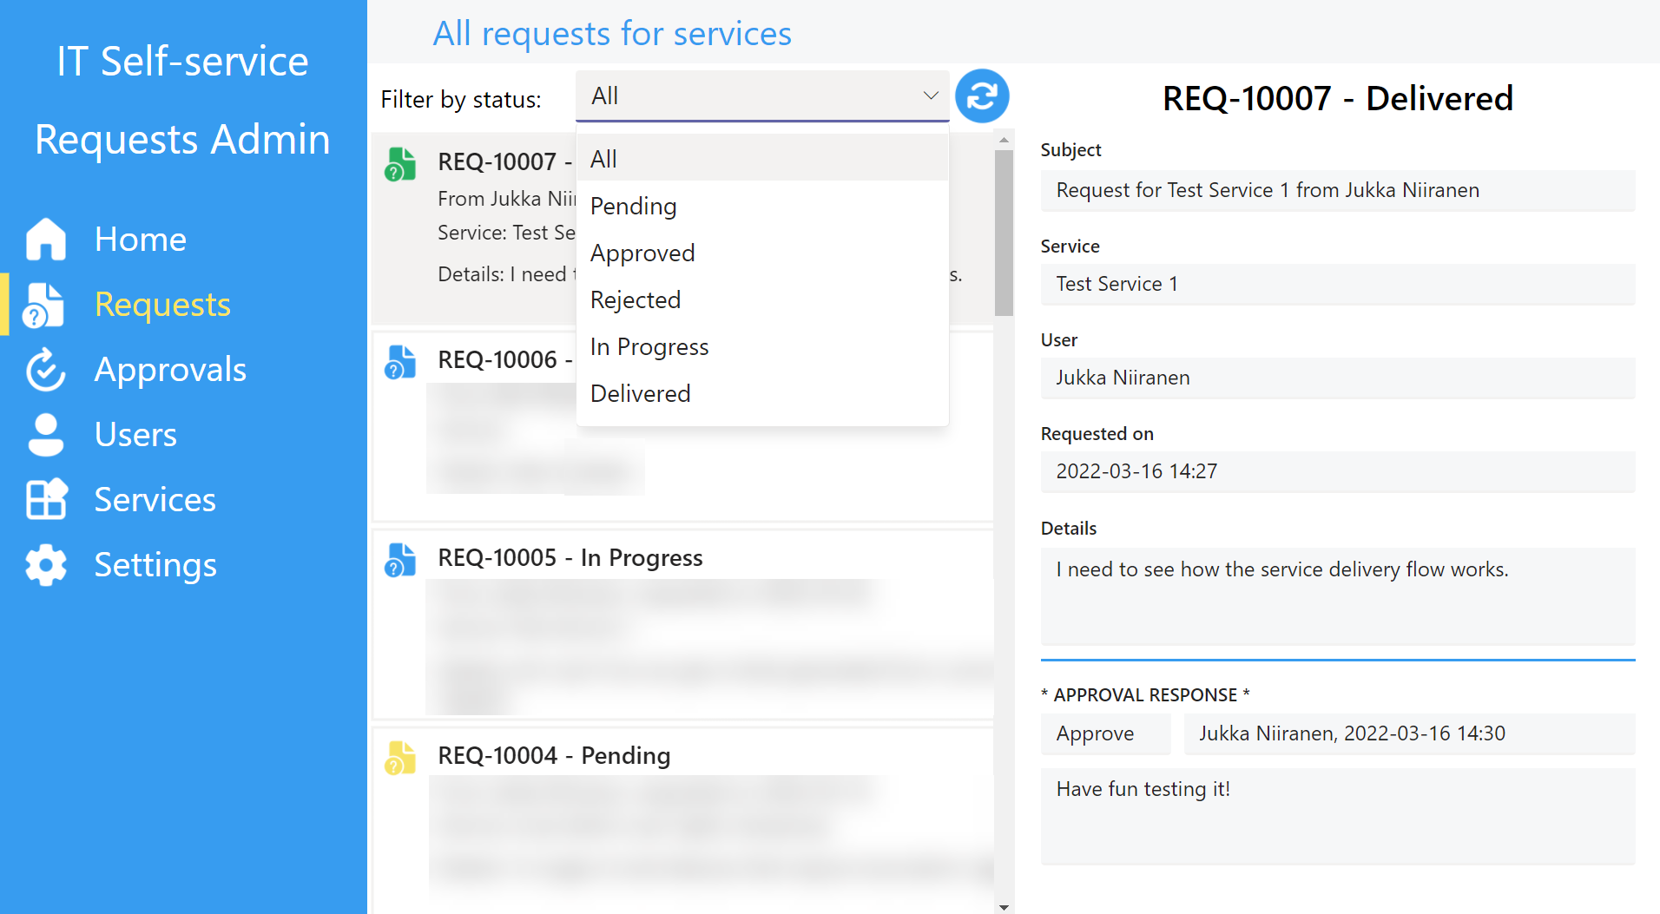





IT Self-service app: team architecture
Data hosted in one Dataverse for Teams environment, shared to other teams for employee access
Access: shared to whole organization, available in any team
Access: only members of the app’s hosting team
Services
Approval Teams
Requests
Approvals
Users/People
Dataverse for Teams
User
Requests app
Admin app
Admin
Azure AD group membership
Service desk ticket via email
Approval team
Approvals app
Cloud flows

Slide 29
When to use / not to use Dataverse for Teams

Slide 30

The “free” version can’t do everything
Building apps for your team to replace Excels or MS Lists used in an encapsulated, independent process is a great fit for Dataverse for Teams
Trying to develop an organization wide app or manage a critical business process with DV4T requires detailed understanding of what the technical limitations are
These limitations are intentional – we aren’t likely to see Microsoft significantly enhance the DV4T feature set in the near future
While you can always upgrade the environment from Teams to full Dataverse later, you should analyze the requirements upfront to avoid nasty surprises

Slide 31
Dataverse for Teams features
Clients
Microsoft Teams
Data
Relational
Basic data types
Common data modeling
(coming soon)
Custom tables
File + Image
Find, filter, sort
Integration
Power automate
O356 and Microsoft Dataverse for Teams included, premium with license
Data flows (import only)
Security + compliance
Encryption at rest
Encryption in transit
Business unit (1 per team)
Admin roles
User roles
Environment lifecycle
One environment per team
Promote to common data service/D365
Backup
Pont-in-time restore
Disaster recovery
App lifecycle
Unmanaged solution (1 per team)
Managed solution (gallery)
Managed solution (classic import/export)
Business rules and workflows
Power automate
N/A
Reporting
Data visualization
Power BI

Slide 32
Dataverse full feature set
Clients
Web
Mobile (power Apps/D365 Player)
Desktop
Microsoft Outlook
Microsoft Excel
Microsoft Teams
Data
Advanced Data Types
Activities/Activity Feeds
Common Data Model
Managed Lake
Mobile Offline
Non-Relational Log
Relevance Search
Virtual Entities
Relational
Basic Datatypes
Common Data Model
Custom Tables
File + Image, Find, Filter, Sort
Integration
API Access
Event to Event Hub
Events to Service Bus
Export to Lake
Plugins
Server-Side Sync
Web Hooks
Power Automate
O365 and Microsoft Dataverse for Teams included, Premium with license
Data Flows (Import only)
Security + compliance
Admin Roles
User Roles
Business unites (multiple)
Customer Managed Keys
Hierarchical Security
Field Level Security
Sharing WS Trust/Legacy AuthN
Activity Logging
Auditing
Encryption at Rest
Encryption in Transit
Business units
Environment lifecycle
Unlimited environments
Reset
Copy
Promote to Dataverse/D365
Backup
Point-in-time Restore
Disaster Recovery
App lifecycle
Unmanaged solutions (unlimited)
Managed solutions (unlimited)
Business rules and workflows
Business Rules
Business Process Flows
Reporting
Paginated reports (SSRS)
Data Visualization
Power BI

Slide 33

Can your app live only within Teams?
For processes that are already discussed and manually managed within Teams, having your apps there makes perfect sense
However, if you need to provide access to users who perform a bulk of their tasks elsewhere, this may become a real barrier for adoption
Mobile use cases are especially cumbersome, since users can’t pin their Power Apps onto phone start screens the way full Dataverse apps would be supported
Opening a DV4T app in a browser tab is supported – but only if you have a premium Power Apps license

Slide 34

Find the right platform for experimentation
Sometimes you need a way to have real users interact with your app “in preview”, before committing to developing the final production solution
Dataverse for Teams is a great option for this, with no extra license purchases required beyond Microsoft 365
If you know you’ll eventually need more than DV4T can support, though, consider an alternative to use full Dataverse right from the start
Pay-as-you-go licensing model for Power Apps could be a solution
  No upfront commitment on number of licensed users, pay only for users who’ve launched the app during the month
  Create dev/test/prod environments on-demand, pay for the storage capacity consumed
  Billed via Azure subscriptions, consumption can be monitored via Azure Cost Management

Slide 35
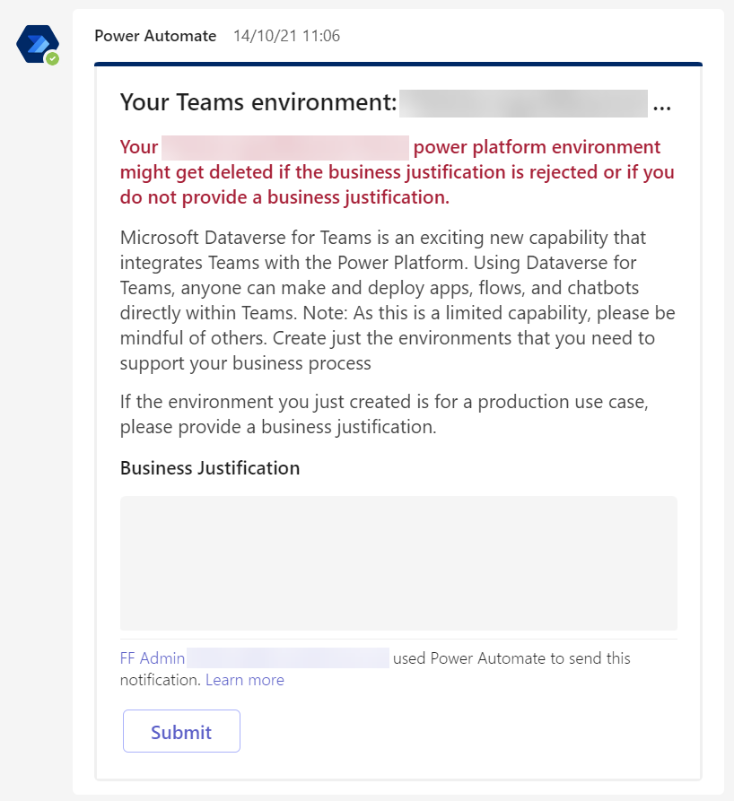
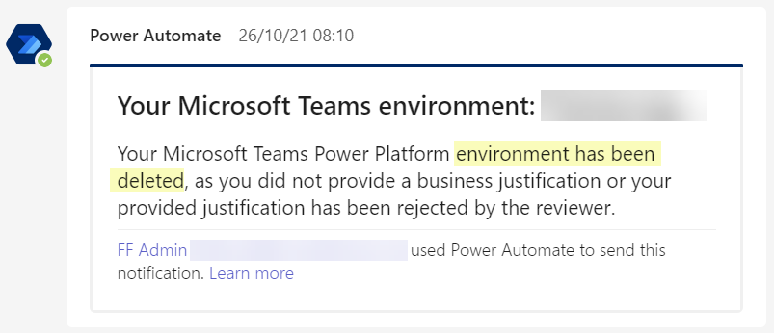
Environment sprawl is very real
Anyone can create a Dataverse for Teams environment if they are a team member
Environments will get created accidentally, or intentionally without full understanding of the implications
Establish a governance policy early on to determine the allowed usage and ownership concept for environments
Leverage the templates available in Power Platform Center of Excellence (CoE) Starter Kit for managing Dataverse for Teams environments: [link]

Slide 36
Closing thoughts

Slide 37
Embrace DV4T with these things in mind
Dataverse for Teams plays a critical role in the “Teams OS” story, while full Dataverse puts the “platform” in Power Platform
Expect to find some quirks in the DV4T app maker experience, especially if you come from the full Dataverse / Dynamics 365 side
Despite of the intentional limitations in Dataverse for Teams, there are plenty of scenarios where the licensing model strongly favors designing your app within these boundaries
Don’t bet your low-code strategy only on the Microsoft 365 feature set – prepare to also consume premium Power Apps/Automate licenses where it makes sense
  Admin/governance capabilities, more complex apps, connecting to external data

Slide 38
THANK YOU,
TEAMS NATION!
Any questions in mind?
jukkaniiranen.com
@jukkan
/in/jukkaniiranen/
Slides will be here (shortly…)

Slide 39




Rate my session & Calls to Action
Rate this session
Attend more sessions and join our keynotes at 19.00 CET
Show your love on social using #TeamsNation and @TeamsNation
1
2
3
https://teamsnation.rocks/
feedback

