Slide 1
Dynamics CRM in 2010:
5 year retrospective
Blog posts from the past & what we know now
Jukka Niiranen (@jukkan) 2015-12-28

Slide 2
About this retrospective
My ”Surviving CRM” blog has been covering topics related to Microsoft Dynamics CRM for a good few years now
At the end of year 2015, I decided to have a look back at some of the writings from 5 years ago, to analyze A) what new technologies & trends I considered to be noteworthy at the time, and B) how the future turned out for each of these
In the slides you’ll find an excerpt from the original post + a link to the article (in top right), alongside my notes on the subject 5 years later
What’s the point of all this? Simply gaining perspective on how the software world around us works, so that we can better evaluate the news we encounter and make more educated guesses on what this world will look like tomorrow

Slide 3
What did I blog about in 2010?
Cloud
Mobile
Portals
MS Office
Social
Business app development/XRM
Outlook
SharePoint
ISV ecosystem
Solution management
Charts & dashboards
MSFT organization

Slide 4
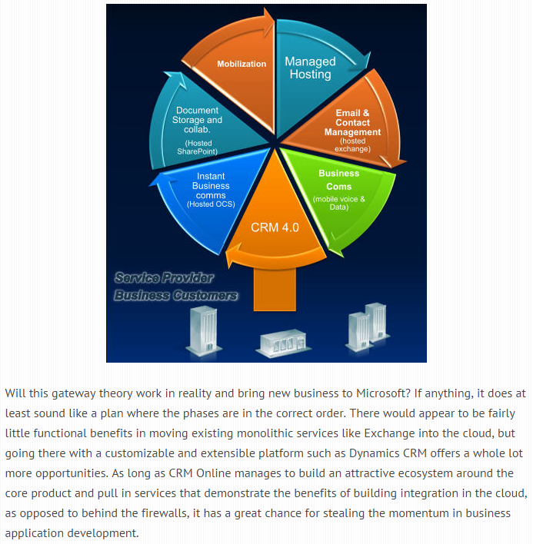
CRM, the gateway drug for the cloud?
Jan 29th, 2010:
“Driving towards the cloud through the CRM mist”
In 2010 Microsoft started their ”we’re all in” campaign for cloud as the focus point for their future business, and CRM was seen as a natural first point of entry for businesses
New Dynamics CRM deployments sure did move quickly to the cloud once Online became available globally in 2011
Migration of existing on-prem instances was a bit slower, as MS didn’t build any tool/service to accelerate these projects
Announcement of Office 365 later the same year set the big wheels in motion for MS business cloud products
It took until late 2015 before CRM Online was sold as add-on license to Office 365, though

Slide 5
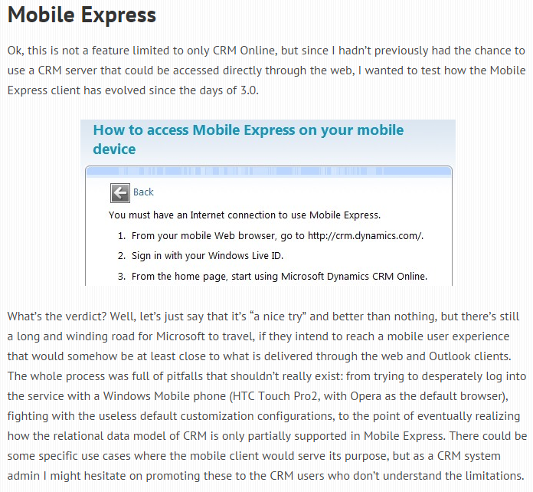
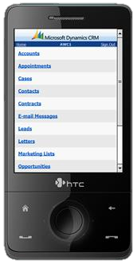
”Mobile” CRM, a bit like ”smart” phones
Feb 7th, 2010:
“Dynamics CRM Online: what does it look like?”
In 2o10 customers started having iPhones and other modern smartphones in their pockets, so mobile access to CRM became a hot topic
MS was offering Mobile Express, a lightweight web edition of CRM as their in-house solution for mobility
Designed for Blackberry/Symbian style keypad navigation, the user experience on a touch screen device left a lot to be desired, not to mention the customization options (or lack of them)
After almost acquiring an ISV solution, MS decided to build their own mobile client (MoCA) application for CRM from the ground up
In mid-2015 the true smartphone app for accessing rich Dynamics CRM functionality finally became available for CRM Online customers

Slide 6
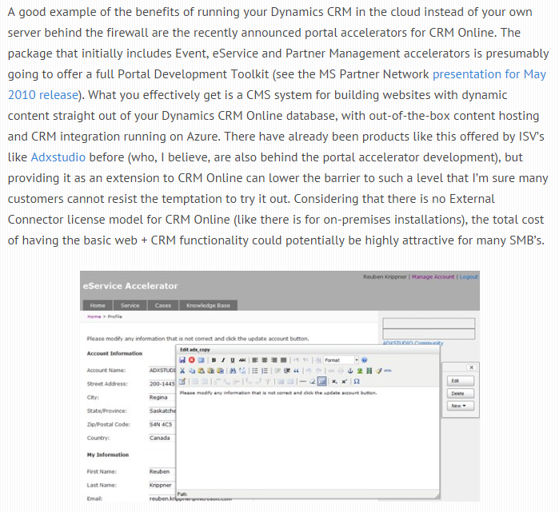
Using CRM as your CMS, is that really a thing?
May 2nd, 2010:
“Greetings from Microsoft Convergence 2010 in Atlanta – Part 1”
In Convergence 2010 the concept of building portal websites on top of Dynamics CRM was introduced
Later on it was bundled into CRM 2011 as Portal Accelerator framework, essentially a ”lite” version of Adxstudio Portals
Despite the obvious needs for having external parties interact with CRM data in many scenarios, customers & partners were slow to adopt this XRM based architecture for their web portals over traditional integration of back/frontend systems
In 2015 Microsoft bought Adxstudio and decided to make these portals the foundation for their customer engagement product offering

Slide 7
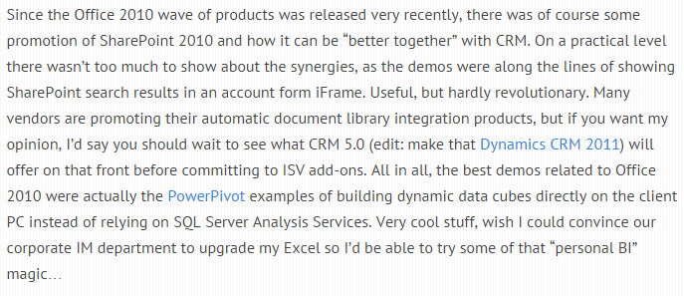
Better Together: CRM and SharePoint… or Excel?
May 2nd, 2010:
“Greetings from Microsoft Convergence 2010 in Atlanta – Part 1”
2010 may have been the year of ”peak SharePoint”, at least in the commercial priorities of Microsoft
Finding ways to push SP in every demo was top priority for MS, but these collaboration tools remained fairly distant from structured CRM systems in many practical implementations, due to factors like system ownership and required development effort
Greater synergies were seen in the BI capabilities that at the time were packaged into Office product line
Unbundling BI from Office turned out to be the strategy MS would later choose in order to let Power BI evolve into the next generation cloud BI solution we see today

Slide 8
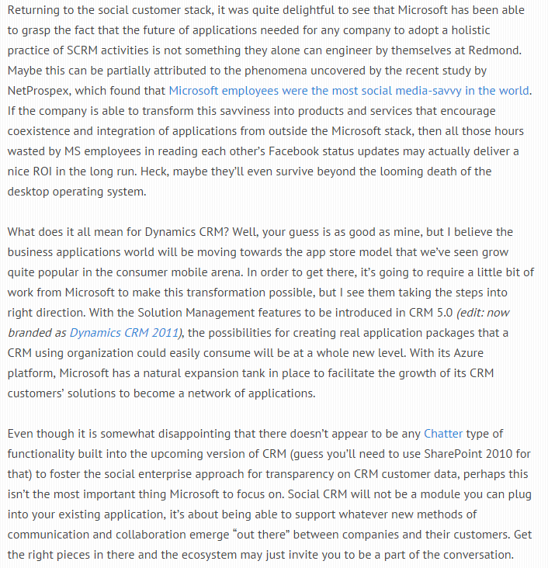
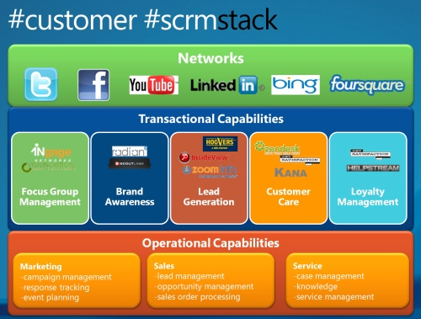
Making Microsoft Social
May 8th, 2010:
“Greetings from Microsoft Convergence 2010 in Atlanta – Part 2”
In 2010 no one was able to hide from social media anymore, ”Social CRM” had become the Next Big Thing, the customers were now in charge
Software giants like MS weren’t able to match the speed of agile startups building all the coolest social tools, so working well together with these new tools was the best that anyone could hope from them
For internal social tools, a response to SFDC Chatter was nowhere in sight yet. As the Office guys weren’t able to deliver it, MS ended up buying Yammer to fit this gap 2 years later
External social channels were covered via Netbreeze acquisition in 2013, which in 2015 integrated with customer social profiles in CRM as MS Social Engagement

Slide 9
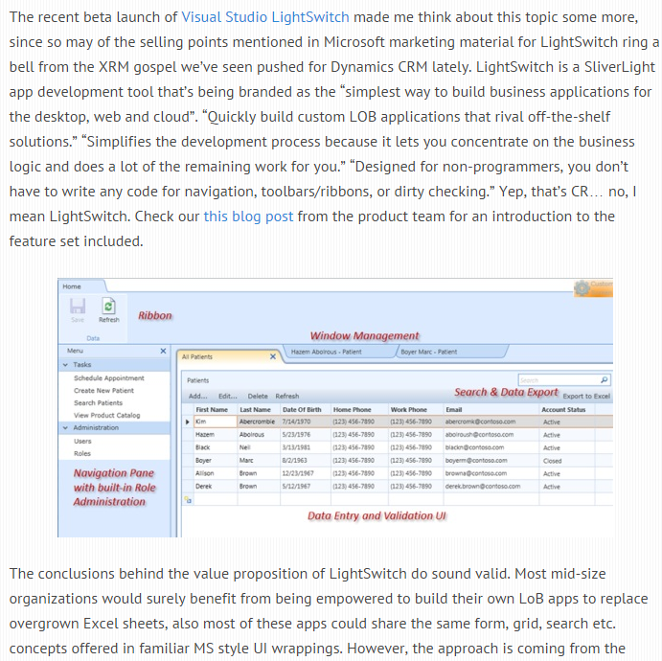
The many faces of LoB app development
Sep 2nd, 2010:
“Dynamics CRM summer news round-up”
In 2010 the question ”what comes after web apps” was answered with ”Rich Internet Applications a.k.a. RIA”
Microsoft’s RIA browser plugin was Silverlight and at that point there was even speculation on if we would see a SL based CRM client app emerge
MS launched LightSwitch as a toolkit for building small business apps in SL, which sounded a lot like the earlier XRM story
As we now know, RIA plugins died within a couple of years as HTML5/Javascript won the battle. LightSwitch got assimilated into the complex app development story of MS, but XRM as a concept is still alive

Slide 10
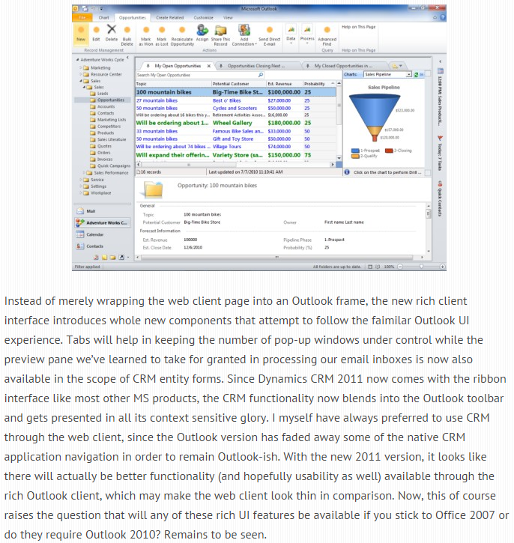
A CRM that works exactly like Outlook
July 12th, 2010:
“Dynamics CRM 2011 and the world of (cloud) apps”
While the CRM Outlook plugin had provided track/sync features for years, the next CRM 2011 version promised to make CRM data truly a native part of the familiar Outlook experience
The Ribbon, reading pane, conditional formatting and all the other MAPI goodness sure made CRM feel like Outlook – in good and bad
While lowering the barrier for Outlook users to access CRM, the reliability of the Outlook client never reached a level where system administrators wouldn’t need to worry about it
In 2015 MS introduced the first version of CRM Outlook (web) App that will potentially make the ”fat” Outlook client a thing of the past (one day)

Slide 11
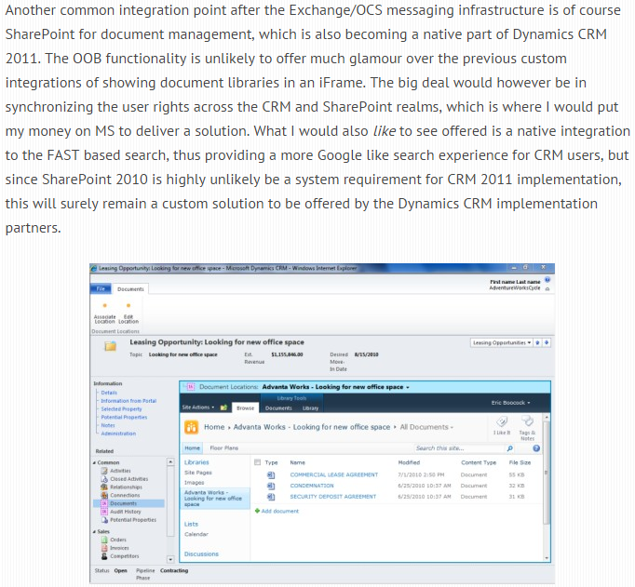
Hey, about that SharePoint integration…
July 12th, 2010:
“Dynamics CRM 2011 and the world of (cloud) apps”
Linking documents to customer records wasn’t an uncommon CRM requirement in 2010, so MS wanted to make SharePoint the obvious choice for document storage with CRM 2011
While automated folder creation for new records in CRM 2011 was neat, the lack of configuration options and dependency on client-side code made this difficult to leverage in real world implementations
CRM-SP security sync was where I put my money for MS to build an OoB solution, but looks like I’ll never see a dime of it now…
SP search features never arrived to CRM, but in 2016 the new Relevance Search powered by Azure Search service promises to finally bring more advanced content indexing to CRM

Slide 12
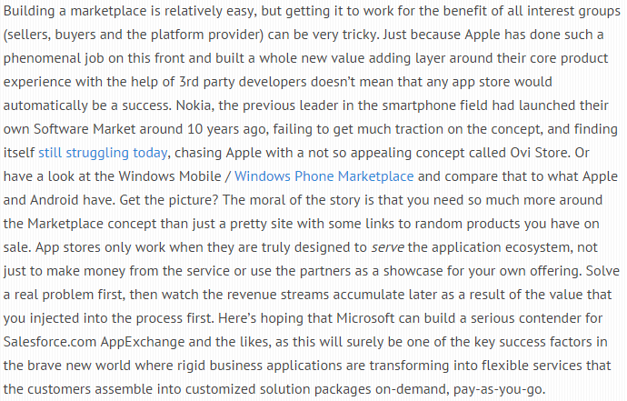
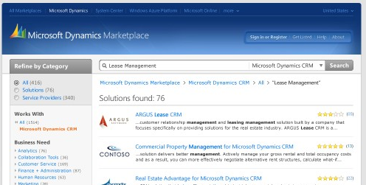
Build a Marketplace and the apps will come?
July 12th, 2010:
“Dynamics CRM 2011 and the world of (cloud) apps”
CRM 2011 was about to deliver a new solution management model into CRM, thus greatly enhancing the technical foundation for installing add-ins from 3rd parties into customized CRM environments
Dynamics Marketplace was promoted as the place from which customers would conveniently find these solutions, listed there by ISV partners and verified via MS’s certification process
Although ”full ecommerce” functionality was promised, it never arrived, thus leaving a central component of a true marketplace missing
Today Dynamics Marketplace is no more and the contents has been rolled back to the generic MS Pinpoint listings that always were behind the service
While great ISV solutions continue to be developed for Dynamics CRM, the inability for MS to support their partner app ecosystem is quite puzzling

Slide 13
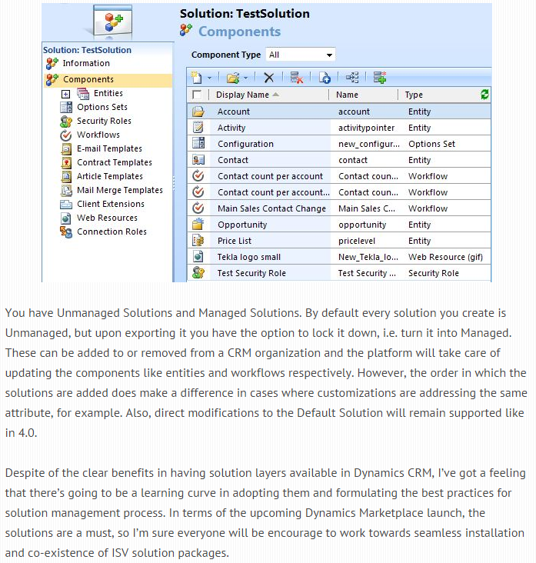
Solutions are the final solution
Sep 11th, 2010:
Dynamics CRM 2011 in all its (beta) glory
Before CRM 2011, trying to merge customizations from multiple vendors into a single CRM organizations was quite painful
The managed solution layers promised peace & harmony for co-existence of various ISV add-ons
In practice, dependencies across different solutions’ components often blocked the graceful uninstall
Fooled by MS’s initial guidance to always use managed solutions in production, many VAR partners learned it the hard way that customer specific customizations were usually best left in unmanaged state
Solution framework has gradually improved and in CRM 2016 the ability to select solution components on a more granular level than whole entities is promising a brighter future

Slide 14
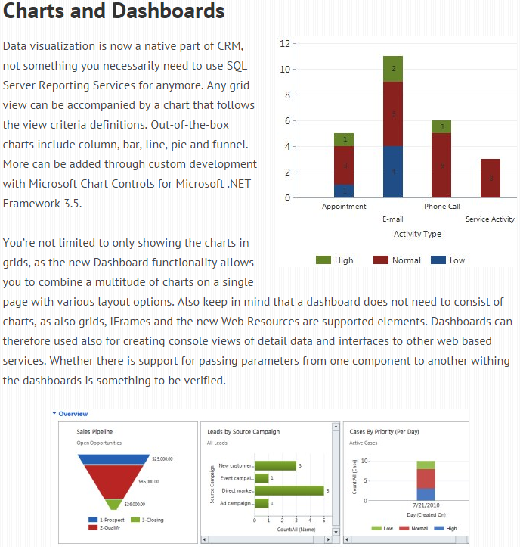
My God, it’s full of charts!
Sep 11th, 2010:
Dynamics CRM 2011 in all its (beta) glory
The addition of charts and dashboards in CRM 2011 greatly expanded the usefulness of the application for managing complete business processes, not just records and fields
Simple SSRS report development was replaced with chart configuration, thus lowering the barrier for applying data visualizations into processes
No major feature development of the ASP.NET based charts was introduced after CRM 2011, advanced customization of CRM visualizations remained quite rare, full SSRS capabilities weren’t ever brought into the cloud
As the Power BI features are rapidly evolving, the future alignment of external analytics and CRM built-in visualizations is becoming a topic to keep a close eye on

Slide 15
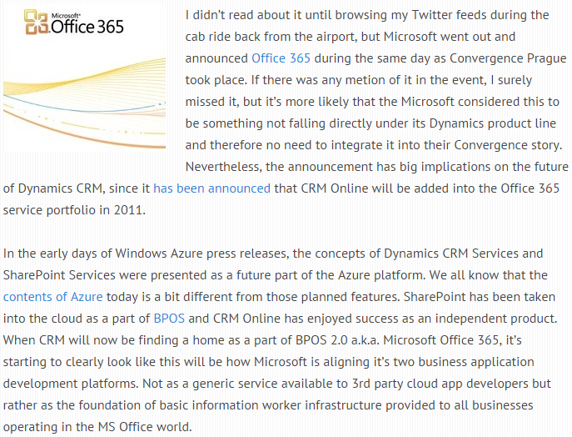
All in the cloud - all on their own trajectories?
Oct 25th, 2010:
“Greetings from Microsoft Convergence 2010 EMEA”
In 2010 Convergence EMEA the concurrent launch event of Office 365 was not mentioned at all to the Dynamics crowd
Earlier plans for including ”XRM Services” as an Azure component had been scrapped, instead the focus was on selling a modern cloud CRM application, with user identities managed via Windows Live ID
Fast forward to 2015, Convergence US event was all about showcasing non-Dynamics products from MS portfolio, rather than the latest CRM/ERP features
Later the same year MBS as a unit was dismantled and Dynamics product development moved to Scott Guthrie’s C+E unit, home of Azure

