Slide 1
Dynamics CRM 2013 Customization and The Platform Evolution
Jukka Niiranen (@jukkan)

Slide 2
Today’s agenda
History of Microsoft’s CRM platform
  CRM 2013 – the start of the next chapter?
Effects of mobile computing
  One app – many, many clients
Customizing CRM today
  Design more than just the data model
Delivering responsive solutions
  …with no code!

Slide 3

About me
Dynamics CRM consultant from Helsinki, Finland
Worked with the platform since 2005
Frequent blogger & #MSDYNCRM evangelist on social media
  Blog: Surviving CRM at niiranen.eu/crm/
  @jukkan on Twitter (& many other networks…)
Awarded as Microsoft MVP last year
Focused on improving CRM solution usability & information work efficiency

Slide 4
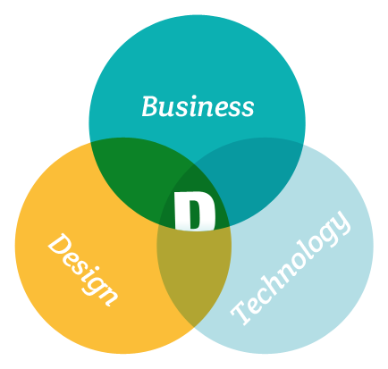
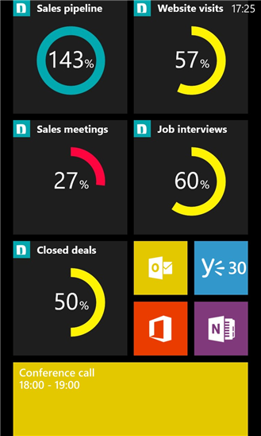

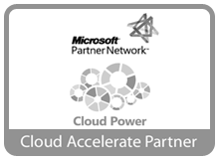


About Digital Illustrated
Digital Illustrated is an agile technology agency that creates business value with Microsoft technologies.
We focus on solutions that improve customer experience, social collaboration and business agility.
Designing and implementing consumer-grade enterprise solutions built on platforms like SharePoint, Dynamics CRM, Yammer, Azure
Founded in 2011, growing fast, and owned by the employees
THIS JUST IN! Download a free CRM Online goal visualization app for your Windows Phone 8 device from crmgoals.com!

Slide 5
History of Microsoft’s CRM
CRM 2013 – The start of a new chapter?

Slide 6
The first chapter of CRM: 2003-2011
CRM 1.0 (2003)
Sales & service modules
Outlook integration
CRM 3.0 (2005)
Custom entities (XRM)
Marketing module
CRM 4.0 (2007)
Multi-tenancy, multi-language, multi-currency
Windows Workflow Foundation
CRM 2011
Charts & dashboards
The Ribbon
Solution model
Native Outlook app
SSRS reporting
From callouts to plugins
Report Wizard
Form subgrids, web resources, goal management, dialogs

Slide 7
From evolution to revolution?
The first 4 major releases of CRM were a steady evolution:
  New functionality and options being added alongside existing ones
  Platform components replaced with more robust technologies
CRM 2011 was a “more of everything” release, a pinnacle of this chapter
CRM 2013 no longer continued on this familiar path, instead it could be seen as an “everything’s different” type of a paradigm shift

Slide 8
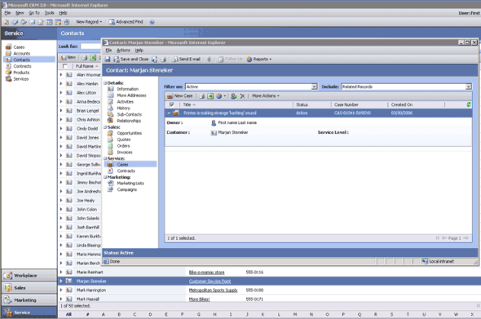
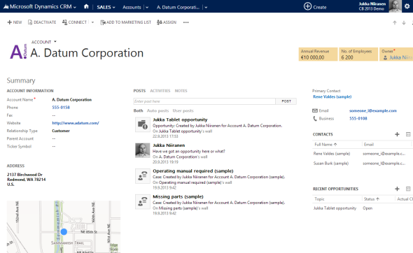
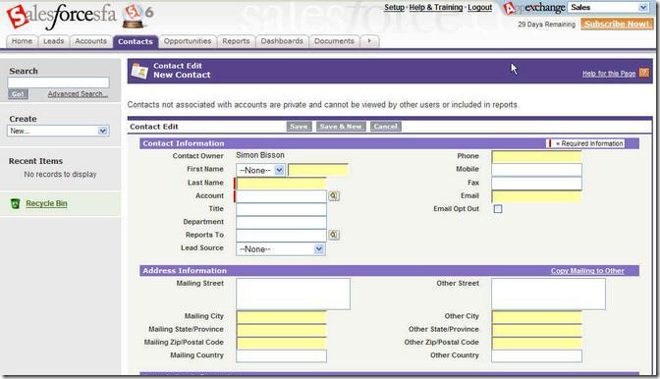
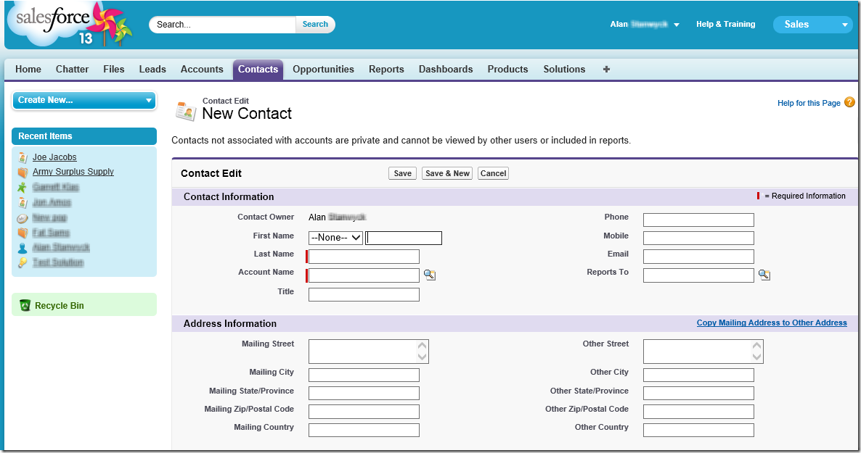
User interface evolution CRM applications: Microsoft vs. Salesforce
2006
2013
Microsoft Dynamics CRM
Salesforce

Slide 9
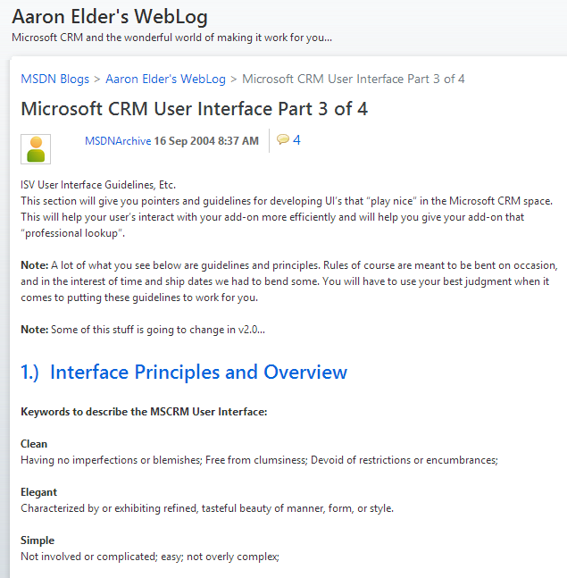
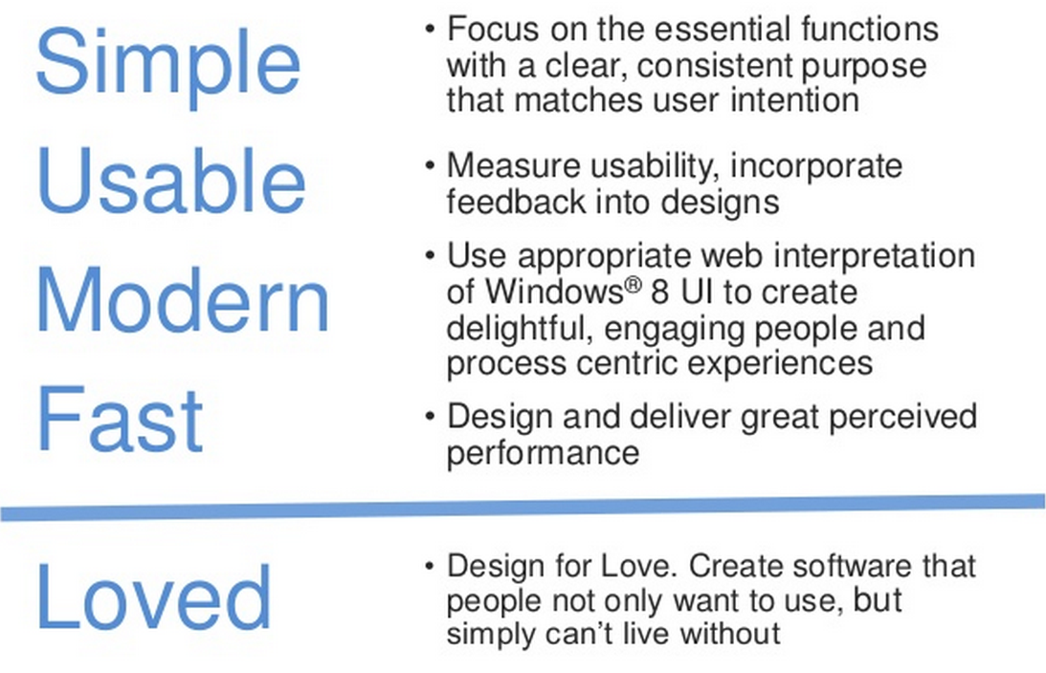
CRM design principles: then and now
2004
2013
Clean
Elegant
Simple

Slide 10
The effects of Mobile Computing
One app – many, many clients

Slide 11
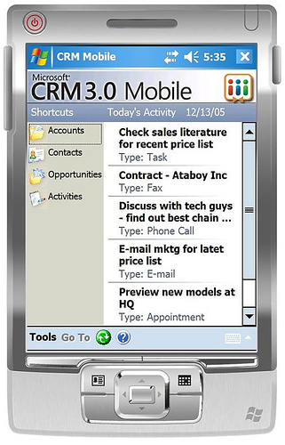
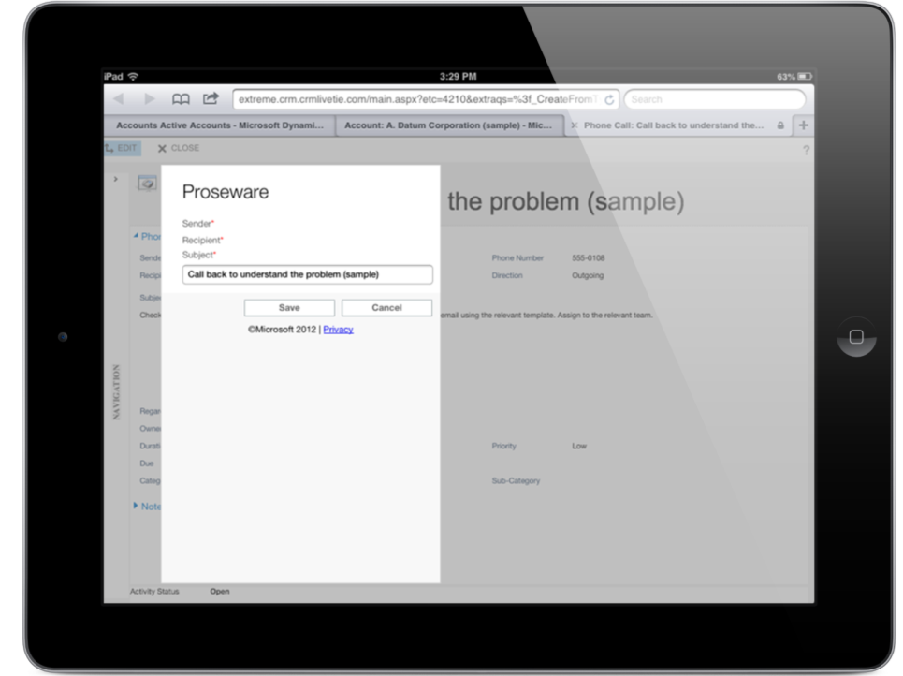
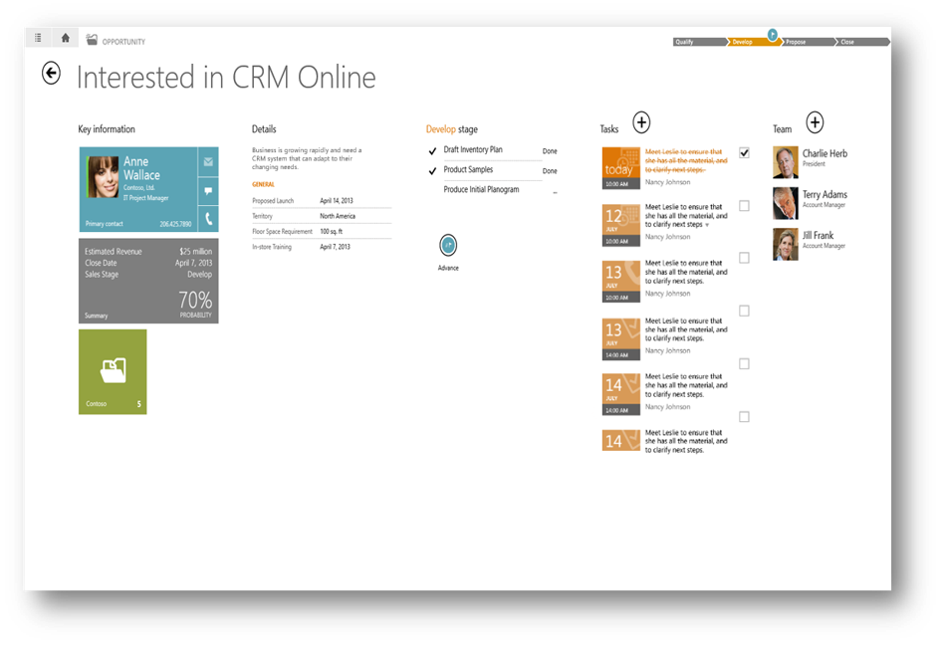
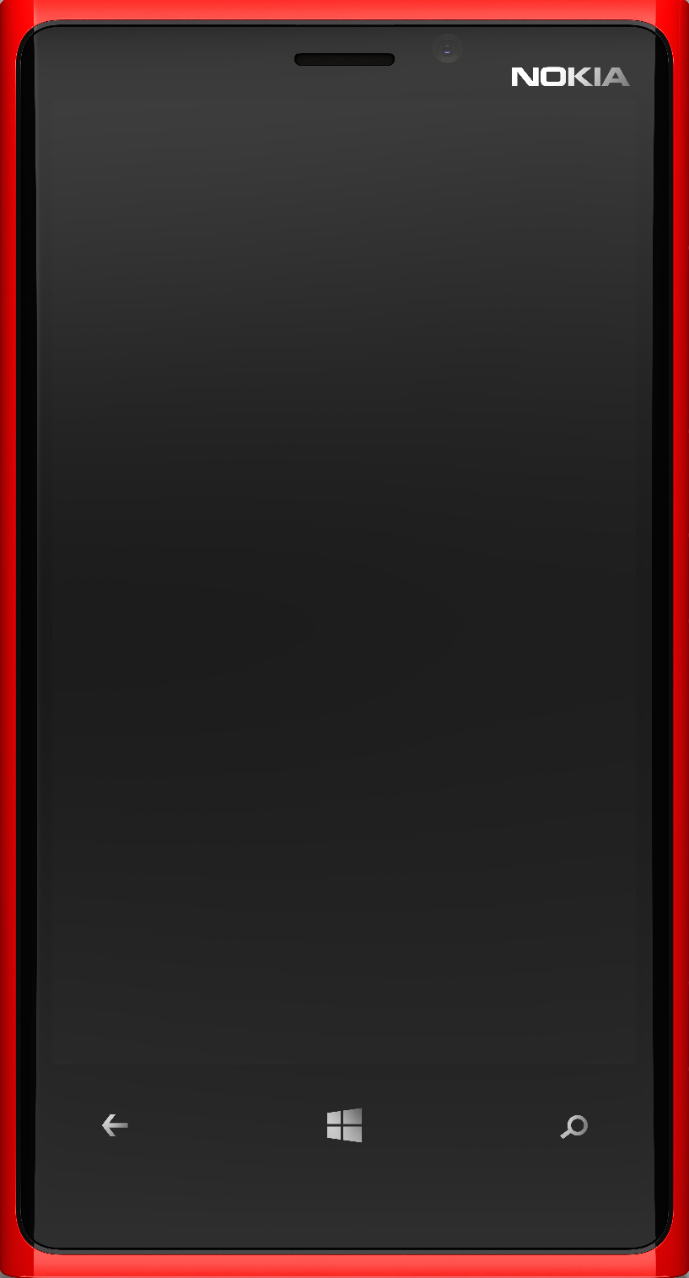
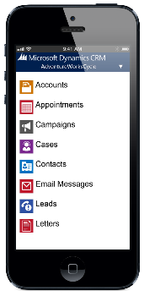
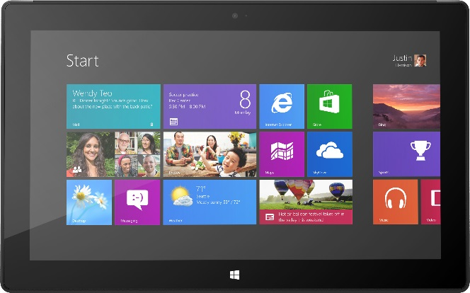
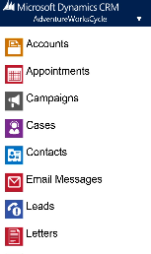
Mobile CRM concept: then and now
What Microsoft originally thought it was
What it actually turned out to be

Slide 12
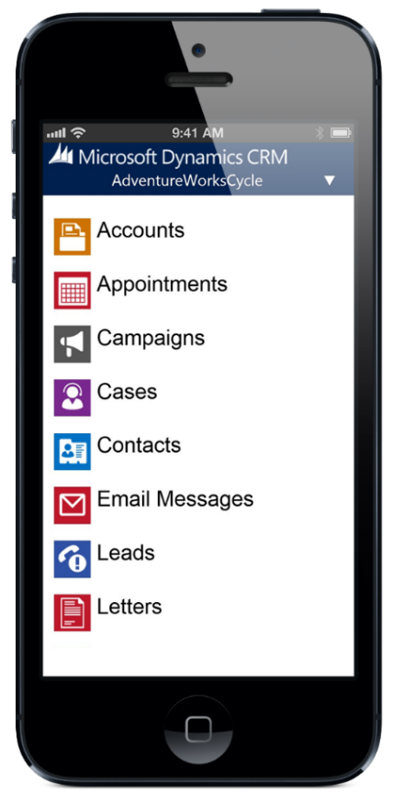
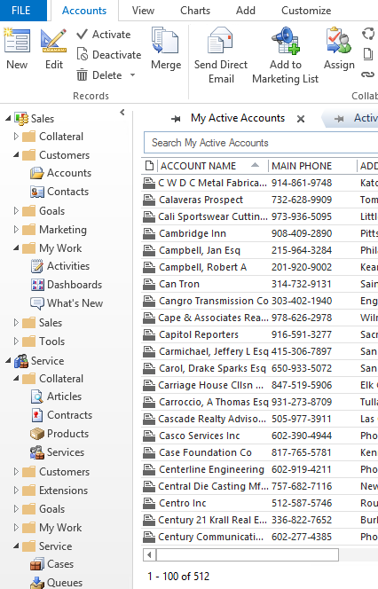
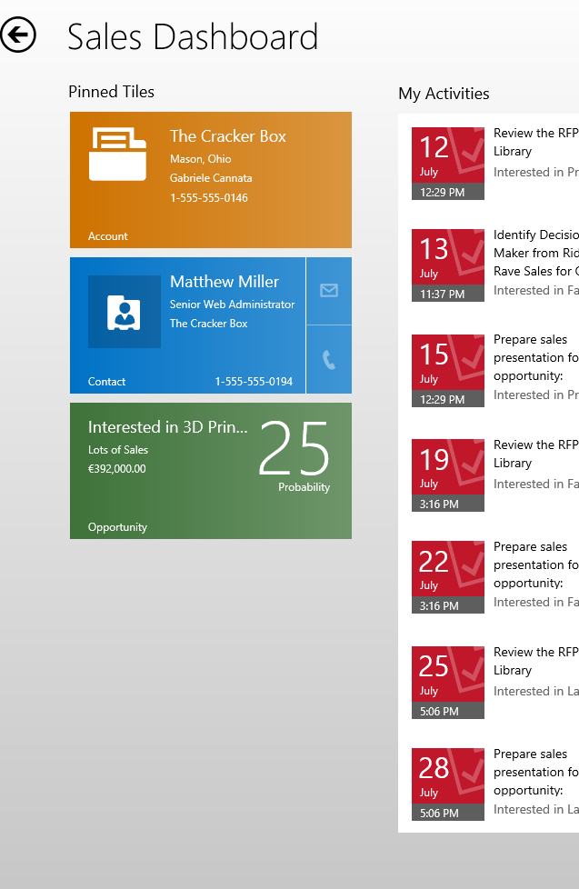
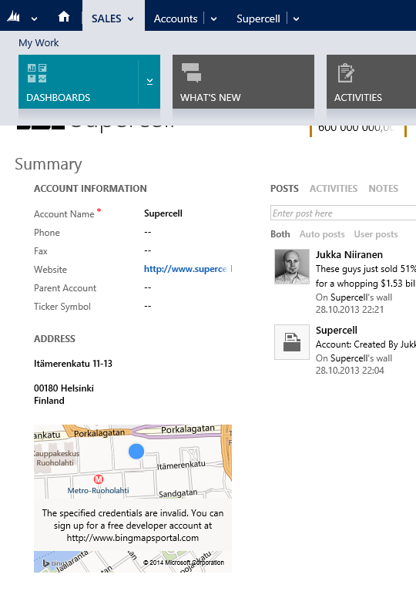
CRM 2013 Client Types
Web
Outlook
Tablet
Phone

Slide 13
Key Differences Between Clients
Web
Mostly single window
Sitemap as global Nav Bar
Outlook
Sitemap shown as folders
Ribbon in main window
Tablet
Standard forms rendered for touch
Business Rules supported
Phone
Popups for record details
Separate Mobile forms
Business Rules not supported
Scripts supported
One dashboard
No HTML or iFrames support
Preview form as single column
3 column form layout by default
No Global Quick Create
No more Ribbon

Slide 14
Client Support Considerations
Every supported client option will require testing – and support
Outlook client is still frequently needed for tracking individual emails and other activities, regardless of the CRM 2013 Server-side Sync support
Not all of your entity form functionality may work when accessing the record via the CRM for Tablets app
The Web UI can be accessed with many non-PC devices

Slide 15
Customizing CRM today
Design more than just the data model

Slide 16
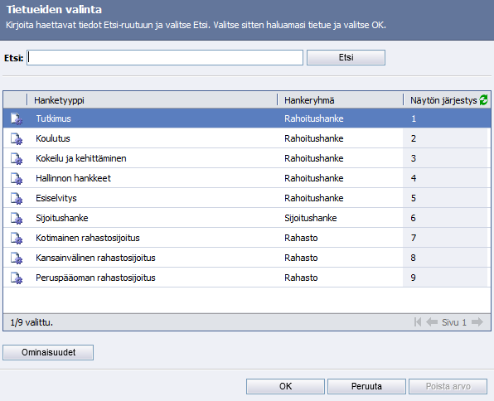
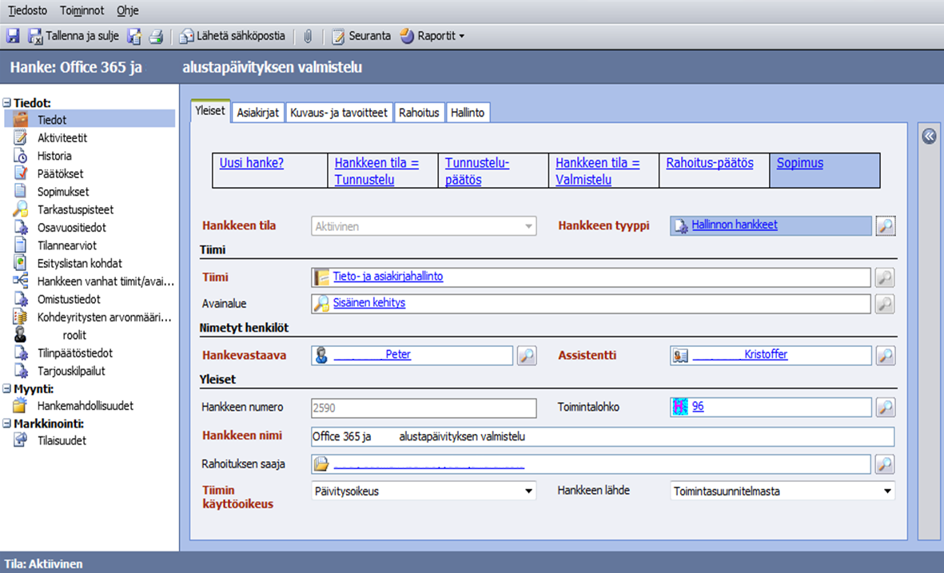
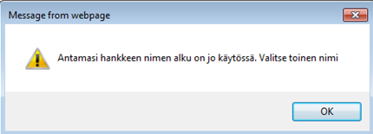
Traditional CRM system
Tabbed navigation
Forms resembling traditional paper forms for data entry
Popups everywhere!
“Exploding” related records menus
Focus on individual records
Little visual guidance available, just fields

Slide 17
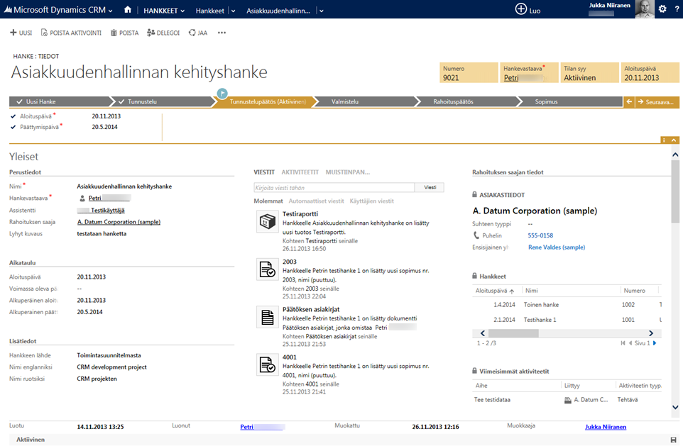
Modern CRM system
Every window is a “main window”
All the latest related events
Data from parent & child records
Consistent grouping of information

Slide 18
CRM is not a graphical UI for designing database tables
CRM customization has traditionally been too much focused on just the data model
End user experience cannot be the direct result of the data model – it requires proper design work in its own right
How to store the data and how to present it to the user are becoming more and more independent design tasks in CRM
However, data model cannot be defined without considering its impact to end user experience

Slide 19
Levels of CRM solution design
Data model
Data presentation
User interaction

Slide 20
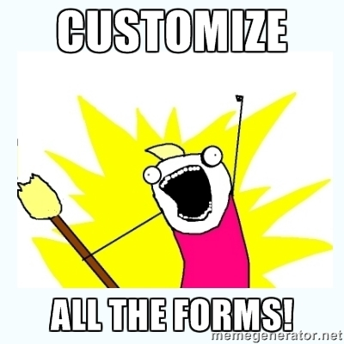
CRM 2013 considerations for user interaction design
Design the Sitemap
Promote child records on parent forms
Be creative with Quick View Forms
Test and customize Quick Create
Optimize the Command Bar
Simulate your process before implementing Business Process Flows

Slide 21
Delivering responsive solutions
…with no code!

Slide 22
No-code process automation tools in CRM
CRM 4.0
Workflows
CRM 2011
Workflows
Dialogs
CRM 2013
Workflows
Dialogs
Asynchronous
Real-time
Business Process Flows
Business Rules
Actions

Slide 23
Microsoft Dynamics CRM 2013 Process Automation Functionality
Business Rule
Executes before save event (form onLoad and field onChange)
Cannot access data from related records
Executes on save event
Can access data from parental records
Asynchronous Workflow
Executes after save event
Can access data from parental records
Dialog
Executes on user demand
Can access data from parental records and query data
Can manipulate data and UI
Can manipulate data only
Can manipulate data only
Can manipulate data only
Real-Time Workflow
Applied to data updates through UI only
Not applied on any data updates
Applied to data updates through UI and API
Applied to data updates through UI and API
For working with a single record
For working with single or multiple records
For working with single or multiple records
For working with a single record
Read more details from my blog at http://bit.ly/crm2013process

Slide 24
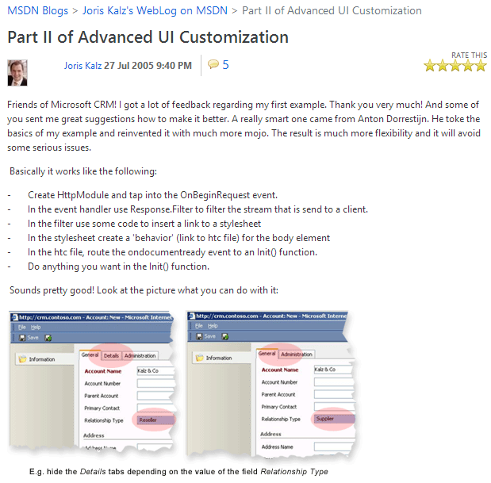
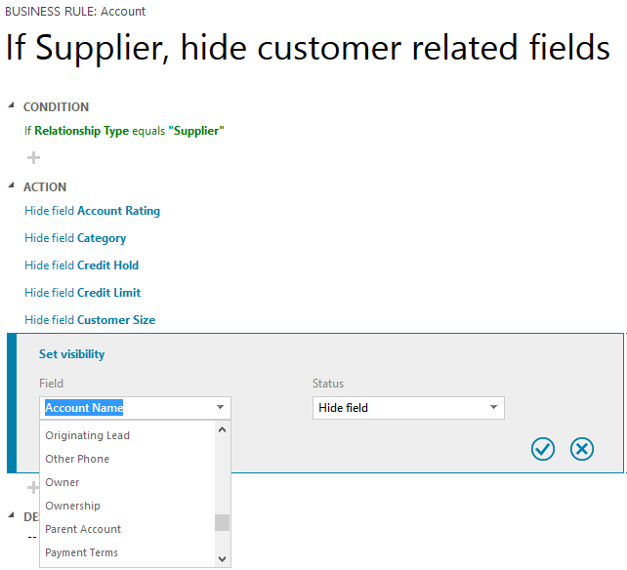
Advanced UI customization: then and now

Slide 25
Takeaways

Slide 26
“Everything is different in CRM 2013 because…”
It’s consumed via a client applications of different shapes & sizes
It accepts your old customizations but it presents them in completely new surroundings
It opens the doors for non-developers to build a truly intelligent, responsive business application

Slide 27
Want to learn more about CRM 2013?
Watch out for an updated CRM 2013 edition of the CRM Field Guide – a book written by Dynamics CRM MVPs: http://www.crmfieldguide.com/
Go and read more about the latest Dynamics CRM news and tips on my Surviving CRM blog: http://niiranen.eu/crm/

Slide 28
Thanks for your time!

