Slide 1
A Non-Developer's Guide to
Smarter Sales Processes in
Microsoft Dynamics CRM 2015
-
Part 1: Lead Qualification
Jukka Niiranen
2015-05-06

Slide 2
About This Presentation
These are the slides from a live webcast on MSDynamicsWorld.com, presented on May 6th 2015
The webcast recording is available on YouTube: http://bit.ly/crm15salesprocess
The topics are covered in more detail in blog posts at http://survivingcrm.com/

Slide 3

About Me
Dynamics CRM consultant from Helsinki
Working at Digital Illustrated Finland
Dynamics CRM addict since 2005
Frequent blogger & #MSDYNCRM evangelist on social media
  Blog: survivingcrm.com
  @jukkan on Twitter
Microsoft MVP since 2013
Focused on improving CRM solution usability & information work efficiency
Jukka Niiranen
@jukkan
Consultant @ Digital Illustrated
Microsoft Dynamics CRM MVP

Slide 4
Customizing Dynamics CRM as a Non-Developer
Point & click configuration/customization tools of Dynamics CRM have come a long way
The ratio of custom code vs. configuration in typical CRM solutions is decreasing
Solution delivery often requires the creative combination of several CRM configuration options
The goal of this article series is to demonstrate a few scenarios where such combinations are used for delivering new functionality for the CRM sales process

Slide 5
Customization Scenarios Explored in This Series
Part 1
1. Lead qualification
2. Opportunity revenue estimation
Convert leads to influencers instead of new opportunities
Calculate opportunity total value from day & rate fields
3. Pipeline development
Capture opportunity count and revenue per sales stage
Streamline data entry for leads on existing accounts & contacts
Schedule data snapshots of historical pipeline size
Replace opportunity product lines with predefined cost estimate fields

Slide 6
Lead Qualification

Slide 7
The Problem
In earlier versions of Dynamics CRM it was possible to qualify lead records into an account/contact only
Starting from CRM 2013 the qualification process changed, together with the introduction of Business Process Flows (BPF)
Now a qualified lead will always create an open opportunity into the sales pipeline
There are many valid scenarios where leads shouldn’t directly be converted into an opportunity, but no option exists in CRM to configure this behavior

Slide 8
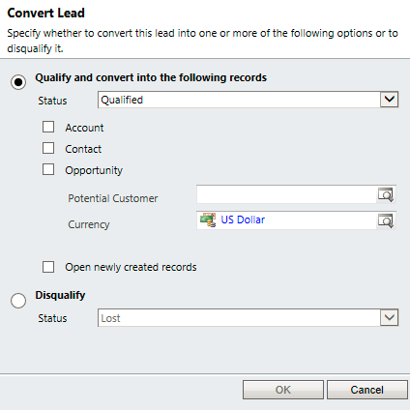
Old Lead Qualification Dialog (before CRM 2013)

Slide 9
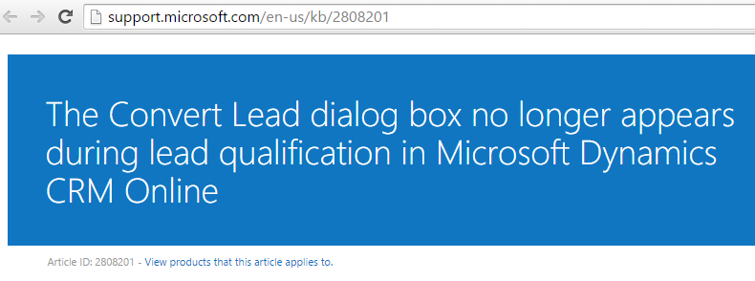

The Big Switch
“After applying the latest Product Update related to the December 2012 Service Update for Microsoft Dynamics CRM Online, users may notice that the lead Qualify button no longer presents the Convert Lead dialog box. This dialog box traditionally allowed users to choose the associated sales records to create during qualify, including Contact, Account, and Opportunity.”
http://support.microsoft.com/en-us/kb/2808201

Slide 10
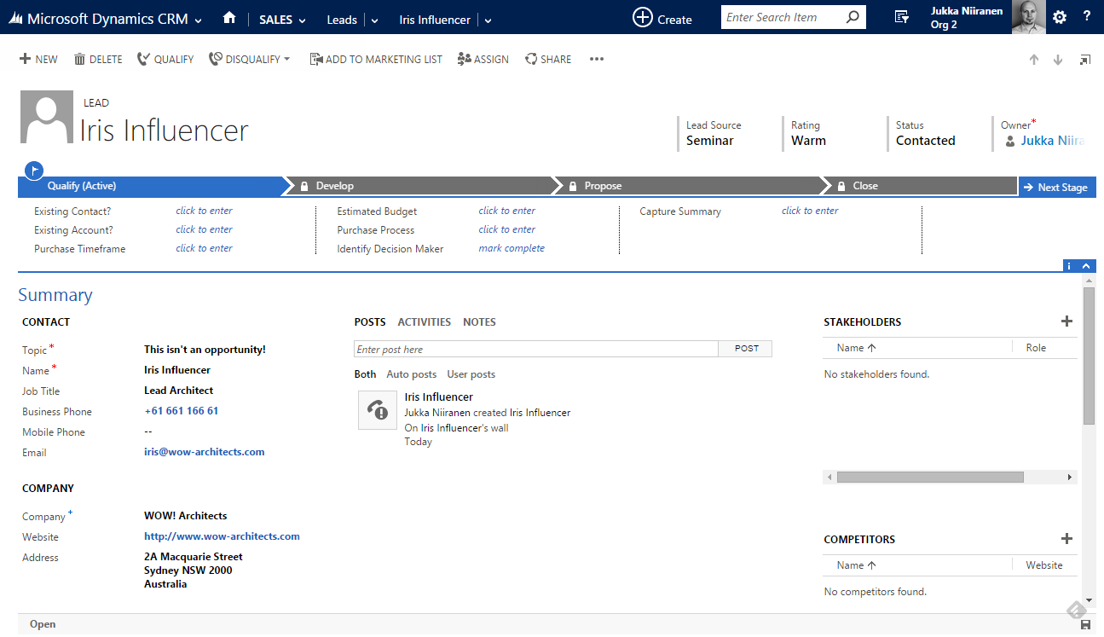
Step 1: Lead Data Entry

Slide 11
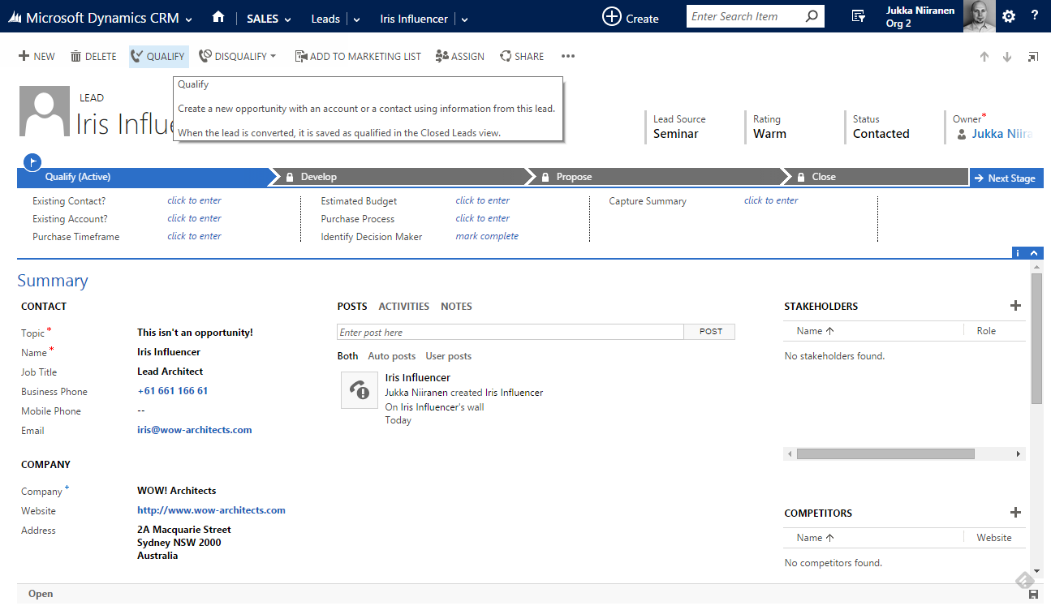
Step 2: Lead Qualification

Slide 12
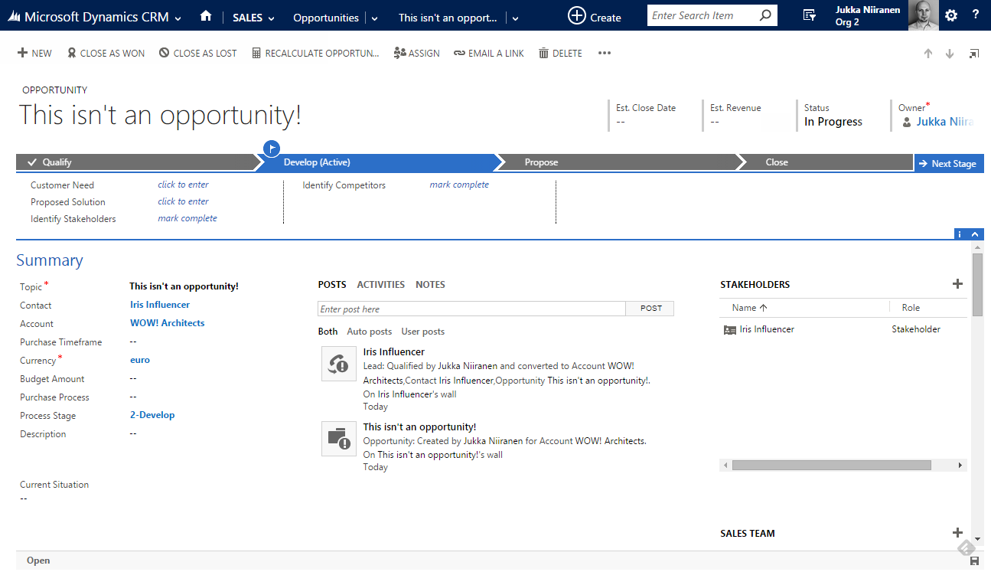
Step 3: New Opportunity

Slide 13
The Solution
Functionality delivered:
  Ability to qualify a lead as an influencer, without creating a new opportunity record
  Ability to associate the qualified lead with an existing opportunity record
Components used:
  Branching Business Process Flow
  Real-time Workflows
  Business Rules
  Quick View Forms

Slide 14
Modifying the Business Process Flow
Turn the standard ”Lead to Opportunity Sales Process” into a branching BPF (new in CRM 2015)
Add a new stage to the very beginning of the BPF: ”Identify”
Add a new option set field on the lead entity: ”Lead Type”
  Option 1: ”Prospect (Create Opportunity)”
  Option 2: ”Influencer (No Opportunity)”
Re-create the necessary stages into each BPF branch
  Option 1: proceed from lead to opportunity
  Option 2: stop at the lead entity

Slide 15
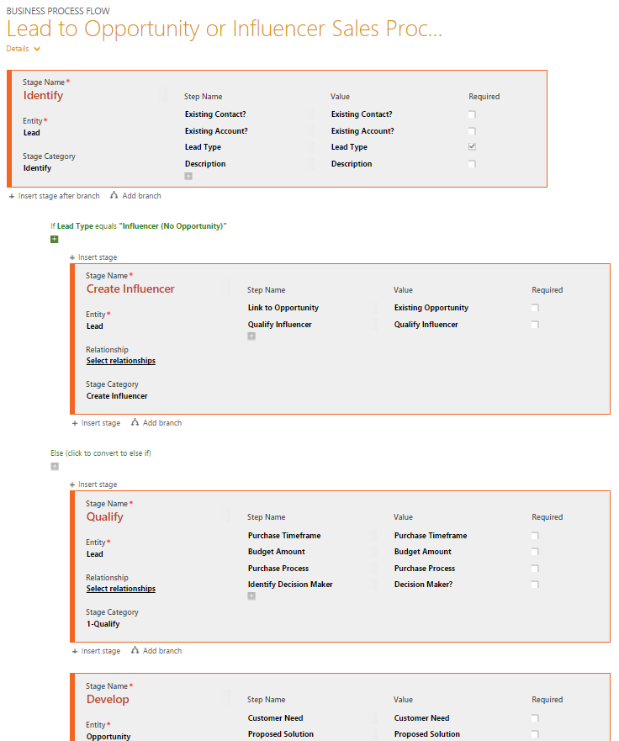
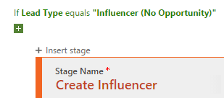
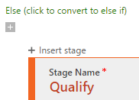
The Branches

Slide 16
Real-time Workflow
Clicking the Qualify button on the lead form will always create a new opportunity record
Merely changing the lead record status to ”Qualified” via a server-side process however does not trigger this action
The workaround we’ll use:
  Create a new two-option field ”Qualify Influencer”, add it to BPF stage, use as a workflow trigger
  Add a new real-time workflow process that runs when this trigger field is set to ”Yes”

Slide 17
Real-time Workflow (2)
Workflow conditions
  Check if the lead is associated with an existing account and/or contact
Workflow actions
  Create the necessary new records in the workflow steps & link them to the originating lead
  If you want to associate the lead to an existing opportunity as a stakeholder, first add a new custom relationship between lead & opportunity entities (N:1). Then create a new Connection record between the selected opportunity and the new contact in WF
  Finally, change the lead status to ”Qualified”

Slide 18
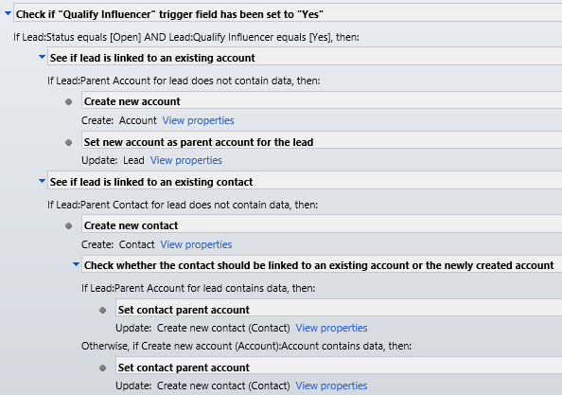
The Logic (1)
On lead record change event, proceed if trigger field is set to ”Yes”
Check if existing account / contact fields are populated
If not, create new records and link to other records

Slide 19
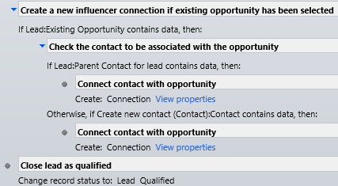
The Logic (2)
Check if the lead has been linked to an existing opportunity
Create a new Connection between the records
Change the lead record’s status to ”Qualified”

Slide 20
Quick View Forms & Business Rules
When linking the lead to existing acccount/contact there shouldn’t be any data entered into lead fields related to them
  These will be discarded during qualification and present unnecessary data entry options for the user
How to improve the lead form’s usability:
  Add the lookup fields for existing account/contact directly onto the lead form (by default only in BPF)
  Use Business Rules to hide the detail fields if existing account/contact has been selected
  Display Quick View Forms of the existing account/contact records on the lead form to provide overview of existing record data

Slide 21
Quick View Forms & Business Rules (2)
Use case:
  User creates a new lead record
  User links the lead to existing account record
  Business Rule hides other account fields
  Quick View Form displays the account summary
Note: this also works as a verification of lead qualification process success indicator after a new account/contact is generated for the lead

Slide 22
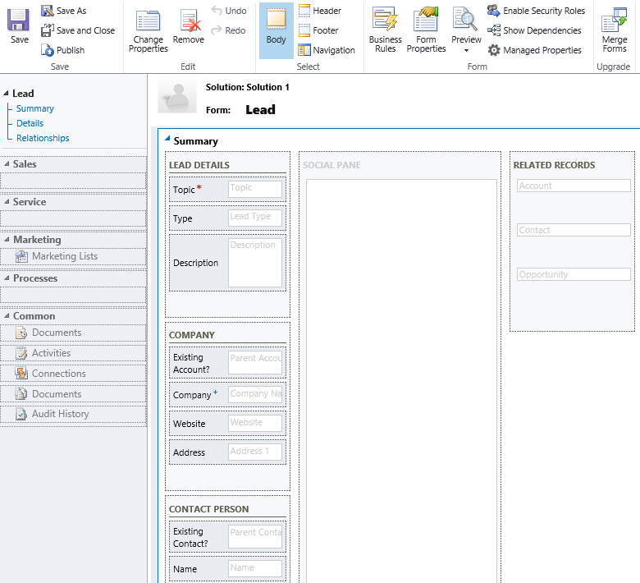
Form Designer
Put the Lead Type option set (BPF branch selector) to the top of the form
Drag the Existing Account / Existing Contact fields onto the form
Add a new section ”Related Records” and include Quick View Forms of Account, Contact and Opportunity

Slide 23
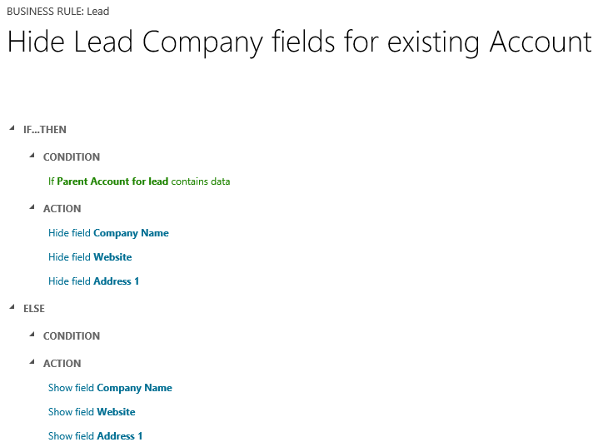
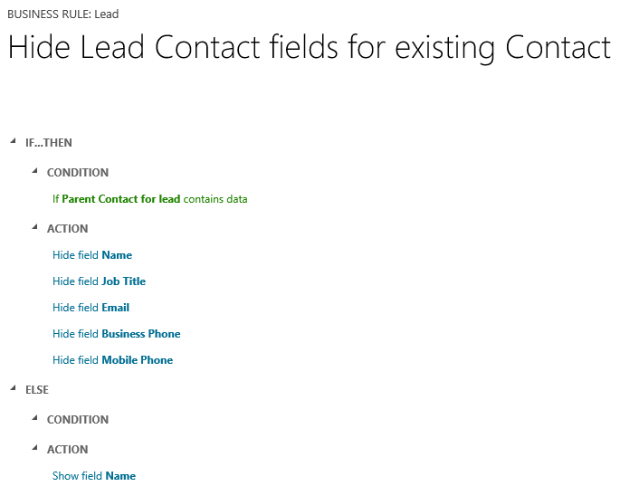
Business Rules
Create 2 rules that watch the Existing Account/Contact lookup fields
Hide other related fields from the form if the lookup contains data

Slide 24
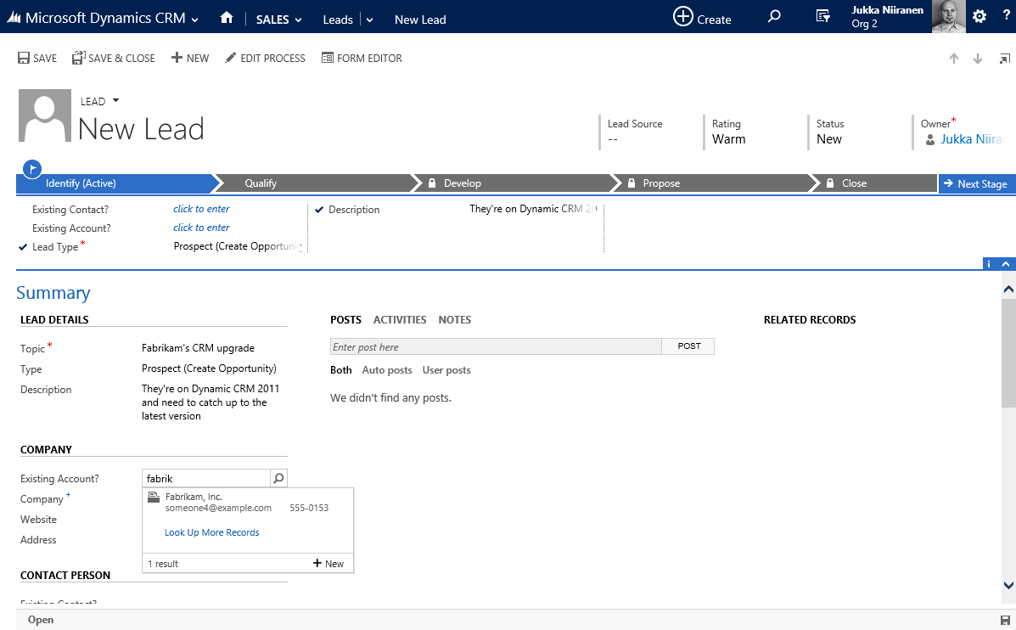
Creating a New Lead, Type Prospect (1)
Lead Type is set to ”Prospect”, standard sales process stages are used
Existing Account ”Fabrikam” is chosen as the company

Slide 25
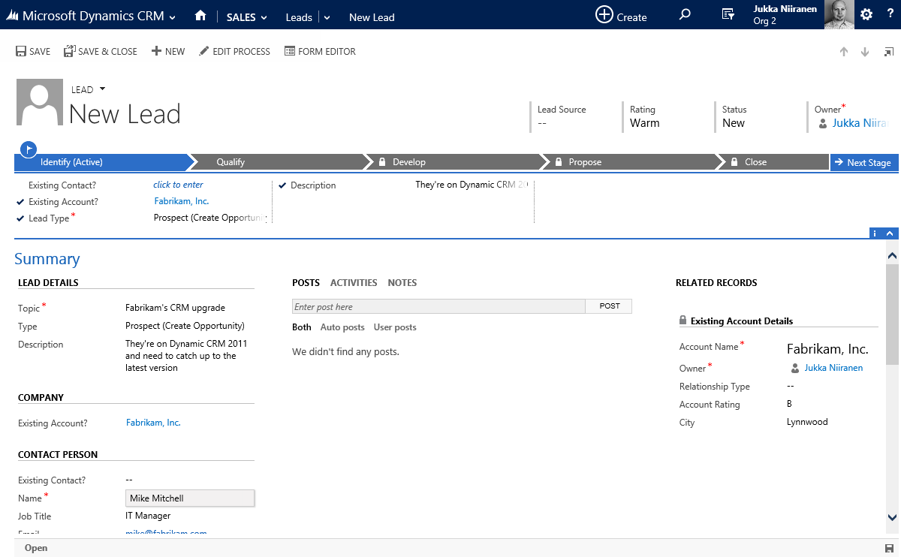
Creating a New Lead, Type Prospect (2)
After selecting Fabrikam, account details are shown on the Quick View Form
Contact information can still be entered on the lead to create a new contact for chosen account

Slide 26
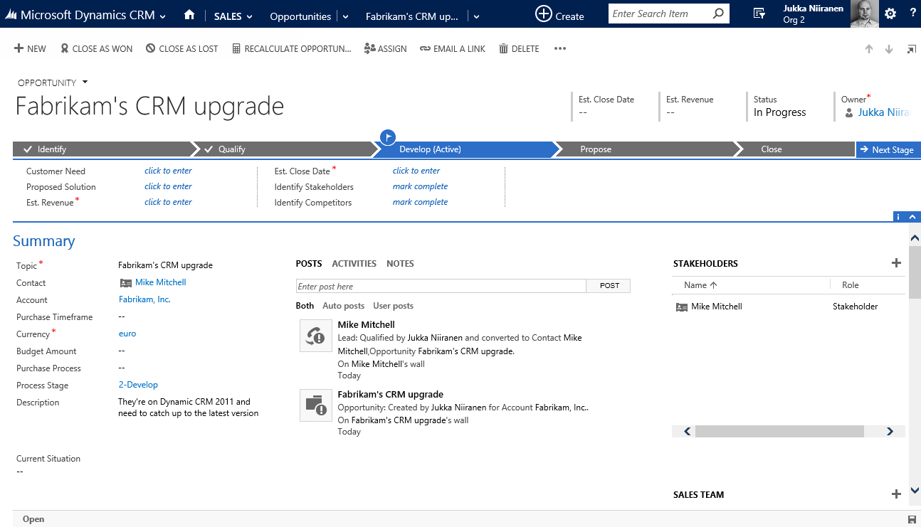
Converting the Lead to Opportunity
After clicking Qualify, a new Opportunity record is created and sales process is set to ”Develop”
New contact has been added to account and set as stakeholder for the opportunity

Slide 27
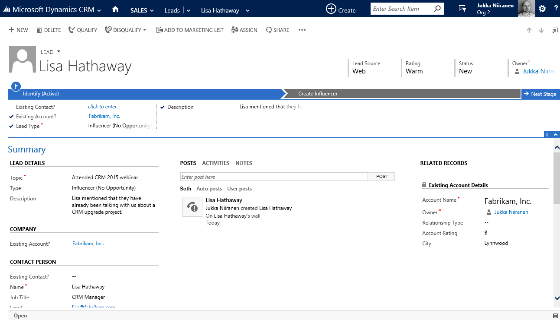
Creating a New Lead, Type Influencer (1)
Lead Type is set to ”Influencer”, sales process stages are updated to reflect this
Using same account, details of another new contact person are added

Slide 28
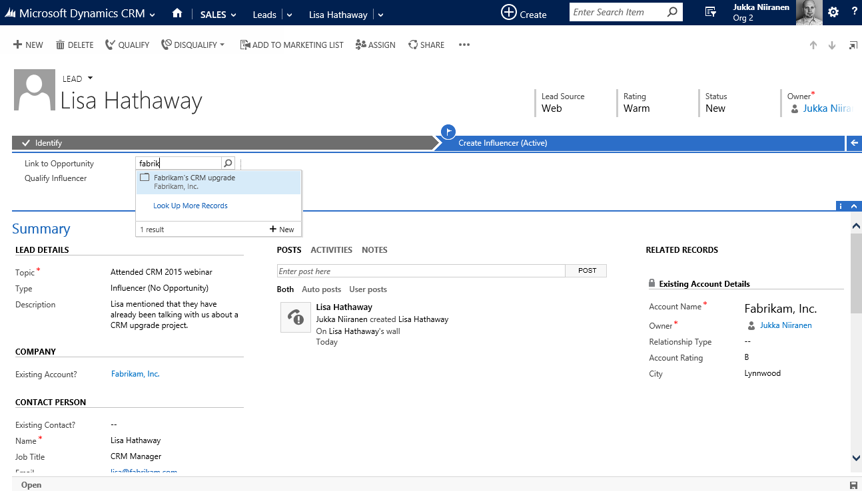
Creating a New Lead, Type Influencer (2)
Process is moved to the ”Create Influencer” stage
Lead is linked to the existing Fabrikam opportunity

Slide 29
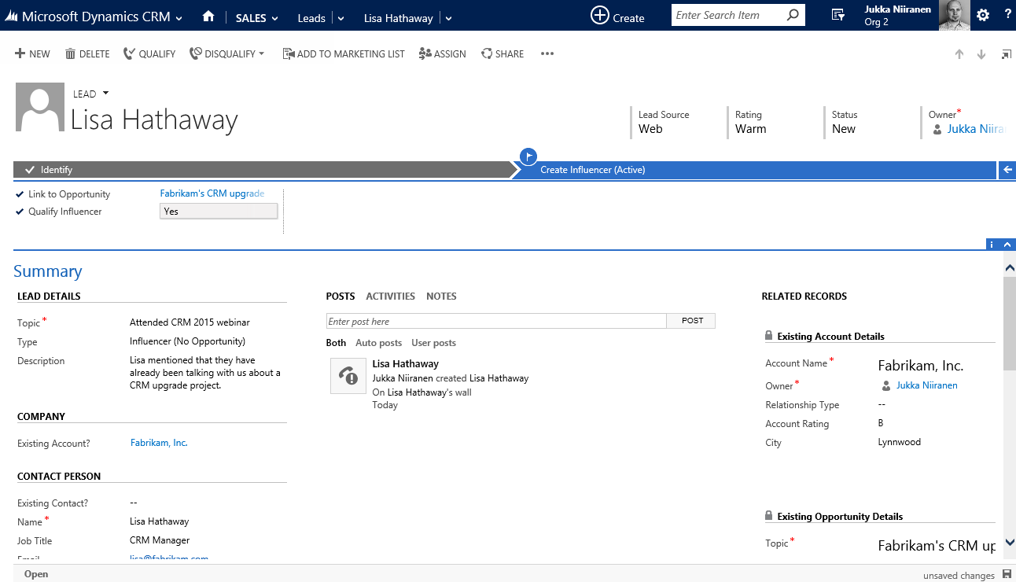
Creating a New Lead, Type Influencer (3)
Field ”Qualify Influencer” is set to ”Yes”
Lead record changes are saved by user or by CRM autosave

Slide 30
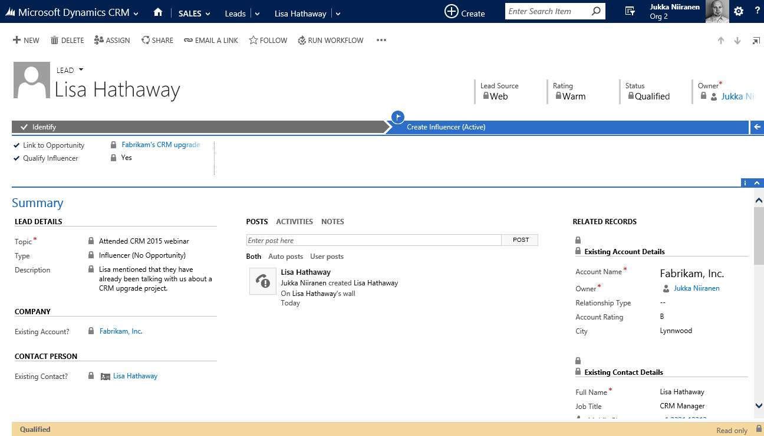
Creating a New Lead, Type Influencer (4)
Workflow closes the lead as Qualified
New contact record details are shown on the Quick View Form

Slide 31
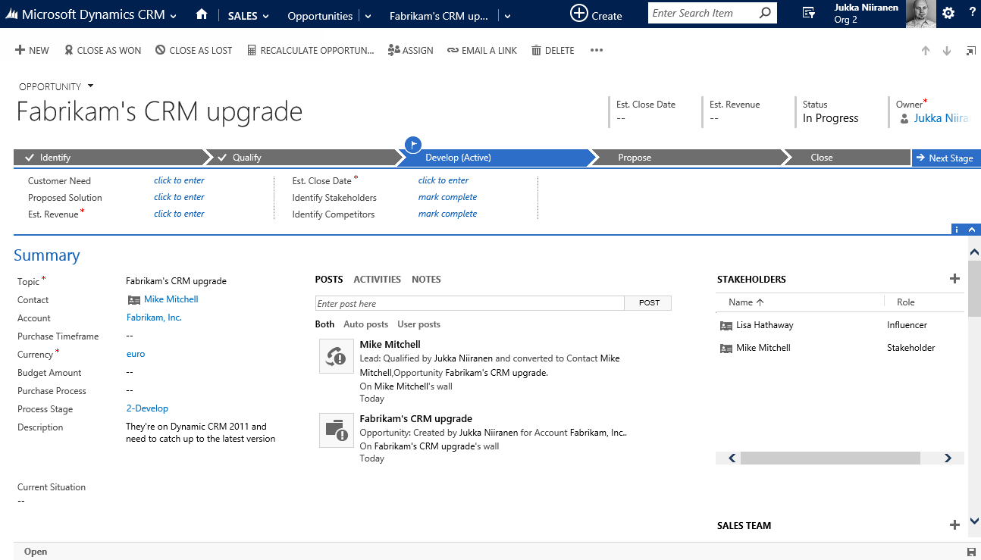
Updated Opportunity
New contact has been added as a stakeholder on the existing opportunity record

Slide 32
Final Notes

Slide 33
Next Steps
Read more articles on Microsoft Dynamics CRM customization best practices at http://survivingcrm.com/
Follow @jukkan on Twitter for the latest #MSDynCRM related news and tips
Check out the Dynamics CRM webcasts series at http://msdynamicsworld.com/webcasts
Thanks for viewing these slides & enjoy customizing your Dynamics CRM environment!

