Slide 1
A Non-Developer's Guide to
Smarter Sales Processes in
Microsoft Dynamics CRM 2015
-
Part 2: Revenue Estimation
Jukka Niiranen
2015-05-06

Slide 2
About This Presentation
These are the slides from a live webcast on MSDynamicsWorld.com, presented on May 6th 2015
The webcast recording is available on YouTube: http://bit.ly/crm15salesprocess
The topics are covered in more detail in blog posts at http://survivingcrm.com/

Slide 3

About Me
Dynamics CRM consultant from Helsinki
Working at Digital Illustrated Finland
Dynamics CRM addict since 2005
Frequent blogger & #MSDYNCRM evangelist on social media
  Blog: survivingcrm.com
  @jukkan on Twitter
Microsoft MVP since 2013
Focused on improving CRM solution usability & information work efficiency
Jukka Niiranen
@jukkan
Consultant @ Digital Illustrated
Microsoft Dynamics CRM MVP

Slide 4
Customizing Dynamics CRM as a Non-Developer
Point & click configuration/customization tools of Dynamics CRM have come a long way
The ratio of custom code vs. configuration in typical CRM solutions is decreasing
Solution delivery often requires the creative combination of several CRM configuration options
The goal of this article series is to demonstrate a few scenarios where such combinations are used for delivering new functionality for the CRM sales process

Slide 5
Customization Scenarios Explored in This Series
Part 2
1. Lead qualification
2. Opportunity revenue estimation
Convert leads to influencers instead of new opportunities
Calculate opportunity total value from day & rate fields
3. Pipeline development
Capture opportunity count and revenue per sales stage
Streamline data entry for leads on existing accounts & contacts
Schedule data snapshots of historical pipeline size
Replace opportunity product lines with predefined cost estimate fields

Slide 6
Opportunity Revenue Estimation

Slide 7
The Problem
Calculating estimated revenue with CRM can require a lot of clicks from the end user
Managing detailed product and price information in CRM product catalog and price lists can be troublesome
Cannot easily have a standard set of opportunity product line items included in all opportunities
Opportunity product editable grid cannot be customized to optimize data entry

Slide 8
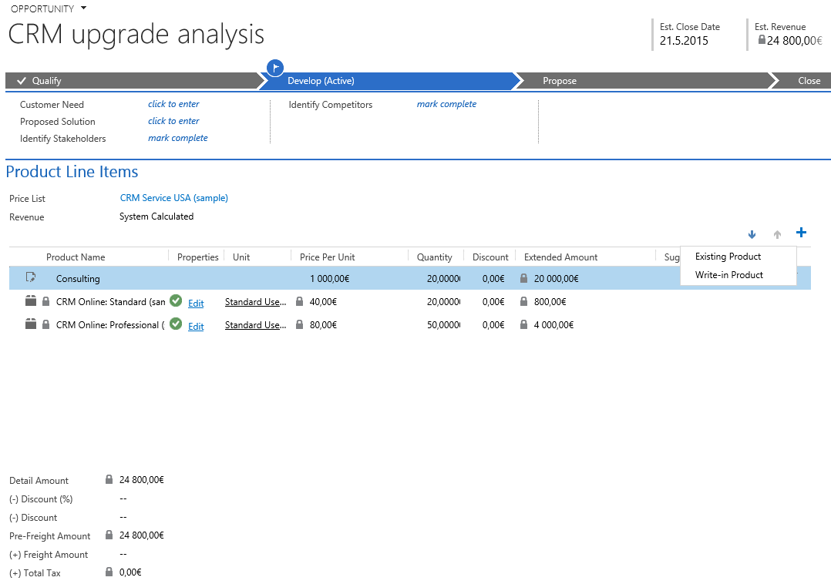
Standard opportunity products grid
Users must add every line item manually
No ability to disable Write-in Products
Product pricing cannot be overriden in grid

Slide 9
The Solution
Create fixed fields for recording the revenue components directly onto the opportunity entity, with no line items
Use CRM 2015 Calculated Fields feature to sum up the estimated revenue across all the individual fields
Use a Real-time workflow to update the Est. Revenue field for the opportunity

Slide 10
Example Revenue Components for Projects
Consulting
  Hours (decimal), Rate per hour (currency)
  Total = Hours * Rate (currency)
Licenses
  Users (whole), Months (whole), Rate per month (currency)
  Total = Users * Months * Rate (currency)
Other
  Other costs (currency)
Total Amount
  Total = Consulting total + Licenses total + Other (currency)

Slide 11
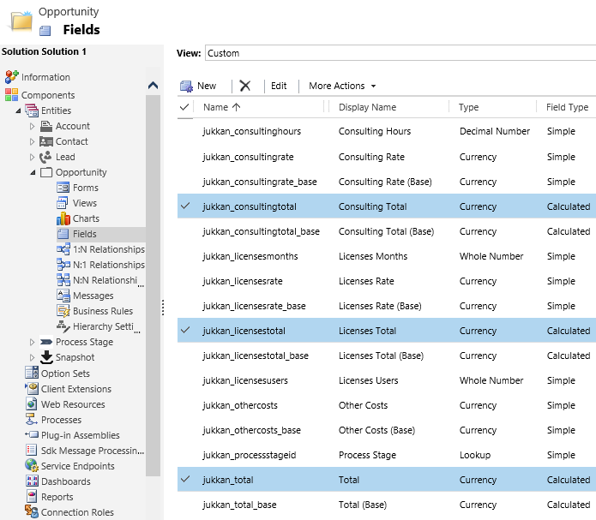
Adding Custom Fields for Opportunity
Simple fields = standard CRM data types
Calculated fields = new CRM 2015 field type

Slide 12
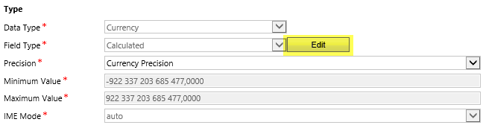
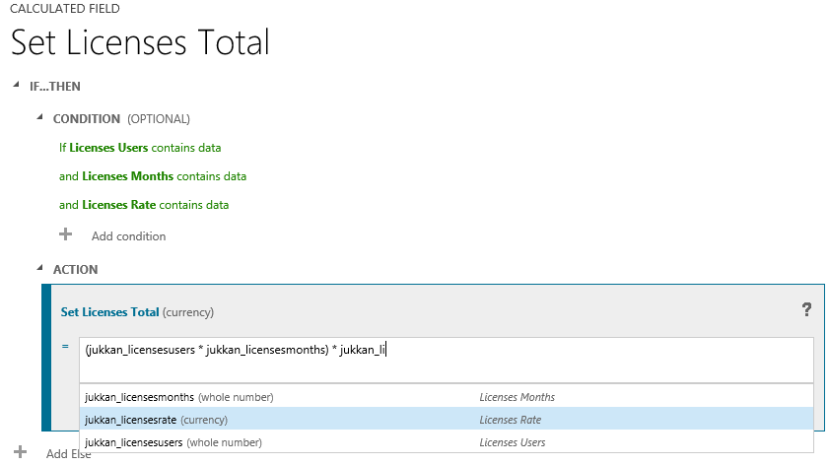
Configuring the Calculated Field Formula
In field definition window, click Edit
Determine conditions for when to perform the calculation
Build calculation formula by picking the fields via ”Intellisense”

Slide 13
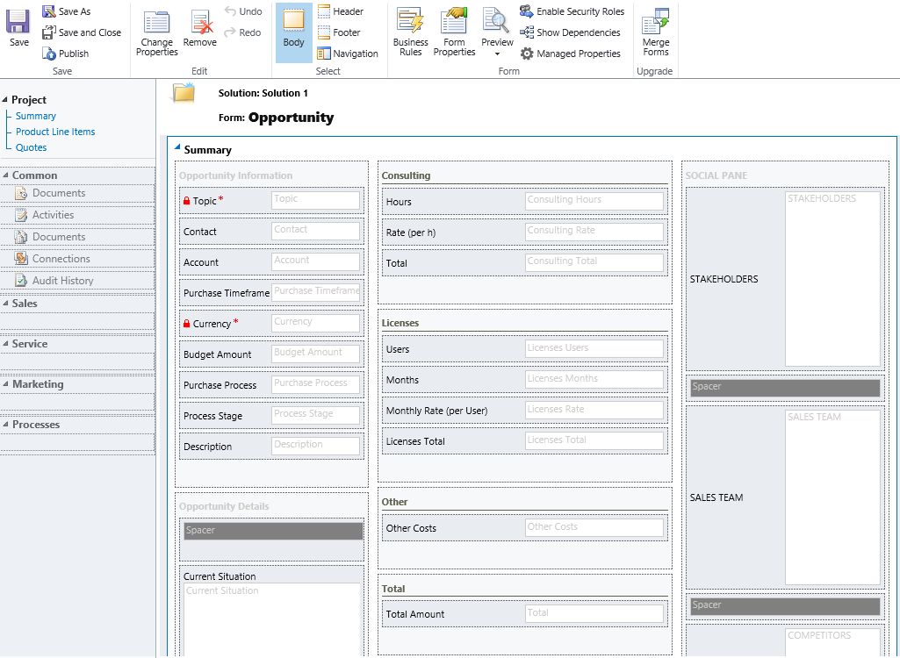
Custom Opportunity Form for Project Sales
Consulting revenue
License revenue
Other revenue
Total revenue

Slide 14
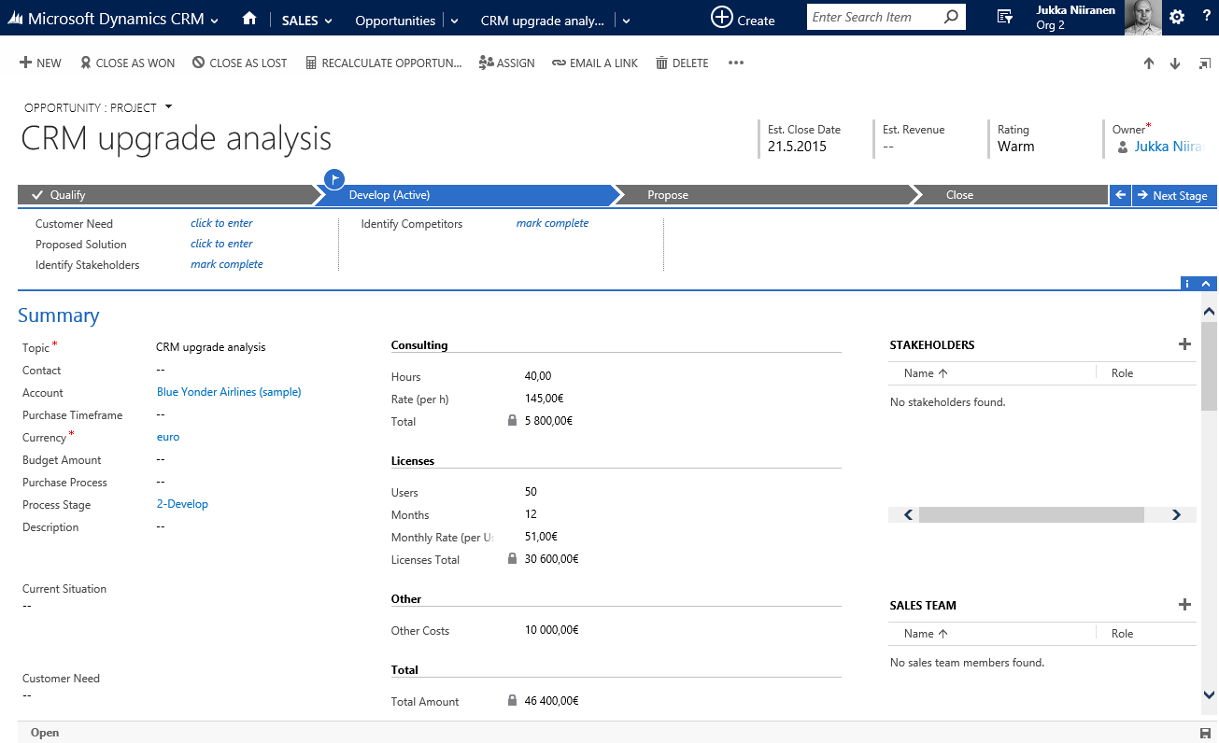
Calculated Fields on the Opportunity Form
...But the standard Est. Revenue field still remains blank
Now we have a Total fields that get calculated on record save

Slide 15
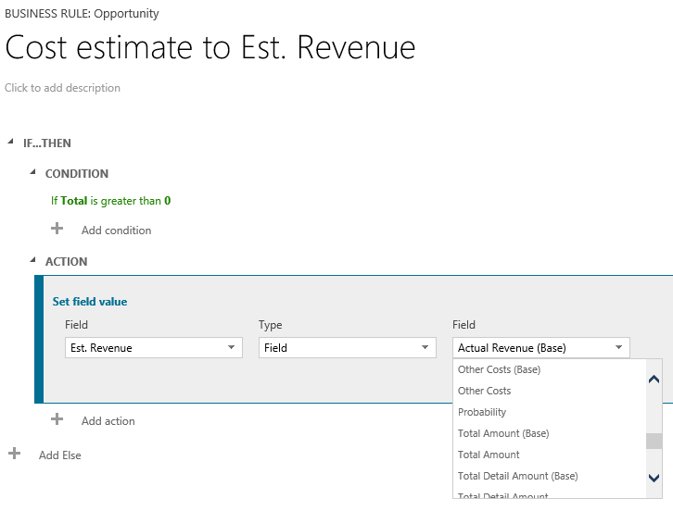
Setting the Est. Revenue field value (1)
Business Rules won’t work for updating the Est. Revenue field
You can’t set a standard field’s value to the value of a calculated field

Slide 16
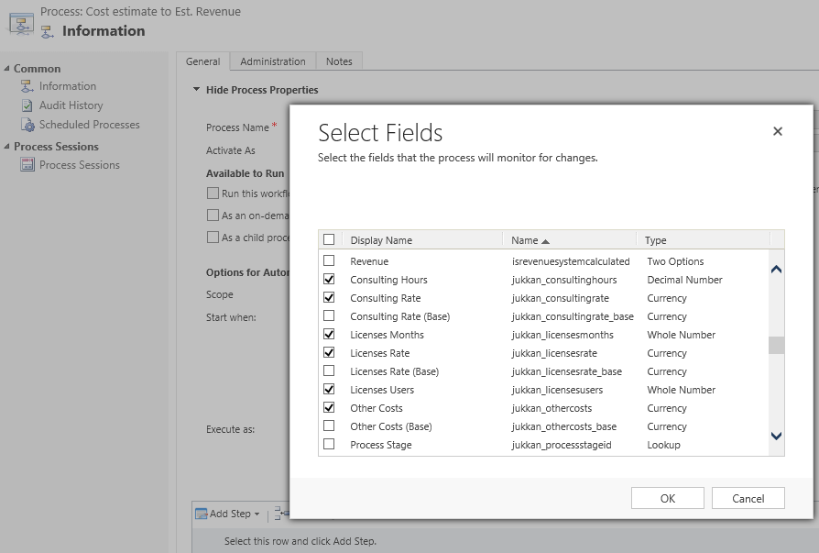

Setting the Est. Revenue field value (2)
Real-time workflows can, however, access the calculated field’s value
Trigger the workflow on record create event and source field value change event
Set Est. Revenue to total cost

Slide 17

Est. Revenue Synchronized with Calculated Total Field
Now the Est. Revenue field will automatically reflect the value from the calculated Total field

Slide 18
Final Notes

Slide 19
Next Steps
Read more articles on Microsoft Dynamics CRM customization best practices at http://survivingcrm.com/
Follow @jukkan on Twitter for the latest #MSDynCRM related news and tips
Check out the Dynamics CRM webcasts series at http://msdynamicsworld.com/webcasts
Thanks for viewing these slides & enjoy customizing your Dynamics CRM environment!

