Slide 1
A Non-Developer's Guide to
Smarter Sales Processes in
Microsoft Dynamics CRM 2015
-
Part 3: Pipeline Development
Jukka Niiranen
2015-05-06

Slide 2
About This Presentation
These are the slides from a live webcast on MSDynamicsWorld.com, presented on May 6th 2015
The webcast recording is available on YouTube: http://bit.ly/crm15salesprocess
The topics are covered in more detail in blog posts at http://survivingcrm.com/

Slide 3

About Me
Dynamics CRM consultant from Helsinki
Working at Digital Illustrated Finland
Dynamics CRM addict since 2005
Frequent blogger & #MSDYNCRM evangelist on social media
  Blog: survivingcrm.com
  @jukkan on Twitter
Microsoft MVP since 2013
Focused on improving CRM solution usability & information work efficiency
Jukka Niiranen
@jukkan
Consultant @ Digital Illustrated
Microsoft Dynamics CRM MVP

Slide 4
Customizing Dynamics CRM as a Non-Developer
Point & click configuration/customization tools of Dynamics CRM have come a long way
The ratio of custom code vs. configuration in typical CRM solutions is decreasing
Solution delivery often requires the creative combination of several CRM configuration options
The goal of this article series is to demonstrate a few scenarios where such combinations are used for delivering new functionality for the CRM sales process

Slide 5
Customization Scenarios Explored in This Series
Part 3
1. Lead qualification
2. Opportunity revenue estimation
Convert leads to influencers instead of new opportunities
Calculate opportunity total value from day & rate fields
3. Pipeline development
Capture opportunity count and revenue per sales stage
Streamline data entry for leads on existing accounts & contacts
Schedule data snapshots of historical pipeline size
Replace opportunity product lines with predefined cost estimate fields

Slide 6
Pipeline Development

Slide 7
The Problem
CRM gives an up-to-date status of the current sales pipeline by opportunity sales stage
Won or lost opportunities create a permanent record of when the deals were closed
This is however not sufficient data to project what the size of the pipeline was at a previous point in time
Therefore, it’s not possible to see the development trend of the open opportunity pipeline from the standard CRM data model

Slide 8
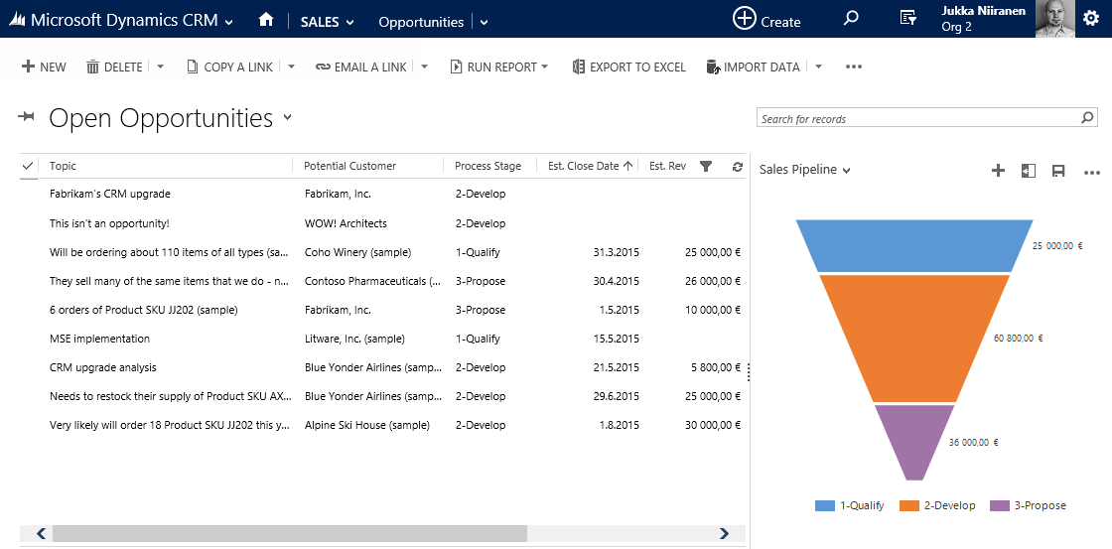
Current Pipeline View
”Hmm, I wonder if our sales pipeline is healthier now than it was last month? Wish I would have taken a screenshot...”

Slide 9
The Solution
Create a custom entity ”Process Stage” to represent each stage in the opportunity business process flow
Use Rollup Fields (new in CRM 2015) to collect information about open opportunity count and value in each stage onto this new entity
Create a custom entity ”Snapshot” to store historical data of the Rollup Field values
Schedule a recurring workflow process to create new Snapshots once a week

Slide 10
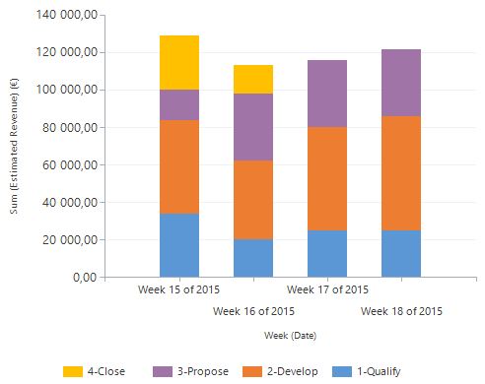
Pipeline Snapshots: Solution Architecture
1. Rollup Fields automatically collect the metrics from open opportunities
2. Recurring workflow creates historical snapshots of these metrics
3. Snapshots are visualized via charts to show weekly pipeline trend
Process Stage
Opportunity
Snapshot
Snapshot
Snapshot

Slide 11
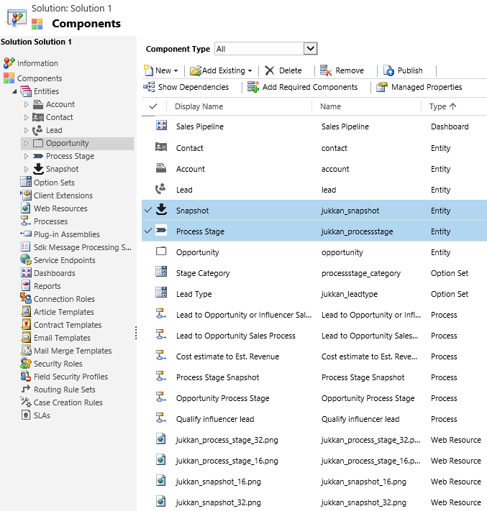
Two Custom Entities
Process Stage will be used as a lookup field on the opportunity records, to enable counting the Rollup Field values from related opportunities
Snapshot will be used for capturing copies of the Rollup Fields values from Process Stage entity

Slide 12
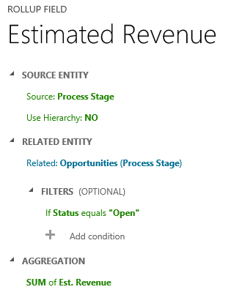
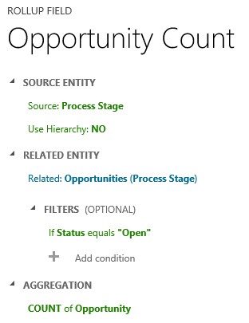
Two Rollup Fields on Process Stage Entity
Create Rollup Fields that retrieve data from the open child opportunities related to each process stage
Use one Rollup Field to sum up the total estimated revenue
...And the other for counting the number of opportunities

Slide 13
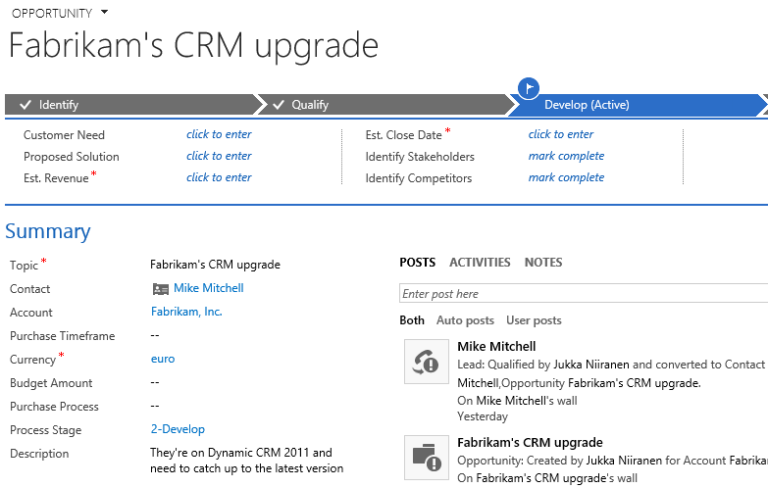
Linking Opportunities to Process Stages via Workflow
Whenever the Opportunity’s BPF stage changes, run a workflow process...
...Which updates the custom Process Stage field with a value that matches the BPF stage

Slide 14
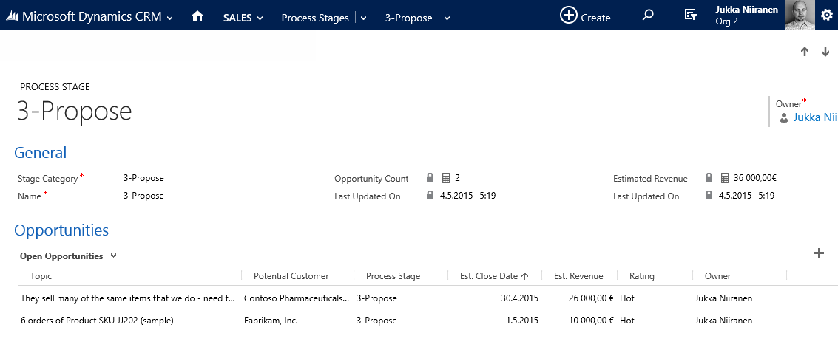
Process Stage with Related Opportunity data
Use the standard Stage Category option set field to group data
Related opportunity values roll up to the Process Stage form
Related opportunities shown in subgrid for quick reference

Slide 15
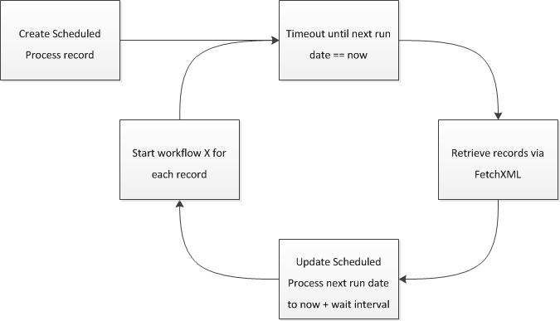
Solution: “Scheduled Recurring Workflows”
Open source solution from Lucas Alexander
Contains one custom workflow activity that allows you to run a specific workflow process weekly/daily/hourly on specific records
When this date is reached...
Query for these records...
...And start a workflow process instance for each result
Download from: http://bit.ly/crmschedwf

Slide 16
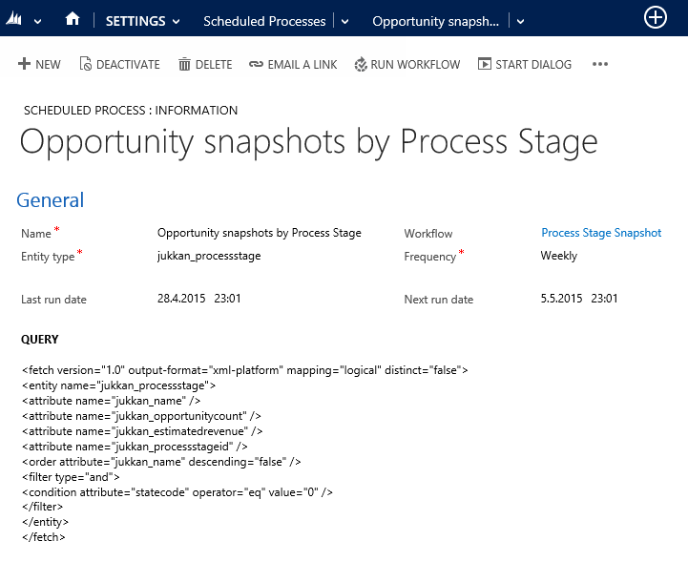
Configuring the Scheduled Process
Which workfow process do we want to schedule?
When should the process be executed?
What’s the (FetchXML) search crieria for records to run it on?

Slide 17
Before Scheduling the Process
We’ll need the Fetch XML query criteria for the records the scheduled process will be searching for
  In our case, all active Process Stage records
Then we’ll need the workflow process that we want to apply to all these records
  A workflow process to create a Snapshot record with the current pipeline values per each Process Stage

Slide 18
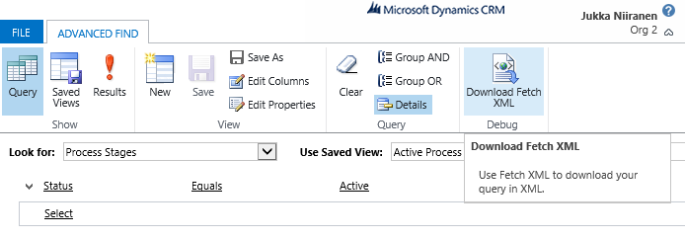
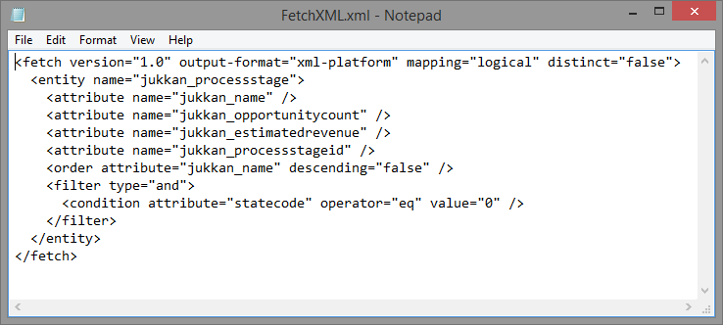
Grabbing the Query Criteria from Advanced Find
Select the Process Stage entity
Select ”Download Fetch XML”

Slide 19
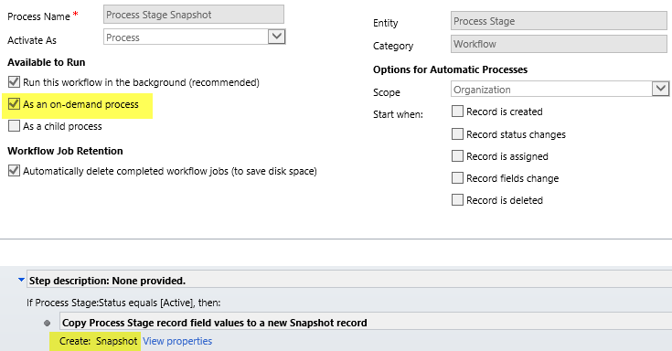
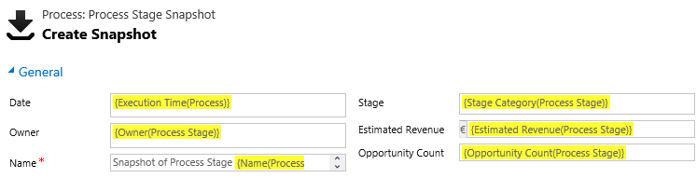
Process Stage Snapshot Creation Workflow
Workflow is created agains the Process Stage entity, run as on-demand process
Creates a new Snapshot record with values copied from the current Process Stage Rollup Fields

Slide 20
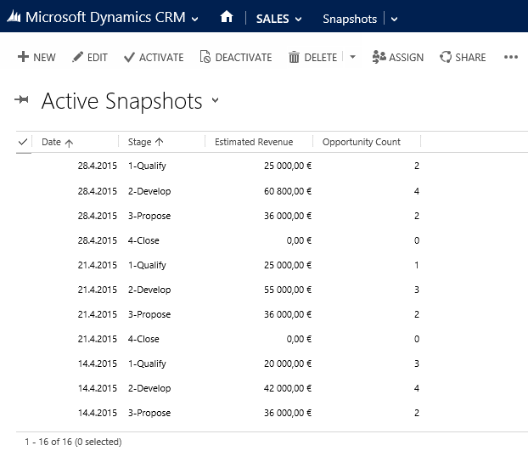
Snapshots Created
The scheduled process will create new Snapshots for each Process Stage once a week

Slide 21
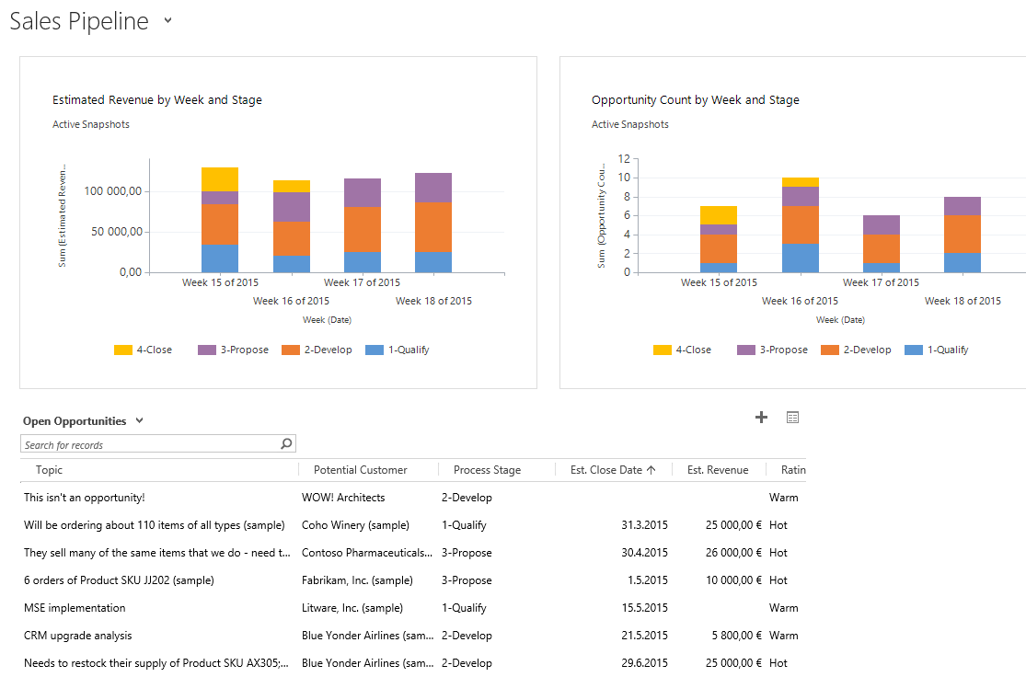
Pipeline overview dashboard
Charts & dashboards can be used for summarizing the pipeline development trends

Slide 22
Final Notes

Slide 23
Next Steps
Read more articles on Microsoft Dynamics CRM customization best practices at http://survivingcrm.com/
Follow @jukkan on Twitter for the latest #MSDynCRM related news and tips
Check out the Dynamics CRM webcasts series at http://msdynamicsworld.com/webcasts
Thanks for viewing these slides & enjoy customizing your Dynamics CRM environment!

