Slide 1
DjangoCon Finland 2013
Mezzanine
and Cartridge
Markus Törnqvist
mjt@skyhood.com
Skyhood
Notes:
I'm Markus Törnqvist, CTO at Skyhood.
I'll go over a CMS called Mezzanine and delve slightly into its shop module called Cartridge.

Slide 2
DjangoCon Finland 2013
Mezzanine?
“The Best Django CMS”
Blog
Plugins
Notes:
Claims to be the best. Ain't bad, that's for sure.
Revolves more around a blog, think Wordpress.
Plugins supported, as apps. More later.

Slide 3
DjangoCon Finland 2013
Competition?
django-cms
Pinax?
???

Slide 4
DjangoCon Finland 2013
mezzanine-project
Built on Django, not exactly Django
INSTALLED_APPS
Configurables
Notes:
Django project. Not app. Explain.
Installed by default, lots of its own apps.
More configurables than ever.

Slide 5
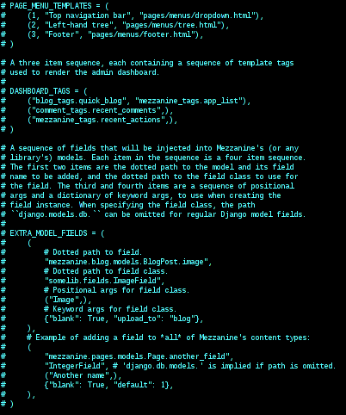
DjangoCon Finland 2013
Notes:
Custom templates for admin
“Dashboard widget” setup
Talk about model fields in a sec

Slide 6
DjangoCon Finland 2013
Configuration
Decent defaults
Monkey-patching, anyone?
Themes are apps
Notes:
Configures more or less automatically
Allows monkey-patching model fields
Themes are apps, with templates.

Slide 7
DjangoCon Finland 2013
Development
class Troll(Page):
EXTRA_MODEL_FIELDS
admin.site.unregister(...)
Notes:
Content inherits from Page model. Does everything between admin and permissions.
Use south's stdout. Sounds painful. Kidney-stone painful. Andrew Godwin and future migration style?
Did you know that? Unregistering models.

Slide 8
DjangoCon Finland 2013
Themes
No, apps.
With templates.
For better or worse...
Notes:
Use apps. Just like everything else. Once there were themes, not anymore.
Regular Django templates. No idea about Jinja, probably not.
So the same good and bad sides apply as with Django.
On templates: in-line editor! Needs templatetags to work. TinyMCE :(

Slide 9
DjangoCon Finland 2013
Cartridge
Every blog needs a shop!
Very similar philosophy
Notes:
Every blog. Or at least CMS.
Ships as a project template. Specify for mezzanine-project.

Slide 10
DjangoCon Finland 2013
Configuration
Custom order forms
Custom steps
More backends needed to pay
Notes:
Customizable forms for ordering
Some flex in the process
Supports PayPal and Stripe, not eg. Paymill

