Slide 1
Naïve Bayes Classifier
Julian Carrasquillo
CIS678 – Winter 2020

Slide 2
Specification
Write a program that labels collection of training data correctly as Spam or Ham using a Naïve Bayes classifier.
Said differently, write a spam filter.

Slide 3
Background
The Naïve Bayes algorithm is a Supervised Learning method that uses probabilities to perform classification.
The probabilities are estimated based on training data for which the value of the classification is known.
The algorithm is called “naïve” because it makes the simplifying assumption that attribute values are completely independent, given the classification

Slide 4
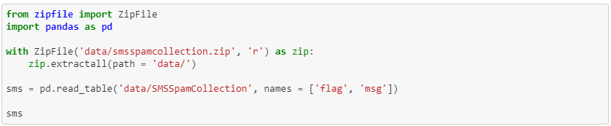
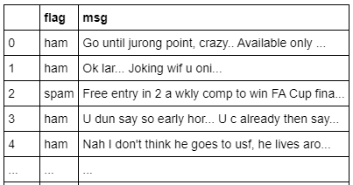
Data set
The data consists of a collection of 5574 labeled SMS text messages in a zipped format. Format consists of 2 columns: classification and full unprocessed text message.
Normally, we can use pandas to read in zip files directly, but the particular folder contained multiple files. I used zipfile to handle.

Slide 5
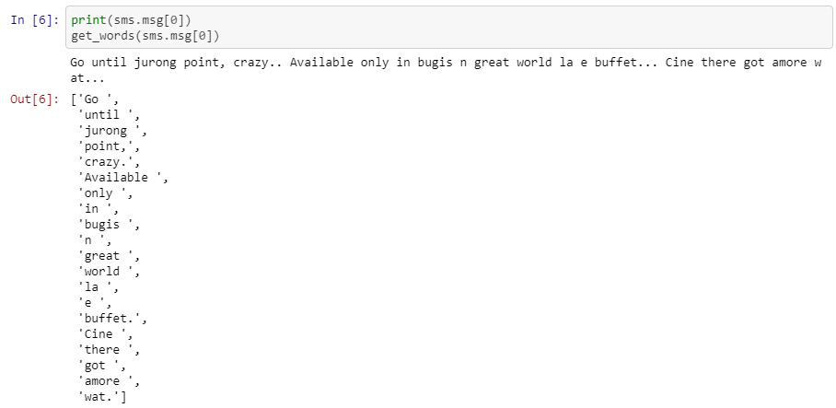

Getting our Words
In order to analyze the words in each text message, we need a way to extract them. This felt very similar to project 1, so I used modified functions from there.

Slide 6
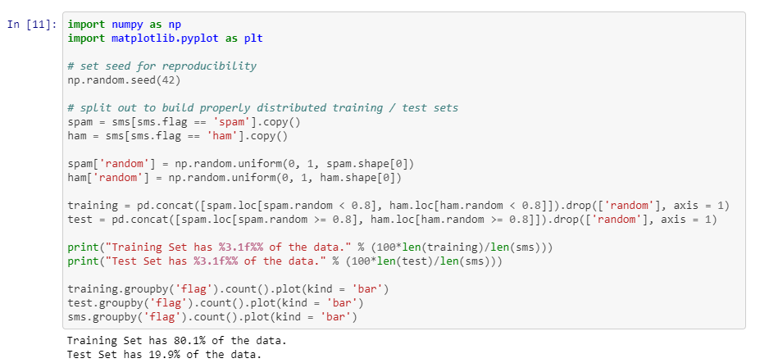
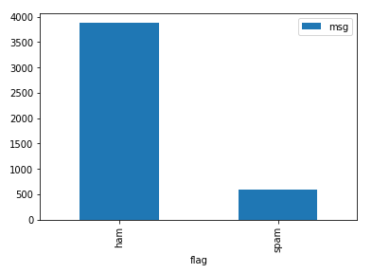
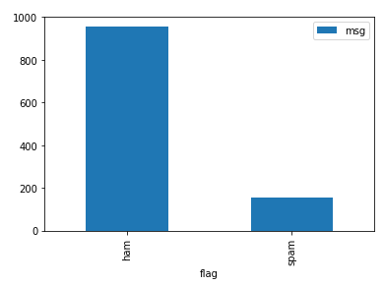
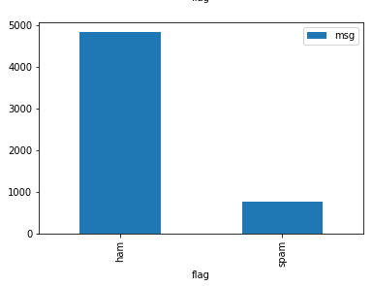
Training
Random number generator to assign the groups.
To make sure the training and test group have similar ratios of spam to ham as the whole population, use the random generator on each group separately.

Slide 7



vocab_classed, vocab_probs
vocab_classed packaged all occurrences of each word in either of the word banks for ham and spam.
vocab_probs is the final model output. It builds off vocab_classed, applying the probability estimate and log transformation.

Slide 8
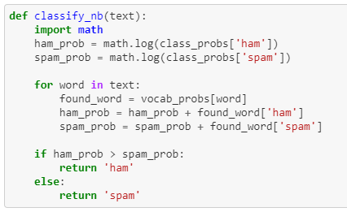
Testing
We had to make sure we apply the same transformations to the test set as the training set

Slide 9
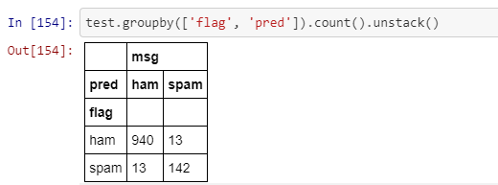

Confusion Matrix
Evaluation criteria are with respect to what we as researchers label as positive or negative. Is a true positive a correctly labeled ham message or is it spam?
Based on how Python printed the confusion matrix, it looks like ham is the true label. With this in mind, it is better to think of your calculations in sentence form to get clearer insights.

Slide 10
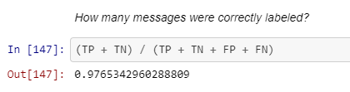

Accuracy Metrics

Slide 11
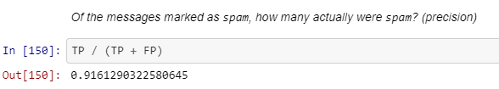
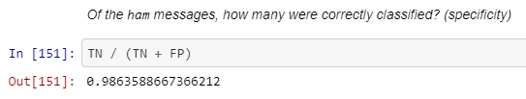
Accuracy Metrics

Slide 12
Discussion
Removing variations in capitalization with the .lower() method helps to concentrate signal, though capital letters can be associated with spam messages.
Similarly, making sure there were similar proportions of spam in both training and test allowed the algorithm to learn in a realistic setting.

Slide 13
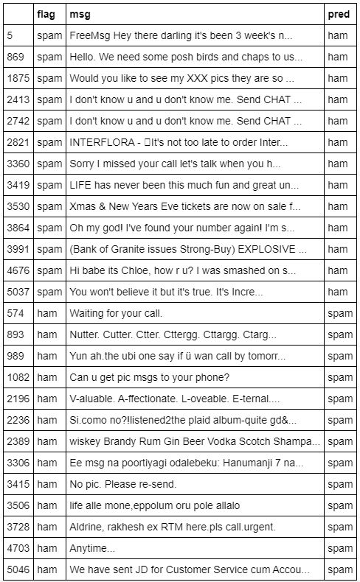
Missed Messages

