Slide 1
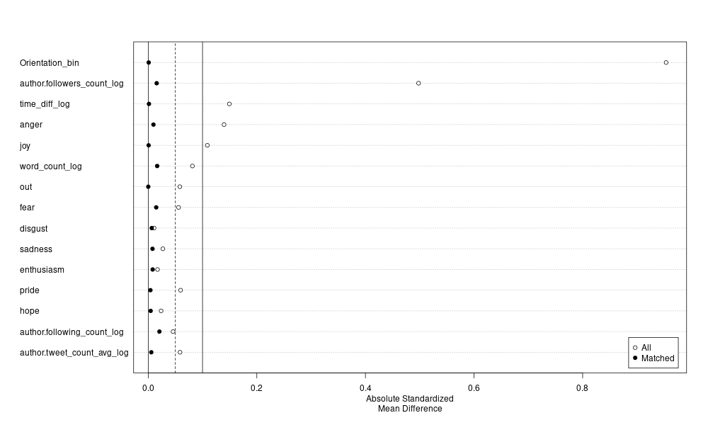
Orientation
Followers
Time_diff
Anger
Joy
Word_count
Out
Fear
Disgust
Sadness
Enthusiams
Pride
Hope
Following
Tweet_count
Absolute Standardized
Mean Difference

Slide 2
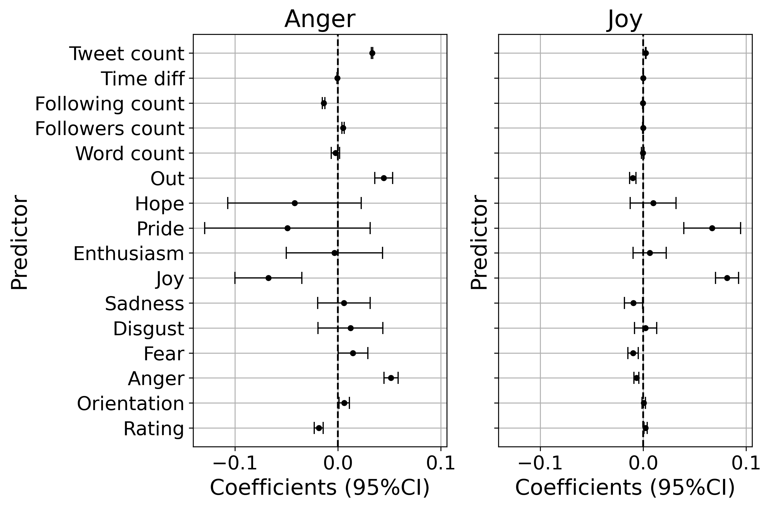

Slide 3



Slide 4
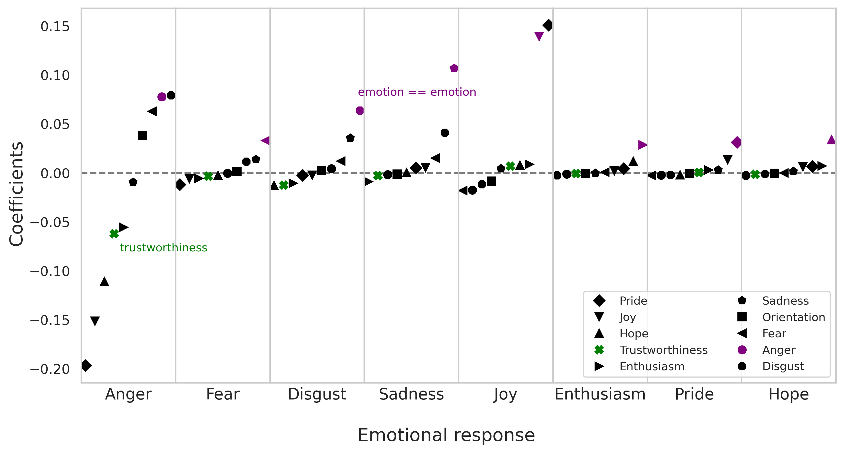


Slide 5






Slide 6






Slide 7







Slide 8


Slide 9




Slide 10


Arousing emotions reinforce partisan-based information processing
Misinformation is a symptom of partisan information ecosystems

Slide 11
Imprecise
but unbiased
Precise
but biased

Slide 12


Slide 13
SOURCE
CROWD
EXPERTS
STORY

Slide 14



Trustworthy
Untrustworthy

Slide 15
