Slide 1















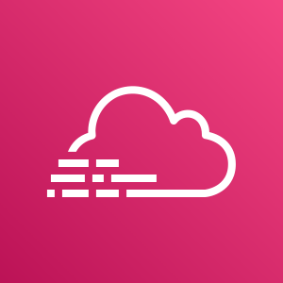




Region: Asia Pacific Region
2022/09/08 時点：全体構成図
Client
Developers
CloudFront
Route53
VPC: 10.0.0.1/16
Public Services
Internet Gateway
Public Subnet: 10.0.0.1/24
Public Subnet: 10.0.0.1/24
SES
NAT
EC2
(Bastion)
NAT
Eslatic Load Balancer
VPC Endpoint
Trend Micro
Deep Security
Symantec Cloud
Workload
Protection for Storage
Private Subnet: 10.0.0.3/24
Private Subnet: 10.0.0.3/24
SNS
EC2
Auto Scaling Group
EC2
Amazon
CloudWatch
AWS
CloudTrail
KMS
Private Subnet: 10.0.0.5/24
Private Subnet: 10.0.0.6/24
RDS
Amazon Aurora
with parallel query enabled
RDS
RDS
S3
AWS WAF
AWS
Certificate
Manager
AZ1: ap-southeast-1
AZ2: ap-southeast-2

