Slide 1


AWS ARCHITECTURE

Slide 2
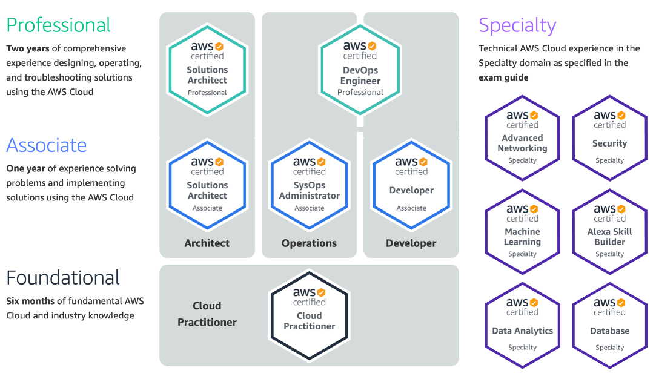
AWS Certifications

Slide 3
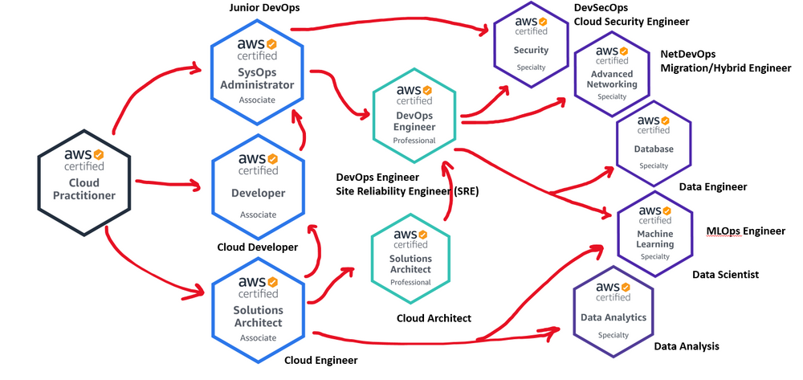
Study Path

Slide 4


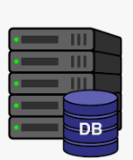

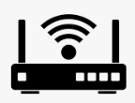








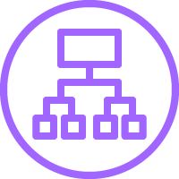











Region: Asia Pacific Region
On premise
Route53
User
Internet
Developers
CloudFront
VPC: 10.0.0.1/16
ClientVPN
Public Services
Internet Gateway
Direct Connect
VPN Site-to-site
SES
Public Subnet: 10.0.0.1/24
Public Subnet: 10.0.0.2/24
NAT
VPC - B
SNS
Eslatic Load Balancer
VPC Endpoint
Private Subnet: 10.0.0.3/24
Private Subnet: 10.0.0.4/24
SQS
VPC Peering
Private Subnet: 10.0.0.5/24
Private Subnet: 10.0.0.6/24
VPC - C
DynamoDB
Transit Gateway
RDS
RDS
S3
AZ1: ap-southeast-1
AZ2: ap-southeast-2

Slide 5
Region, Availability Zone
EC2, Lambda
VPC, Subnet, CIDR
Internet Gateway, Elastic IP
Route Table
NAT
Security Group
Bastion
Client VPN
RDS
S3

Slide 6
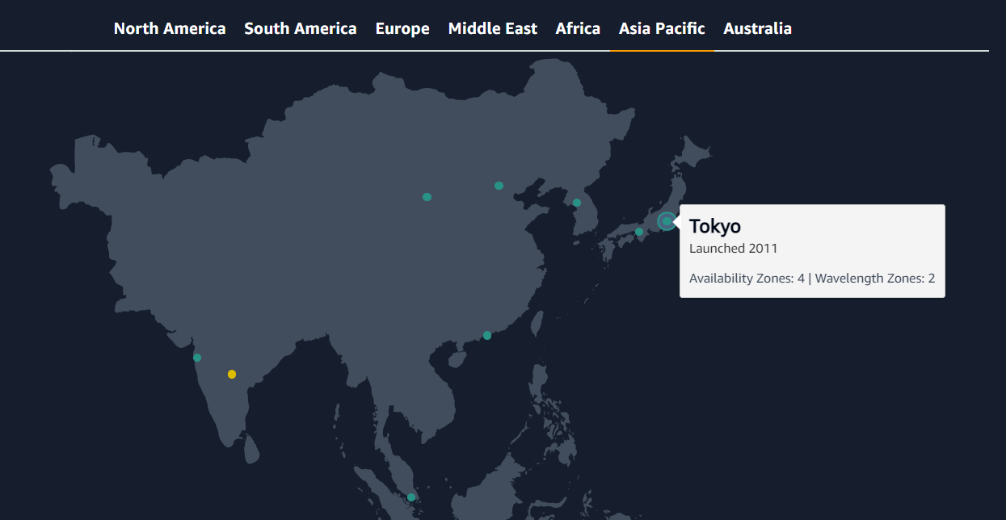
１．Region, Availability Zone
Region: Asia Pacific (Tokyo)
Region: a physical location around the world where AWS cluster a group of logical data centers

Slide 7
2. Availability Zone
Region: Asia Pacific (Tokyo)
An Availability Zone (AZ) is one or more discrete data centers with redundant power, networking, and connectivity in an AWS Region
AZ1: ap-northeast-1a
AZ2: ap-northeast-1b
AZ3: ap-northeast-1c
AZ4: ap-northeast-1d

Slide 8
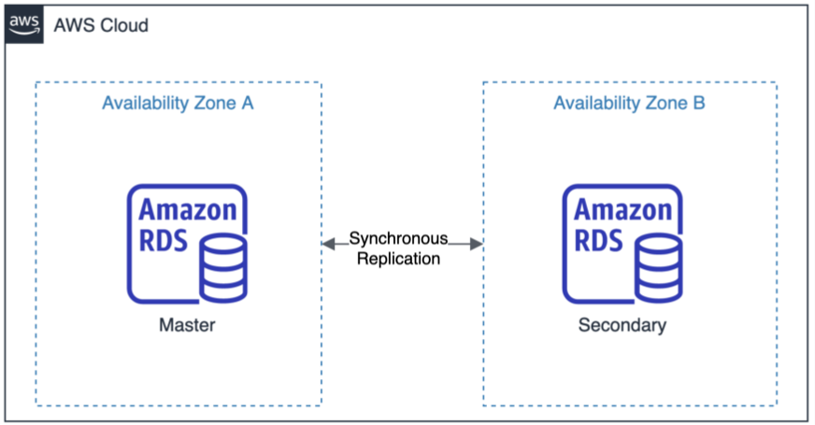
2. Availability Zone

Slide 9


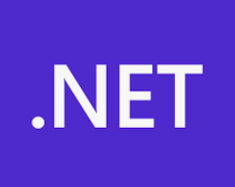



3. EC2, Lambda
User
Region: Asia Pacific
EC2
Lambda
AZ1: ap-northeast-1 (Tokyo)
AZ2: ap-northeast-2
(Seoul)
AZ3: ap-northeast-3
(Osaka)

Slide 10
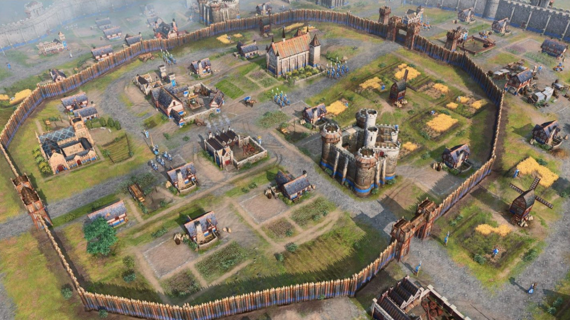
4．VPC, Subnet, CIDR
CIDR: a range of IPv4 or IPv6 addresses
VPC: is a secure, isolated private cloud hosted within a public cloud
VPC: 10.0.0.1/16
Public Subnet: 10.0.0.1/24
Public Subnet: 10.0.0.2/24
Private Subnet: 10.0.0.3/24
Private Subnet: 10.0.0.4/24
AZ1: ap-southeast-1
AZ2: ap-southeast-2

Slide 11
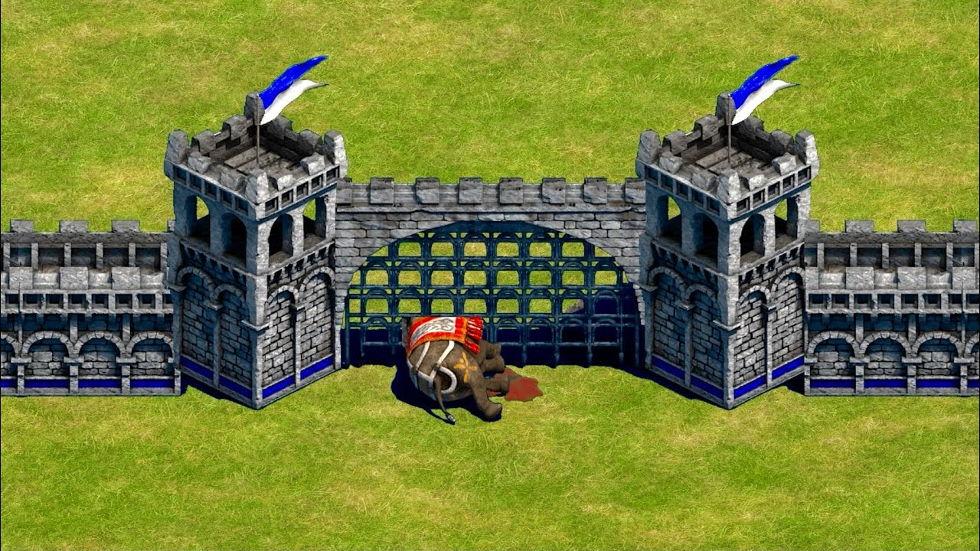
5．Internet Gateway, Route Table
Internet
An internet gateway is a highly available VPC component that allows communication between your VPC and the internet
VPC: 10.0.0.1/16
Internet Gateway
Public Subnet: 10.0.1.0/24
Public Subnet: 10.0.2.0/24
Private Subnet: 10.0.3.0/24
Private Subnet: 10.0.4.0/24
AZ1: ap-southeast-1
AZ2: ap-southeast-2

Slide 12
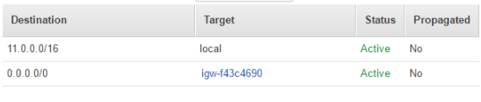
5．Internet Gateway, Route Table
Internet
An internet gateway is a highly available VPC component that allows communication between your VPC and the internet
VPC: 10.0.0.1/16
Internet Gateway
Public Subnet: 10.0.0.1/24
Public Subnet: 10.0.0.2/24
Private Subnet: 10.0.0.3/24
Private Subnet: 10.0.0.4/24
AZ1: ap-southeast-1
AZ2: ap-southeast-2

Slide 13
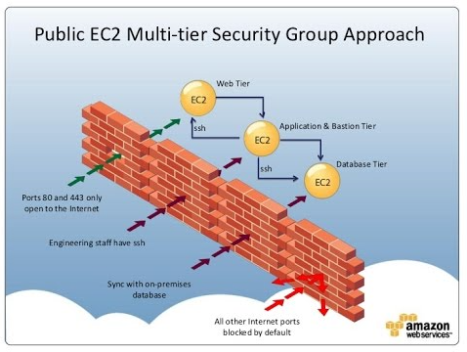
6．Security Group
Security Group: A security group controls the traffic that is allowed to reach and leave the resources that it is associated with

Slide 14
7．Bastion
User
VPC: 10.0.0.1/16
Internet Gateway
Public Subnet: 10.0.0.1/24
Public Subnet: 10.0.0.2/24
NAT
Private Subnet: 10.0.0.3/24
Private Subnet: 10.0.0.4/24
AZ1: ap-southeast-1
AZ2: ap-southeast-2

Slide 15
9．Load Balancer
Internet
VPC: 10.0.0.1/16
A load balancer: an AWS component that distributes incoming application traffic across multiple targets, such as EC2 instances, in multiple Availability Zone
Internet Gateway
Public Subnet: 10.0.0.1/24
Public Subnet: 10.0.0.2/24
NAT
Eslatic Load Balancer
Private Subnet: 10.0.0.3/24
Private Subnet: 10.0.0.4/24
AZ1: ap-southeast-1
AZ2: ap-southeast-2

Slide 16
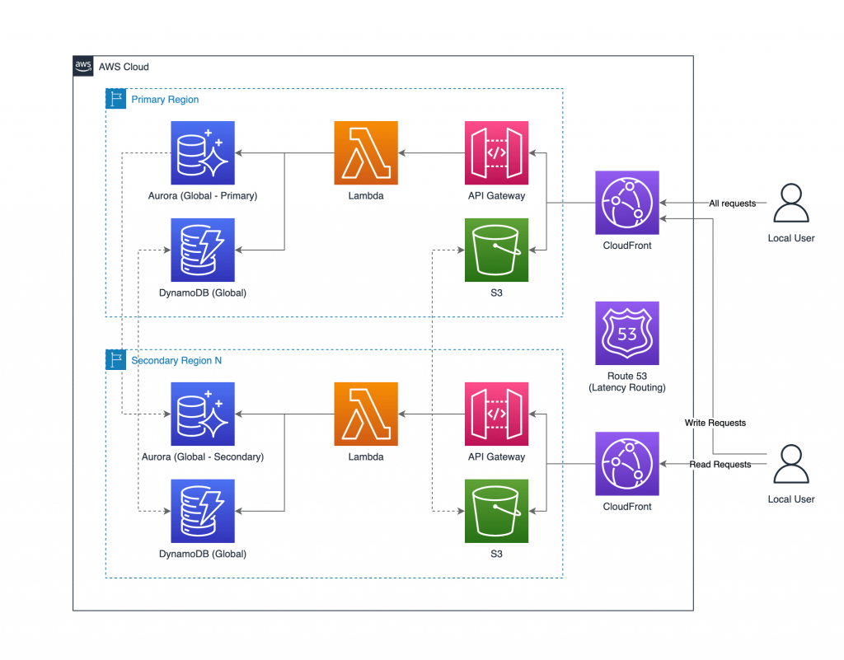

Slide 17
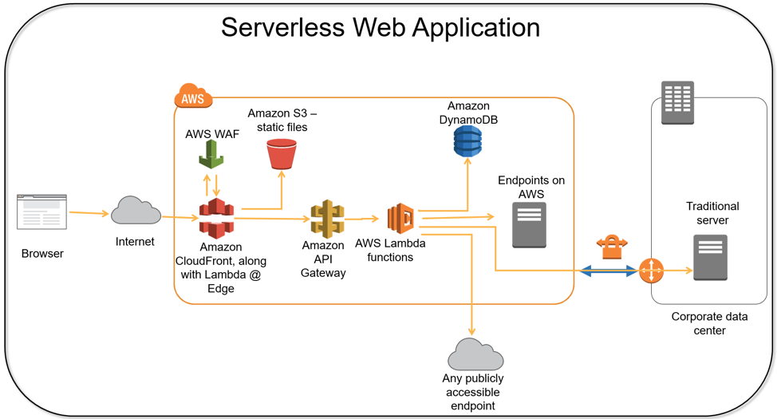

Slide 18
