Slide 1
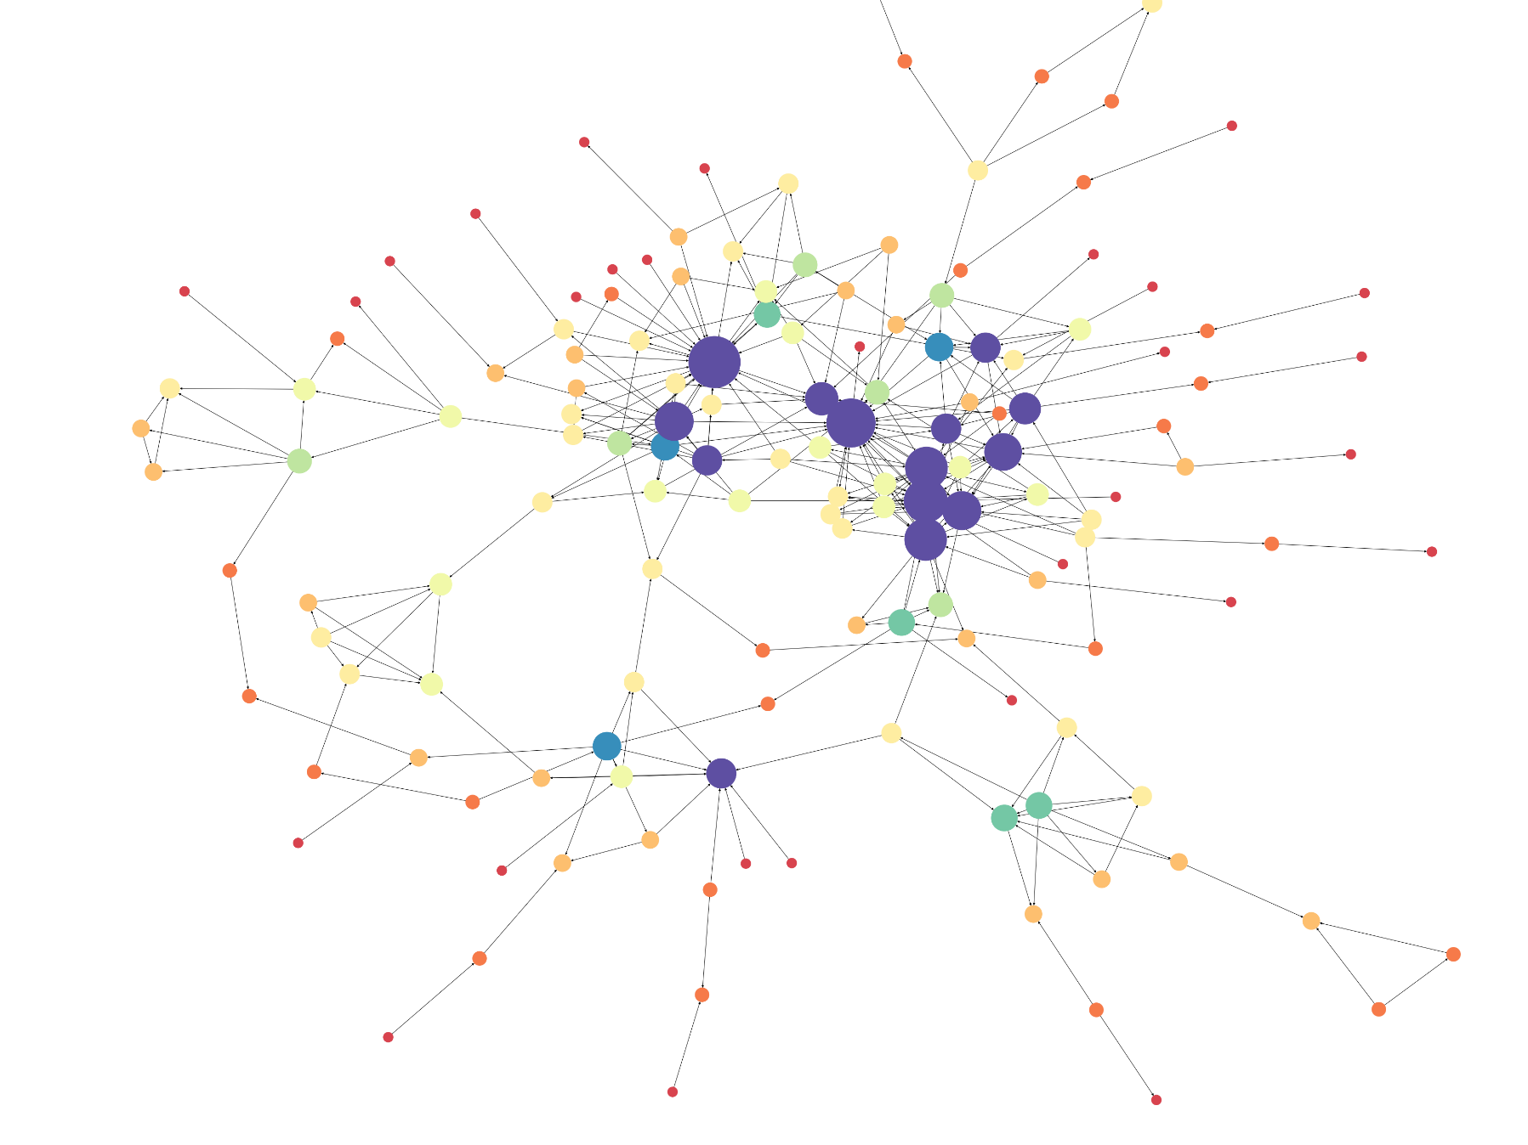

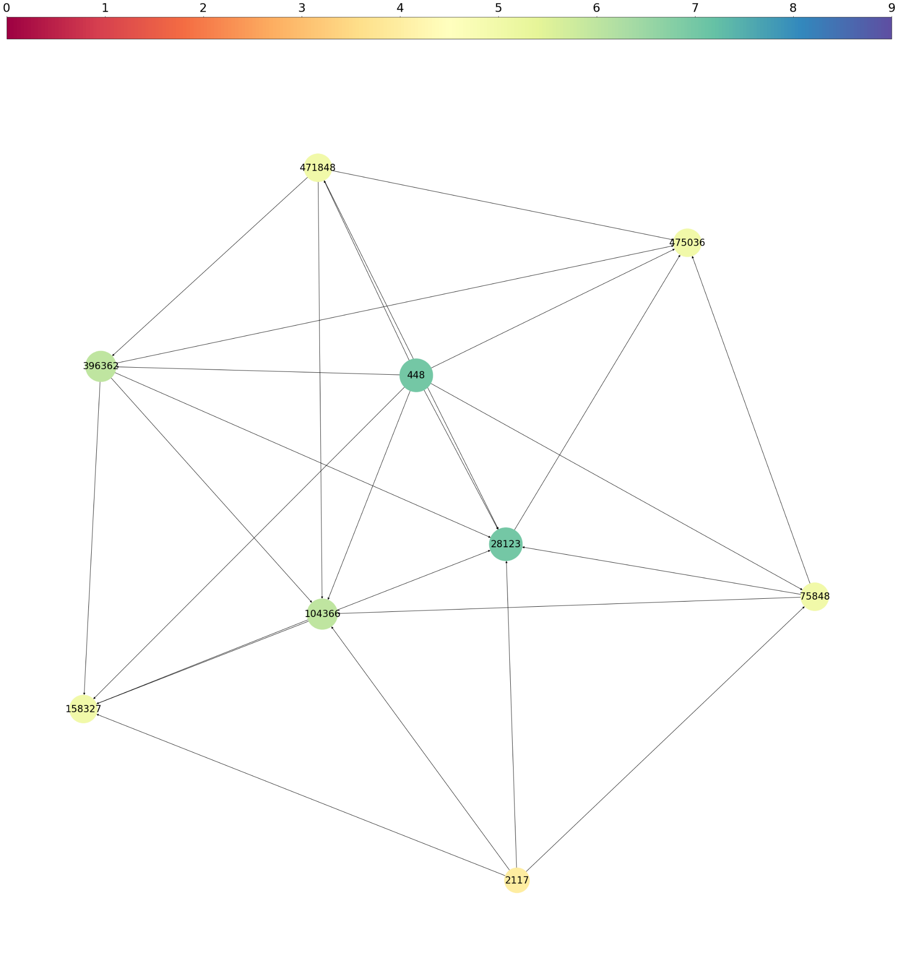
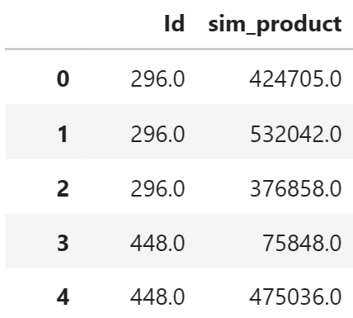
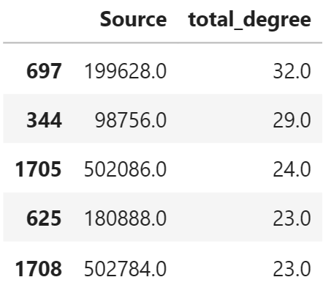
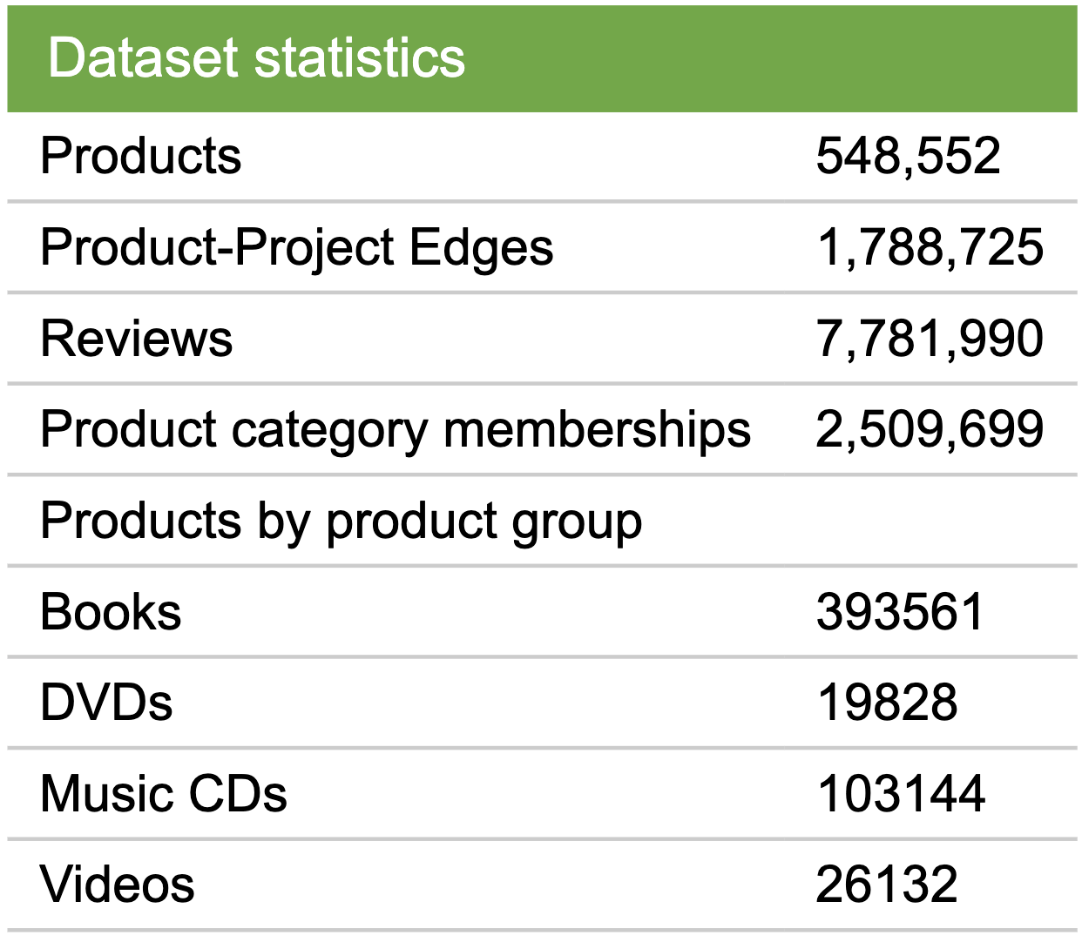
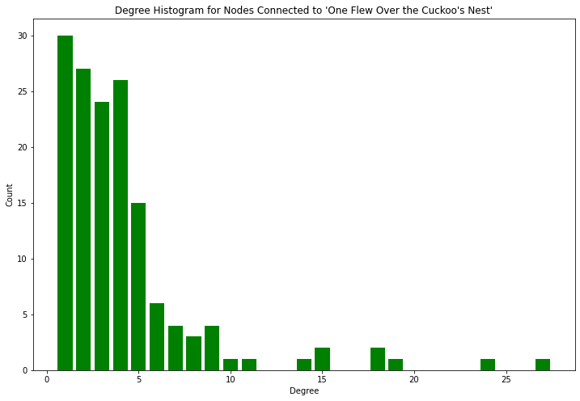
Amazon Co-Purchasing Trend Analysis
Kiet Nguyen, Vibha Mandayam, Zhuldyz Ualikhankyzy
Department of Computer and Data Sciences, Case School of Engineering
Objective: Carry out co-purchasing trend analysis of books from Amazon marketplace in 2006 by using graph networks.
Graph network analysis
In order to create a social network depicting the co-purchase trends, all of the connected nodes to a specific node based on in-degree and out-degree of all involved nodes were collected. Their corresponding nodes and edges were then connected where the most-connected nodes appear larger in size and darker in color.
Evaluation
Strengths:
Developed efficient algorithms to successfully parse the large set of semi-structured text data.
Efficiently aggregated parsed data into directed graph network structure with products and co-purchasing relationships.
Utilized newly learned package networkx to produce graph
Limitations:
Carried out co-purchasing analysis on smaller subset of the Amazon marketplace dataset due to low computational power
Leading to potential loss in valuable co-purchasing insights
Demonstrated graph network structure with limited complexity due to limited computational power
Background
With online becoming an irreplaceable purchasing method of the consumer mass, the e-commerce market has become more competitive and lucrative than ever with a high estimate at roughly 905 billion U.S. dollars in 2022 (Statista). To be ahead of the race in this market, it is crucial to be able to harness the powerful insights of the purchase data, which ultimately will help companies become more appealing towards prospective customers by predicting their purchasing preferences and habits. To that end, one of the biggest obstacles is to develop insightful graph networks that depict customer behavior for the purchasing of items across Amazon’s marketplace.
Data overview and scope
For the sake of computational power, we decided to focus on products from the group Book with a sales rank above 5000, meaning the top 5000 most-sold books.
Fig4. a) connected nodes and b) degree of each node in graph network
Conclusion
From the graph networks and degree analyses, it was observed that a minority of nodes have very high degrees, making their resulting subgraph networks densely connected. Book titles with related themes create dense clusters, which predicts higher co-purchasing rate in the cluster of similar books.
Fig1. Data statistics (Leskovec et al.)
Fig2. Graph network for node 448, a book titled “Three to get Deadly: A Stephanie Plum Novel”
Data collection and cleaning
The data was sourced from Stanford University’s SNAP program, where metadata on Amazon’s product co-purchasing network was collected as a text file. From this, the data was parsed using Python packages like regex and pandas to form the schemas described below:
Products <id, asin, title, group, salesrank>
Similarity <id, sim1, sim2, sim3, sim4, sim5>
Review <id, cus1, cus2, cus3, cus4, cus5>
where id - product id, asin - Amazon Standard Identification Number, title - name of the product, sim_{n} - the ASIN of similar product, cus_{n} - customer id.
Future work
This project can be further enhanced by using more computationally powerful machines to widen the scope of the objects of investigation. Having a higher computational power will prevent possible loss in co-purchasing insights. Additionally, as the Amazon data used in this project was collected in 2006, carrying out the analysis on more up-to-date data with potentially more attributes would enable the development of machine learning models to predict co-purchasing of different products by specific users.
Reference and acknowledgements:
Statista. "Retail E-commerce Revenue in The United States from 2017 to 2027 (in Billion U.S.Dollars)." Statista, Statista Inc., 11 Nov 2022, https://www.statista.com/statistics/272391/us-retail-e-commerce-sales-forecast/
Leskovec, J., Adamic, L. A., & Huberman, B. A. (2007). The dynamics of viral marketing. ACM Transactions on the Web, 1(1), 5. https://doi.org/10.1145/1232722.1232727
Social Networks. 2019. Github project. https://github.com/haoyingyang/SN.
Co-purchasing investigation
A subset of the tuples from the original schemata was selected for the analysis. The out-degree of each node shows how many similar products it has, and in-degree describes how many times a product was encountered as a product similar to another product.
Fig3. Distribution of nodes by their total degree

