Slide 1


Lambda expressions with multiple parameters
The rules for multiple parameters used in a lambda expression are shown here.
Lambda Expression | Description
 | Parentheses are always required. Explicit types are not.
 | If you use an explicit type for one parameter, you must use explicit types for all the parameters.
 | If you use var for one parameter, you must use var for all parameters.
COMPLETE JAVA MASTERCLASS
Lambda Expressions, Continued

Slide 2

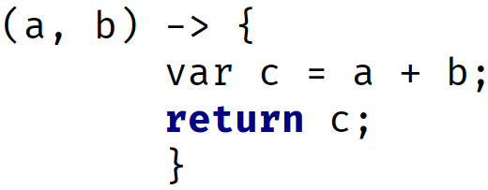
Lambda expressions that return values
This slide shows the two rules for returning values from a lambda expression.
Lambda Expression | Description
 | when not using curly braces, the return keyword is unnecessary, and will throw a compiler error.
 | If you use a statement block, meaning you use the curly braces, a return is required.
COMPLETE JAVA MASTERCLASS
Lambda Expressions, Continued

