Slide 1

The Setup
In this example, I'll be using HashSets as fields, and I'll use the Scanner class, which I've used many times before.
I'll be using Scanner with just a String passed to the constructor.
It works similarly. If you want to see this in action, be sure to follow along.
Eventually, I'll cover reading input from files, although the code in this video won't be doing that.
Using scanner this way gives you a taste for a way to do this.
Again, the purpose of having a separate setup video here, is to keep the new topic material more on point later.
COMPLETE JAVA MASTERCLASS
Code Setup (Phone and Email Contacts) for Sets and Maps

Slide 2
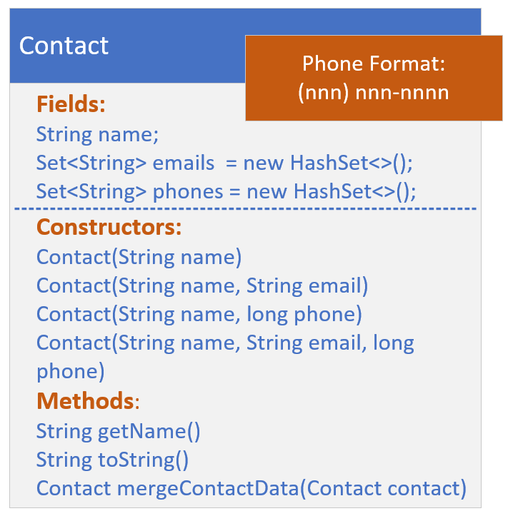
The Setup Challenge - The Contact Class
In this challenge, you need to create a Contact class, that has the fields, name, a String, emails, a HashSet of String, and phones, another HashSet of String.
This class should have four constructors.
The first just takes a name.
The second should have name, and a single email of type String.
COMPLETE JAVA MASTERCLASS
Code Setup (Phone and Email Contacts) for Sets and Maps

Slide 3
The Setup Challenge - The Contact Class
The third constructor should also have two arguments, name, and the second parameter being a long, which represents a 10-digit phone number.
Lastly, the fourth constructor that should do most of the work, the last in your chain, in other words, should take name, a single email, and a single phone.
COMPLETE JAVA MASTERCLASS
Code Setup (Phone and Email Contacts) for Sets and Maps

Slide 4
The Setup Challenge - The Contact Class
This last constructor should do the following:
Add the email argument to the emails set, if email is not null.
Transform the phone argument, a long, (if it's not zero), to a string in the format (123) 456-7890, for example.
Add the transformed phone to the phones set.
Finally, include a method called mergeContactData, that takes a contact, and returns a new Contact instance, which merges the current instance with the Contact passed.
COMPLETE JAVA MASTERCLASS
Code Setup (Phone and Email Contacts) for Sets and Maps

Slide 5
The Setup Challenge - The Data (ContactData class)
The ContactData class is going to emulate getting data from an external source, but instead of an external source, I just want you to set this data up with two different text blocks, in the format shown on this slide.
This data purposely has duplicates.
Phone Data | Email Data
Charlie Brown, 3334445555 Maid Marion, 1234567890 Mickey Mouse, 9998887777 Mickey Mouse, 1247489758 Minnie Mouse, 4567805666 Robin Hood, 5647893000 Robin Hood, 7899028222 Lucy Van Pelt, 5642086852 Mickey Mouse, 9998887777 | Mickey Mouse, mckmouse@gmail.com Mickey Mouse, micky1@aws.com Minnie Mouse, minnie@verizon.net Robin Hood, rhood@gmail.com Linus Van Pelt, lvpelt2015@gmail.com Daffy Duck, daffy@google.com
COMPLETE JAVA MASTERCLASS
Code Setup (Phone and Email Contacts) for Sets and Maps

Slide 6
The Setup Challenge - The Data (ContactData class)
Create a Method named getData, that takes a String type (either "phone" or "email") and returns a List of Contact.
Now, I'm going to use Scanner to parse the data in these text blocks.
You're welcome to try another approach.
Don't worry, you won't be missing any content I haven't already covered or won't cover shortly.
COMPLETE JAVA MASTERCLASS
Code Setup (Phone and Email Contacts) for Sets and Maps

