Slide 1

Sealed Classes
JDK17 introduced a new modifier, sealed, for classes and interfaces.
This modifier can be used for both outer types and nested types.
When used, a permits clause is also required in most cases, which lists the allowed subclasses.
Subclasses can be nested classes, classes declared in the same file, classes in the same package, or if using Java's modules, in the same module.
What this means though, for this specific conversation, is that all our code so far, since JDK9, is part of what's called, the unnamed default module.
Because of this, I can't use subclasses in the permits clause that are in other packages.
A sealed class and its direct subclasses create a circular reference.
COMPLETE JAVA MASTERCLASS
Sealed Classes

Slide 2
sealed class
Using the sealed keyword, requires the parent class to declare it's subclasses, using a permits clause.
This means the parent class has to know about every direct subclass, and these have to exist in the same package in this case.
In addition, the sealed keyword puts a requirement on all the subclasses that were declared in the permits clause.
It requires each subclass to declare one of the three valid modifiers for a class extending a sealed class.
These are final, sealed or non-sealed.
COMPLETE JAVA MASTERCLASS
Sealed Classes

Slide 3
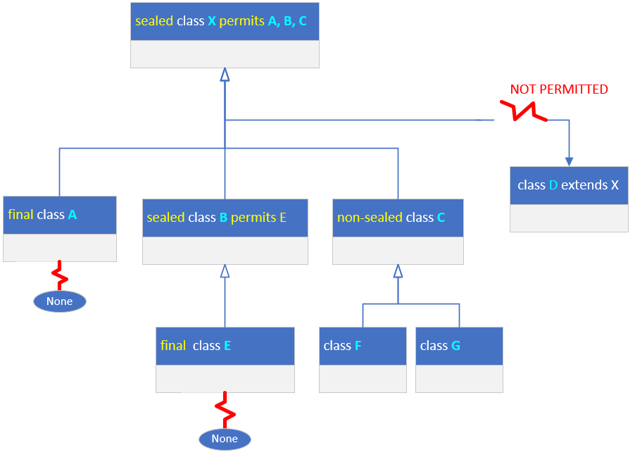
sealed class
On this slide, I have a parent class X, declared as a sealed class, and permitting only classes A, B and C to subclass it.
For that reason, class D, which may exist and extends X, won't compile.
You'll have to either add D to the permits clause on X or remove D from the hierarchy in some way.
COMPLETE JAVA MASTERCLASS
Sealed Classes

Slide 4
sealed class
All subclasses declared in the permits clause, must be declared as final, sealed or non-sealed.
Declaring a class final, means no other subclasses can extend that class, as I show with class A, on this slide.
A subclass declared with a sealed modifier, shown here with class B, must in turn use a permits clause. Its subclasses in turn, have to use one of the three valid modifiers.
COMPLETE JAVA MASTERCLASS
Sealed Classes

Slide 5
sealed class
Lastly, a subclass can use the non-sealed modifier, as shown with class C.
This means it's basically unsealing itself for all its subclasses.
COMPLETE JAVA MASTERCLASS
Sealed Classes

