Slide 1
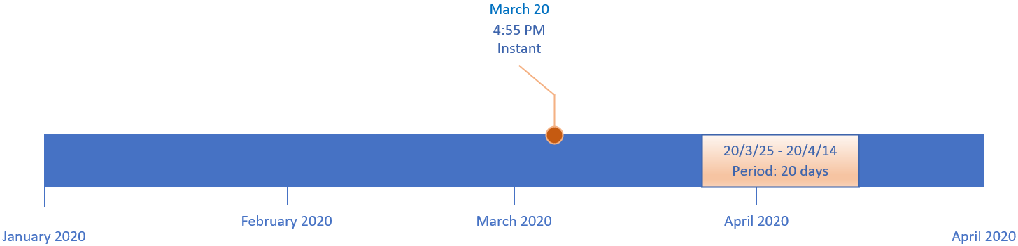

A Date-Based Timeline
This slide shows a timeline from January 1, 2020, through the end of April of the same year.
A point on a timeline, shown here as March 20, at 4:55 pm, is called an Instant in time.
An interval (or span of time) on a date time line is called a Period.
It's often represented by elapsed time in date units such as years, months, or days.
COMPLETE JAVA MASTERCLASS
Overview: Instance, Period, Duration and Time Zones

Slide 2
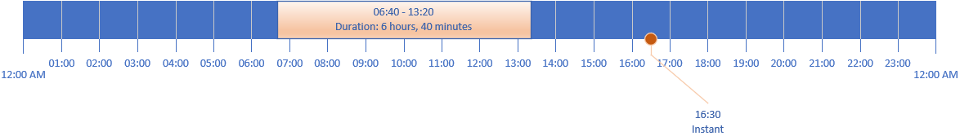
An Hourly Timeline
This slide shows a timeline for a single 24-hour day.
This timeline can have an Instant as well, as shown at 16:30 which represents 4:30 pm, on this timeline.
This slide is also showing a span of time, from 6:40 am until 1:20 pm.
When the interval is time based (in terms of the units being in hours, minutes or seconds), this is called a Duration.
On this slide, the Duration lasted 6 hours and 40 minutes.
COMPLETE JAVA MASTERCLASS
Overview: Instance, Period, Duration and Time Zones

Slide 3
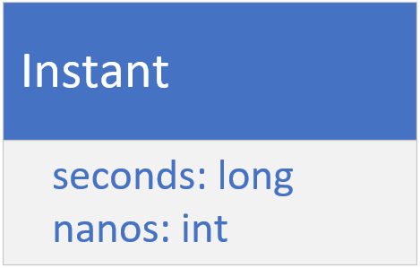
Instant
On the previous slide, I showed you that you can represent an event on a timeline as an Instant.
Java provides the Instant class for this.
It has two fields, one for seconds, a long, and one for nano seconds, an int.
COMPLETE JAVA MASTERCLASS
Overview: Instance, Period, Duration and Time Zones

Slide 4
Instant
If you're new to programming, you might be asking what does seconds mean?
How can you store a moment in time as seconds?
Doesn't it need some context, like a starting point in time, from which to measure these seconds, or a defined timeline?
These seconds are called epoch seconds, and the epoch is the starting point for many such points in time.
Instead of having to specify this point in time, every time you want a time stamp or instant of time, many software languages use a specific date and time, called Epoch Time.
COMPLETE JAVA MASTERCLASS
Overview: Instance, Period, Duration and Time Zones

Slide 5
What's the significance of the EPOCH Time?
00:00:00 UTC, Thursday 1st January 1970 is called alternately Unix Time, POSIX Time, Epoch Time or Unix Epoch Time.
Computer systems have different epoch times, but many software languages use this particular date and time, including Java, as the predetermined start of time.
It's used to create time stamps whose meaning, as seconds, can be understood.
If you ever do want to see it, or use it, it's a constant named EPOCH, on the LocalDate and Instant classes.
UTC is a symbol that stands for Coordinated Universal Time, which coordinates with Greenwich Mean Time (GMT).
COMPLETE JAVA MASTERCLASS
Overview: Instance, Period, Duration and Time Zones

Slide 6
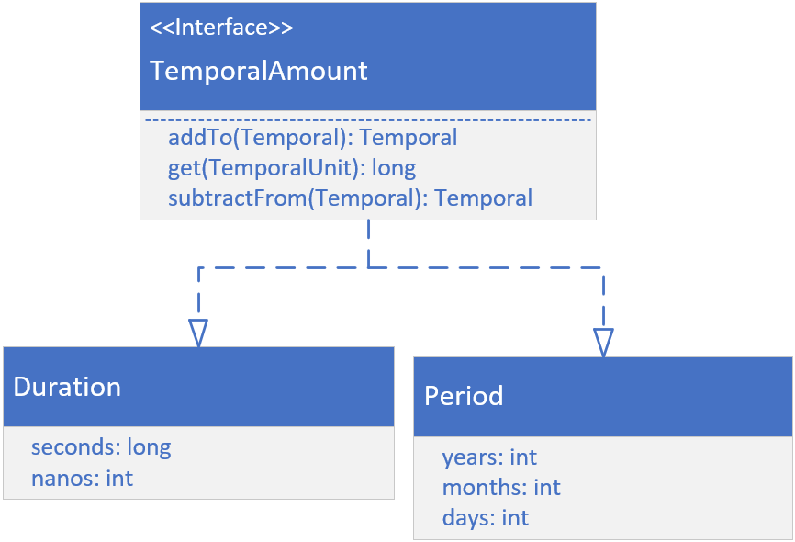
Duration and Period
If you look at the Duration class on this slide, you might think it looks like the Instant class, but there are significant differences.
First, Duration and Period do not implement Temporal or TemporalAccessor.
They instead implement TemporalAmount, as shown.
This means these classes are something quite different from a unit of date or time.
They are amounts of time.
Both represent elapsed time between units of time (or dates).
COMPLETE JAVA MASTERCLASS
Overview: Instance, Period, Duration and Time Zones

Slide 7
Greenwich Mean Time
Maybe you'll remember from an old geography class, that the earth is drawn with imaginary lines on it, to help uniformly describe locations on earth.
The lines drawn from the north pole to the south pole are called meridians.
These could be drawn anywhere, but a Prime Meridian was historically agreed upon, as a starting point or the zero measurement.
This is a reference point for all other measurements.
COMPLETE JAVA MASTERCLASS
Overview: Instance, Period, Duration and Time Zones

Slide 8
Greenwich Mean Time
The time in Greenwich, was solar time, based on the position of the sun in the sky.
When atomic clocks were introduced, they were able to provide more precise time than Greenwich Mean Time (GMT).
In 1972, GMT was superseded by UTC, which stands for Coordinated Universal Time, and is based on atomic time.
The differences between GMT and UTC can differ by up to 0.9 seconds in a day.
For this reason, GMT and UTC are often used interchangeably, when you don't need great precision.
COMPLETE JAVA MASTERCLASS
Overview: Instance, Period, Duration and Time Zones

Slide 9
Time Zone
A Time Zone consists of two parts, a UTC offset, and optionally, information about Daylight Savings Time.
Java derives it's time zone data from three sources:
The Internet Assigned Numbers Authority (IANA)'s Time Zone Database (TZDB) is the default, and takes precedence over the others.
IATA (the airline industry body).
Microsoft.
COMPLETE JAVA MASTERCLASS
Overview: Instance, Period, Duration and Time Zones

Slide 10
Time Zone
Two helpful links are displayed on this slide.
The first site gives you a list of the time zone identifiers.
The second gives you a list of day light savings rules.
Both of these sites use the IANA Time Zone database as their source.
https://twiki.org/cgi-bin/xtra/tzdatepick.html
https://en.wikipedia.org/wiki/Daylight_saving_time_by_country
COMPLETE JAVA MASTERCLASS
Overview: Instance, Period, Duration and Time Zones

Slide 11
Before JDK 8 and the introduction of the java.time package
There are classes in java.util that may look attractive to use, and were used before JDK 8.
You'll probably run across these classes at some point in older code.
These are
Date
TimeZone
GregorianCalendar
COMPLETE JAVA MASTERCLASS
Overview: Instance, Period, Duration and Time Zones

Slide 12
Before JDK 8 and the introduction of the java.time package
Additional classes for formatting are in the java.text package:
DateFormat
SimpleDateFormat
The use of these classes in new code is discouraged.
The immutable thread-safe classes, provided by the java.time packages, should be used, instead.
I won't be covering these old classes in this course, except to point them out here, so you'll recognize them if you see them.
COMPLETE JAVA MASTERCLASS
Overview: Instance, Period, Duration and Time Zones

Slide 13
System.currentTimeMillis
System.currentTimeMillis returns the milliseconds since epoch time, so midnight, January 1, 1970 UTC.
This time is based on the operating system.
This can be used to measure elapsed times, or provide timestamps.
COMPLETE JAVA MASTERCLASS
Overview: Instance, Period, Duration and Time Zones

Slide 14
System.nanoTime
System.nanoTime uses the JVM's high resolution time source, to return nanoseconds, from an arbitrary origin time, which is not Epoch time, and may even be a time in the future.
This origin time may differ across different JVM instances.
For this reason, this time can't be used to represent real time, or wall clock time.
It shouldn't be used as timestamps for data.
Instead, it's purpose is to measure elapsed time for invocations in a single JVM instance.
COMPLETE JAVA MASTERCLASS
Overview: Instance, Period, Duration and Time Zones

